Slide 1
Lecture 16
CSE 331

Slide 2
Quiz 1 this FRIDAY

Slide 3
Project groups finalized

Slide 4
Interval Scheduling Problem
Input: n intervals [s(i), f(i)) for 1≤ i ≤ n
Output: A schedule S of the n intervals
No two intervals in S conflict
|S| is maximized

Slide 5
Example 3
Task 4
Task 5
More than one conflict
Task 3
Task 2
Task 1
Set S to be the empty set
While R is not empty
Choose i in R
Add i to S
Remove all tasks that conflict with i from R
Return S*= S

Slide 6
Greedily solve your blues!
Arrange tasks in some order and iteratively pick non-overlapping tasks
Write up a term paper
Party!
Exam study
331 HW
Project
Saturday
Sunday
Monday
Tuesday
Wednesday

Slide 7
Making it more formal
Task 4
Task 5
More than one conflict
Task 3
Task 2
Task 1
Set S to be the empty set
Associate a value v(i) with task i
While R is not empty
Choose i in R
Choose i in R that minimizes v(i)
Add i to S
Remove all tasks that conflict with i from R
Return S*= S

Slide 8
What is a good choice for v(i)?
Task 4
Task 5
More than one conflict
Task 3
Task 2
Task 1
Set S to be the empty set
Associate a value v(i) with task i
While R is not empty
Choose i in R that minimizes v(i)
Add i to S
Remove all tasks that conflict with i from R
Return S*= S

Slide 9
v(i) = f(i) – s(i)
Task 4
Task 5
Smallest duration first
Task 3
Task 2
Task 1
Set S to be the empty set
While R is not empty
Choose i in R that minimizes f(i) – s(i)
Add i to S
Remove all tasks that conflict with i from R
Return S*= S

Slide 10
v(i) = s(i)
Task 4
Task 5
Earliest time first?
Task 3
Task 2
Task 1
So are we done?
Set S to be the empty set
While R is not empty
Choose i in R that minimizes s(i)
Add i to S
Remove all tasks that conflict with i from R
Return S*= S

Slide 11
Not so fast….
Task 4
Task 5
Earliest time first?
Task 3
Task 2
Task 1
Task 6
Set S to be the empty set
While R is not empty
Choose i in R that minimizes s(i)
Add i to S
Remove all tasks that conflict with i from R
Return S*= S

Slide 12
Pick job with minimum conflicts
Task 4
Task 5
Task 3
Task 2
Task 1
Task 6
Set S to be the empty set
So are we done?
While R is not empty
Choose i in R that has smallest number of conflicts
Add i to S
Remove all tasks that conflict with i from R
Return S*= S

Slide 13
Nope (but harder to show)
Set S to be the empty set
While R is not empty
Choose i in R that has smallest number of conflicts
Add i to S
Remove all tasks that conflict with i from R
Return S*= S

Slide 14
Task 7
Task 4
Task 5
Task 17
Task 18
Task 3
Task 2
Task 15
Task 16
Task 1
Task 12
Task 13
Task 14
Task 6
Task 8
Task 9
Task 10
Task 11
Set S to be the empty set
While R is not empty
Choose i in R that has smallest number of conflicts
Add i to S
Remove all tasks that conflict with i from R
Return S*= S

Slide 15
Algorithm?
Task 7
Task 4
Task 5
Task 17
Task 18
Task 3
Task 2
Task 15
Task 16
Task 1
Task 12
Task 13
Task 14
Task 6
Task 8
Task 9
Task 10
Task 11
Set S to be the empty set
While R is not empty
Choose i in R that minimizes v(i)
Add i to S
Remove all tasks that conflict with i from R
Return S*= S

Slide 16
Earliest finish time first
Task 7
Task 4
Task 5
Task 17
Task 18
Task 3
Task 2
Task 15
Task 16
Task 1
Task 12
Task 13
Task 14
Task 6
Task 8
Task 9
Task 10
Task 11
Set S to be the empty set
While R is not empty
Choose i in R that minimizes f(i)
Add i to S
Remove all tasks that conflict with i from R
Return S*= S

Slide 17
Find a counter-example?
Task 7
Task 4
Task 5
Task 17
Task 18
Task 3
Task 2
Task 15
Task 16
Task 1
Task 12
Task 13
Task 14
Task 6
Task 8
Task 9
Task 10
Task 11
It works!
Set S to be the empty set
While R is not empty
Choose i in R that minimizes f(i)
Add i to S
Remove all tasks that conflict with i from R
Return S*= S

Slide 18
Final Algorithm
R: set of requests
Set S to be the empty set
While R is not empty
Choose i in R with the earliest finish time
Add i to S
Remove all requests that conflict with i from R
Return S*= S

Slide 19
Argue correctness
Observation: A valid schedule sorted by start/finish time gives the same order.
Assume that input intervals are sorted (in increasing order) by finish time
==> f(1) ≤ f(2) ≤ f(3) ≤ … ≤ f(n).
(If the input is not sorted, sort it in O(nlogn) time.)
Task 3
Task 4
Task 5

Slide 20
Greedy Algorithm
0. R ← [n]
S ← Φ
while R ≠ Φ
(2.1) let i be the smallest index in R
(2.2) add i to S
(2.3) remove i from R
(2.4) delete all j ∈ R that conflict with i
Return S* ← S

Slide 21
Greedy Algorithm
0. R ← [n]
S ← Φ
while R ≠ Φ
(2.1) let i be the smallest index in R
(2.2) add i to S
(2.3) remove i from R
(2.4) delete all j ∈ R that conflict with i
Return S* ← S
Theorem: S* is an optimal solution.
(that is, ∀ inputs, among all possible valid schedules for the input, S* has the maximum number of intervals.)
Ex 1: Algorithm terminates.
Ex. 2: S* is a valid schedule.
Proof of correctness of Greedy algorithm:
1. Greedy stays ahead
2. Exchange argument (minimize max. lateness, sec. 4.2 of KT)

Slide 22
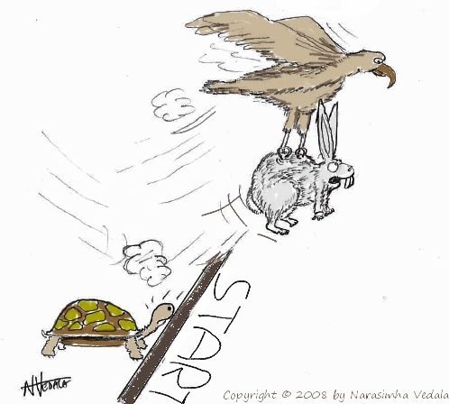
Greedy “stays ahead”
Greedy
OPT

Slide 23
Argue correctness on the board…

