Slide 1
Lecture 2
CSE 331

Slide 2
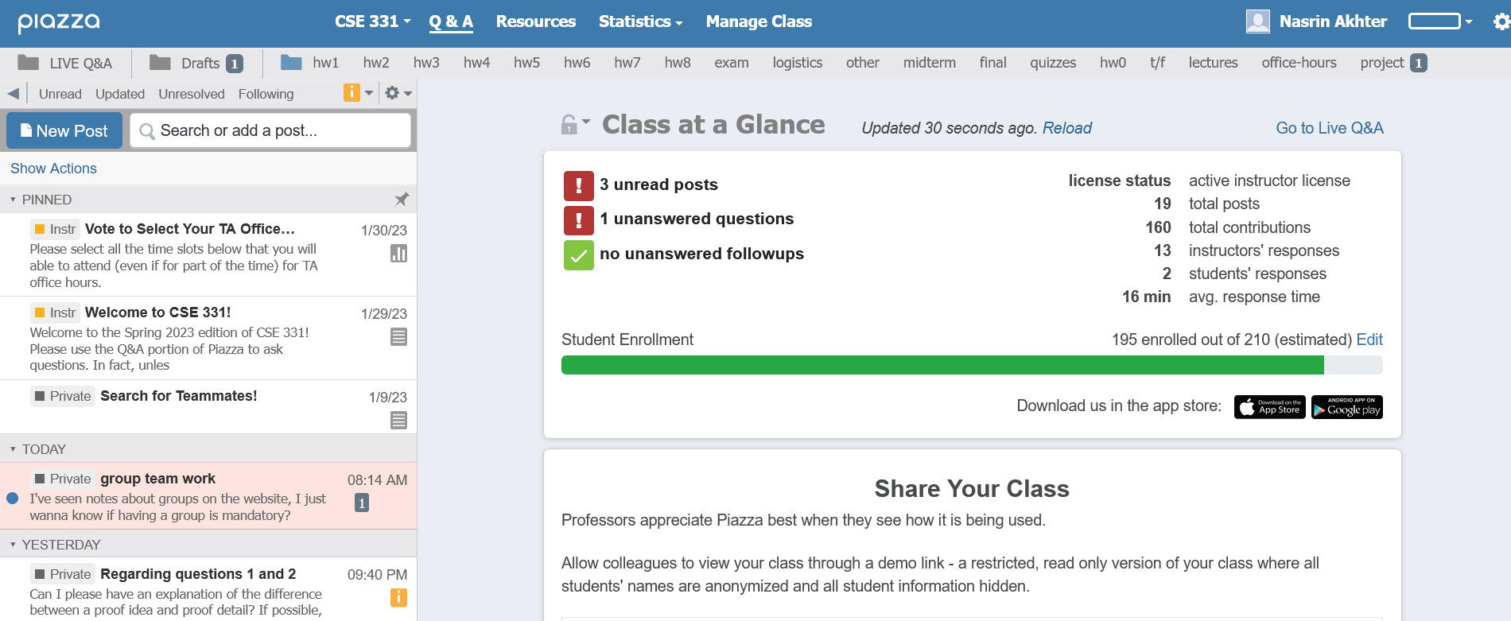
Enroll on Piazza
https://piazza.com/buffalo/spring2023/cse331/home

Slide 3
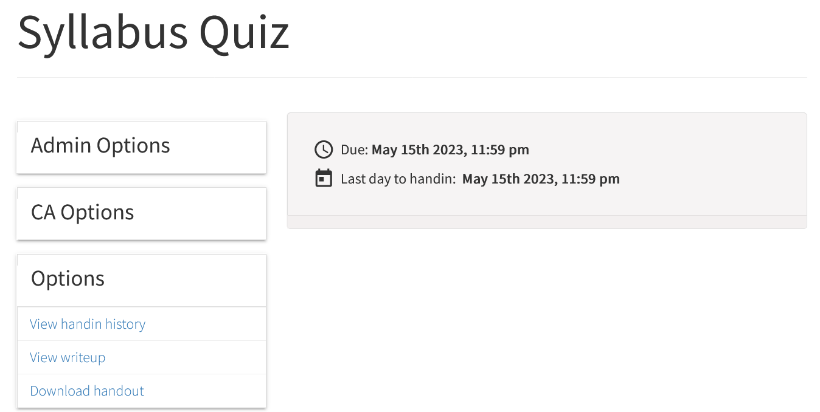
Read the syllabus CAREFULLY!
No graded material will be handed back till you pass the syllabus quiz!

Slide 4
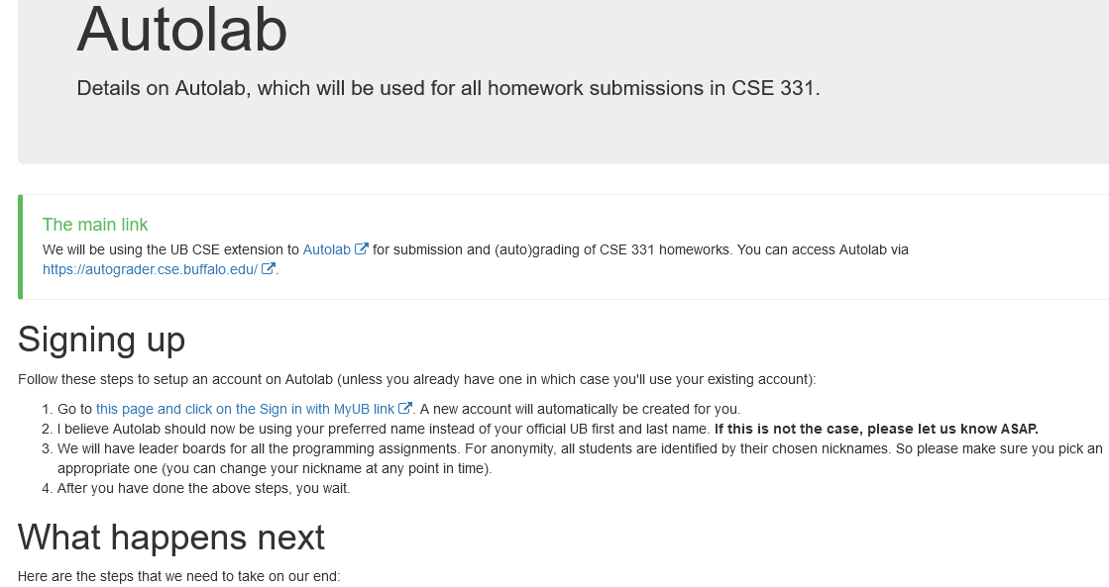
Autolab FAQ

Slide 5
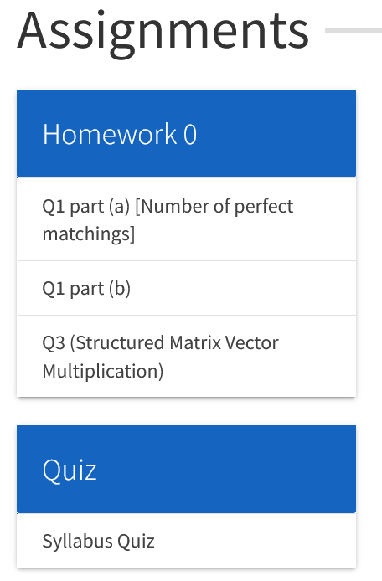
HW 0 is Out
HW0 is out!
Submit Q1 and Q3 (not Q2).

Slide 6
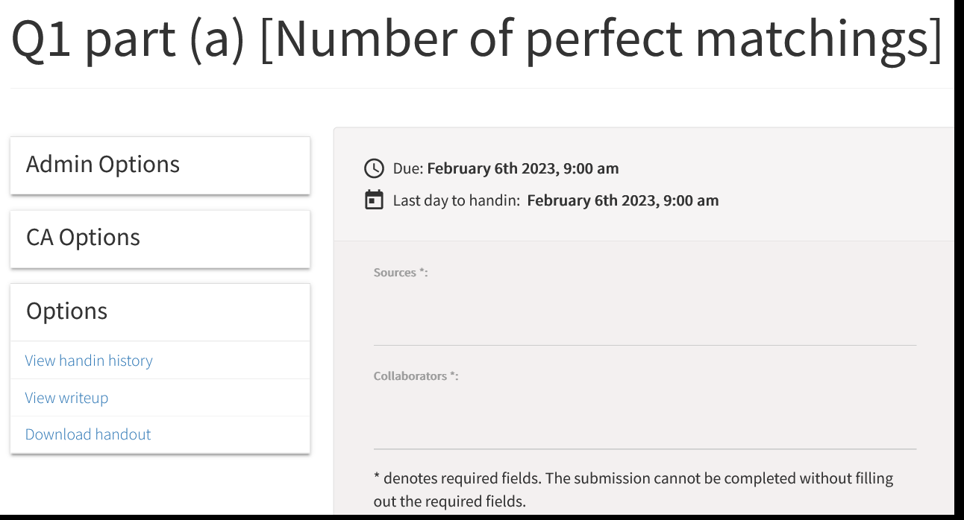
HW 0 is Out

Slide 7
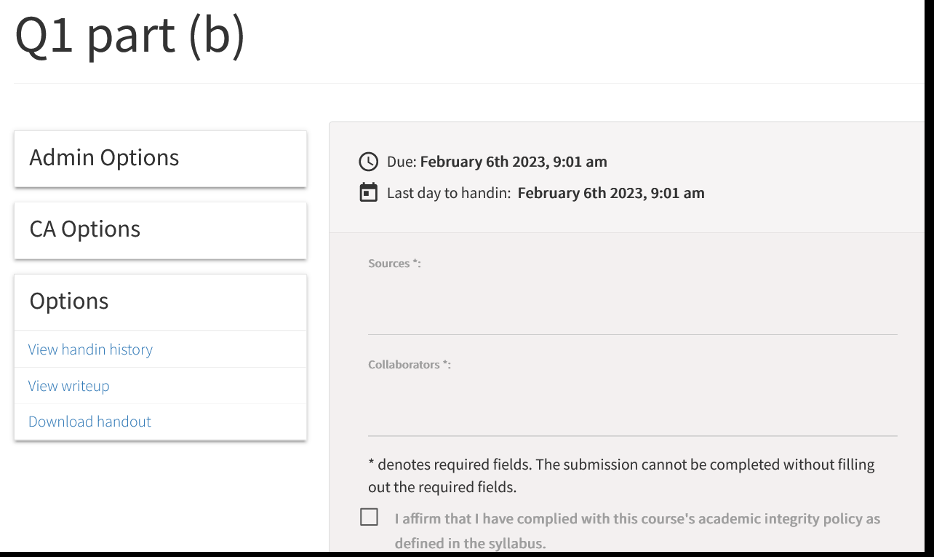
HW 0 is Out

Slide 8
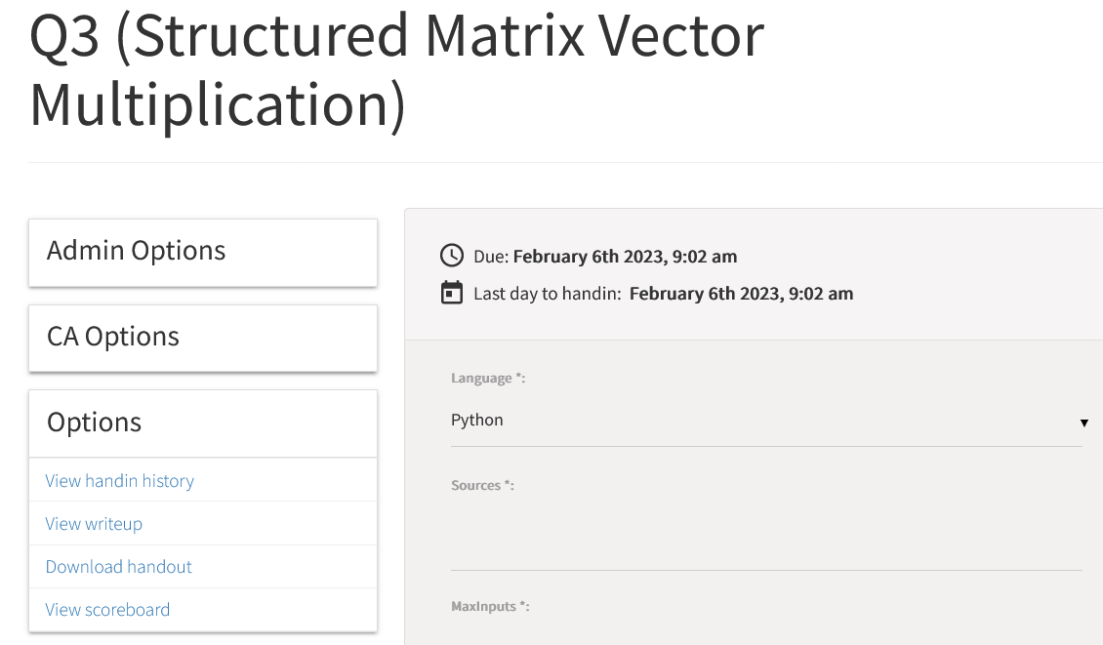
HW 0 is Out
https://cse.buffalo.edu/~nasrinak/cse331/SP23/autolab.html

Slide 9
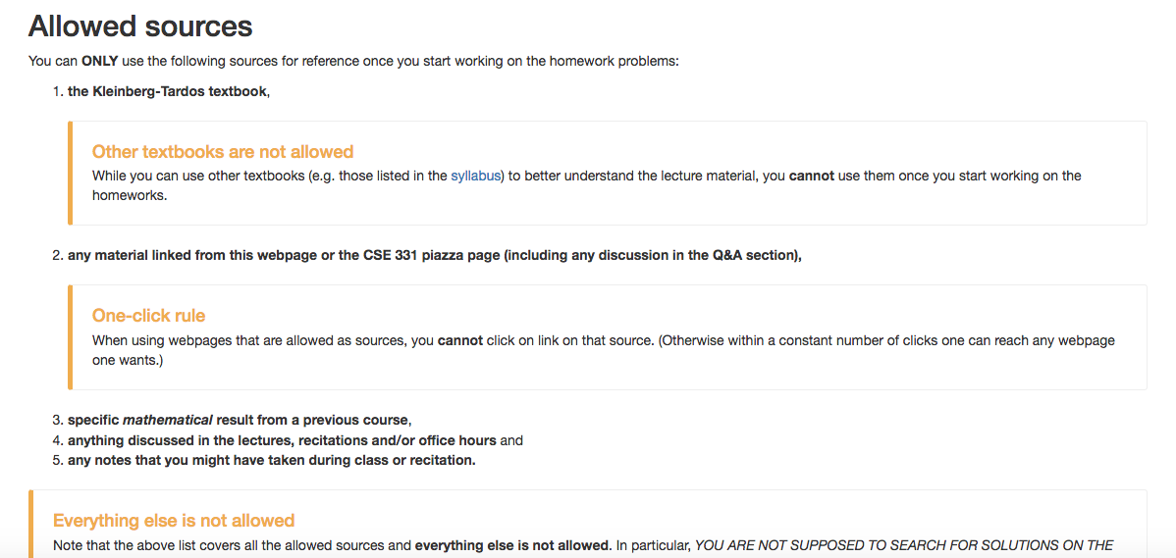
Allowed Sources

Slide 10
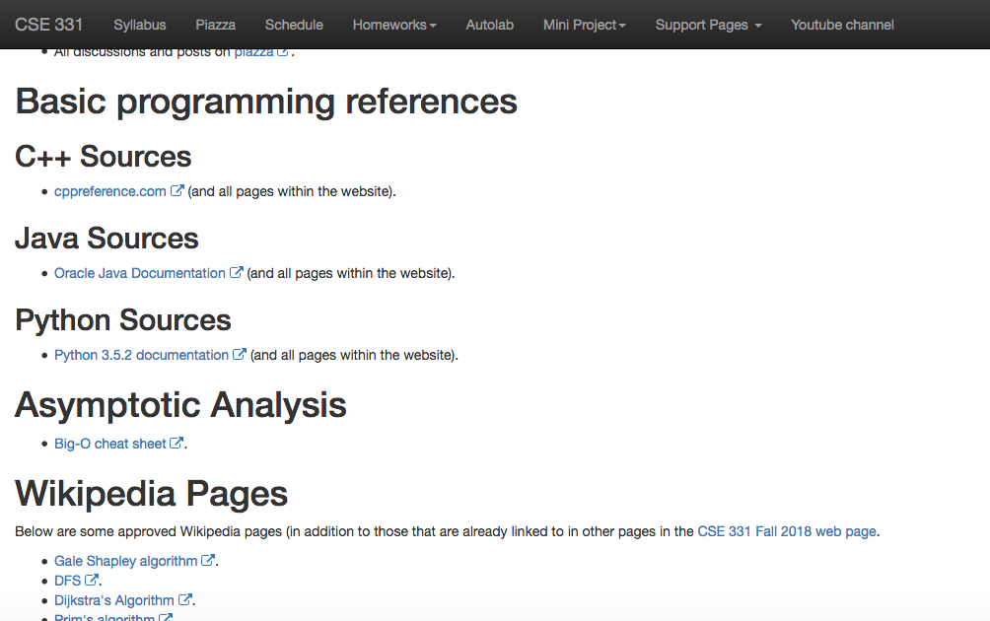
… even for programming Q
http://www-student.cse.buffalo.edu/~atri/cse331/fall18/policies/allowed-sources.html

Slide 11
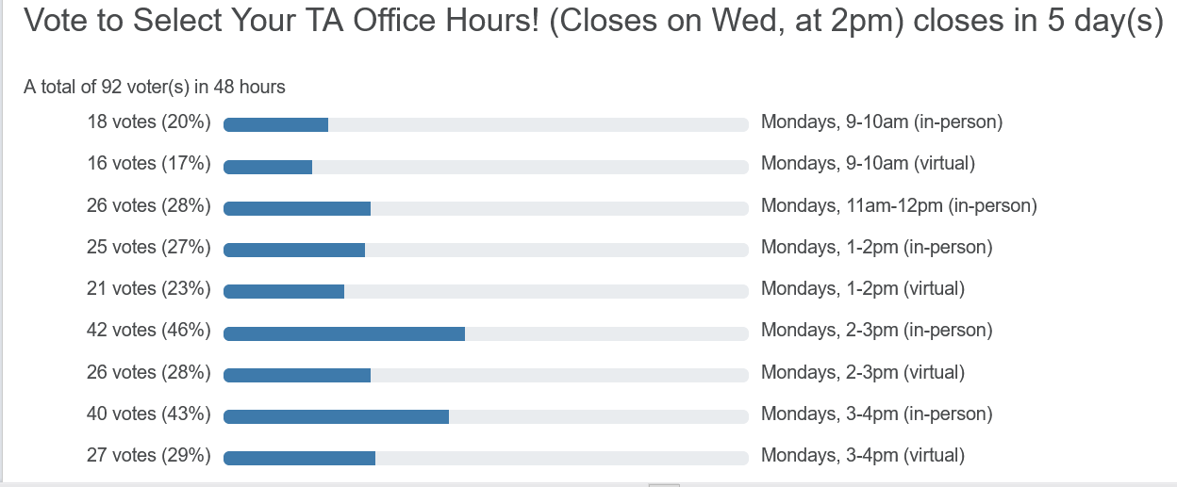
TA Office hours finalize tomorrow

Slide 12
Questions/Comments?

Slide 13
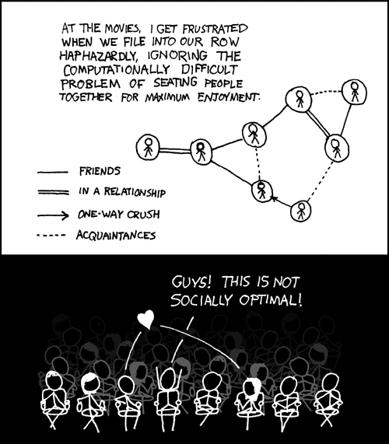
This course: how to solve problems!
http://xkcd.com/173/

Slide 14
Why should I care ?

Slide 15
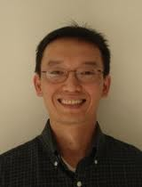
Combining Shadows to Understanding the network

Slide 16
The key technical problem
Given the three projections, what is the largest size of the original set of points?

Slide 17
Detecting Communities

Slide 18
Conquering Shadows to Conquering the Internet
Algorithmically compute the missing set

Slide 19
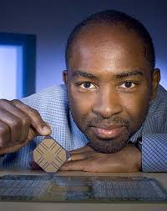
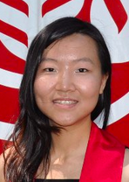
The proof is in the performance
>
10x faster
Better algorithm with little hacking will beat a worse algorithm with tons of hacking

Slide 20
The key technical problem
Highly trivial: 4³ = 64
Still trivial: 4² = 16
Correct answer: 4^{1.5} = 8

Slide 21
If detecting communities is not for you

Slide 22
From someone who got a Google job
“You can let your algorithms class know that the phone interviews are essentially like a difficult algorithms test.
Lots of data structures, specifying the algorithm, analyzing the
run time and space requirements... And all on the phone and
you're supposed to talk through your thought process.”

Slide 23
Coding jobs will be done by AI

Slide 24
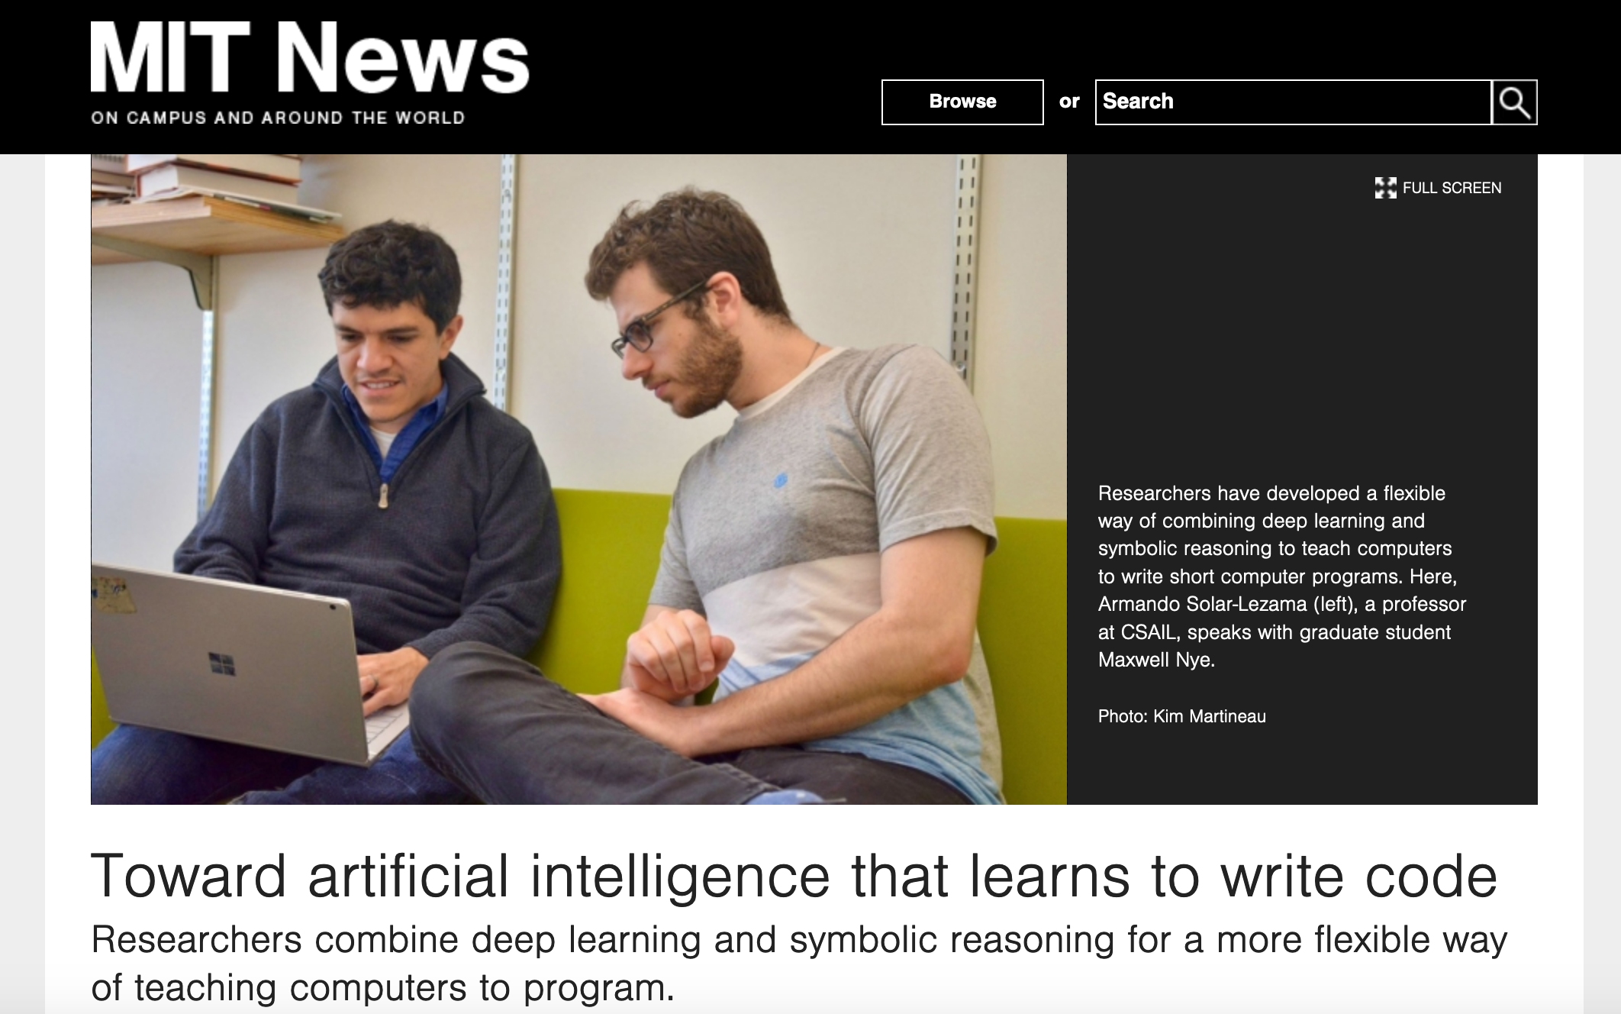
Coding jobs will be done by AI

Slide 25
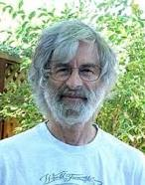
So am I doomed?
There will still be room for high level algorithmic thinking!

Slide 26
Questions/Comments?

Slide 27
Proof Idea vs. Proof Details

Slide 28
Questions/Comments?

