Slide 1
Lecture 20
CSE 331

Slide 2
Dijkstra’s shortest path algorithm
1
d’(w) = min _{e=(u,w) in E, u in R} d(u)+l_{e}
3
y
3
u
4
1
1
1
d(s) = 0
d(u) = 1
s
4
x
4
2
d(w) = 2
d(x) = 2
2
2
2
d(y) = 3
d(z) = 4
w
z
5
3
4
2
s
Input: Directed G=(V,E), l_{e} ≥ 0, s in V
u
w
R = {s}, d(s) =0
Shortest paths
While there is a x not in R with (u,x) in E, u in R
x
Pick w that minimizes d’(w)
Add w to R
y
z
d(w) = d’(w)

Slide 3
Couple of remarks
The Dijkstra’s algo does not explicitly compute the shortest paths
Can maintain “shortest path tree” separately
Dijkstra’s algorithm does not work with negative weights
Left as an exercise

Slide 4
Rest of Today’s agenda
Prove the correctness of Dijkstra’s Algorithm

Slide 5
Dijkstra’s shortest path algorithm
d’(w) = min _{e=(u,w) in E, u in R} d(u)+l_{e}
P_{u} shortest s-u path in “Dijkstra tree”
Input: Directed G=(V,E), l_{e} ≥ 0, s in V
R = {s}, d(s) =0
While there is a x not in R with (u,x) in E, u in R
Pick w that minimizes d’(w)
Add w to R
d(w) = d’(w)
Lemma 1: At end of each iteration, if u in R, then P_{u} is a shortest s-u path
Lemma 2: If u is connected to s, then u in R at the end

Slide 6
Proof idea of Lemma 1

Slide 7
Dijkstra’s shortest path algorithm
d’(w) = min _{e=(u,w) in E, u in R} d(u)+l_{e}
Input: Directed G=(V,E), l_{e} ≥ 0, s in V
R = {s}, d(s) =0
While there is a x not in R with (u,x) in E, u in R
At most n iterations
Pick w that minimizes d’(w)
Add w to R
d(w) = d’(w)
O((m+n)n) time bound is trivial
O((m+n) log n) time implementation with priority Q

Slide 8
Reading Assignment
Sec 4.4 of [KT]

Slide 9
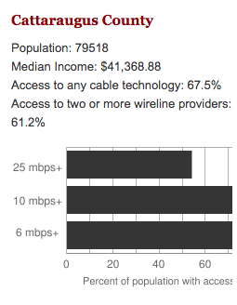
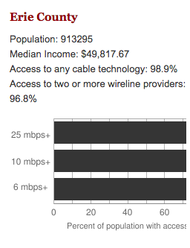
Make broadband more available
BOTH technical and societal issues
Say you are tasked to come up with the infrastructure

Slide 10
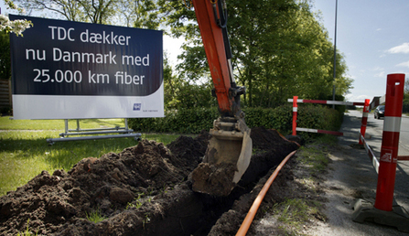
Building a fiber network
Lay down fibers to connect n locations
All n locations should be connected
Laying down a fiber costs money
What is the cheapest way to lay down the fibers?

Slide 11
Today’s agenda
Minimum Spanning Tree (MST) Problem
Greedy algorithm(s) for MST problem

Slide 12
On to the board…

