Slide 1
Lecture 21
CSE 331

Slide 2
Minimum Spanning Tree Problem
Input: Undirected, connected G = (V,E), edge costs c_{e}
Output: Subset E’ ⊆ E), s.t. T = (V,E’) is connected
C(T) is minimized
If all c_{e} > 0, then T is indeed a tree

Slide 3
Rest of today’s agenda
Greedy algorithm(s) for MST problem

Slide 4
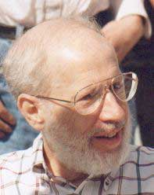
Kruskal’s Algorithm
Input: G=(V,E), c_{e}> 0 for every e in E
T = Ø
Sort edges in increasing order of their cost
Joseph B. Kruskal
Consider edges in sorted order
If an edge can be added to T without adding a cycle then add it to T

Slide 5
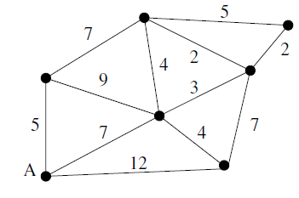
Kruskal’s Algorithm
7
2
2
3
5
4
Input: G=(V,E), c_{e}> 0 for every e in E
T = Ø
Sort edges in increasing order of their cost
2, 2, 3, 4, 4, 5, 5, 7, 7, 7, 9, 12
Consider edges in sorted order
If an edge can be added to T without adding a cycle then add it to T

Slide 6
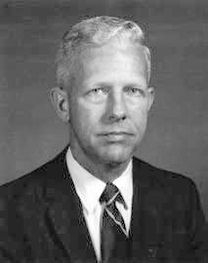
Prim’s algorithm
Similar to Dijkstra’s algorithm
2
0.5
1
3
50
51
Robert Prim
2
0.5
Input: G=(V,E), c_{e}> 0 for every e in E
S = {s}, T = Ø
1
50
While S is not the same as V
Among edges e= (u,w) with u in S and w not in S, pick one with minimum cost
Add w to S, e to T

Slide 7
Reverse-Delete Algorithm
2
0.5
1
3
50
51
Input: G=(V,E), c_{e}> 0 for every e in E
2
0.5
T = E
1
3
50
Sort edges in decreasing order of their cost
51
Consider edges in sorted order
If an edge can be removed T without disconnecting T then remove it

Slide 8
Prim’s algorithm
Similar to Dijkstra’s algorithm
2
0.5
1
3
50
51
Robert Prim
2
0.5
Input: G=(V,E), c_{e}> 0 for every e in E
S = {s}, T = Ø
1
50
While S is not the same as V
Among edges e= (u,w) with u in S and w not in S, pick one with minimum cost
Add w to S, e to T

Slide 9
Cut Property Lemma for MSTs
Condition: S and V\S are non-empty
V \ S
S
Cheapest crossing edge is in all MSTs
Assumption: All edge costs are distinct

Slide 10
Agenda
Optimality of Prim’s algorithm
Prove Cut Property Lemma
Optimality of Kruskal’s algorithm
Remove distinct edge weights assumption

Slide 11
On to the board…

