Slide 1
Lecture 22
CSE 331

Slide 2
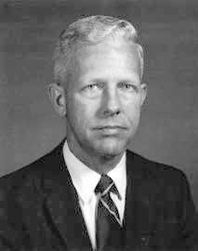
Prim’s algorithm
Similar to Dijkstra’s algorithm
2
0.5
1
3
50
51
Robert Prim
2
0.5
Input: G=(V,E), c_{e}> 0 for every e in E
S = {s}, T = Ø
1
50
While S is not the same as V
Among edges e= (u,w) with u in S and w not in S, pick one with minimum cost
Add w to S, e to T

Slide 3
Cut Property Lemma for MSTs
Condition: S and V\S are non-empty
V \ S
S
Cheapest crossing edge is in all MSTs
Assumption: All edge costs are distinct

Slide 4
Agenda
Optimality of Prim’s algorithm
Prove Cut Property Lemma
Optimality of Kruskal’s algorithm
Remove distinct edge weights assumption

Slide 5
On to the board…

Slide 6
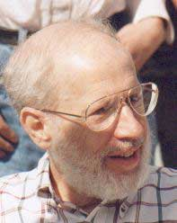
Kruskal’s Algorithm
Input: G=(V,E), c_{e}> 0 for every e in E
T = Ø
Sort edges in increasing order of their cost
Joseph B. Kruskal
Consider edges in sorted order
If an edge can be added to T without adding a cycle then add it to T

Slide 7
Kruskal’s Algorithm
Theorem 2: Kruskal’s algorithm is correct.
(Similar to correctness of Prim’s)
Consider a run of the algorithm when it is about to add edge (u, w) to T.
Goal: show that e is the cheapest “crossing” edge across some cut (S, V\S).
Define S:
Let S be the set of vertices connected to u using only the edges in T (i.e., u has a path to all nodes in S).

Slide 8
Optimality of Kruskal’s Algorithm
S
V \ S
S
Nodes connected to red in (V,T)
Input: G=(V,E), c_{e}> 0 for every e in E
S is non-empty
T = Ø
V\S is non-empty
Sort edges in increasing order of their cost
First crossing edge considered
Consider edges in sorted order
If an edge can be added to T without adding a cycle then add it to T

Slide 9
Is (V,T) a spanning tree?
No cycles by design
G is disconnected!
Just need to show that (V,T) is connected
V \ S’
S’
No edges here

