Slide 1
Lecture 25
CSE 331

Slide 2
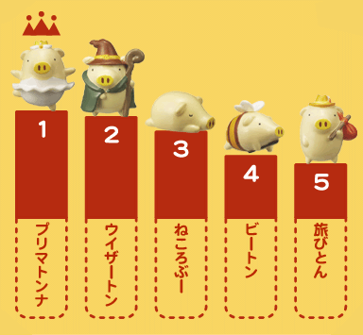
Rankings

Slide 3

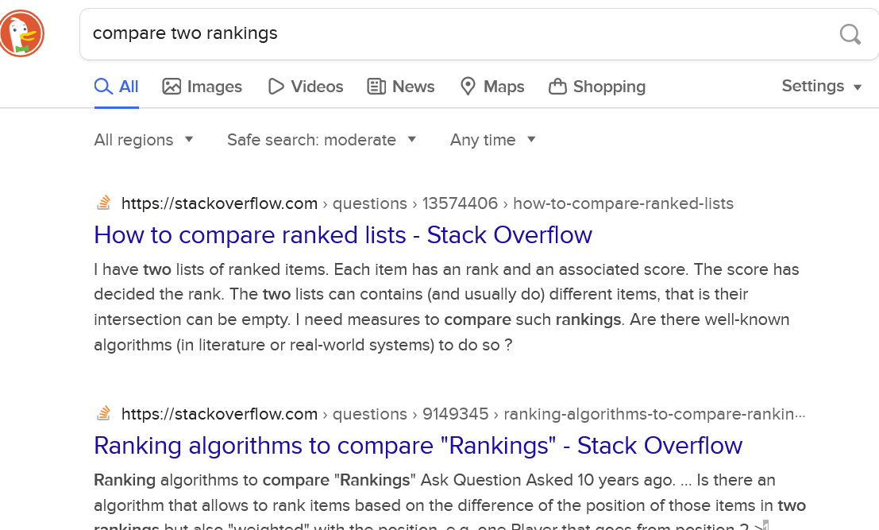
How close are two rankings?

Slide 4
(A Very Simple) Collaborative Filtering Example
Each user: a ranking of movies/shows on Netflix.
Assumption: Each user ranks all movies/shows on Netflix.
Hypothesis: A user is close to another user if their rankings are close.
1. Movie-X 2. Movie-Y 3. Movie-Z
User 1 | User 2 | User 3
1 | 3 | 1
2 | 2 | 3
3 | 1 | 2
Rankings
Problem Formulation
Input: A ranking a₁, …, a_{i}, a_{j}, …a_{n}. ( i.e., a permutation of 1, 2, …, n)
Implicit assumption: 1, 2, …, n is the “true” ranking (i.e., you compare other rankings to this ranking).
Output: The number of inversions.
Inversion: (i, j) is an inversion if
1. i < j AND 2. a_{i} > a_{j}

Slide 5
(A Very Simple) Collaborative Filtering Example
Each user: a ranking of movies/shows on Netflix.
Assumption: Each user ranks all movies/shows on Netflix.
Hypothesis: A user is close to another user if their rankings are close.
1. Movie-X 2. Movie-Y 3. Movie-Z
User 1 | User 2 | User 3
1 | 3 | 1
2 | 2 | 3
3 | 1 | 2
Rankings
Example 1:
User 2: how many inversions?
Answer: every pair is an inversion.

Slide 6
(A Very Simple) Collaborative Filtering Example
Each user: a ranking of movies/shows on Netflix.
Assumption: Each user ranks all movies/shows on Netflix.
Hypothesis: A user is close to another user if their rankings are close.
1. Movie-X 2. Movie-Y 3. Movie-Z
User 1 | User 2 | User 3
1 | 3 | 1
2 | 2 | 3
3 | 1 | 2
Rankings
Example 1:
User 2: how many inversions?
Answer: every pair is an inversion.

Slide 7
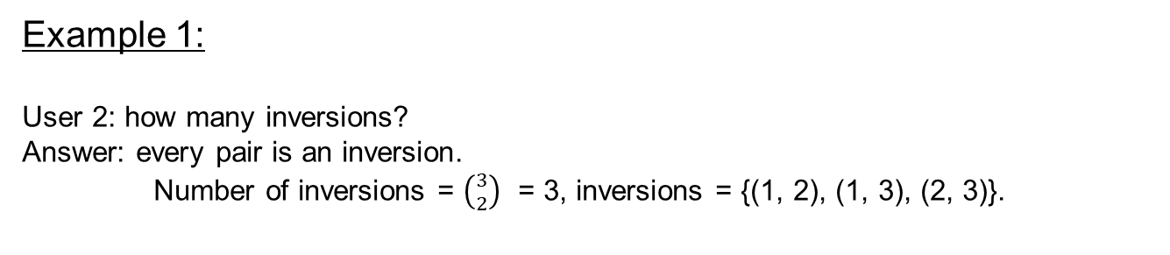
(A Very Simple) Collaborative Filtering Example
Each user: a ranking of movies/shows on Netflix.
Assumption: Each user ranks all movies/shows on Netflix.
Hypothesis: A user is close to another user if their rankings are close.
1. Movie-X 2. Movie-Y 3. Movie-Z
User 1 | User 2 | User 3
1 | 3 | 1
2 | 2 | 3
3 | 1 | 2
Rankings
Example 1:
User 2: how many inversions?
Answer: every pair is an inversion.
Number of inversions = $\left({3 \atop 2}\right)$ = 3, inversions = {(1, 2), (1, 3), (2, 3)}.

Slide 8
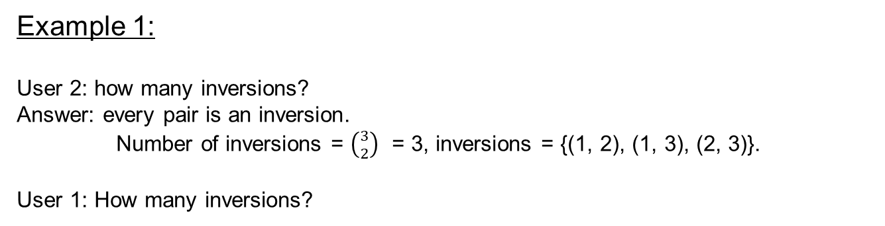
(A Very Simple) Collaborative Filtering Example
Each user: a ranking of movies/shows on Netflix.
Assumption: Each user ranks all movies/shows on Netflix.
Hypothesis: A user is close to another user if their rankings are close.
1. Movie-X 2. Movie-Y 3. Movie-Z
User 1 | User 2 | User 3
1 | 3 | 1
2 | 2 | 3
3 | 1 | 2
Rankings
Example 1:
User 2: how many inversions?
Answer: every pair is an inversion.
Number of inversions = $\left({3 \atop 2}\right)$ = 3, inversions = {(1, 2), (1, 3), (2, 3)}.
User 1: How many inversions?

Slide 9
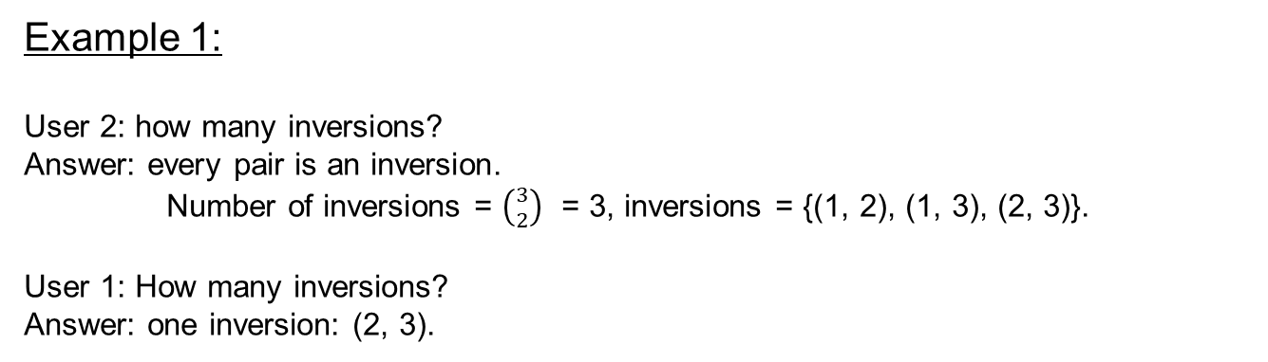
(A Very Simple) Collaborative Filtering Example
Each user: a ranking of movies/shows on Netflix.
Assumption: Each user ranks all movies/shows on Netflix.
Hypothesis: A user is close to another user if their rankings are close.
1. Movie-X 2. Movie-Y 3. Movie-Z
User 1 | User 2 | User 3
1 | 3 | 1
2 | 2 | 3
3 | 1 | 2
Rankings
Example 1:
User 2: how many inversions?
Answer: every pair is an inversion.
Number of inversions = $\left({3 \atop 2}\right)$ = 3, inversions = {(1, 2), (1, 3), (2, 3)}.
User 1: How many inversions?
Answer: one inversion: (2, 3).

Slide 10

(A Very Simple) Collaborative Filtering Example
Each user: a ranking of movies/shows on Netflix.
Assumption: Each user ranks all movies/shows on Netflix.
Hypothesis: A user is close to another user if their rankings are close.
1. Movie-X 2. Movie-Y 3. Movie-Z
User 1 | User 2 | User 3
1 | 3 | 1
2 | 2 | 3
3 | 1 | 2
Rankings
Example 2:
A = (1, 2, …, n).
How many inversions?
If a₁, …, a_{i}, a_{j}, …a_{n} are sorted, then no inversions.
0
Example 3:
A = (n, …, 1).
How many inversions?
$$\left({n \atop 2}\right)$$
0 ≤ # inversions ≤ $\left({n \atop 2}\right)$

Slide 11

Solve a harder problem
Input: a₁, .., a_{n}
Output: LIST of all inversions
Optimal for the listing problem
for i in 1 to n-1
for j in i+1 to n
If a_{i} > a_{j}
add (i,j) to L
return L

Slide 12
Example 1: All inversions-- (2i-1,2i)
Only check (i,i+1) pairs
2 | 1 | 3 | 4 | 6 | 5 | 7 | 8
Q1: Solve listing problem in O(n) time?
Q2: Recursive divide and conquer algorithm to count the number of inversions?
CountInv (a,n)
if n = 1 return 0
if n = 2 return a₁ > a₂
a_{L} = a₁ , .., a_{[n/2]}
a_{R} = a_{[n/2]+1} , .., a_{n}
return CountInv(a_{L}, [n/2]) + CountInv(a_{R}, n- [n/2])

Slide 13

Can be horribly wrong in general
CountInv (a,n)
if n = 1 return 0
if n = 2 return a₁ > a₂
a_{L} = a₁ , .., a_{[n/2]}
a_{R} = a_{[n/2]+1} , .., a_{n}
return CountInv(a_{L}, [n/2]) + CountInv(a_{R}, n- [n/2])
5
6
1
2
All 4 “crossing” pairs are inversions

Slide 14
Bad case: “crossing inversions”
CountInv (a,n)
Are a_{L} and a_{R} sorted?
if n = 1 return 0
Yes!
if n = 2 return a₁ > a₂
a_{L} = a₁ , .., a_{[n/2]}
a_{R} = a_{[n/2]+1} , .., a_{n}
return CountInv(a_{L}, [n/2]) + CountInv(a_{R}, n- [n/2])
a_{L}
a_{R}

Slide 15
Example 2: Solving the bad case
5
6
…..
1
a_{L}
a_{R}
a_{L} is sorted
First element is a_{L} is larger than first/only element in a_{R}
O(1) algorithm to count number of inversions?
return size of a_{L}

Slide 16
Example 3: Solving the bad case
1
5
6
…..
a_{L}
a_{R}
a_{R} is sorted
First/only element is a_{L} is smaller than first element in a_{R}
O(1) algorithm to count number of inversions?
return 0

Slide 17
Solving the bad case
Try to modify the MERGE algorithm
First element of a_{L} is larger than first element of a_{R}
5
6
…..
1
a_{L}
a_{R}
First element of a_{L} is smaller than first element of a_{R}
1
5
6
…..
a_{L}
a_{R}
a_{L}
a_{R}

Slide 18
Divide and Conquer
Divide up the problem into at least two sub-problems
Solve all sub-problems: Mergesort
Recursively solve the sub-problems
Solve stronger sub-problems: Inversions
“Patch up” the solutions to the sub-problems for the final solution

Slide 19
MergeSortCount algorithm
Input: a₁, a₂, …, a_{n}
Output: Numbers in sorted order+ #inversion
MergeSortCount( a, n )
If n = 1 return ( 0 , a₁)
If n = 2 return ( a1 > a2, min(a₁,a₂); max(a₁,a₂))
a_{L} = a₁,…, a_{n/2}
a_{R} = a_{n/2+1},…, a_{n}
(c_{L}, a_{L}) = MergeSortCount(a_{L}, n/2)
(c_{R}, a_{R}) = MergeSortCount(a_{R}, n/2)
Counts #crossing-inversions+ MERGE
(c, a) = MERGE-COUNT(a_{L},a_{R})
return (c+c_{L}+c_{R},a)

