Slide 1
Lecture 35
CSE 331

Slide 2
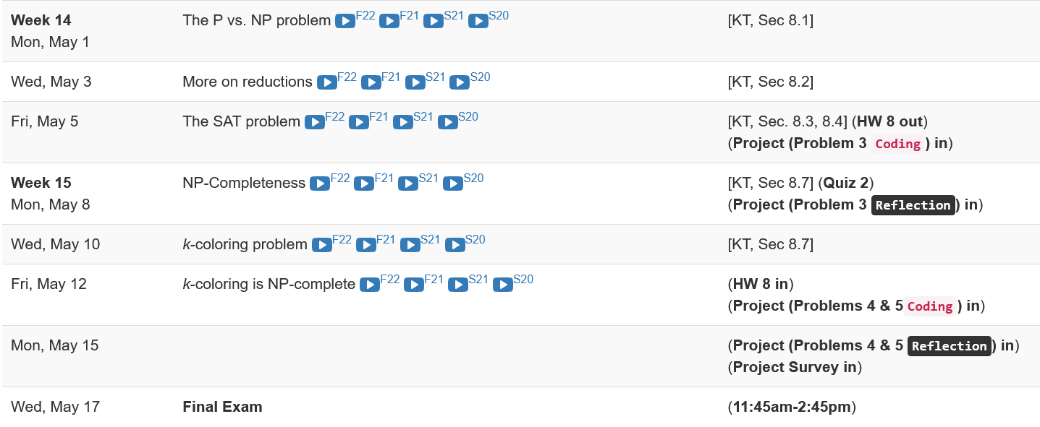
Lecture 35
Last two weeks will be rough…
CSE 331

Slide 3
Shortest Path Problem
Input: (Directed) Graph G=(V,E) and for every edge e has a cost c_{e} (can be <0)
t in V
Output: Shortest path from every s to t
Assume that G has no negative cycle
1
1
s
t
Shortest path has cost negative infinity
899
100
-1000

Slide 4
The recurrence
OPT(u,i) = shortest path from u to t with at most i edges
OPT(u,i) = min { OPT(u,i-1), min_{(u,w) in E} { c_{u,w} + OPT(w, i-1)} }

Slide 5
Some consequences
OPT(u,i) = cost of shortest path from u to t with at most i edges
OPT(u,i) = min { OPT(u, i-1), min_{(u,w) in E} { c_{u,w} + OPT(w,i-1)} }
OPT(u,n-1) is shortest path cost between u and t
Can compute the shortest path between s and t given all OPT(u,i) values

Slide 6
Bellman-Ford Algorithm
Runs in O(n(m+n)) time
Only needs O(n) additional space

Slide 7
Reading Assignment
Sec 6.8 of [KT]

Slide 8
Longest path problem
Given G, does there exist a simple path of length n-1 ?

Slide 9
Longest vs Shortest Paths

Slide 10
Two sides of the “same” coin
Shortest Path problem
Can be solved by a polynomial time algorithm
Is there a longest path of length n-1?
Given a path can verify in polynomial time if the answer is yes

Slide 11
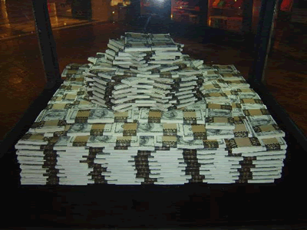
Poly time algo for longest path?

Slide 12
P vs NP question

Slide 13
P vs NP question
P: problems that can be solved by poly time algorithms
Is P=NP?
NP: problems that have polynomial time verifiable witness to optimal solution
Alternate NP definition: Guess witness and verify!

Slide 14
Proving P ≠ NP
Pick any one problem in NP and show it cannot be solved in poly time
Pretty much all known proof techniques provably will not work

Slide 15
Proving P = NP
Will make cryptography collapse
Compute the encryption key!
Prove that all problems in NP can be solved by polynomial time algorithms
Solving any ONE problem in here in poly time will prove P=NP!
NP
NP-complete problems

Slide 16
A book on P vs. NP

Slide 17
The course so far…
https://www.teepublic.com/sticker/1100935-obama-yes-we-can

Slide 18
The rest of the course…
Under certain assumptions,
https://www.madduckposters.com/products/megamind-no-you-cant?variant=13565168320556

Slide 19
No, you can’t– what does it mean?
NO algorithm will be able to solve a problem in polynomial time
Still for worst-case runtime

Slide 20
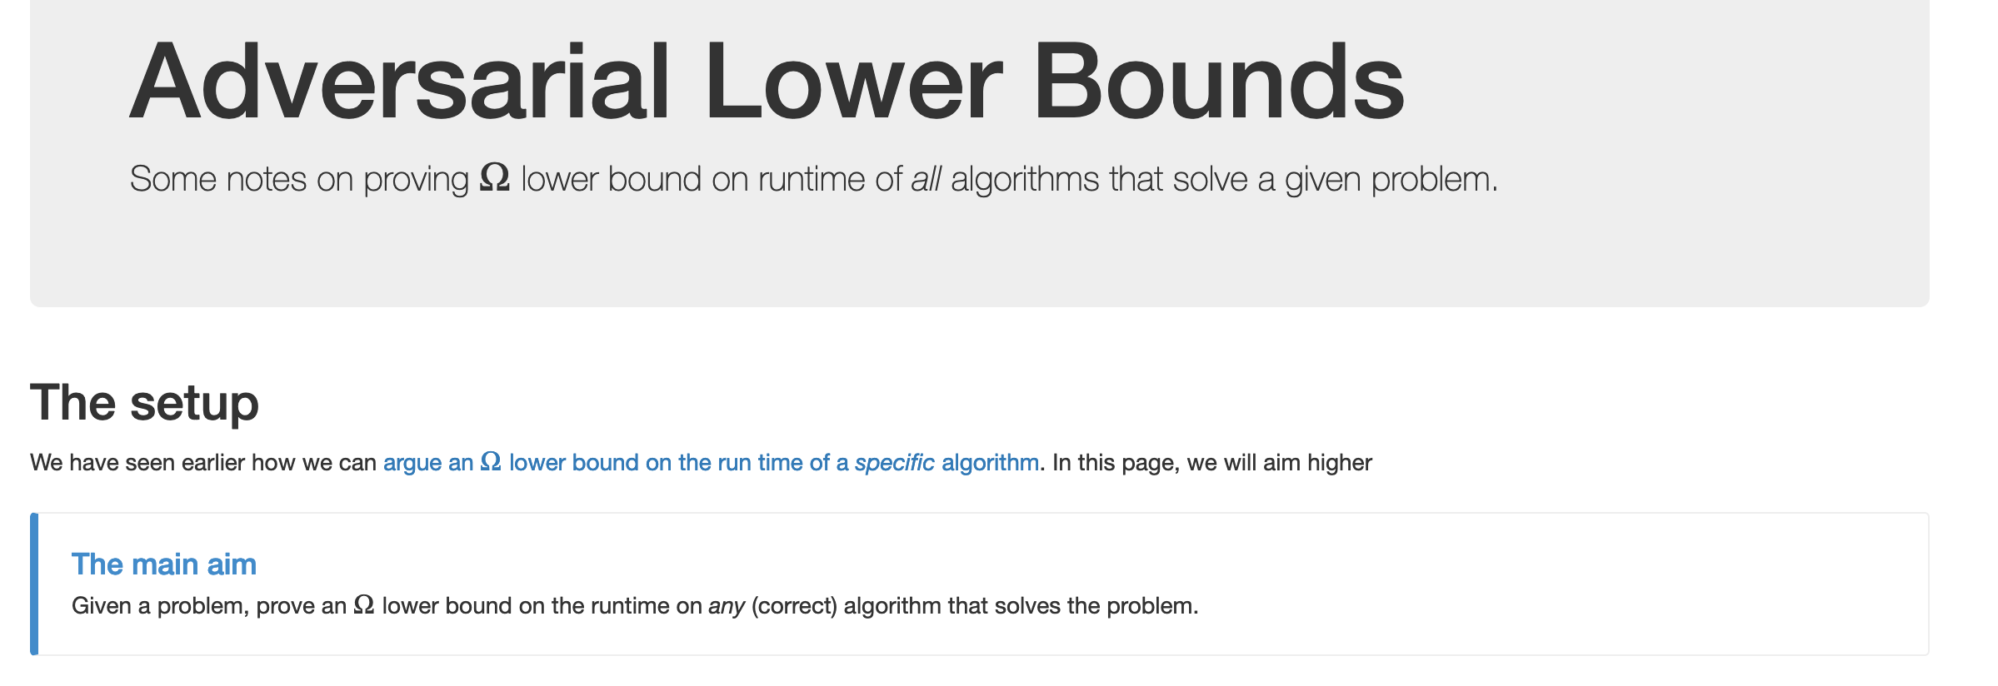
No, you can’t take- 1
What is the best lower bound you can prove?

Slide 21
No, you can’t take- 2
Lower bounds based on output size
Exists graphs with m^{3/2} triangles

Slide 22
No, you can’t take- 2
Lower bounds based on output size
On input n, output 2^{n} many ones
Every algo takes (doubly) exponential time
But at heart problem is “trivial”
From now on, output size is always O(N) and could even be binary.

Slide 23
No, you can’t take -3
Argue that a given problem is AS HARD AS
a “known” hard problem
How can we argue something like this?
Reductions

Slide 24
So far: “Yes, we can” reductions
https://www.teepublic.com/sticker/1100935-obama-yes-we-can

Slide 25
Reduce Y to X where X is “easy”

Slide 26
“Yes, we can” reductions (Example)

Slide 27
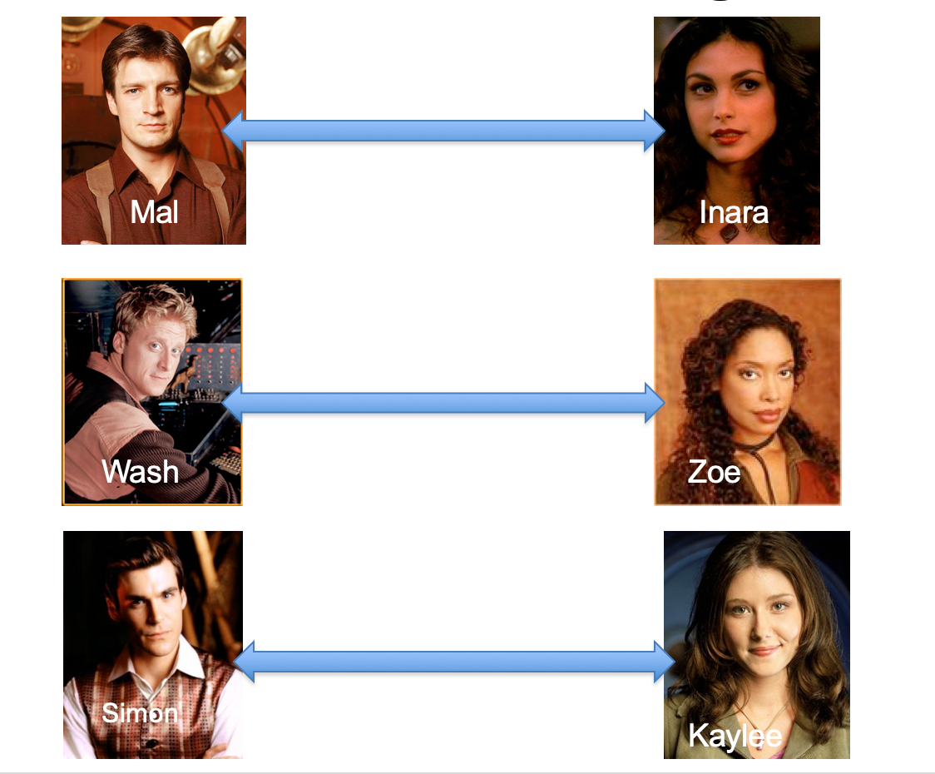
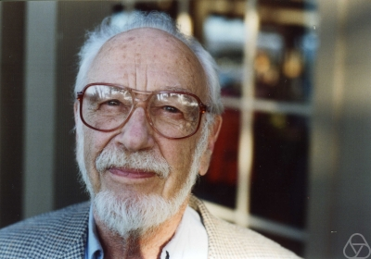
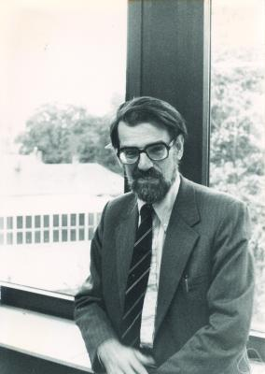
Overview of the reduction

Slide 28
Nothing special about GS algo
ANY algo for stable matching problem works!

Slide 29
Another observation
Poly time steps
ANY algo for stable matching problem works!

Slide 30
Poly time reductions
Poly time steps
ANY algo for stable matching problem works!

Slide 31
Poly time steps
Arbitrary Y instance
ANY algo for stable matching problem works!
Pre-process the input
Output for Y instance
All processing
is poly-time
Algo for X
Post-process the output

