Slide 1
Lecture 36
CSE 331

Slide 2
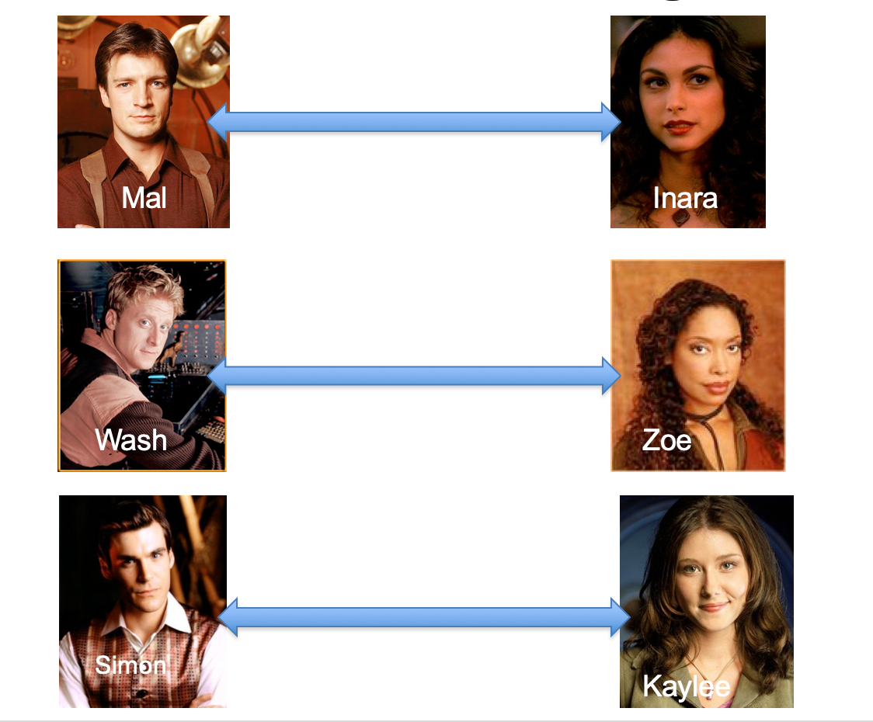
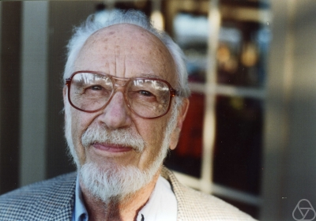
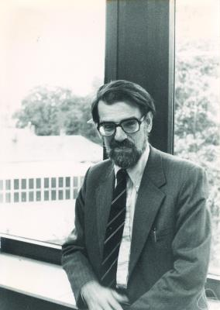
Overview of the reduction

Slide 3
Nothing special about GS algo
ANY algo for stable matching problem works!

Slide 4
Another observation
Poly time steps
ANY algo for stable matching problem works!

Slide 5
Poly time reductions
Poly time steps
ANY algo for stable matching problem works!

Slide 6
Poly time steps
Arbitrary Y instance
ANY algo for stable matching problem works!
Pre-process the input
Output for Y instance
All processing
is poly-time
Algo for X
Post-process the output

Slide 7
Poly time algo for X
Arbitrary Y instance
Poly time algo for Y
Pre-process the input
Output for Y instance
All processing
is poly-time
Algo for X
Post-process the output

Slide 8
!B !A

Slide 9
No poly time algo for Y
Poly time algo for X
Arbitrary Y instance
No poly time algo for X
Poly time algo for Y
Pre-process the input
Output for Y instance
All processing
is poly-time
Algo for X
Post-process the output

