Slide 1
Lecture 40
CSE 331

Slide 2




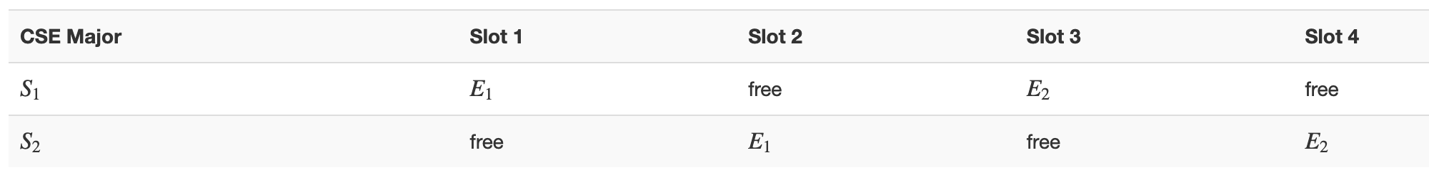
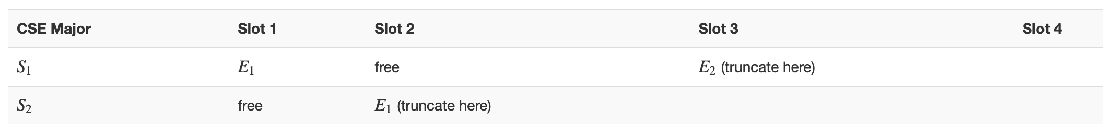






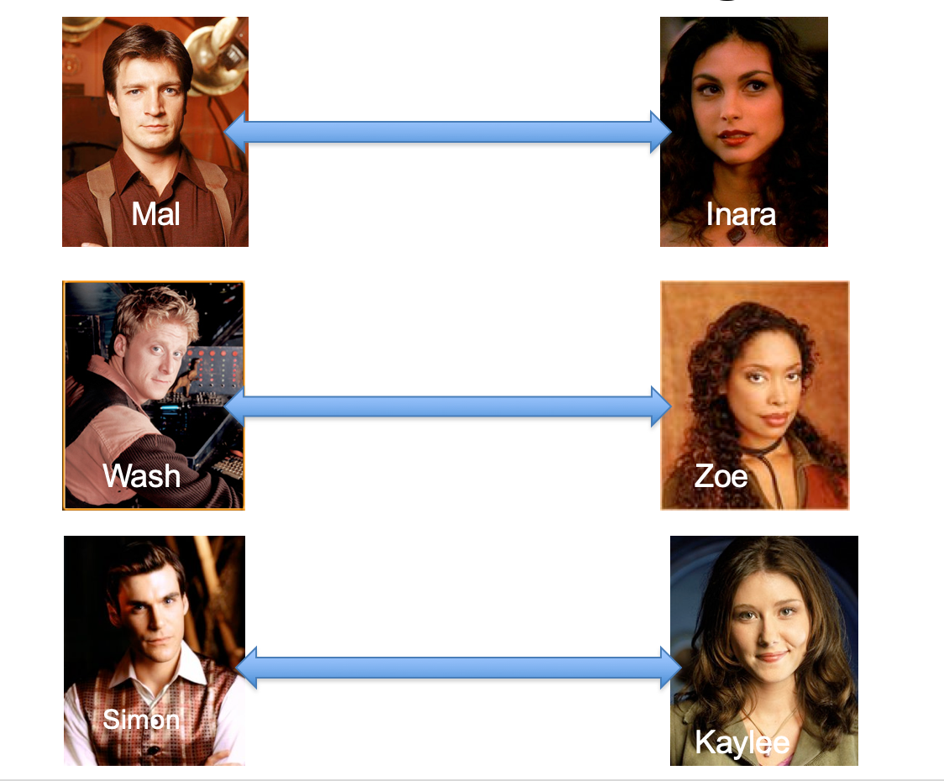
Poly time steps
Arbitrary Y instance
ANY algo for stable matching problem works!
Pre-process the input
Output for Y instance
All processing
is poly-time
Algo for X
Post-process the output

Slide 3



Poly time algo for X
Y is NP-hard
Arbitrary Y instance
Poly time algo for Y
X is NP-hard
Pre-process the input
Output for Y instance
All processing
is poly-time
Algo for X
Post-process the output
Mostly trivial

Slide 4

Arbitrary Y instance
AlgoIS (G,k)
G’ = G
Pre-process the input
Output for Y instance
k’ = n-k
b = AlgoVC(G’,k’)
Algo for X
return b
Post-process the output
(G,n-k)
Algo for VC
(G,k)

Slide 5
Today’s agenda
NP-completeness of k-colorability
Beyond NP-completeness

Slide 6
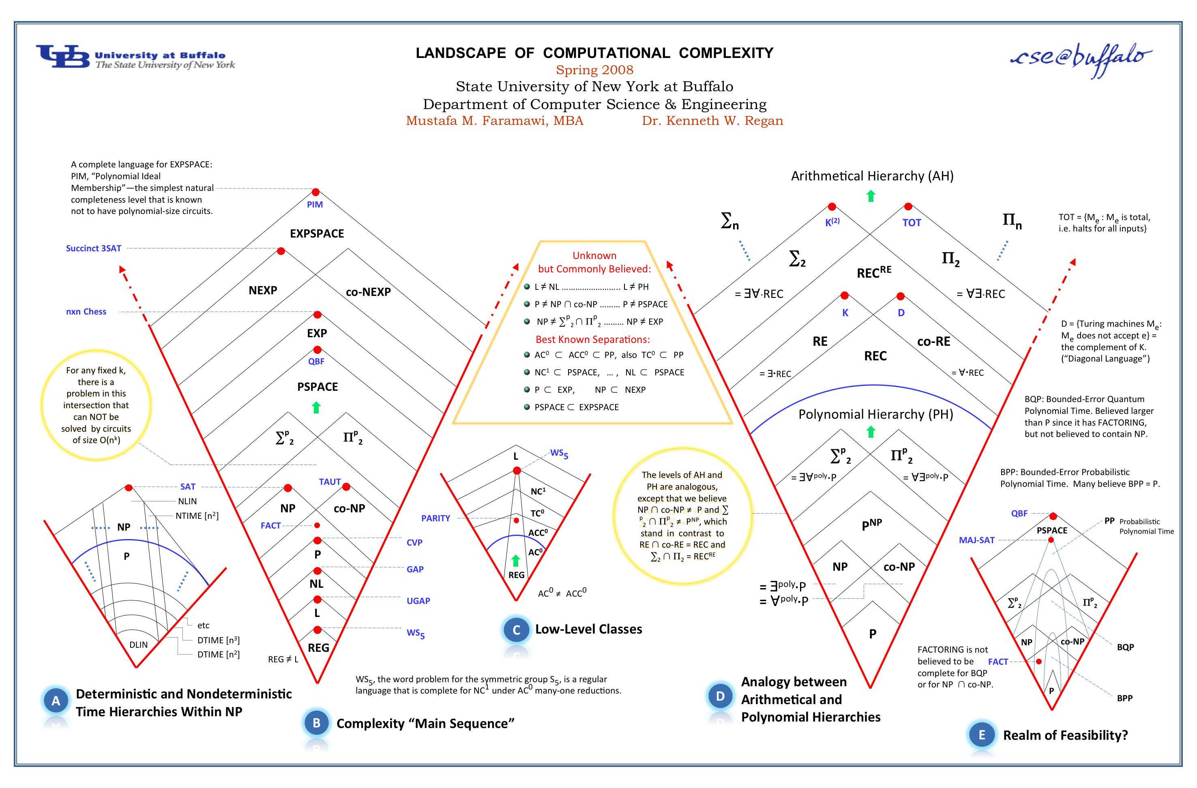
Anything > NP and < undecidability?

