Slide 1
Welcome
to
CSE 331

Slide 2
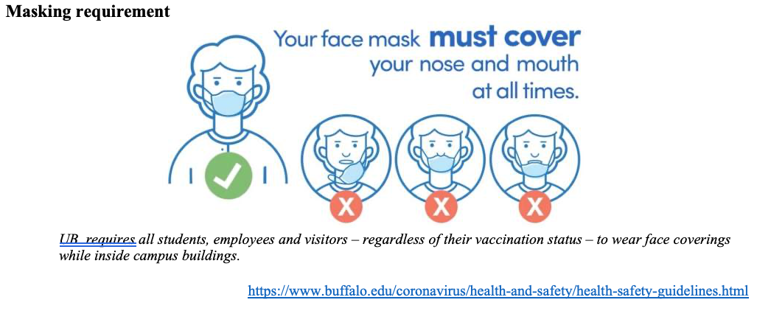
Please have a face mask on

Slide 3
Let’s do some introductions

Slide 4
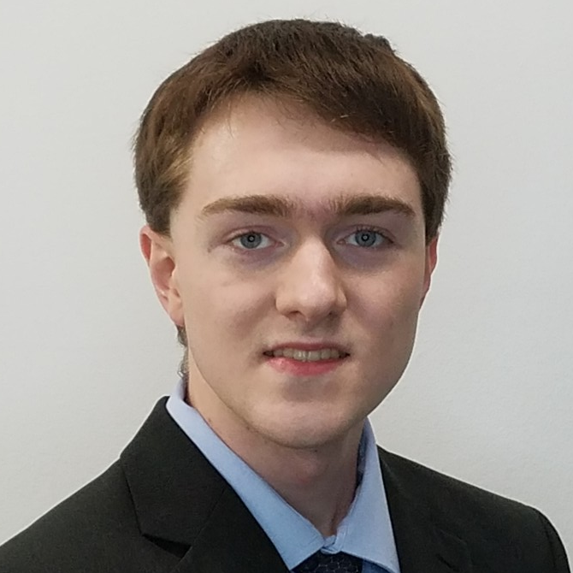

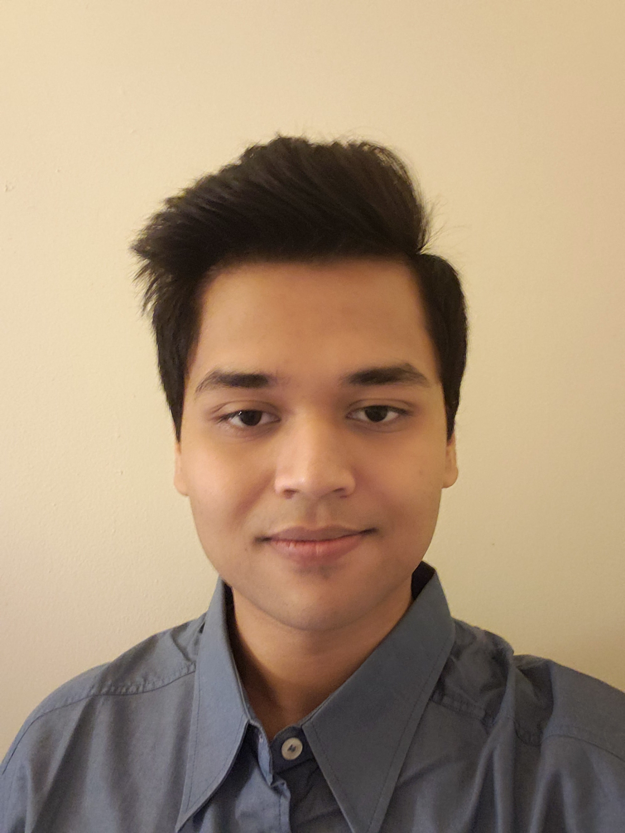

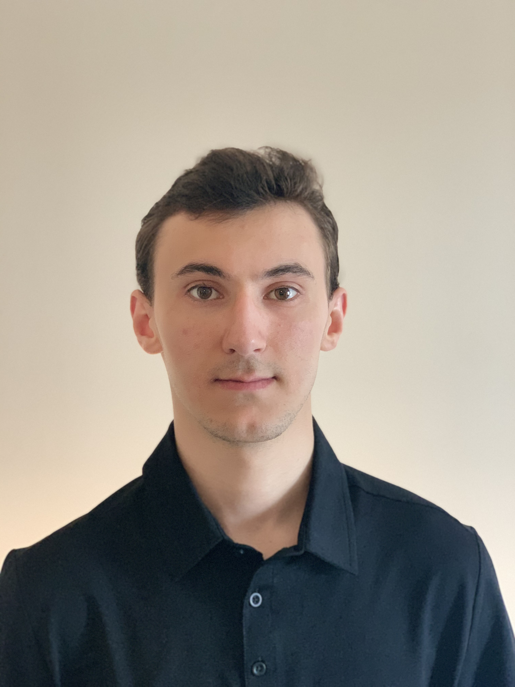


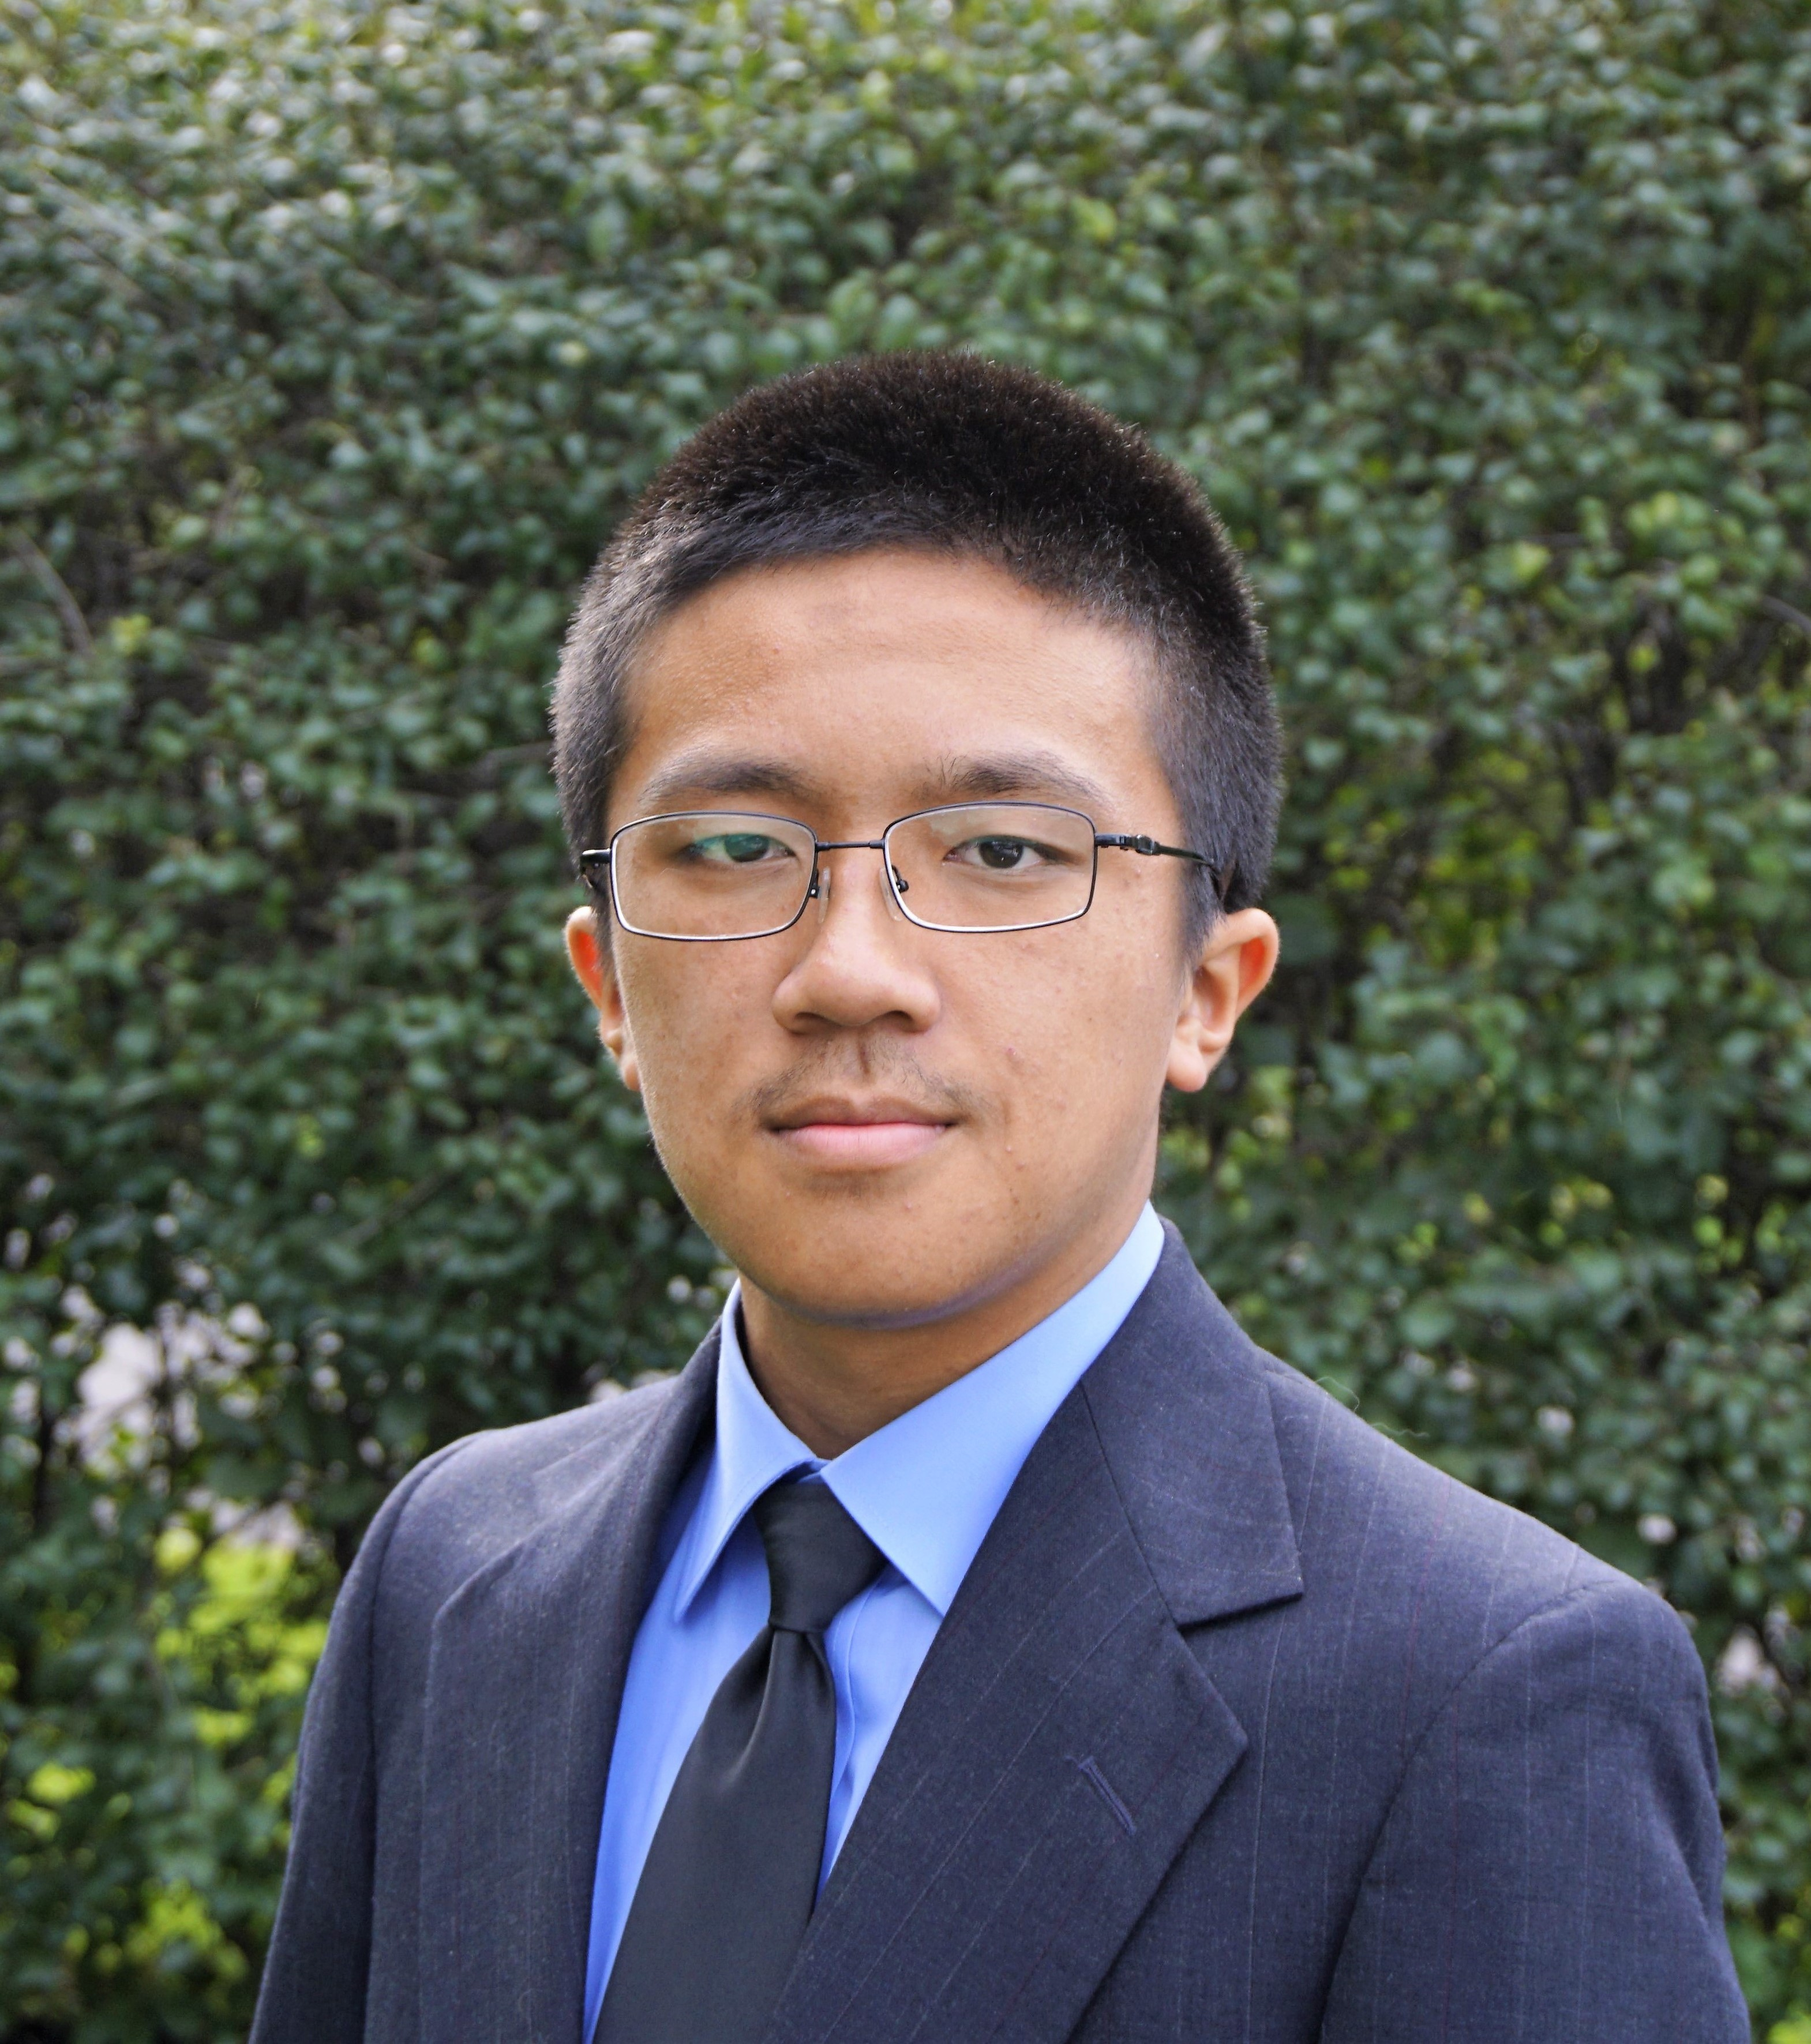
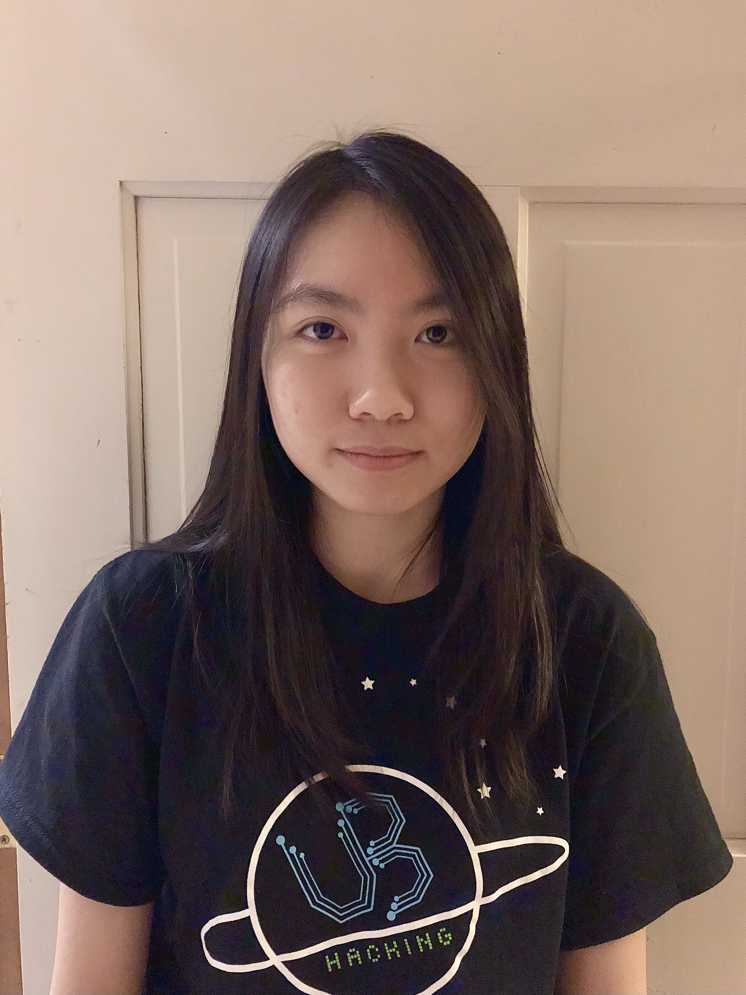
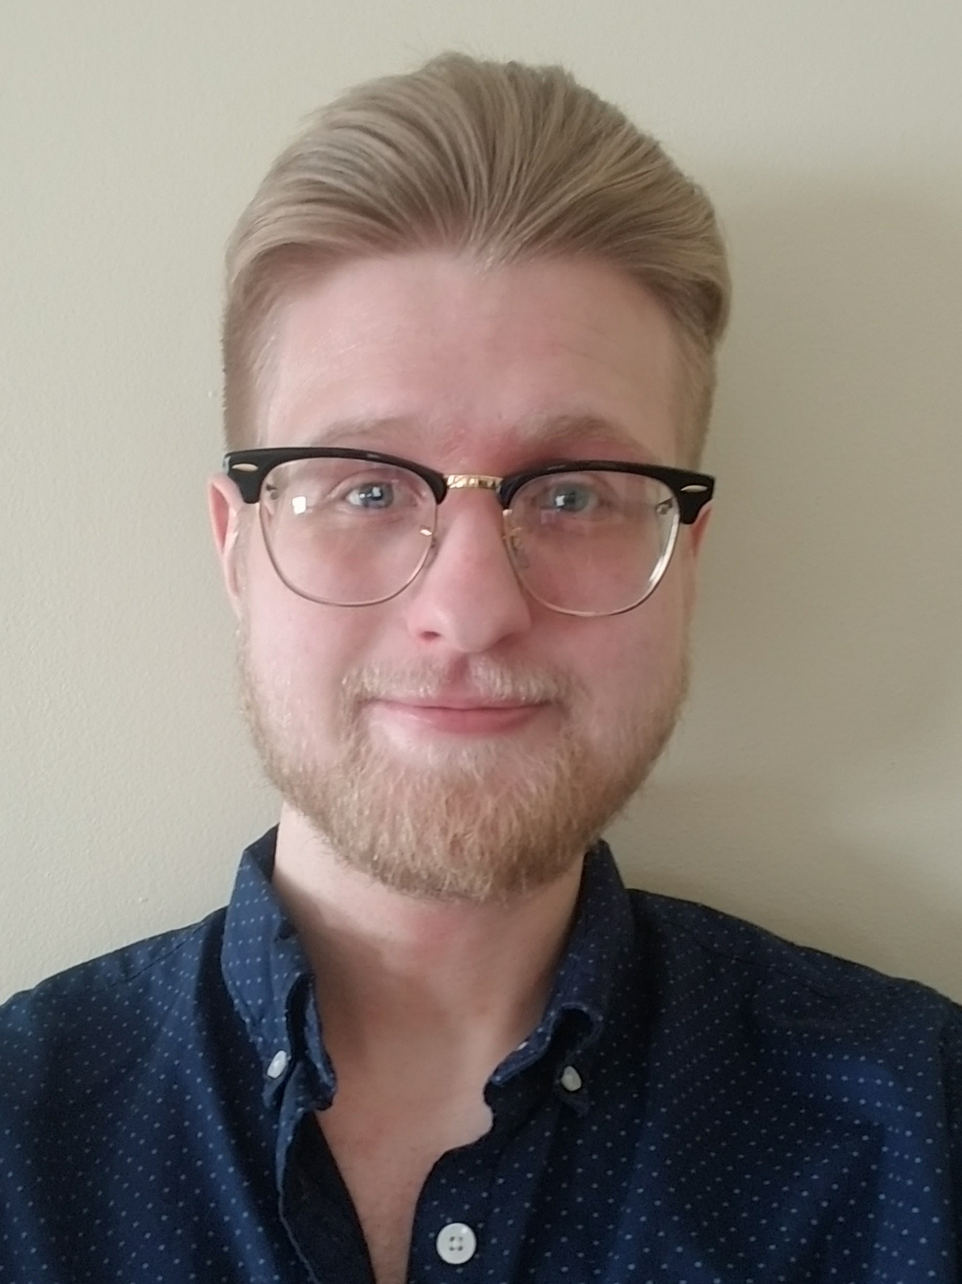


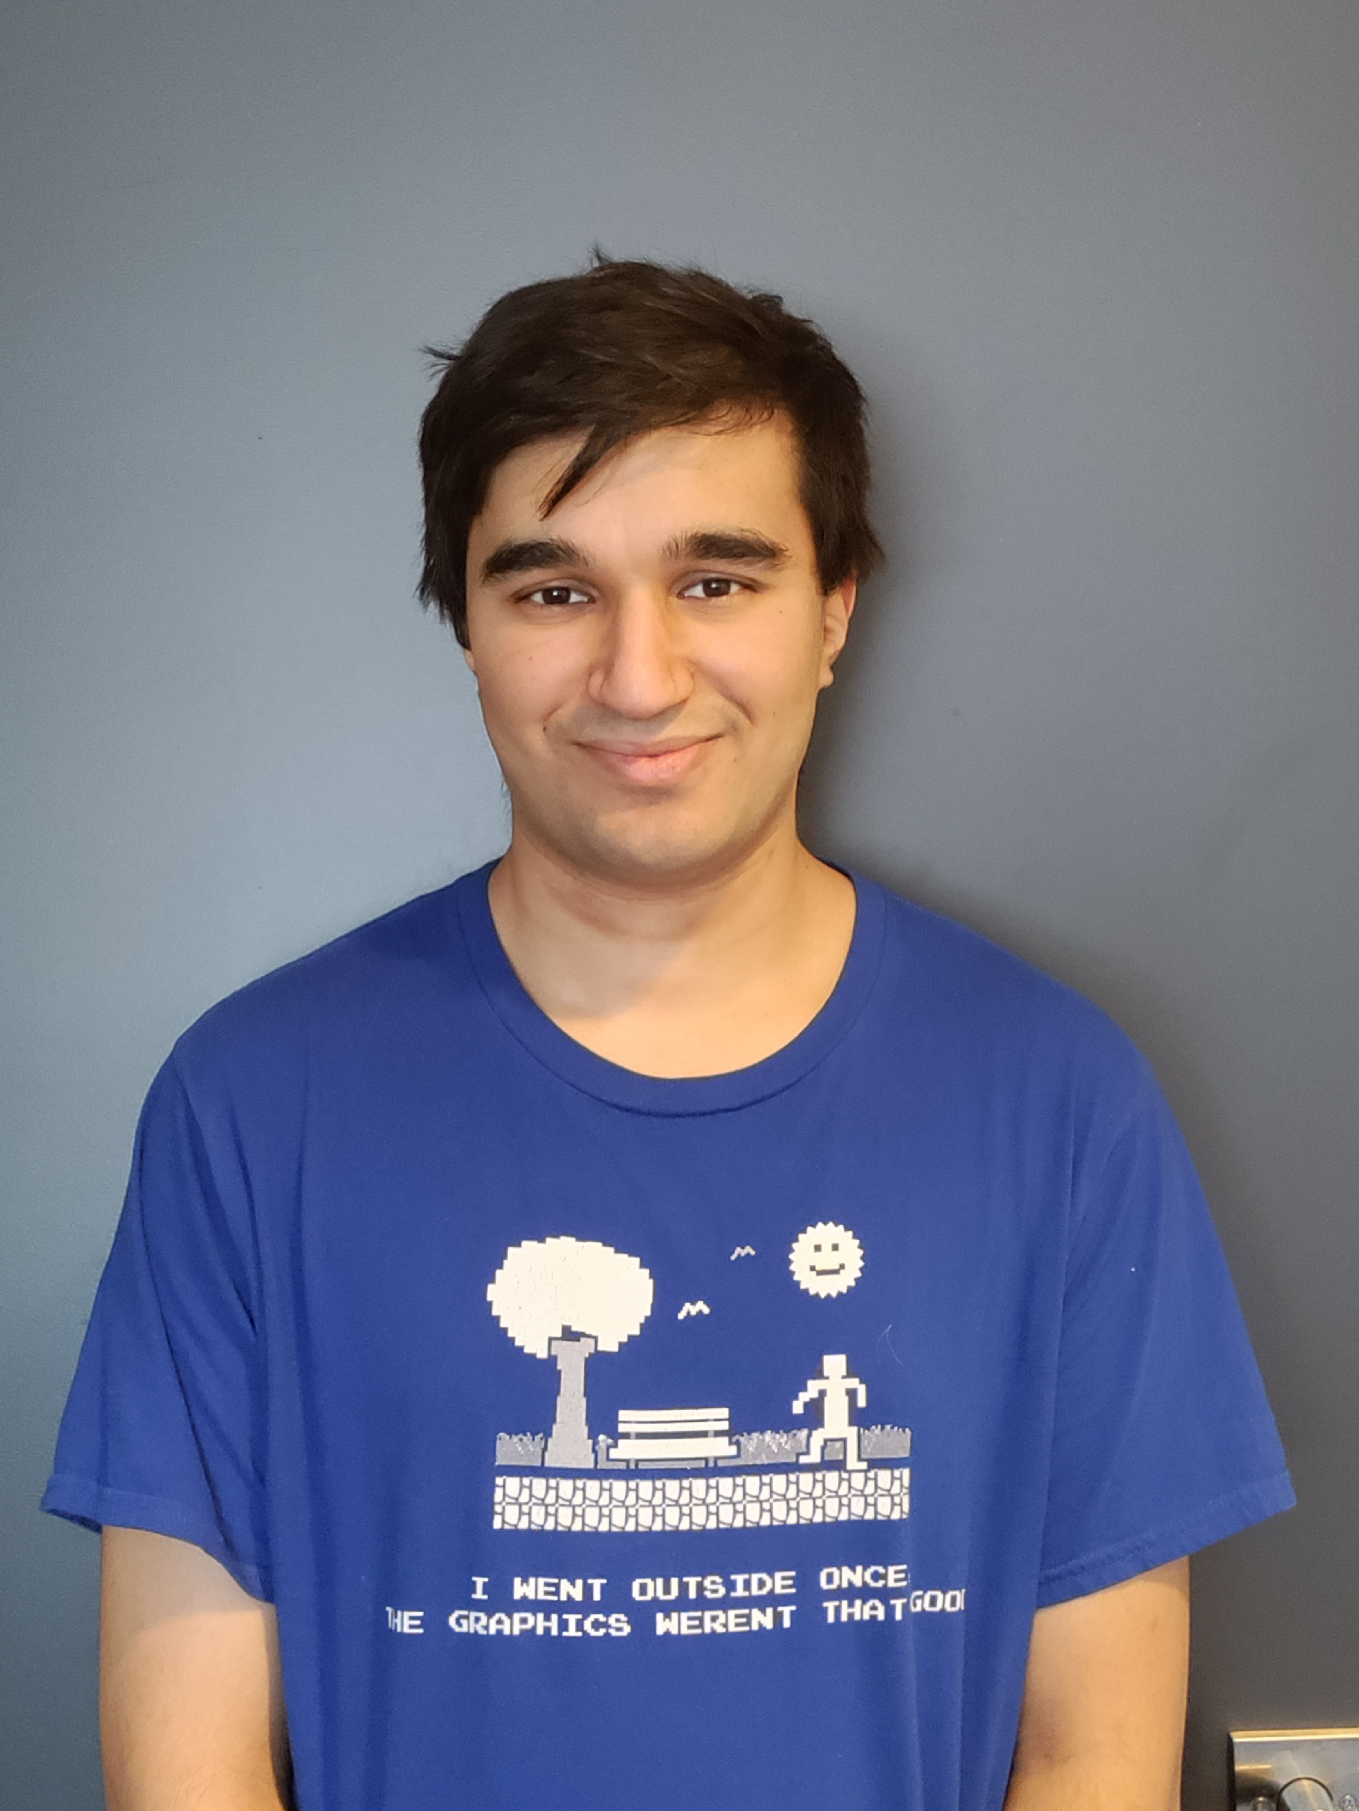

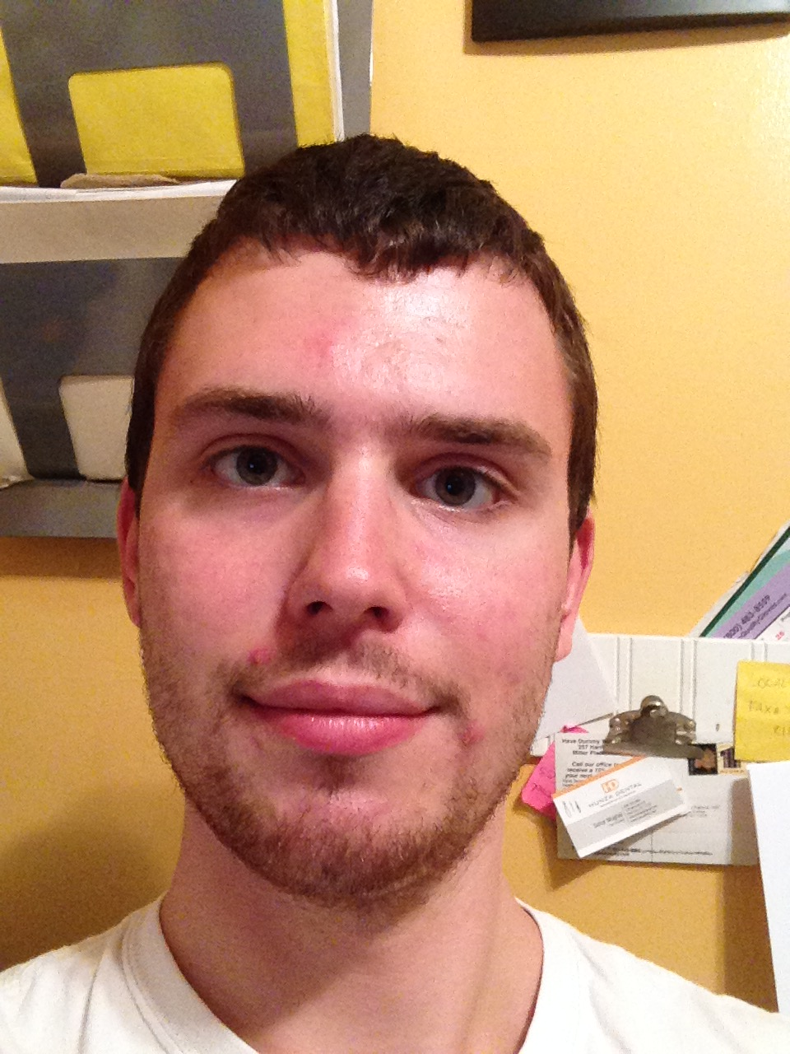
TAs first
Robert
Alex
Asif
Snigdha
Ben
Aman
Connor
Joseph
Megan
Nick
James
Trevor
Felipe
Michael
Prathamesh

Slide 5

Lectures will be videotaped
http://www.imdb.com/title/tt0363510/mediaviewer/rm2499681792

Slide 6
About Me
Nasrin Akhter
nasrinak@buffalo.edu
Office: Davis 303
Office hours: M W 4:10-5:00PM ET
If you'd like to meet via Zoom, here is the meeting link: https://buffalo.zoom.us/j/92008530869?pwd=cEwrYi9VMkZ2YlpKall4SGhHWUtSZz09

Slide 7
Contact us all at
Or use piazza!
cse-331-staff@buffalo.edu
TAs will not respond to individual emails (except for re-grading requests)

Slide 8
CSE 331 in times of COVID
Lectures and recitations will be in-person
Office hours will be a mix of in-person and virtual locations
Exams and Quizzes will be in-person

Slide 9
Questions/Comments?

Slide 10
Handouts for today
Syllabus (online)
Homework Policy document (online)

Slide 11
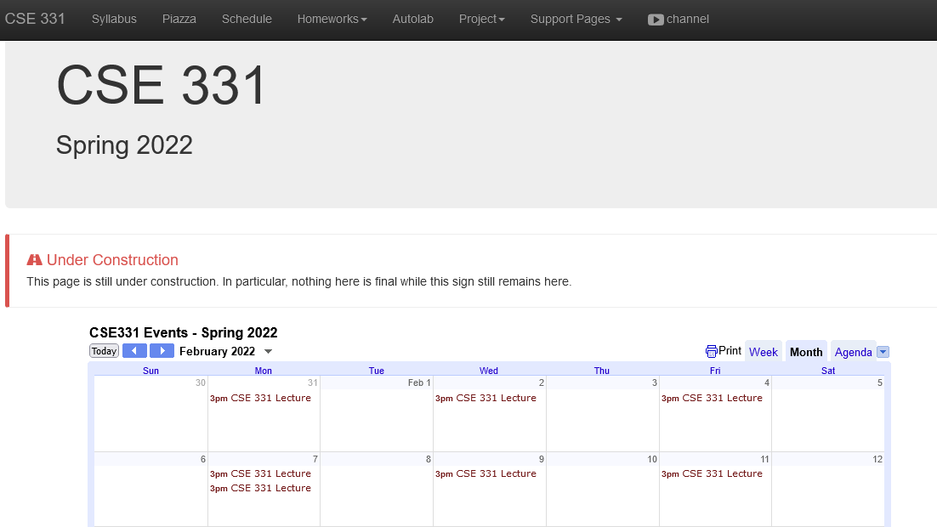
One Stop Shop for the Course
https://cse.buffalo.edu/~nasrinak/cse331/spr22/index.html

Slide 12
Three things to remember
WORK HARD!
DO NOT CHEAT!
READ CAREFULLY!

Slide 13
Wait.. What???
Make sure you follow submission instructions.
Two most common ways of losing points
Make sure you read problem statements carefully.

Slide 14
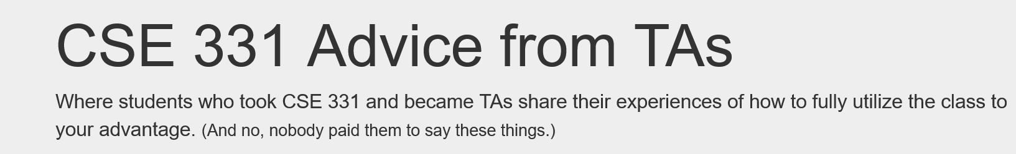
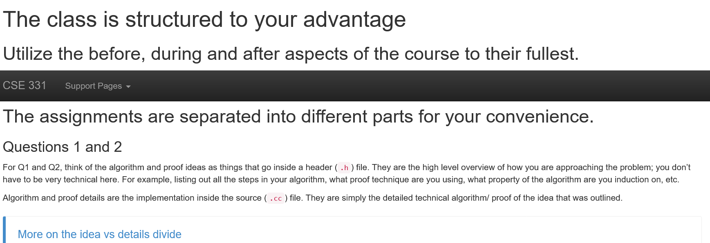
Advice from 331 TAs
https://cse.buffalo.edu/~nasrinak/cse331/support/advice/index.html

Slide 15
Academic Dishonesty
All your submissions must be your own work
Penalty:
  Minimum: A grade reduction in course
  Possible: F (or higher penalty) if warranted
YOUR responsibility to know what is cheating, plagiarism etc.
  If not sure, come talk to me
Excuses like “I have a job,” “This was OK earlier/in my country,” “This course is hard,” etc. WON’T WORK.
IN FACT, NO EXCUSE OR NO AMOUNT OF ARGUMENT WILL WORK:
YOU WILL GET A GRADE REDUCTION IN THE COURSE
FOR YOUR FIRST MISTAKE

Slide 16
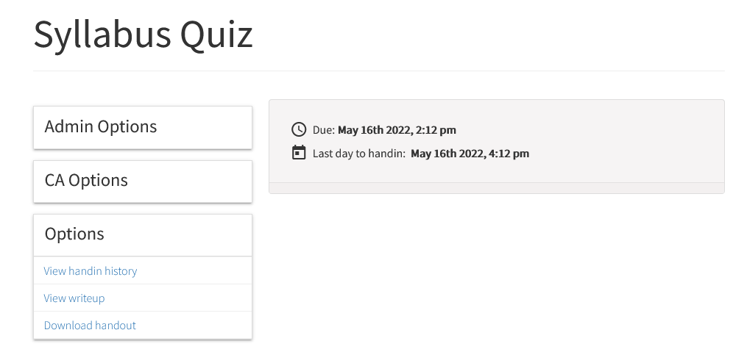
Read the syllabus CAREFULLY!
No graded material will be handed back till you pass the syllabus quiz!

Slide 17
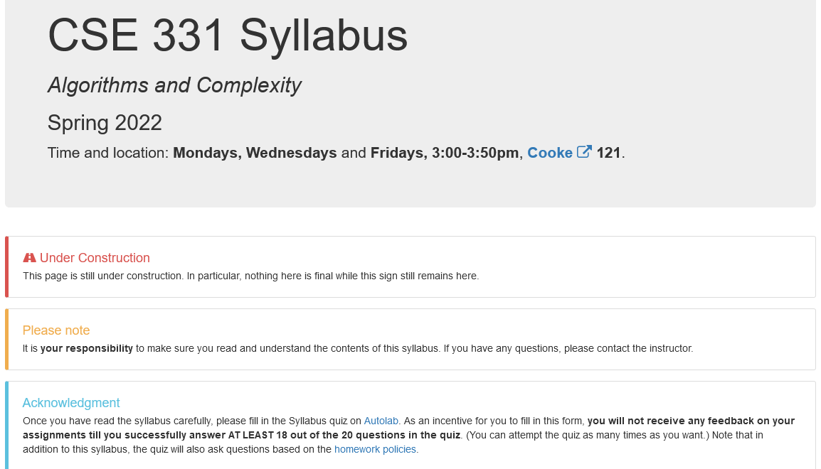
More information on the quiz

Slide 18
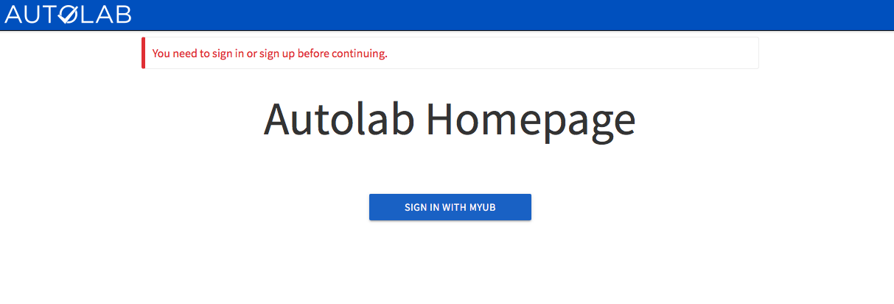
Autolab
https://autograder.cse.buffalo.edu/

Slide 19

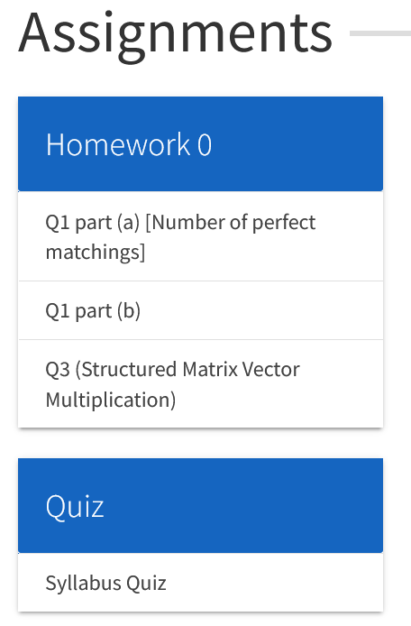
You can submit the following now
HW0 is out!

Slide 20
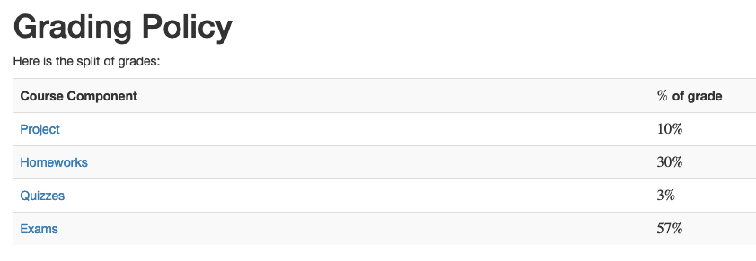
Grading break-down

Slide 21
Questions/Comments?

Slide 22
Pre-requisites
Required (officially)
  CSE 250, [CSE 191 or MTH 311] and MTH 142
  At least a C- (this is recommended)
Required (for practical purposes)
  Comfort with proofs
  Willingness to work hard!

Slide 23
Accessibility Resources
Information included in the syllabus
In short, let me know and consult with Accessibility Resources

Slide 24

Critical Campus Resources

Slide 25
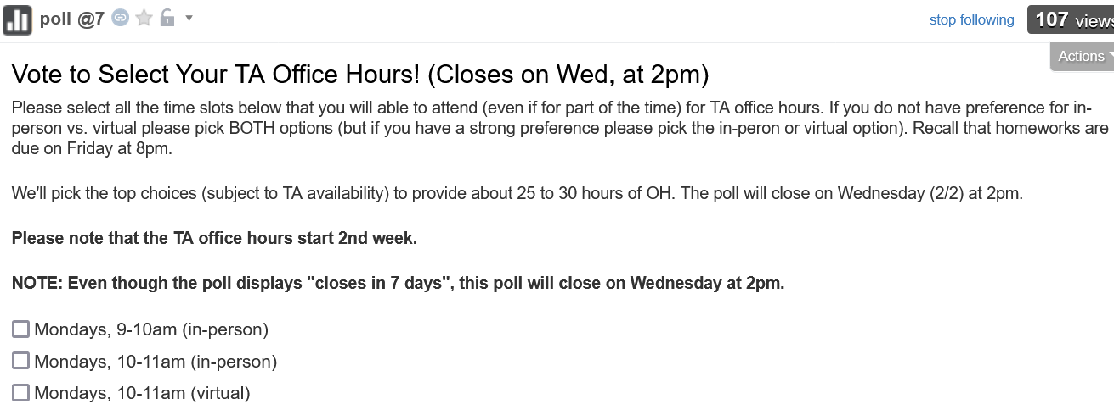
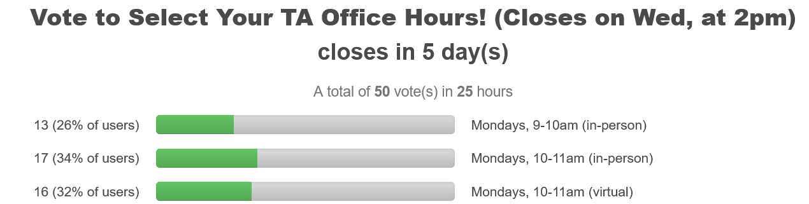
TA Office hours
YOU decide!

Slide 26
Recitations
Are on for this week!
RECITATIONS

Slide 27
Please stick to your recitation section

Slide 28
Exams
Mid term (two parts)
Tentative dates:
  Mon, March 14 and Wed, March 16, 2021. Usual place and time.
Final exam
  Wednesday, May 18, 2022. Cooke 121, 3:30-6:30pm

Slide 29
The HW structure
DROP lowest 2 HW scores
Three questions
Q1 and Q2 are proof based while Q3 is programming
Q1 worth 50 points
The hard proof based Q2 and programming Q3 worth 25 points each
HWs due by 8:00pm on Fridays
A few exceptional cases: HW0, HW8
Please keep an eye on the schedule

Slide 30
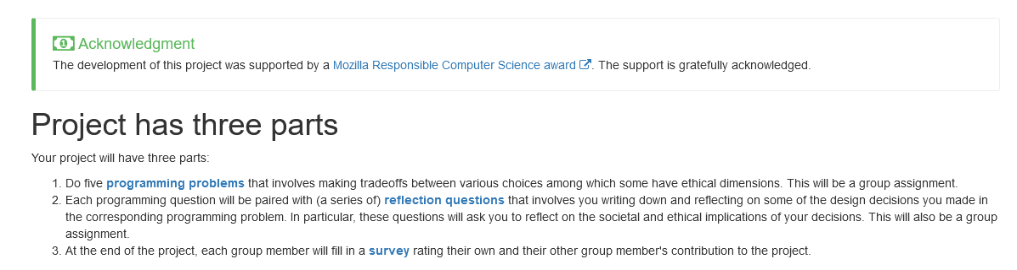
Project

Slide 31
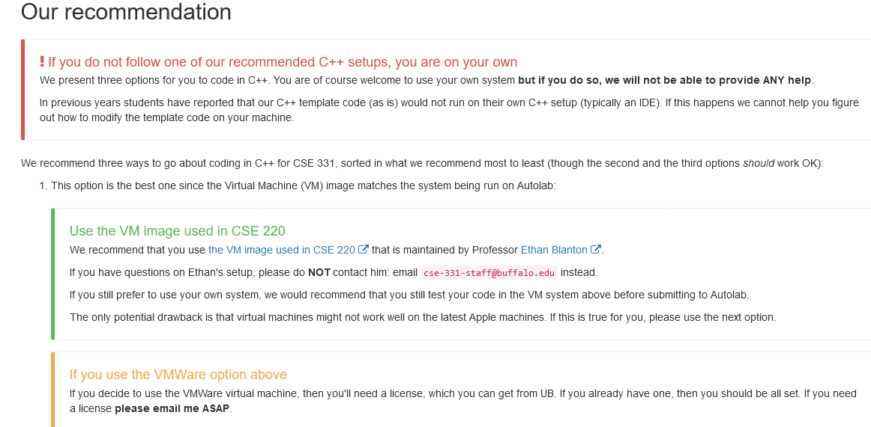
C++ vs Java/Python
Use Java/Python if as you just as comfortable with as C++

Slide 32
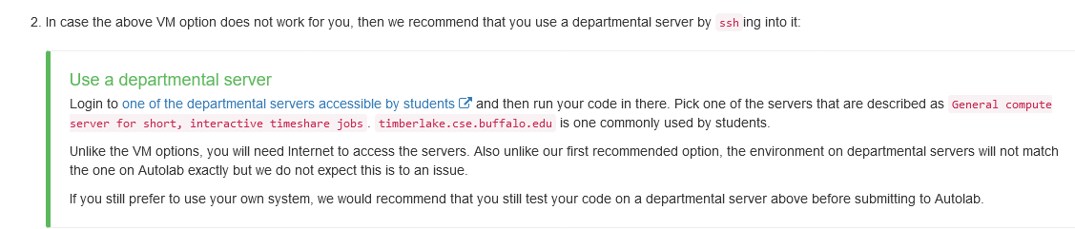
C++ vs Java/Python
Use Java/Python if as you just as comfortable with as C++

Slide 33
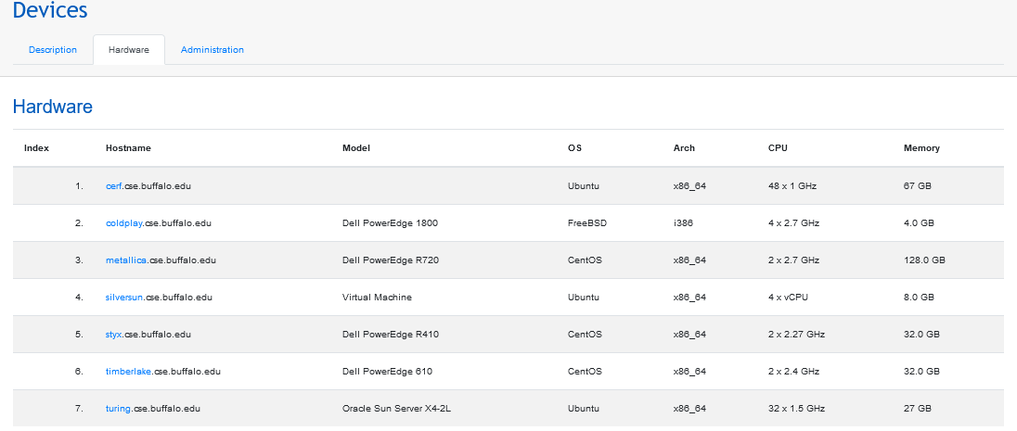
C++ vs Java/Python
Use Java/Python if as you just as comfortable with as C++
https://cse.buffalo.edu/apps/devices/

Slide 34
C++ vs Java/Python
Use Java/Python if as you just as comfortable with as C++

Slide 35
Questions/Comments?

Slide 36
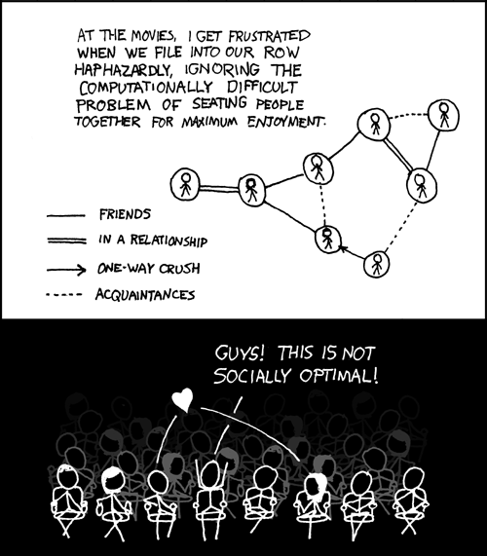
This course: how to solve problems!
http://xkcd.com/173/

Slide 37
Why should I care ?

Slide 38

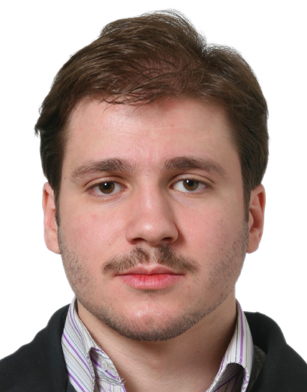
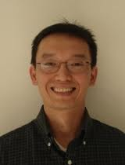
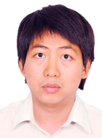



Combining Shadows to Understanding the network

Slide 39
The key technical problem
Given the three projections, what is the largest size of the original set of points?

Slide 40
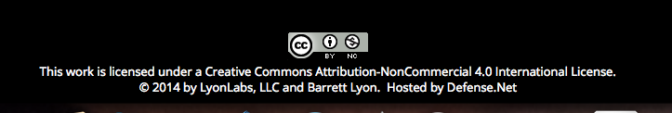
Detecting Communities

Slide 41
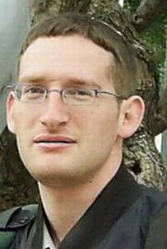
Conquering Shadows to Conquering the Internet
Algorithmically compute the missing set

Slide 42




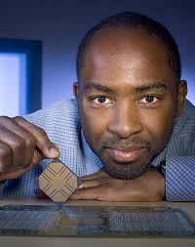

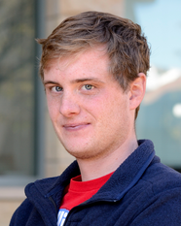
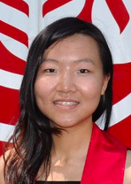

The proof is in the performance
>
10x faster
Better algorithm with little hacking will beat a worse algorithm with tons of hacking

Slide 43
The key technical problem
Highly trivial: 4³ = 64
Still trivial: 4² = 16
Correct answer: 4^{1.5} = 8

Slide 44



If detecting communities is not for you

Slide 45
From someone who got a Google job
“You can let your algorithms class know that the phone interviews are essentially like a difficult algorithms test.
Lots of data structures, specifying the algorithm, analyzing the
run time and space requirements... And all on the phone and
you're supposed to talk through your thought process.”

Slide 46
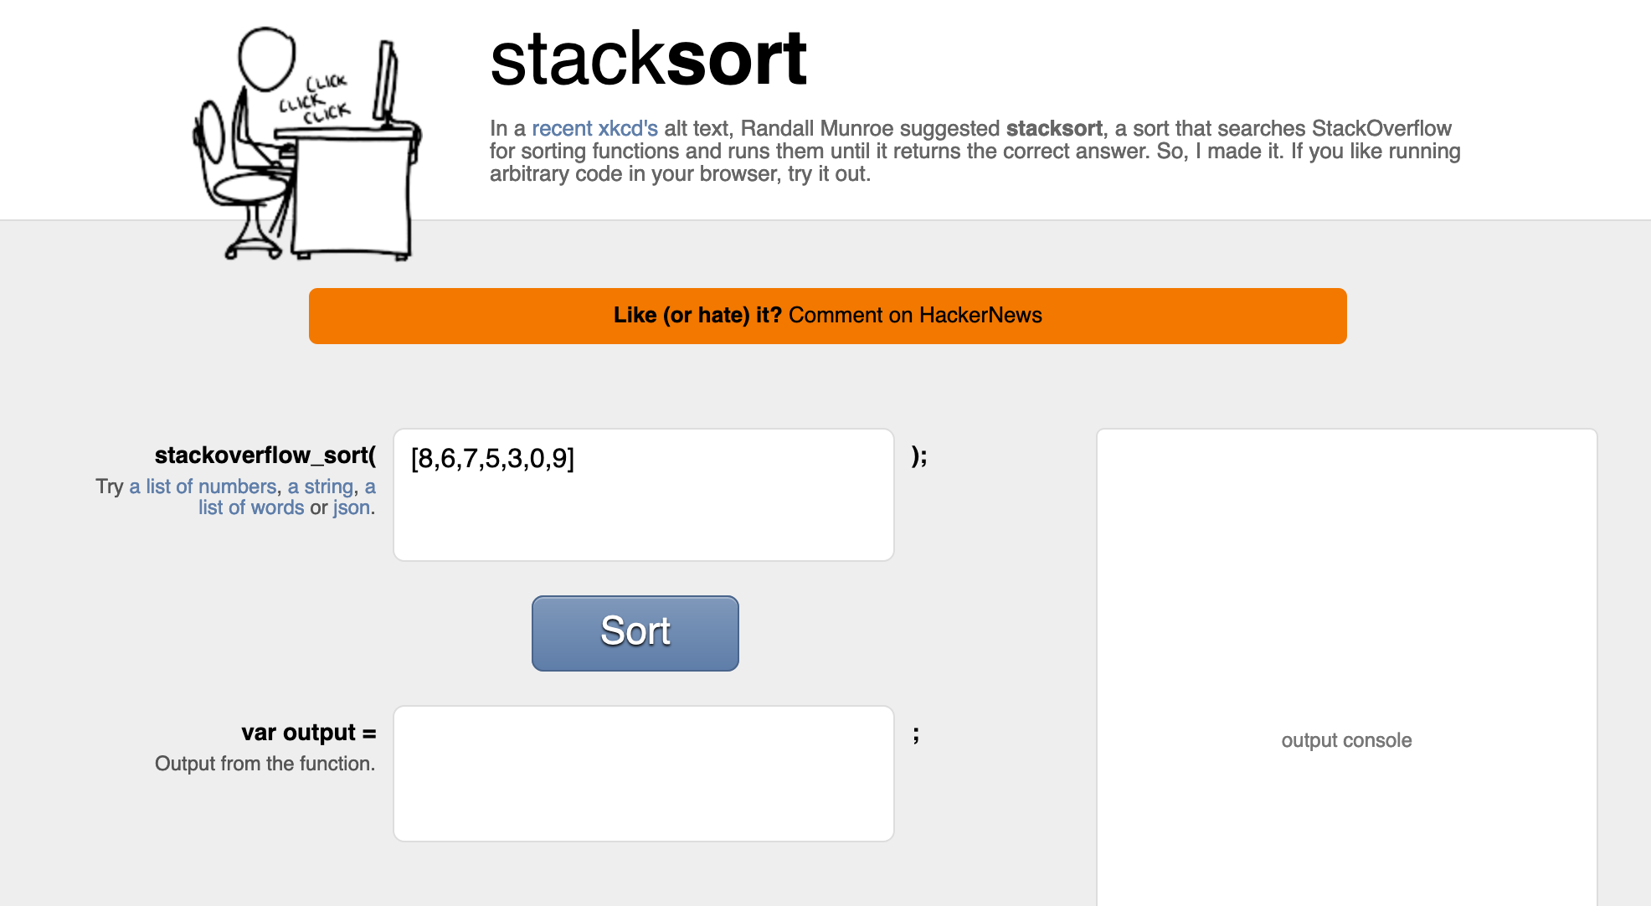
Coding jobs will be done by AI

Slide 47
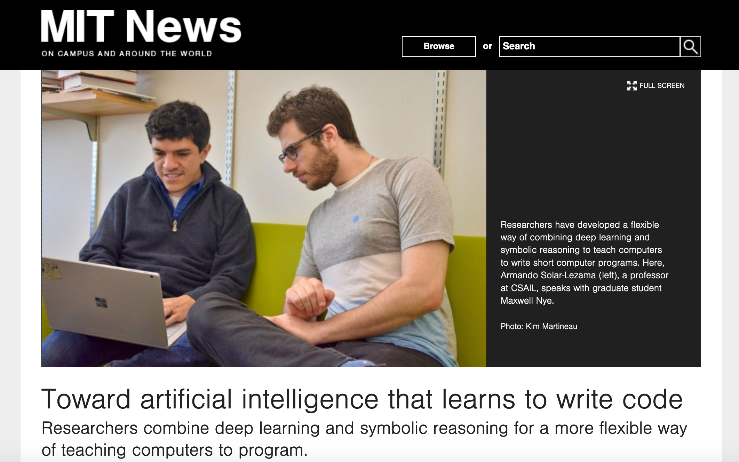
Coding jobs will be done by AI

Slide 48
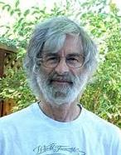

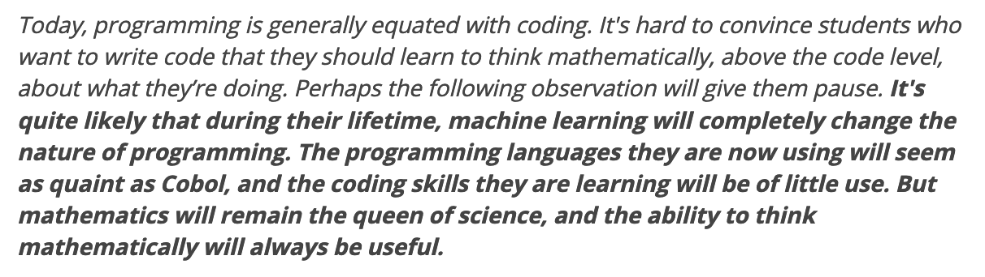
So am I doomed?
There will still be room for high level algorithmic thinking!

Slide 49
Questions/Comments?

