Slide 1
Lecture 15
CSE 331

Slide 2
Few points…
Project group signups
Your UBIT ID is XXX if XXX@buffalo.edu is the email ID
Please don’t enter your person number!
HWs
Cite your sources
Answers should be self-contained
Separate out proof idea and proof details
Summary in idea and detailed proof in details.
Upload a legible PDF file. If Autograder can’t open it, we can’t grade it.
Please don’t cheat!
Recitations in week 6 and 7
Week 6: TAs will briefly go over the sample midterm, suggest studying tips, etc.
Week 7: (this is the midterm week!) Q/A with the TAs.

Slide 3
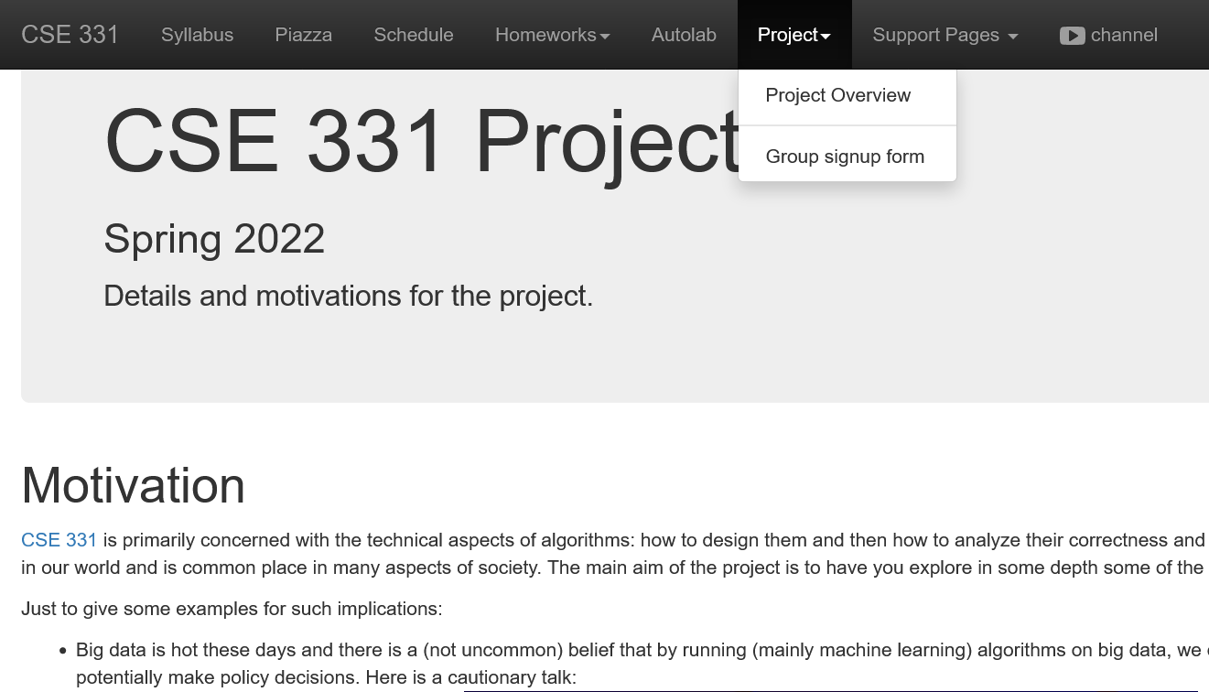
Project groups due TODAY!
Deadline: Friday, March 4, 11:59pm

Slide 4
Greedy algorithms
Build the final solution piece by piece
Being short sighted on each piece
Never undo a decision
Know when you see it

Slide 5
End of Semester blues
Can only do one thing at any day: what is the maximum number of tasks that you can do?
Write up a term paper
Party!
Exam study
331 homework
331 HW
Project
Saturday
Sunday
Monday
Tuesday
Wednesday

Slide 6
The optimal solution
Can only do one thing at any day: what is the maximum number of tasks that you can do?
Party!
Exam study
331 HW
Saturday
Sunday
Monday
Tuesday
Wednesday

Slide 7
Interval Scheduling Problem
Input: n intervals [s(i), f(i)) for 1≤ i ≤ n
{ s(i), … ,f(i)-1 }
Output: A schedule S of the n intervals
No two intervals in S conflict
|S| is maximized

Slide 8
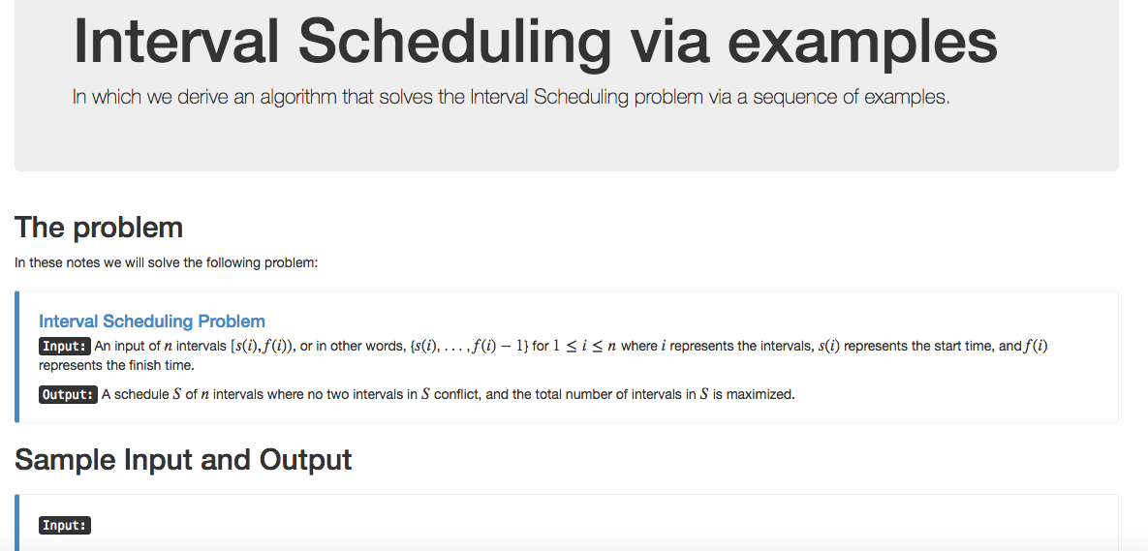
Algorithm with examples

Slide 9
Interval Scheduling Problem
Input: n intervals; ith interval: [s(i), f(i)).
Output: A valid schedule with maximum number of intervals in it (over all valid schedules).
Def: A schedule S ⊆ [n] ([n] = {1, 2, …, n})
Def: A valid schedule S has no conflicts.
Def: intervals i and j conflict if they overlap.

Slide 10
Interval Scheduling Problem
Conflicts:
i
j
No conflicts:
i
j

Slide 11
Example 1
No intervals overlap

Slide 12
Algorithm?
No intervals overlap
R: set of requests
Set S to be the empty set
While R is not empty
Choose i in R
Add i to S
Remove i from R
Return S*= S

Slide 13
Example 2
At most one overlap/task

Slide 14
Algorithm?
At most one overlap
R: set of requests
Set S to be the empty set
While R is not empty
Choose i in R
Add i to S
Remove all tasks that conflict with i from R
Remove i from R
Return S*= S

Slide 15
Example 3
Task 4
Task 5
More than one conflict
Task 3
Task 2
Task 1
Set S to be the empty set
While R is not empty
Choose i in R
Add i to S
Remove all tasks that conflict with i from R
Return S*= S

Slide 16
Greedily solve your blues!
Arrange tasks in some order and iteratively pick non-overlapping tasks
Write up a term paper
Party!
Exam study
331 HW
Project
Saturday
Sunday
Monday
Tuesday
Wednesday

Slide 17
Making it more formal
Task 4
Task 5
More than one conflict
Task 3
Task 2
Task 1
Set S to be the empty set
Associate a value v(i) with task i
While R is not empty
Choose i in R
Choose i in R that minimizes v(i)
Add i to S
Remove all tasks that conflict with i from R
Return S*= S

Slide 18
What is a good choice for v(i)?
Task 4
Task 5
More than one conflict
Task 3
Task 2
Task 1
Set S to be the empty set
Associate a value v(i) with task i
While R is not empty
Choose i in R that minimizes v(i)
Add i to S
Remove all tasks that conflict with i from R
Return S*= S

Slide 19
v(i) = f(i) – s(i)
Task 4
Task 5
Smallest duration first
Task 3
Task 2
Task 1
Set S to be the empty set
While R is not empty
Choose i in R that minimizes f(i) – s(i)
Add i to S
Remove all tasks that conflict with i from R
Return S*= S

Slide 20
v(i) = s(i)
Task 4
Task 5
Earliest time first?
Task 3
Task 2
Task 1
So are we done?
Set S to be the empty set
While R is not empty
Choose i in R that minimizes s(i)
Add i to S
Remove all tasks that conflict with i from R
Return S*= S

Slide 21
Not so fast….
Task 4
Task 5
Earliest time first?
Task 3
Task 2
Task 1
Task 6
Set S to be the empty set
While R is not empty
Choose i in R that minimizes s(i)
Add i to S
Remove all tasks that conflict with i from R
Return S*= S

Slide 22
Pick job with minimum conflicts
Task 4
Task 5
Task 3
Task 2
Task 1
Task 6
Set S to be the empty set
So are we done?
While R is not empty
Choose i in R that has smallest number of conflicts
Add i to S
Remove all tasks that conflict with i from R
Return S*= S

Slide 23
Nope (but harder to show)
Set S to be the empty set
While R is not empty
Choose i in R that has smallest number of conflicts
Add i to S
Remove all tasks that conflict with i from R
Return S*= S

Slide 24
Task 7
Task 4
Task 5
Task 17
Task 18
Task 3
Task 2
Task 15
Task 16
Task 1
Task 12
Task 13
Task 14
Task 6
Task 8
Task 9
Task 10
Task 11
Set S to be the empty set
While R is not empty
Choose i in R that has smallest number of conflicts
Add i to S
Remove all tasks that conflict with i from R
Return S*= S

