Slide 1
Lecture 18
CSE 331

Slide 2
The “real” end of Semester blues
There are deadlines and durations of tasks
Write up a term paper
Party!
Exam study
331 HW
Project
Saturday
Sunday
Monday
Tuesday
Wednesday

Slide 3
The “real” end of Semester blues
There are deadlines and durations of tasks
Write up a term paper
Exam study
Party!
331 HW
Project
Saturday
Sunday
Monday
Tuesday
Wednesday

Slide 4
The algorithmic task
YOU decide when to start each task
Write up a term paper
Exam study
You have to do ALL the tasks
Party!
331 HW
Project
Saturday
Sunday
Monday
Tuesday
Wednesday

Slide 5
Scheduling to minimize lateness
All the tasks have to be scheduled
GOAL: minimize maximum lateness
Write up a term paper
Exam study
Party!
331 HW
Project
Saturday
Sunday
Monday
Tuesday
Wednesday

Slide 6
One possible schedule
All the tasks have to be scheduled
GOAL: minimize maximum lateness
Lateness = 0
Lateness = 2
331 HW
Party!
Exam study
Write up a term paper
Saturday
Sunday
Monday
Tuesday
Wednesday

Slide 7
Minimizing Max Lateness

Slide 8
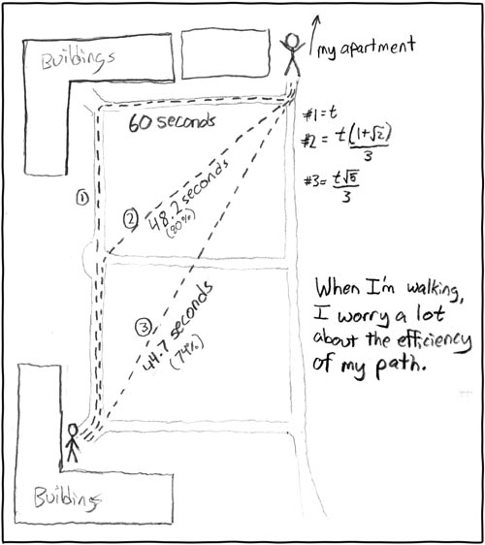
Rest of today
Shortest Path Problem
http://xkcd.com/85/

Slide 9
Reading Assignment
Sec 2.5 of [KT]

Slide 10
Shortest Path problem
s
100
Input: Directed graph G=(V,E)
Edge lengths, l_{e} for e in E
“start” vertex s in V
w
5
15
u
s
s
w
5
5
15
u
u
Output: All shortest paths from s to all nodes in V

Slide 11
Naïve Algorithm
Ω(n!) time

Slide 12
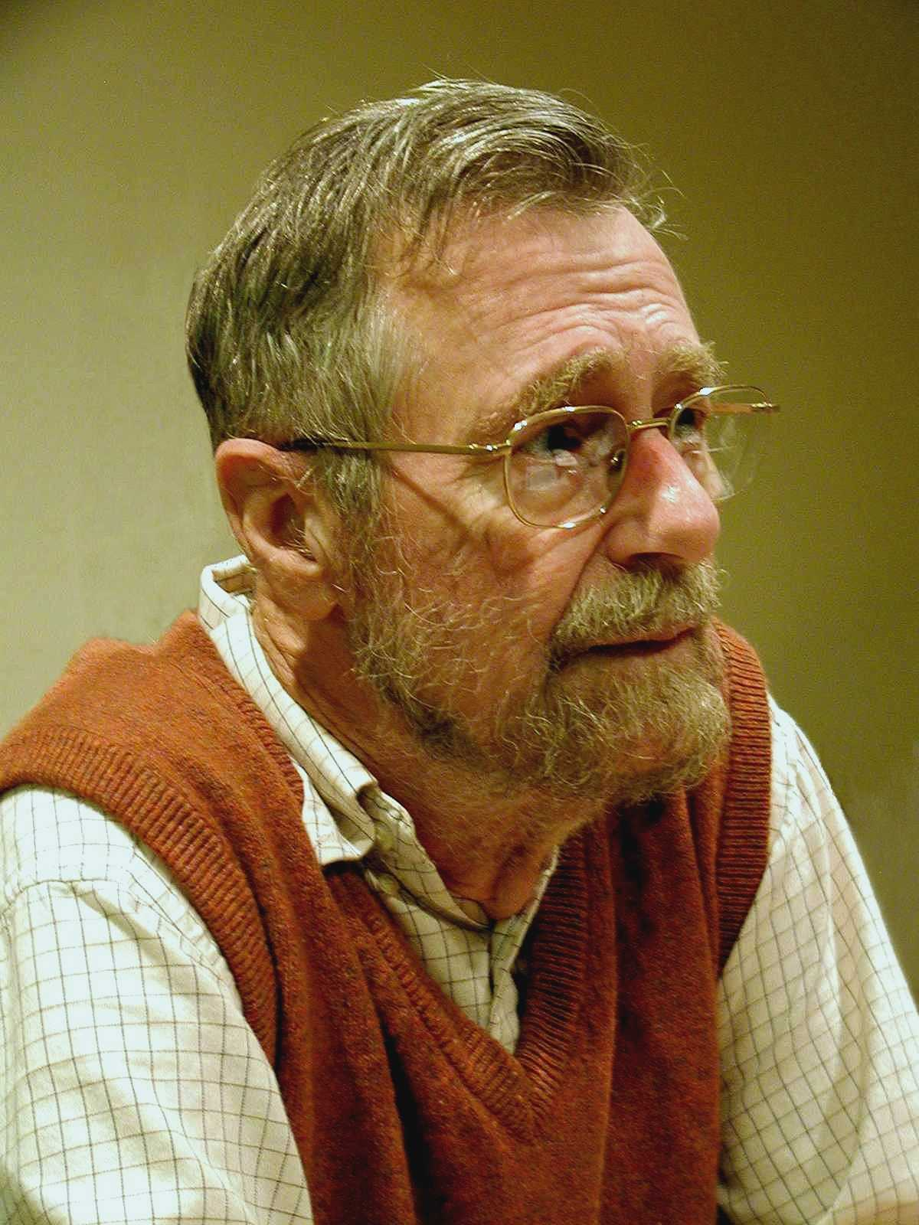
Dijkstra’s shortest path algorithm
E. W. Dijkstra (1930-2002)

Slide 13
On to the board…

