Slide 1
Lecture 21
CSE 331

Slide 2
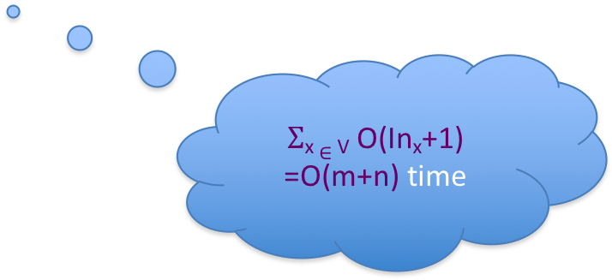
Dijkstra’s shortest path algorithm
d’(w) = min _{e=(u,w) in E, u in R} d(u)+l_{e}
Input: Directed G=(V,E), l_{e} ≥ 0, s in V
R = {s}, d(s) =0
While there is a x not in R with (u,x) in E, u in R
At most n iterations
Pick w that minimizes d’(w)
Add w to R
d(w) = d’(w)
O((m+n)n) time bound is trivial
O((m+n) log n) time implementation with priority Q

Slide 3
Reading Assignment
Sec 4.4 of [KT]

Slide 4
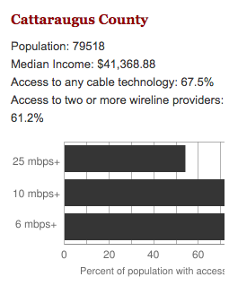
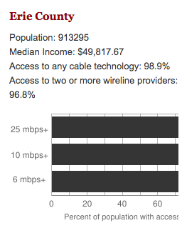
Make broadband more available
BOTH technical and societal issues
Say you are tasked to come up with the infrastructure

Slide 5
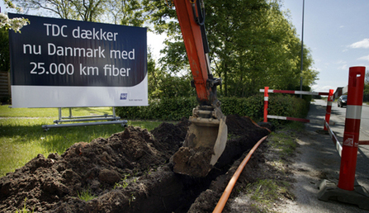
Building a fiber network
Lay down fibers to connect n locations
All n locations should be connected
Laying down a fiber costs money
What is the cheapest way to lay down the fibers?

Slide 6
Today’s agenda
Minimum Spanning Tree (MST) Problem
Greedy algorithm(s) for MST problem

Slide 7
On to the board…

Slide 8
Minimum Spanning Tree Problem
Input: Undirected, connected G = (V,E), edge costs c_{e}
Output: Subset E’ ⊆ E), s.t. T = (V,E’) is connected
C(T) is minimized
If all c_{e} > 0, then T is indeed a tree

Slide 9
Rest of today’s agenda
Greedy algorithm(s) for MST problem

Slide 10
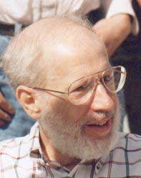
Kruskal’s Algorithm
Input: G=(V,E), c_{e}> 0 for every e in E
T = Ø
Sort edges in increasing order of their cost
Joseph B. Kruskal
Consider edges in sorted order
If an edge can be added to T without adding a cycle then add it to T

Slide 11
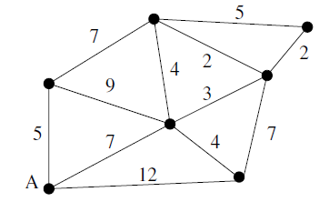
Kruskal’s Algorithm
7
2
2
3
5
4
Input: G=(V,E), c_{e}> 0 for every e in E
T = Ø
Sort edges in increasing order of their cost
2, 2, 3, 4, 4, 5, 5, 7, 7, 7, 9, 12
Consider edges in sorted order
If an edge can be added to T without adding a cycle then add it to T

Slide 12
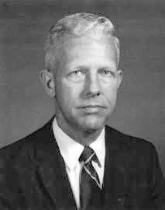
Prim’s algorithm
Similar to Dijkstra’s algorithm
2
0.5
1
3
50
51
Robert Prim
2
0.5
Input: G=(V,E), c_{e}> 0 for every e in E
S = {s}, T = Ø
1
50
While S is not the same as V
Among edges e= (u,w) with u in S and w not in S, pick one with minimum cost
Add w to S, e to T

Slide 13
Reverse-Delete Algorithm
2
0.5
1
3
50
51
Input: G=(V,E), c_{e}> 0 for every e in E
2
0.5
T = E
1
3
50
Sort edges in decreasing order of their cost
51
Consider edges in sorted order
If an edge can be removed T without disconnecting T then remove it

