Slide 1
Lecture 24
CSE 331

Slide 2
MergeSort Runtime analysis on the board…

Slide 3
Comments on Sorting Algorithms…
Any comparison-based algorithm needs to make Ω(n logn) comparisons.
O(n logn) is the best known upper bound on general, comparison-based sorting algorithms.
Can sort faster (i.e., O(n)) if domain of the elements a_{i} is of size O(n) (e.g., T/F poll #1 where a_{i} ∈ {0, 1}) .
Can run faster if the input is almost “sorted”.

Slide 4
Rankings

Slide 5
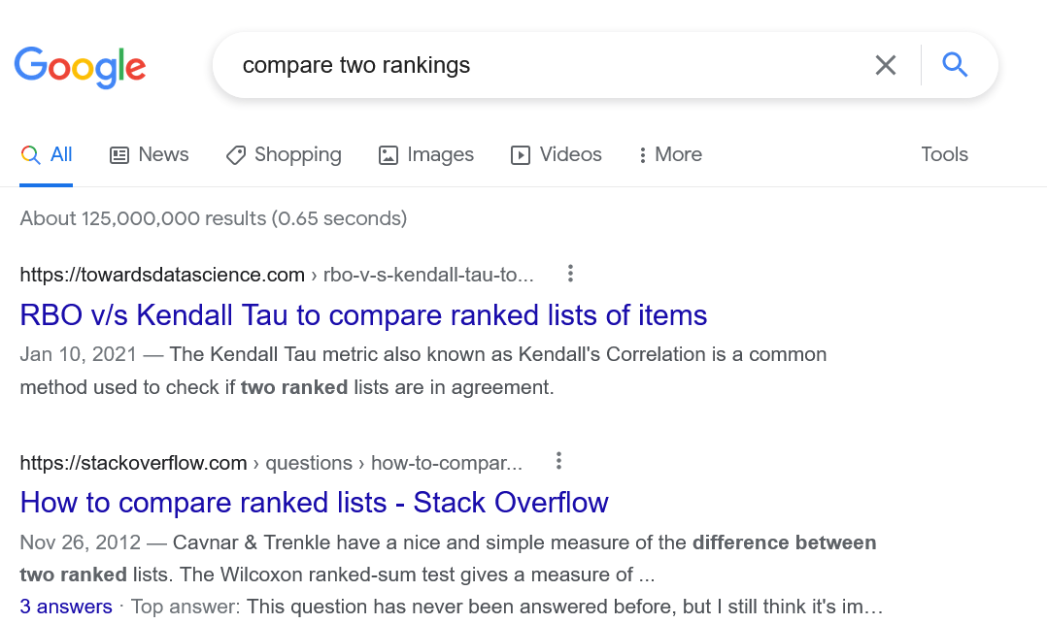
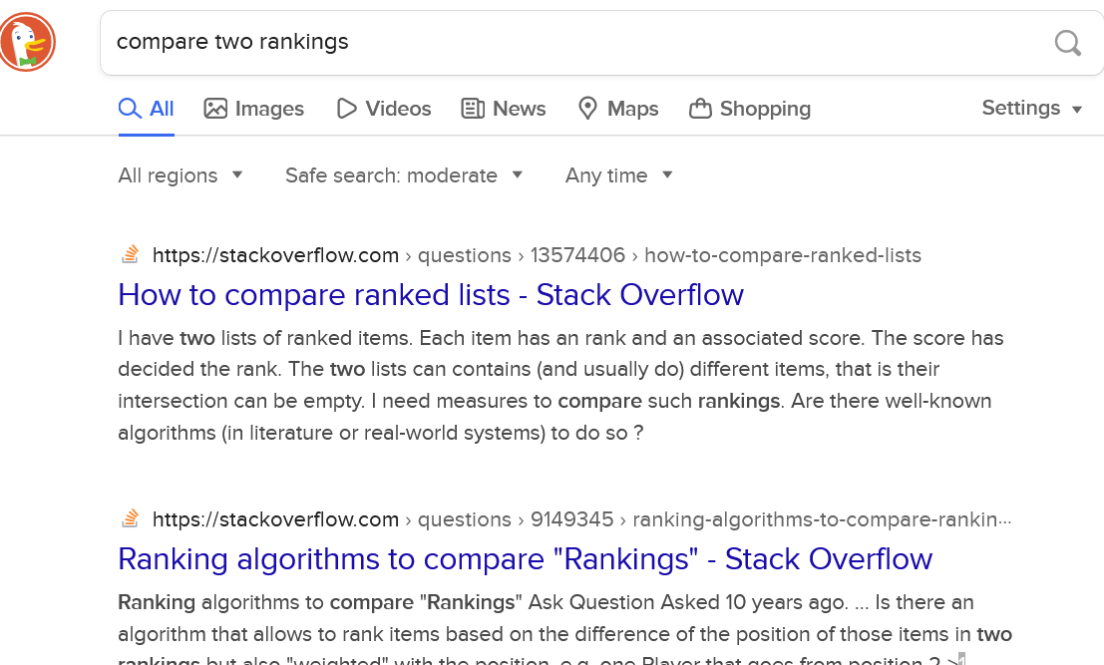
How close are two rankings?

Slide 6
Collaborative Filtering
Image credit: By Moshanin - Own work, CC BY-SA 3.0, https://commons.wikimedia.org/w/index.php?curid=24097346

Slide 7
Rest of today’s agenda
Formal problem: Counting inversions
Divide and Conquer algorithm

