Slide 1
Lecture 31
CSE 331

Slide 2
A recursive algorithm
Proof of correctness by induction on j
Correct for j=0
Compute-Opt(j)
If j = 0 then return 0
return max { v_{j} + Compute-Opt( p(j) ), Compute-Opt( j-1 ) }
= OPT( p(j) )
= OPT( j-1 )
OPT(j) = max { v_{j} + OPT( p(j) ), OPT(j-1) }

Slide 3
Exponential Running Time
1
p(j) = j-2
2
3
Only 5 OPT values!
4
5
OPT(5)
Formal proof: Ex.
OPT(3)
OPT(4)
OPT(3)
OPT(1)
OPT(2)
OPT(2)
OPT(1)
OPT(2)
OPT(1)
OPT(1)
OPT(1)

Slide 4
Using Memory to be smarter
Using more space can reduce runtime!

Slide 5
How many distinct OPT values?

Slide 6
A recursive algorithm
M-Compute-Opt(j) = OPT(j)
M-Compute-Opt(j)
If j = 0 then return 0
If M[j] is not null then return M[j]
M[j] = max { v_{j} + M-Compute-Opt( p(j) ), M-Compute-Opt( j-1 ) }
return M[j]
Run time = O(# recursive calls)

Slide 7
Bounding # recursions
M-Compute-Opt(j)
O(n) overall
If j = 0 then return 0
If M[j] is not null then return M[j]
M[j] = max { v_{j} + M-Compute-Opt( p(j) ), M-Compute-Opt( j-1 ) }
return M[j]
Whenever a recursive call is made an M value is assigned
At most n values of M can be assigned

Slide 8
Property of OPT
OPT(j) = max { v_{j} + OPT( p(j) ), OPT(j-1) }
Given OPT(1), …, OPT(j-1),
one can compute OPT(j)

Slide 9
Recursion+ memory = Iteration
Iteratively compute the OPT(j) values
Iterative-Compute-Opt
M[0] = 0
For j=1,…,n
M[j] = max { v_{j} + M[p(j)], M[j-1] }
M[j] = OPT(j)
O(n) run time

Slide 10
Algo run on the board…

Slide 11
Reading Assignment
Sec 6.1, 6.2 of [KT]

Slide 12
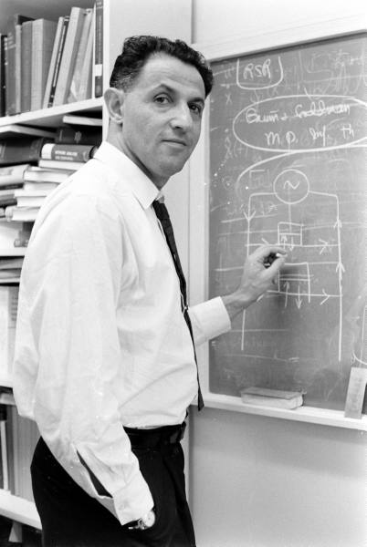
When to use Dynamic Programming
There are polynomially many sub-problems
OPT(1), …, OPT(n)
Richard Bellman
Optimal solution can be computed from solutions to sub-problems
OPT(j) = max { v_{j} + OPT( p(j) ), OPT(j-1) }
There is an ordering among sub-problem that allows for iterative solution
OPT (j) only depends on OPT(j-1), …, OPT(1)

Slide 13
Scheduling to min idle cycles
n jobs, i^{th} job takes w_{i} cycles
You have W cycles on the cloud
What is the maximum number of cycles you can schedule?

Slide 14
Subset sum problem
Input:
n integers w₁, w₂, …, w_{n}
bound W
Output:
subset S of [n] such that
sum of w_{i} for all i in S is at most W
w(S) is maximized

Slide 15
Rest of today’s agenda
Dynamic Program for Subset Sum problem

Slide 16
Algo on the board…

