Slide 1
Lecture 35
CSE 331

Slide 2
Shortest Path Problem
Input: (Directed) Graph G=(V,E) and for every edge e has a cost c_{e} (can be <0)
t in V
Output: Shortest path from every s to t
Assume that G has no negative cycle
1
1
s
t
Shortest path has cost negative infinity
899
100
-1000

Slide 3
The recurrence
OPT(u,i) = shortest path from u to t with at most i edges
OPT(u,i) = min { OPT(u,i-1), min_{(u,w) in E} { c_{u,w} + OPT(w, i-1)} }

Slide 4
Some consequences
OPT(u,i) = cost of shortest path from u to t with at most i edges
OPT(u,i) = min { OPT(u, i-1), min_{(u,w) in E} { c_{u,w} + OPT(w,i-1)} }
OPT(u,n-1) is shortest path cost between u and t
Can compute the shortest path between s and t given all OPT(u,i) values

Slide 5
Bellman-Ford Algorithm
Runs in O(n(m+n)) time
Only needs O(n) additional space

Slide 6
Reading Assignment
Sec 6.8 of [KT]

Slide 7
Longest path problem
Given G, does there exist a simple path of length n-1 ?

Slide 8
Longest vs Shortest Paths

Slide 9
Two sides of the “same” coin
Shortest Path problem
Can be solved by a polynomial time algorithm
Is there a longest path of length n-1?
Given a path can verify in polynomial time if the answer is yes

Slide 10
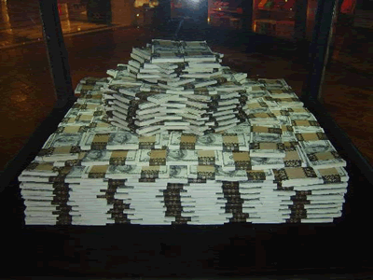
Poly time algo for longest path?

Slide 11
P vs NP question
P: problems that can be solved by poly time algorithms
Is P=NP?
NP: problems that have polynomial time verifiable witness to optimal solution
Alternate NP definition: Guess witness and verify!

Slide 12
Proving P ≠ NP
Pick any one problem in NP and show it cannot be solved in poly time
Pretty much all known proof techniques provably will not work

Slide 13
Proving P = NP
Will make cryptography collapse
Compute the encryption key!
Prove that all problems in NP can be solved by polynomial time algorithms
Solving any ONE problem in here in poly time will prove P=NP!
NP
NP-complete problems

Slide 14
A book on P vs. NP

Slide 15
The course so far…
https://www.teepublic.com/sticker/1100935-obama-yes-we-can

Slide 16
The rest of the course…
Under certain assumptions,
https://www.madduckposters.com/products/megamind-no-you-cant?variant=13565168320556

Slide 17
No, you can’t– what does it mean?
NO algorithm will be able to solve a problem in polynomial time
Still for worst-case runtime

Slide 18
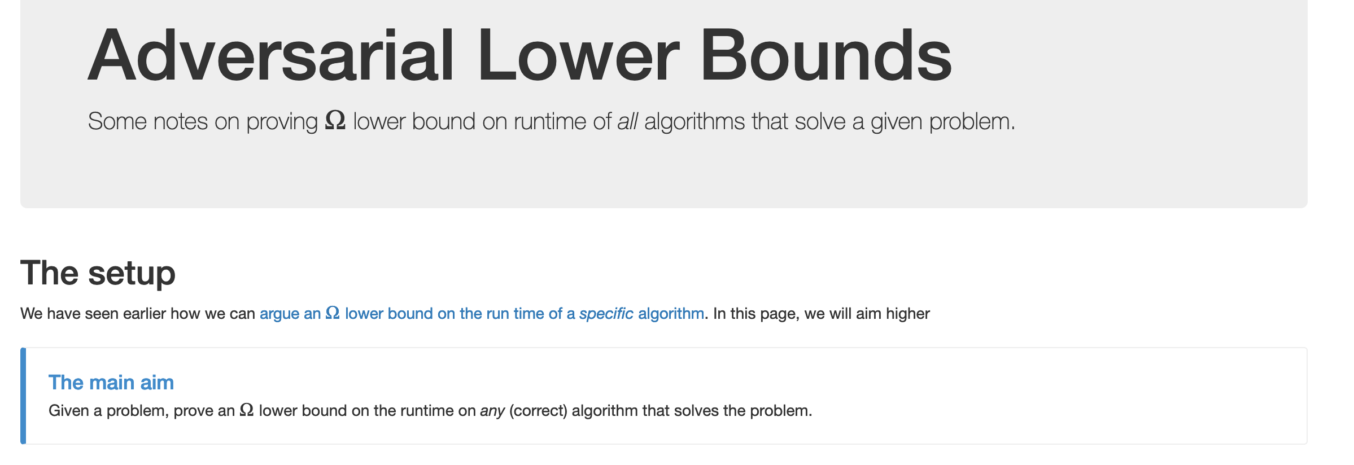
No, you can’t take- 1
What is the best lower bound you can prove?

Slide 19
No, you can’t take- 2
Lower bounds based on output size
Exists graphs with m^{3/2} triangles

Slide 20
No, you can’t take- 2
Lower bounds based on output size
On input n, output 2^{n} many ones
Every algo takes (doubly) exponential time
But at heart problem is “trivial”
From now on, output size is always O(N) and could even be binary.

Slide 21
No, you can’t take -3
Argue that a given problem is AS HARD AS
a “known” hard problem
How can we argue something like this?
Reductions

Slide 22
So far: “Yes, we can” reductions
https://www.teepublic.com/sticker/1100935-obama-yes-we-can

Slide 23
Reduce Y to X where X is “easy”

Slide 24
“Yes, we can” reductions (Example)

Slide 25
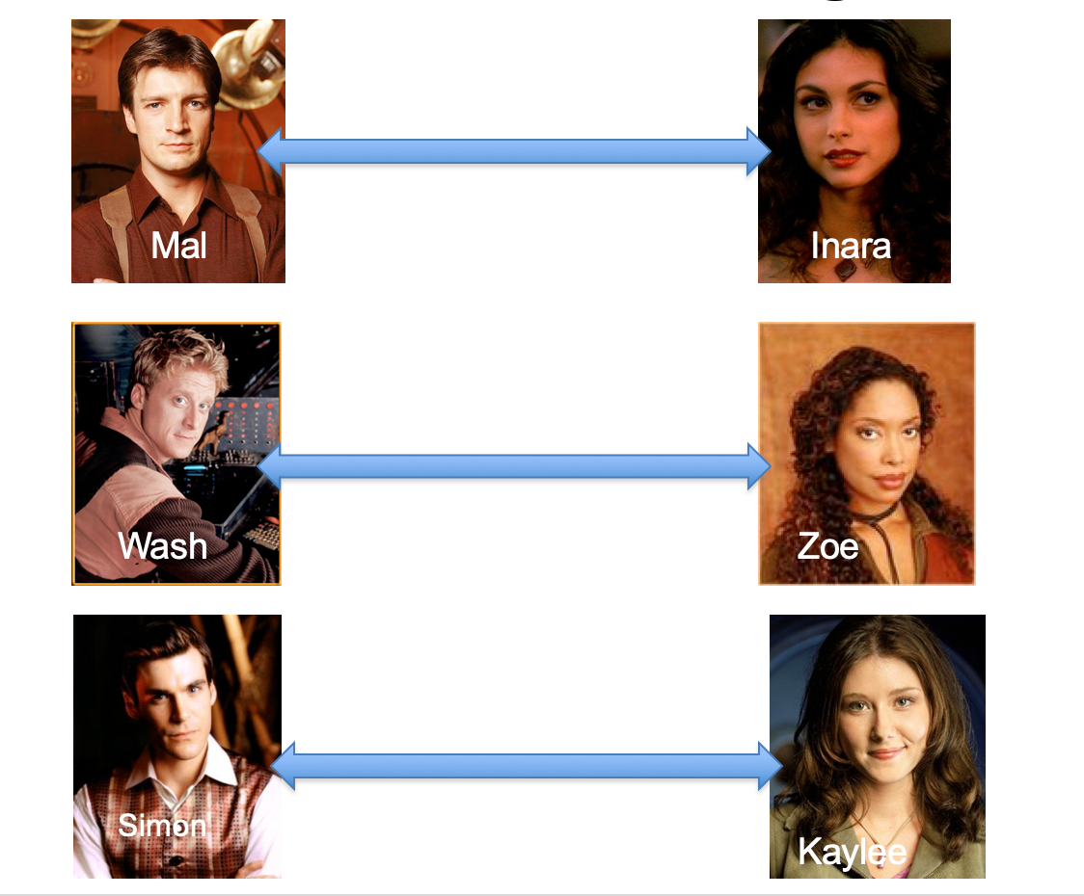
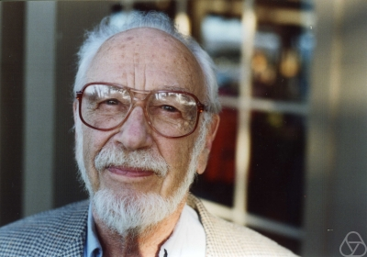
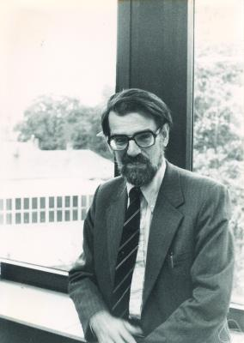
Overview of the reduction

Slide 26
Nothing special about GS algo
ANY algo for stable matching problem works!

Slide 27
Another observation
Poly time steps
ANY algo for stable matching problem works!

Slide 28
Poly time reductions
Poly time steps
ANY algo for stable matching problem works!

Slide 29
Poly time steps
Arbitrary Y instance
ANY algo for stable matching problem works!
Pre-process the input
Output for Y instance
All processing
is poly-time
Algo for X
Post-process the output

Slide 30
Poly time algo for X
Arbitrary Y instance
Poly time algo for Y
Pre-process the input
Output for Y instance
All processing
is poly-time
Algo for X
Post-process the output

Slide 31
!B !A

Slide 32
No poly time algo for Y
Poly time algo for X
Arbitrary Y instance
No poly time algo for X
Poly time algo for Y
Pre-process the input
Output for Y instance
All processing
is poly-time
Algo for X
Post-process the output

