Slide 1
HadoopDB: An Architectural Hybrid of MapReduce and DBMS Technologies for Analytical Workloads
Azza Abouzeid1, Kamil BajdaPawlikowski1,
Daniel Abadi1, Avi Silberschatz1, Alexander Rasin2
1Yale University, 2Brown University
{azza,kbajda,dna,avi}@cs.yale.edu; alexr@cs.brown.edu
Presented by Ying Yang
10/01/2012

Slide 2
Outline
Introduction, desired properties and background
HadoopDB Architecture
Results
Conclusions

Slide 3
Introduction
Analytics are important today
Data amount is exploding
Previous problem → DBMS on Shared-nothing architectures
(a collection of independent, possibly virtual, machines, each with local disk and local main memory, connected together on a high-speed network.)

Slide 4
Introduction

Slide 5
Introduction

Slide 6
Introduction
Approachs:
Parallel databases(analytical DBMS systems that deploy on a shared-nothing architecture)
Map/Reduce systems

Slide 7
Introduction
Sales Record Example
Consider a large data set of sales log records, each consisting of sales information including:
1 a date of sale 2 a price
We would like to take the log records and generate a report showing the total sales for each year.
SELECT YEAR(date) AS year, SUM(price)
FROM sales GROUP BY year
Question:
How do we generate this report efficiently and cheaply over massive data contained in a shared-nothing cluster of 1000s of machines?

Slide 8
Introduction
Sales Record Example using Hadoop:
Query: Calculate total sales for each year.
We write a MapReduce program:
Map: Takes log records and extracts a key-value pair of year and sale price in dollars. Outputs the key-value pairs.
Shuffle: Hadoop automatically partitions the key-value pairs by year to the nodes executing the Reduce function
Reduce: Simply sums up all the dollar values for a year.

Slide 9
Introduction

Slide 10
Introduction
Parallel Databases:
Parallel Databases are like single-node databases except:
Data is partitioned across nodes
Individual relational operations can be executed in parallel
SELECT YEAR(date) AS year, SUM(price)
FROM sales GROUP BY year
Execution plan for the query:
projection(year,price) --> partial hash aggregation(year,price) --> partitioning(year) --> final aggregation(year,price).
Note that the execution plan resembles the map and reduce phases of Hadoop.

Slide 11
Introduction
Parallel Databases:
Fault tolerance
Not score so well
Assumption: dozens of nodes in clusters,failures are rare
MapReduce
Satisfies fault tolerance
Works on heterogeneus environment
Drawback: performance
Not previous modeling
No enhacing performance techniques

Slide 12
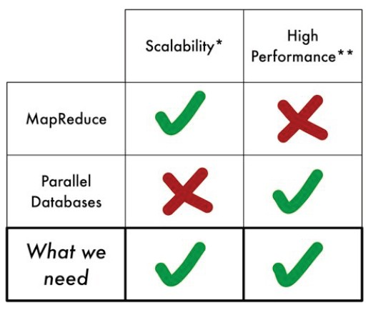
Introduction
In summary
Notes:
Since we need both, we result in an architecture of Hyb Mapreduce and DBMS techinology.

Slide 13
Desired properties
Performance(Parallel DBMS)
Fault tolerance(MapReduce)
Heterogeneus environments (MapReduce)
Flexible query interface(both)
Notes:
Let us check whether this hybrid architecture fulfilled the desired properties.

Slide 14
Outline
Introduction, desired properties and background
HadoopDB Architecture
Results
Conclusions

Slide 15
HadoopDB Architecture
Main goal: achieve the properties described before
Connect multiple single-datanode systems
Hadoop reponsible for task coordination and network layer
Queries parallelized along the nodes
Fault tolerant and work in heterogeneus nodes
Parallel databases performance
Query processing in database engine

Slide 16
HadoopDB Architecture

Slide 17
HadoopDB Architecture

Slide 18
HadoopDB’s Components
Database connector
replace the functionality of HDFS with the database connector. Give Mappers the ability to read the results of a database query
Responsabilities
Connect to the database
Execute the SQL query
Return the results as key-value pairs
Achieved goal
Datasources are similar to datablocks in HDFS

Slide 19
HadoopDB’s Components
Catalog
Metadata about databases
Database location, driver class, credentials
Datasets in cluster, replica or partitioning
Catalog stored as xml file in HDFS
Plan to deploy as separated service(similar to NameNode)
Notes:
Last point like nameNode.

Slide 20
HadoopDB’s Components
Data loader
Responsibilities:
Globally repartitioning data
Breaking single data node in chunks
Bulk-load data in single data node chunks
Two main components:
Global hasher
Map/Reduce job read from HDFS and repartition(splits data across nodes (i.e., relational database instances))
Local Hasher
Copies from HDFS to local file system(subdivides data within each node)
Notes:
The global hasher splits data across nodes (i.e., relational database instances), while the local hasher further subdivides data within each node.

Slide 21
HadoopDB’s Components
Data loader
Global Hasher local Hasher
…
BlockA
Aa
A
Raw data files
Ab
A
B
B
Az
B
Notes:
Fault tolerance/recovery time -- make a forward reference to the discussion in the experiments section.

Slide 22
HadoopDB’s Components
SMS (SQL to MapReduce to SQL)Planner
SMS planner extends Hive.
Hive processing Steps:
Abstract Syntax Tree building
Semantic analyzer connects to catalog
DAG of relational operators(Directed acyclic graph)
Optimizer restructuration
Convert plan to M/R jobs
DAG in M/R serialized in xml plan

Slide 23
HadoopDB’s Components
SELECT YEAR(date) AS year, SUM(price)
FROM sales GROUP BY year

Slide 24
HadoopDB’s Components
SMS Planner extensions
Two phases before execution
Retrieve data fields to determine partitioning keys
Traverse DAG (bottom up). Rule based SQL generator

Slide 25
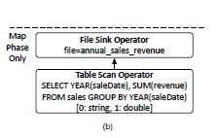
HadoopDB’s Components
MapReduce job generated by SMS assuming sales is partitioned by YEAR(saleDate). This feature is still unsupported

Slide 26
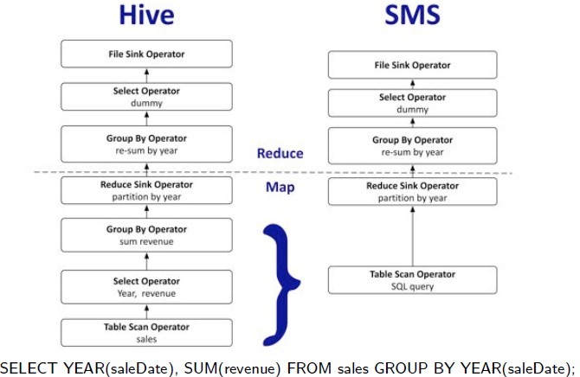
HadoopDB’s Components
MapReduce job generated by SMS assuming no partitioning of sales

Slide 27
Outline
Introduction, desired properties and background
HadoopDB Architecture
Results
Conclusions

Slide 28
Benckmarks
Environment:
Amazon EC2 “large” instances
Each instance
7,5 GB memory
2 virtual cores
850 GB storage
64 bits Linux Fedora 8

Slide 29
Benckmarks
Benchmarked systems:
Hadoop
256MB data blocks
1024 MB heap size
200Mb sort buffer
HadoopDB
Similar to Hadoop conf,
PostgreSQL 8.2.5
No compress data

Slide 30
Benckmarks
Benchmarked systems:
Vertica
New parallel database (column store),
Used a cloud edition
All data is compressed
DBMS-X
Comercial parallel row
Run on EC2 (not cloud edition available)

Slide 31
Benckmarks
Used data:
Http log files, html pages, ranking
Sizes (per node):
155 millions user visits (~ 20Gigabytes)
18 millions ranking (~1Gigabyte)
Stored as plain text in HDFS

Slide 32
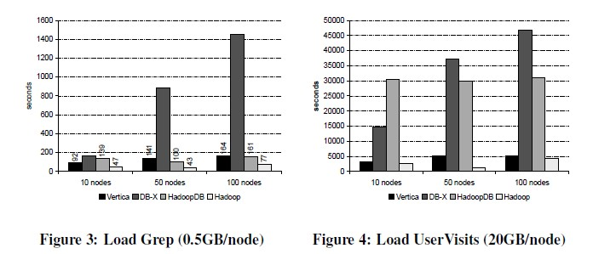
Loading data
Notes:
DB-X increasing linerly with more nodes. Hadoop and HadoopDB remain the same.

Slide 33
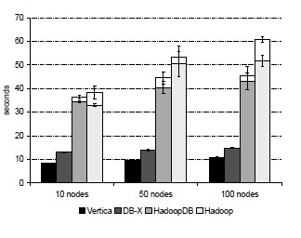
Grep Task
(1)Full table scan, highly
selective filter
(2)Random data, no
room for indexing
(3)Hadoop overhead
outweighs query
processing time in
single-node databases
SELECT * FROM Data WHERE field LIKE ‘%xyz%’;

Slide 34
Selection Task
Query:
Select pageUrl, pageRank
from Rankings
where pageRank > 10
All except Hadoop used clustered indices on the pageRank column.
HadoopDB each chunk is 50MB,overhead scheduling of small data leads to bad performance.

Slide 35
Aggregation Task
Smaller query
SELECT SUBSTR(sourceIP,1, 7),SUM(adRevenue)
FROM UserVisits
GROUP BY SUBSTR(sourceIP, 1,7);
Larger query
SELECT sourceIP, SUM(adRevenue)
FROM UserVisits
GROUP BY sourceIP;

Slide 36
Join Task
Query
SELECT sourceIP, COUNT(pageRank), SUM(pageRank),SUM(adRevenue)
FROM Rankings AS R, UserVisits AS UV
WHERE R.pageURL = UV.destURL AND
UV.visitDate BETWEEN ‘2000-01-15’ AND ‘2000-01-22’
GROUP BY UV.sourceIP;
No full table scan due to clustered indexing
Hash partitioning and efficient join algorithm

Slide 37
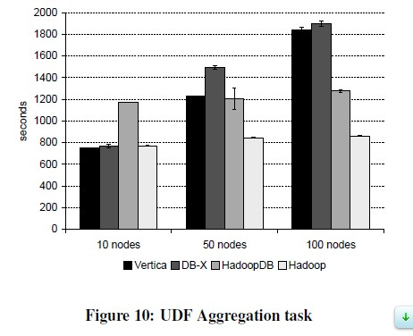
UDF Aggregation Task

Slide 38
Summary
HaddopDB approach parallel databases in absence of failures
PostgreSQL not column store
DBMS-X 15% overly optimistic
No compression in PosgreSQL data
Overhead in the interaction between Hadoop and PostgreSQL.
Outperforms Hadoop

Slide 39
Benckmarks
Fault tolerance and heterogeneus environments

Slide 40
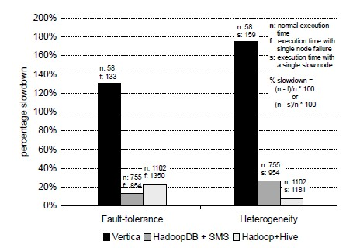
Fault tolerance and heterogeneus environments
Fault tolerance is important

Slide 41
Discussion
Vertica is faster
Vertica reduces the number of nodes to achieve the same order of magnitude
Fault tolerance is important

Slide 42
Conclusion
Approach parallel databases and fault tolerance
PostgreSQL is not a column store
Hadoop and hive relatively new open source projects
HadoopDB is flexible and extensible

Slide 43
References
Hadoop web page
HadoopDB article
HadoopDB project
Vertica
Apache Hive

Slide 44
Thank you!

