Slide 1
AGING AWARE DESIGN OF A MICROPROCESSOR BY DUTY CYCLE BALANCING
ABHINAY RAJ KALAMBUR SABARAJAN - 50133612
Guided by: Professor Sridhar Ramalingam

Slide 2
Overview
Introduction
Device Aging
My work
Aging aware Instruction Set Encoding(ArISE)
Duty Cycle Balancing
HP cacti 6.5 for cache memory analysis
Algorithm for ArISE based on duty cycle balancing
Simplescalar
Results of SimpleScalar Simulation
Reference

Slide 3
INTRODUCTION
The degradation of CMOS devices over the lifetime.
The Negative Bias Temperature Instability (NBTI).
Microprocessors fabricated at nanoscale nodes are exposed to accelerated transistor aging.
Device delays increase over time reducing the Mean Time To Failure (MTTF) of the processor.
Novel Aging-aware Instruction Set Encoding methodology (ArISE) that improves the instruction encoding.
based on Duty Cycle balancing which directly relates to the variation in threshold voltages of CMOS transistors.

Slide 4
DEVICE AGING
Transistors do age… like humans
Rate of aging related to stress on the devices.
Circuit aging refers to the deterioration of circuit performance over time.
Aging wasn't significant until the Moore's Law pushed the transistor channel lengths to 0.18 µm.
use of extremely small channel lengths and higher operating frequencies has elevated circuit aging.

Slide 5
Different Aging Phenomena
NBTI
- Transistor holds same data for long periods.
HCI
- Related to amount of switching.
Oxide Breakdown
-Breakdown of gate-oxide between semi-conductor slowly over time.
Electron-Migration
- Electron flow in same direction.

Slide 6
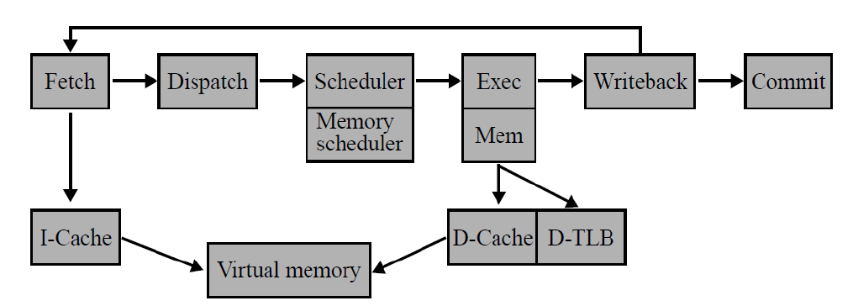
My Work
Technique to improve MTTF and reduce delay in microprocessors due to device aging.
Analysis of Out-of-order 11 stage pipeline microprocessor.

Slide 7
My Work(Contd.)
Fetch, decode and Execution unit most important.
Cache memory, decode and Execution unit – analyzed for duty cycle balancing.
Done at a system level using Cacti 6.5 for analyzing Cache memories.
Optimum Duty Cycle.
A system level iterative algorithm for developing new ISE.
Obtained ISE is implemented in Simplescalar.
Provides Aging aware solution for Cache memory and Decode stages.

Slide 8
Duty Cycle Balancing
The aging of devices are proportional to the device stress time and the switching frequency of the internal nodes.
A highly biased duty cycle ratio, will have a heavy stress and the aging of the device will be accelerated.
Microarchitecture solution to balance the utilization and the aging stress.
lifetime behaviors of the microprocessor and divide them into two groups, invalid and valid paths.
Finding optimum duty cycle value from the above method.
Reduces aging effect significantly.

Slide 9
HP cacti 6.5 for cache memory analysis
Caches are extremely important for single core processor performance.
CACTI is a memory modeling tool that currently comes from HP Labs.
CACTI is a tool that allows you to explore the performance, area, and power impacts of cache memories.
CACTI can correctly evaluate the power, area, and timing overhead of adding the power management units, including the penalties of wakeup latency and wakeup energy.
Using CACTI 6.5, cache memory was simulated according to our requirements.
Trade off between Cacti and Simcache
Cacti helps in segregating cache memory based on pipeline stages.
Simcache segregates cache memory into I-cache and D-cache.

Slide 10
Decoding and Execution stages
Decoding and Execution are two stages which must be analyzed at the gate level and device level for duty cycle analysis.
Analysis done by using cadence.
For execution part, a simple ALU along with mux and register blocks are considered.
Cadence provided values which was indeed close to the real world scenarios.

Slide 11
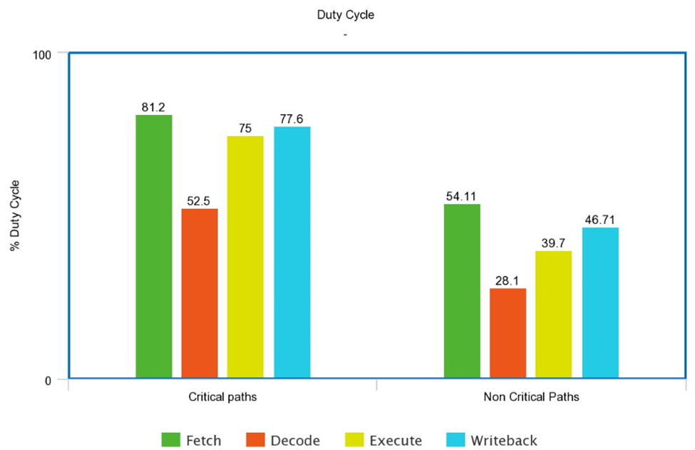
Duty Cycle Data

Slide 12
Aging aware Instruction Set Encoding(ArISE)
Instruction Set Encoding (ISE) has a considerable impact on the wearout of the decoding stages.
An aging-aware opcode for each instruction in such a way, that the overall lifetime of the decoding stages is improved.
only the representing bit patterns are modified, while the opcode length remains unchanged.
Improving the ISE is a challenging task.
most encodings infer modifications in the gate-level implementation of the stages.

Slide 13
Simplescalar
Modern processor are incredibly complex and are becoming increasingly hard to evaluate.
SimpleScalar tool set - fast, flexible, and accurate simulation of modern processors.
implement the SimpleScalar architecture (a close derivative of the MIPS architecture).
model applications that simulate real programs running on a range of modern processors and systems.
can emulate the Alpha, PISA, ARM, and x86 instruction sets.

Slide 14
Algorithm for ArISE based on duty cycle balancing
ITERATIVE APPROACH
1. Select a starting instruction set encoding (ISE): ISE old
2. Compute duty cycle
3. While solution is not good enough or number of steps < limit do
3.0. Adjust temperature T
3.1. Generate ISE new
3.2. compute duty cycle
3.3. If duty cycle not equal to optimum duty cycle
3.3.1. then GoTo 3.1.
3.3.2. else ISE old = ISE new
ISE best = ISE old /* store best ISE */
GoTo 3.1.
EndIf
End.

Slide 15
Instruction Set Encoding based on Iterative approach
Basic MIPS ISE - Eg
ADD – 00100000
MUL – 00011000
DIV – 00011010
Iterative Approach
Encoding using Smaller bits
ADD – 00000010
MUL – 00000011
DIV – 00000110
This model gave an improvement of 10% in delay and MTTF.

Slide 16
Delay values for various ISE models
ISE 1 ISE 2 ISE 3
No of Hits | Delay (ns)
2000 | 2.2
4000 | 6.47
6000 | 15.8
8000 | 22.91
10000 | 22.92
12000 | 22.89
No of Hits | Delay (ns)
2000 | 1.9
4000 | 5.12
6000 | 13.97
8000 | 19.26
10000 | 19.26
12000 | 19.26
No of Hits | Delay (ns)
2000 | 2.1
4000 | 3.75
6000 | 12.65
8000 | 18.7
10000 | 18.7
12000 | 18.7

Slide 17
Algorithm for ArISE based on duty cycle balancing
HIERARCHICAL APPROACH
1. Partition instructions into groups and subgroups
/*Instruction groups, subgroups inside groups, */ /*instructions insides subgroups, etc.*/
2. Rank each group (and subgroups subsequently)
2.1 Based on their hardware-impact
2.2 If there are groups/subgroups with same ranking then use occurrence frequency to rank these
3. For the coarsest down to the finest hierarchy-level do
For the highest ranked group down to the lowest do
3.1 Find the best encoding for the elements within that group
/*Either exhaustive or with simulated annealing*/
3.2 Stop as soon as duty cycle is satisfactory.
Endfor
Endfor

Slide 18
Instruction Set Encoding based on Hierarchical approach
Instructions are categorized into groups and subgroups
Based on hardware impact and occurrence frequency
Group 1
Group 2
ADD,
MOV,
AND
Sub-group1
SUB,
XOR,
MULT
Sub-group1
ADDU,
MOVL,
OR
NOR,
DIV,
SRL
Sub-group2
Sub-group2

Slide 19
Delay values for various ISE models
ISE 1 ISE 2 ISE 3
No of Hits | Delay (ns)
2000 | 1.95
4000 | 6.62
6000 | 10.4
8000 | 14.11
10000 | 16.29
12000 | 16.05
No of Hits | Delay (ns)
2000 | 1.81
4000 | 6.1
6000 | 11.1
8000 | 13.00
10000 | 14.38
12000 | 14.38
No of Hits | Delay (ns)
2000 | 1.6
4000 | 3.75
6000 | 7.2
8000 | 11.69
10000 | 12.31
12000 | 12.31

Slide 20
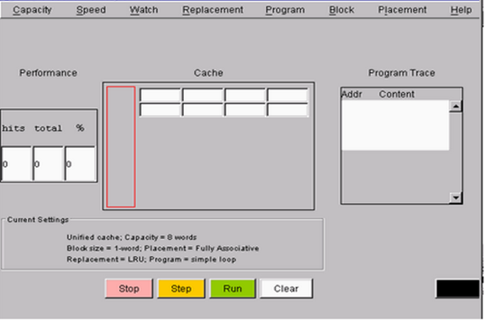
Results of SimpleScalar Simulation
User Interface of Sim Out-of-order simulator

Slide 21
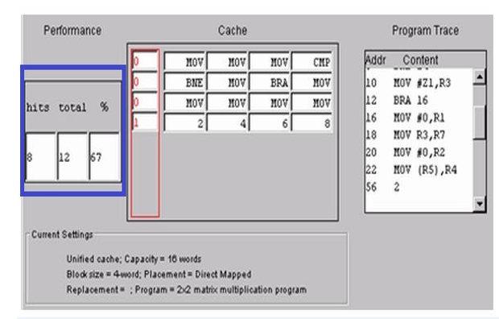
Results of SimpleScalar Simulation
Duty Cycle results on Simple Scalar.

Slide 22
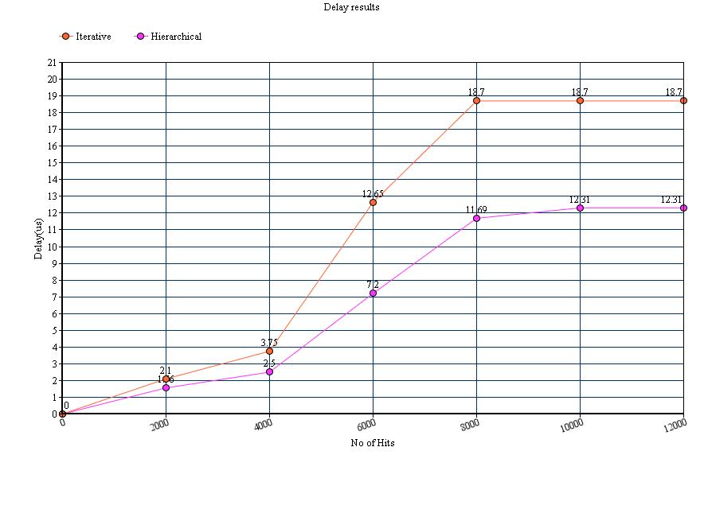
Delay model for both algorithms

Slide 23
RESULT
The Optimum value of Duty cycle I got was 64% including valid and invalid paths. By using simplescalar and Hierarchical algorithm, I was able to reach as much as 67%.
Initially, I used the iterative algorithm which improved the delay and MTTF by 10% which was not satisfactory. Later I used the Hierarchical algorithm with which I was able to improve the delay and MTTF by 54%.
With proper grouping and subgrouping of instructions and current device level aging inhibition techniques, the delay and MTTF can be improved as much as to 80%.

Slide 24
REFERENCES
[1] ArISE: Aging-aware instruction set encoding for lifetime improvement by Oboril, Fabian; Tahoori, Mehdi, 2014 19th Asia and South Pacific Design Automation Conference (ASP-DAC), 2014.
[2] Aging-Aware Instruction Cache Design by Duty Cycle Balancing by Tao Jin; Shuai Wang,
2012 IEEE Computer Society Annual Symposium on VLSI, 2012.
[3] System-Level Modeling And Reliability Analysis Of Microprocessor Systems, Dissertation
Presented by Chang-Chih Chen.
[4] Efficient Instruction Encoding for Automatic Instruction Set Design of Configurable ASIPs,
by Lee, Jong-eun; Choi, Kiyoung; Dutt, Nikil, Proceedings of the 2002 IEEE/ACM international conference on computer-aided design, 11/2002.
[5] The SimpleScalar Tool Set, Version 2.0, by Doug burger and Todd M Austin, SimpleScalar LLC.
[6] Aging-Aware Design of Microprocessor Instruction Pipelines, Fabian Oboril and Mehdi B. Tahoori, Ieee Transactions On Computer-Aided Design Of Integrated Circuits And Systems, Vol. 33, No. 5, May 2014.

Slide 25
[7] Aging-Aware Instruction Cache Design by Duty Cycle Balancing, Tao Jin and Shuai Wang,
2012 IEEE Computer Society Annual Symposium on VLSI.
[8] Aging-aware Timing Analysis Considering Combined Effects of NBTI and PBTI, Saman Kiamehr, Farshad Firouzi, Mehdi. B. Tahoori, International Symposium on Quality Electronic Design (ISQED), 2013.
[9] System-level modeling of microprocessor reliability degradation due to BTI and HCI, by Chen, Chang-Chih; Soonyoung Cha; Taizhi Liu; Milor, Linda, 2014 IEEE International Reliability Physics Symposium, 2014.
[10] Aging mitigation in memory arrays using self-controlled bit-flipping technique, by Gebregiorgis, Anteneh; Ebrahimi, Mojtaba; Kiamehr, Saman; Oboril, Fabian; Hamdioui, Said; Tahoori, Mehdi B, The 20th Asia and South Pacific Design Automation Conference, 2015.

Slide 26
Questions?

Slide 27
Thank You!!!

