Slide 1
FAULT-TOLERANT ROUTING SCHEME FOR NOCS
USING DYNAMIC RECONFIGURATION OF PARTIAL-FAULTY ROUTING RESOURCES
Harshmitha Kondur
5009 8068

Slide 2
Overview
Network on Chip
Router
Topology & Properties
Faults
  NoC Faults
  Router Faults
Fault Recovery Systems
  Existing System
  Proposed System
Detection of Faults
Dynamic Buffer Swapping
Dynamic Mux Swapping
Deadlock Recovery
Simulation and Results
Summary
Significance

Slide 3
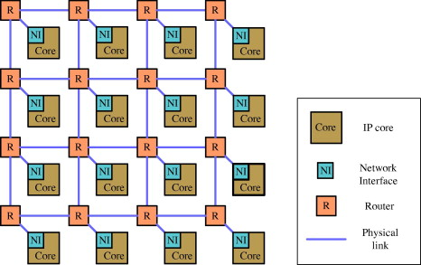
Network on Chips
Network on chip (NoC) is a communication subsystem on an integrated circuit
Communication occurs between cores in a system on a chip.
Implements multi-hop and predominantly packet-switched communication.

Slide 4

Network on Chips
NoCs borrow ideas and concepts from Computer Networks & apply them to the embedded SoC domain.
NoCs use packets to route data from the source PE to the destination PE via a network fabric that consists of
  Network interfaces/adapters (NI)
  Routers (a.k.a. switches)
  Interconnection links (channels, wires bundles)
Multiple routes from the host to clients.
Each node directly connects to a limited number of neighboring nodes. 

Slide 5
Overview
Network on Chip
Router
Topology & Properties
Faults
  NoC Faults
  Router Faults
Fault Recovery Systems
  Existing System
  Proposed System
Detection of Faults
Dynamic Buffer Swapping
Dynamic Mux Swapping
Deadlock Recovery
Simulation and Results
Summary
Significance

Slide 6
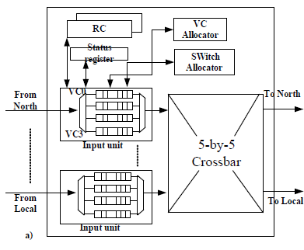
Router
Routers handle communication and directly connects to neighboring nodes’ routers.
Routing is the route/path (a sequence of channels) of streets from source to destination
The router consists of 2 major modules:
  Control Path
  Data Path

Slide 7
Router
Contol Path:
Routing Computation (RC)
Switch Allocation (SA)
Virtual Channel Allocation(VA)
Data Path:
Buffers
Switching Cross-bars
Output Registers

Slide 8
Router features
5 ports, wormhole, 5cycle pipeline
39-bit (32data , 6ctrl, 1str) bidirectional mesochronous P2P links per port
2 logical lanes each with 16 flit-buffers
Performance, area, power
  Freq 5.1GHz @ 1.2V
  102GB/s raw bandwidth
  Area 0.34mm2 (65nm)
  Power 945mW (1.2V), 470mW (1V), 98mW (0.75V)
Fine-grained clock-gating + sleep (10 regions)

Slide 9
Overview
Network on Chip
Router
Topology & Properties
Faults
  NoC Faults
  Router Faults
Fault Recovery Systems
  Existing System
  Proposed System
Detection of Faults
Dynamic Buffer Swapping
Dynamic Mux Swapping
Deadlock Recovery
Simulation and Results
Summary
Significance

Slide 10
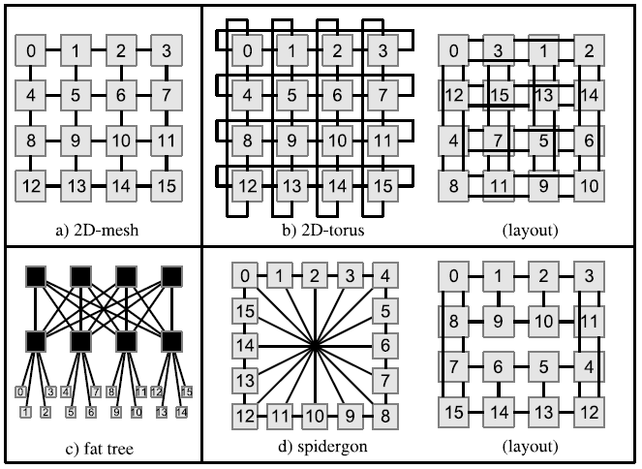
Topology of NoCs
“The topology is the network of streets, the roadmap”.

Slide 11
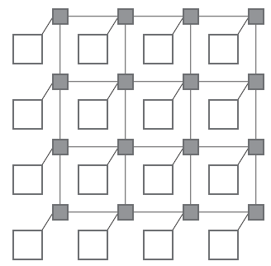
2D Mesh Topology
Most popular topology
All links have same length
  Eases physical design
Area grows linearly with number of nodes
Must be designed in such a way as to avoid traffic accumulating in the center of the mesh

Slide 12
Advantages of NoC
High level of parallelism
Enhanced performance (such as throughput) and scalability
Efficient utilization of communication resources than traditional on-chip buses.
Regular NoC structures reduce VLSI layout complexity compared to custom routed wires

Slide 13
NoC Properties
Multi-hop and predominantly packet-switched communication
Dynamic Adaptive Routing algorithm
Flexible QoS guarantees
Higher bandwidth
Reusable components
  Buffers, arbiters, routers, protocol stack

Slide 14
Overview
Network on Chip
Router
Topology & Properties
Faults
  NoC Faults
  Router Faults
Fault Recovery Systems
  Existing System
  Proposed System
Detection of Faults
Dynamic Buffer Swapping
Dynamic Mux Swapping
Deadlock Recovery
Simulation and Results
Summary
Significance

Slide 15
Faults in NoC
Faults in a NoC router are of 2 types:
  Transient Faults
  Permanent Faults
Transient Faults: on-chip cross-talks and coupling noise
  Alpha particles emitted by trace uranium and thorium impurities in packages and high-energy neutrons from cosmic radiations can cause soft errors in semi-conductor devices.
  Similarly, low energy cosmic neutrons interacting with isotope boron-10 can cause soft errors.

Slide 16
Faults in NoC
Permanent Faults: worn-out devices, manufacturing defects and accelerated aging effects.
  Electro-migration of a conductor, broken wires, dielectric breakdowns etc. are a few examples of permanent failures on chip.
  Permanent faults, at one level, are modeled as stuck-at faults, or as fail-stop model where a complete module malfunctions and informs its neighbors about its out-of-order status.

Slide 17
Root cause
Faults appear due to the following reasons:
  susceptibility of shrinking feature sizes to process variability
  age-related degradation
  crosstalk
  single-event upsets.
Large numbers of faults will have to be tolerated to sustain chip production yield and reliable operation
Rapid development in silicon technology is enabling the chips to accommodate billions of transistors .

Slide 18
Root cause
  Shrinking silicon die size : enhanced levels of cross talks, high field effects and critical leakage currents.
Growing number of cores on a chip
Electro-migration of a conductor
Gaussian noise on a channel and alpha particles: strikes on memory and logic can cause one or more bits to be in error

Slide 19
Router Faults
We focus on dealing with the permanent NoC faults since it has a more significant impact on the system performance.
The permanent faults are divided into two:
  Static fault : Faults occurred at the interconnect wires
  Dynamic fault : Recovery of the router faults, cross bar and buffer faults.
  Since the major portion of the router constitutes of the cross-bar and the buffer, the majority of the faults occur there.

Slide 20
Overview
Network on Chip
Router
Topology & Properties
Faults
  NoC Faults
  Router Faults
Fault Recovery Systems
  Existing System
  Proposed System
Detection of Faults
Dynamic Buffer Swapping
Dynamic Mux Swapping
Deadlock Recovery
Simulation and Results
Summary
Significance

Slide 21
Existing Systems
1) The faulty router is treated as a node fault and the routing algorithm can be dynamically reconfigured to re-route the packets following the contour around the faulty nodes.
  Reference: Zhen Zhang, A. Greiner, and S. Taktak, “A reconfigurable routing algorithm for a fault-tolerant 2d-mesh network-on-chip," in Proc DAC, 2008, pp. 441 {446.
Disadvantages:
This region-based routing algorithm is only suitable for one-faulty-router topology.
Also, the node fault model may cause the faulty router totally isolated from the network, while in real situation, the faults may only affect a certain part of the router and the rest of it can still function correctly.

Slide 22
Existing Systems
2) After the built-in-self-test procedure and a static port swapping, the remaining faults (both link faults and unswapped buffer/MUX faults) are all treated as link level hard failures
  Reference:D. Fick, A. DeOrio, Jin Hu, V. Bertacco, D. Blaauw, and D. Sylvester, “Vicis: A reliable network for unreliable silicon,“ in Proc DAC, 2009, pp. 812 - 817.
  D. Fick, A. DeOrio, G. Chen, V. Bertacco, D. Sylvester, and D. Blaauw, “A highly resilient routing algorithm for fault-tolerant nocs," in Proc DATE, 2009, pp. 21 - 26.
A resilient routing algorithm is designed to reconfigure the routing table in an offline process so as to bypass these fault links.
Both the port swapping operation and routing table reconfiguration in are static in nature

Slide 23
Existing Systems
3) A deflection routing algorithm is proposed to dynamically re-route the packets towards the destinations.
  Reference: A. Hosseini, T. Ragheb, and Y. Massoud, “A fault-aware dynamic routing algorithm for on-chip networks," in Proc ISCAS, 2008, pp. 2653 - 2656.
The NoC faults are treated as the link faults also and it needs to avoid deadlock and livelock based on the stress factors.

Slide 24
Proposed System
A faulty router with an appropriate reconfiguration strategy tolerates the buffer or crossbar errors
Supports the full connectivity in the NoC with reduced capacity
Previously suggested fault tolerant models result in the network being partitioned.
Hence the dynamic swapping scheme is suggested which shares the healthy resources in the router for different ports at run time.

Slide 25
Proposed System
Dynamic reconfiguration (DR) enables resources to be added or removed while the operating system (OS) is running
DBS and DMS operation will dynamically share the healthy resources among different ports in run time and hence improve the performance.
A deflection routing algorithm is proposed to dynamically re-route the packets towards the destinations.
Leveraging the other healthy buffers or multiplexers (Muxes) and dynamically re-allocating the resources
These dynamically reconfigure the routers to handle buffer faults and crossbar faults while still maintaining the maximum service of the router.

Slide 26
Overview
Network on Chip
Router
Topology & Properties
Faults
  NoC Faults
  Router Faults
Fault Recovery Systems
  Existing System
  Proposed System
Detection of Faults
Dynamic Buffer Swapping
Dynamic Mux Swapping
Deadlock Recovery
Simulation and Results
Summary
Significance

Slide 27
Detection of Faults
Faults In routers can be detected with built-in-self-test (BIST) and self-diagnose circuits.
A hybrid fine-grained fault model distinguishes the nature and consequence of faults
Suggests fault-diagnosis technique to determine the type of fault.

Slide 28
Detection of Faults in a router
Fault Diagnosis Structure:
To determine the occurrence, type and position of the faults.
Module in this system are:
  Cyclic Redundancy check:
    Switch – Switch error
    Intra router error
  BIST controller: sends test patterns to the other router.
  TPG 1: TP for buffers
  TPG2: TP for cross bar

Slide 29
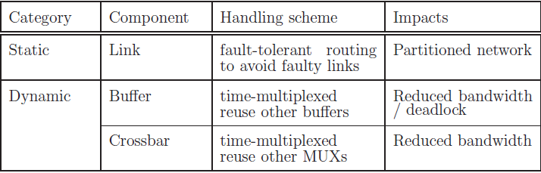
Detection of Faults in a router
These errors are forwarded to the DBS and DMS modules for router reconfiguration

Slide 30
Overview
Network on Chip
Router
Topology & Properties
Faults
  NoC Faults
  Router Faults
Fault Recovery Systems
  Existing System
  Proposed System
Detection of Faults
Dynamic Buffer Swapping
Dynamic Mux Swapping
Deadlock Recovery
Simulation and Results
Summary
Significance

Slide 31
Dynamic Buffer Swapping (DBS)
Dynamic buffer swapping (DBS) algorithm is proposed to handle the input buffer faults.
Proper swapping of another substitute buffer to hold the packets destined for the faulty buffer
Graceful performance degradation can be achieved by fully utilizing the link
No extra buffers or virtual channels are needed in the router, which satisfies the stringent area constraint of NoC.

Slide 32
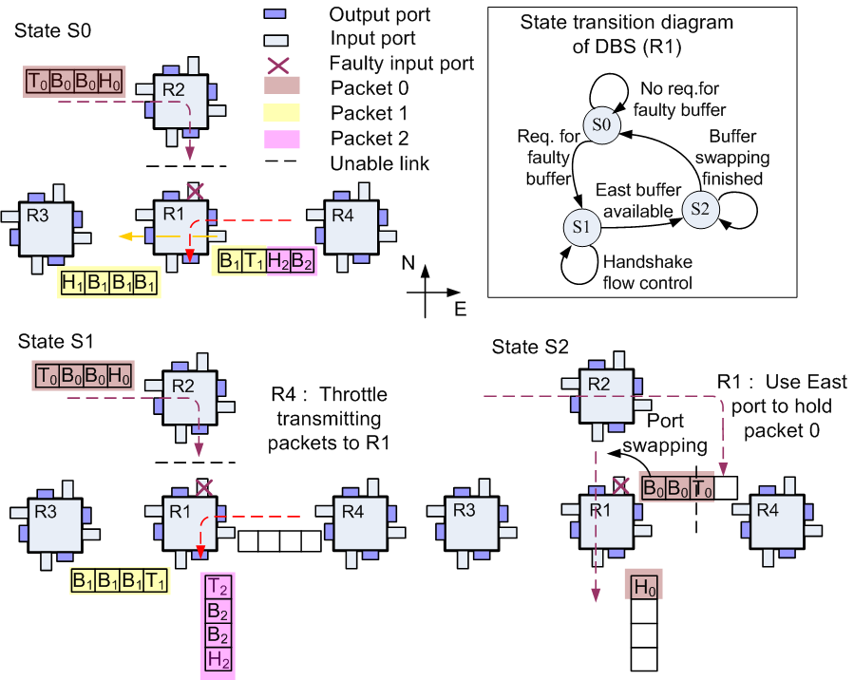
Dynamic Buffer Swapping
DBS Operation:
State S0
Assume fault occurs at the north input buffer of router R1
packet 0 is blocked in router R2
State S1
R1 will arrange east port buffer to substitute the north buffer.
Traffic control token is sent to router R4 indicating that the transmission link (R1-R4) will be shut down in the next state for DBS operation
State S2
communication between R2-R1 link is enabled
packet 0 can thus be transmitted to R1’s east input buffer and further be forwarded towards its destinations.
State S0 is regained.

Slide 33
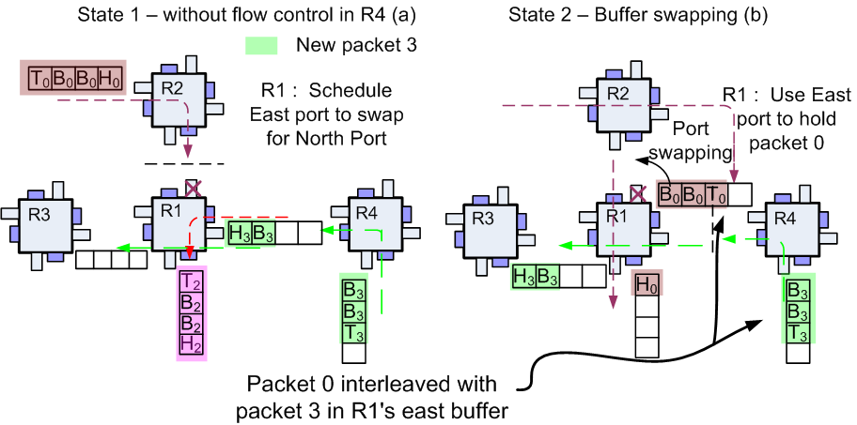
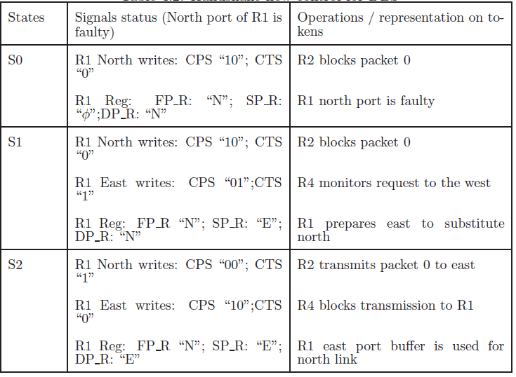
Dynamic Buffer Swapping
Avoid Packet interleaving:
Interference of packets from 2 routers
Two handshake signals, current transmit status (CTS) and current port status (CPS) for each port.
The router can send the packets across the link only when it receives a ’1’ in the CTS

Slide 34
Overview
Network on Chip
Router
Topology & Properties
Faults
  NoC Faults
  Router Faults
Fault Recovery Systems
  Existing System
  Proposed System
Detection of Faults
Dynamic Buffer Swapping
Dynamic Mux Swapping
Deadlock Recovery
Simulation and Results
Summary
Significance

Slide 35
Dynamic Mux Swapping (DMS)
Dynamic MUX swapping (DMS) technique is used to mitigate the MUX faults and make all the output links available for routing.
The crossbar in the router is usually implemented in the form of five 4×1 MUXs
If one of the MUX malfunctions, the data will not be presented to the output link correctly.
Ring-based crossbar swapper is proposed
The ring topology allows each MUX to be shared among its neighboring output ports.
All output links can be maintained.

Slide 36
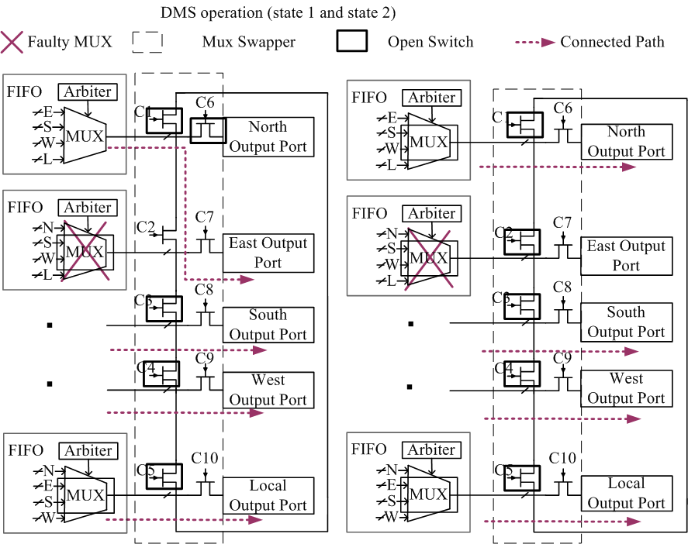
Dynamic Mux Swapping
If the MUX corresponding to the east output port is faulty, the MUX for the north port can be time shared with the north and east ports by turning on-off the switches in MUX swapper accordingly.
By doing so, all the output links can be maintained.

Slide 37
Overview
Network on Chip
Router
Topology & Properties
Faults
  NoC Faults
  Router Faults
Fault Recovery Systems
  Existing System
  Proposed System
Detection of Faults
Dynamic Buffer Swapping
Dynamic Mux Swapping
Deadlock Recovery
Simulation and Results
Summary
Significance

Slide 38
Deadlock Recovery
Routers working in the DBS mode may face potential deadlocks.
When faults occur, due to the DBS or the re-routing, a deadlock may be introduced.
To ensure deadlock free routing, in normal operation, Odd-even (OE) routing algorithm is used in our framework.
Circular dependency on the NoC resources may bring deadlocks and stall the whole system.
For DMS operation, we only time-share the MUX between two output ports and do not change the dependency of the buffers in the routing algorithm.
No deadlocks.

Slide 39
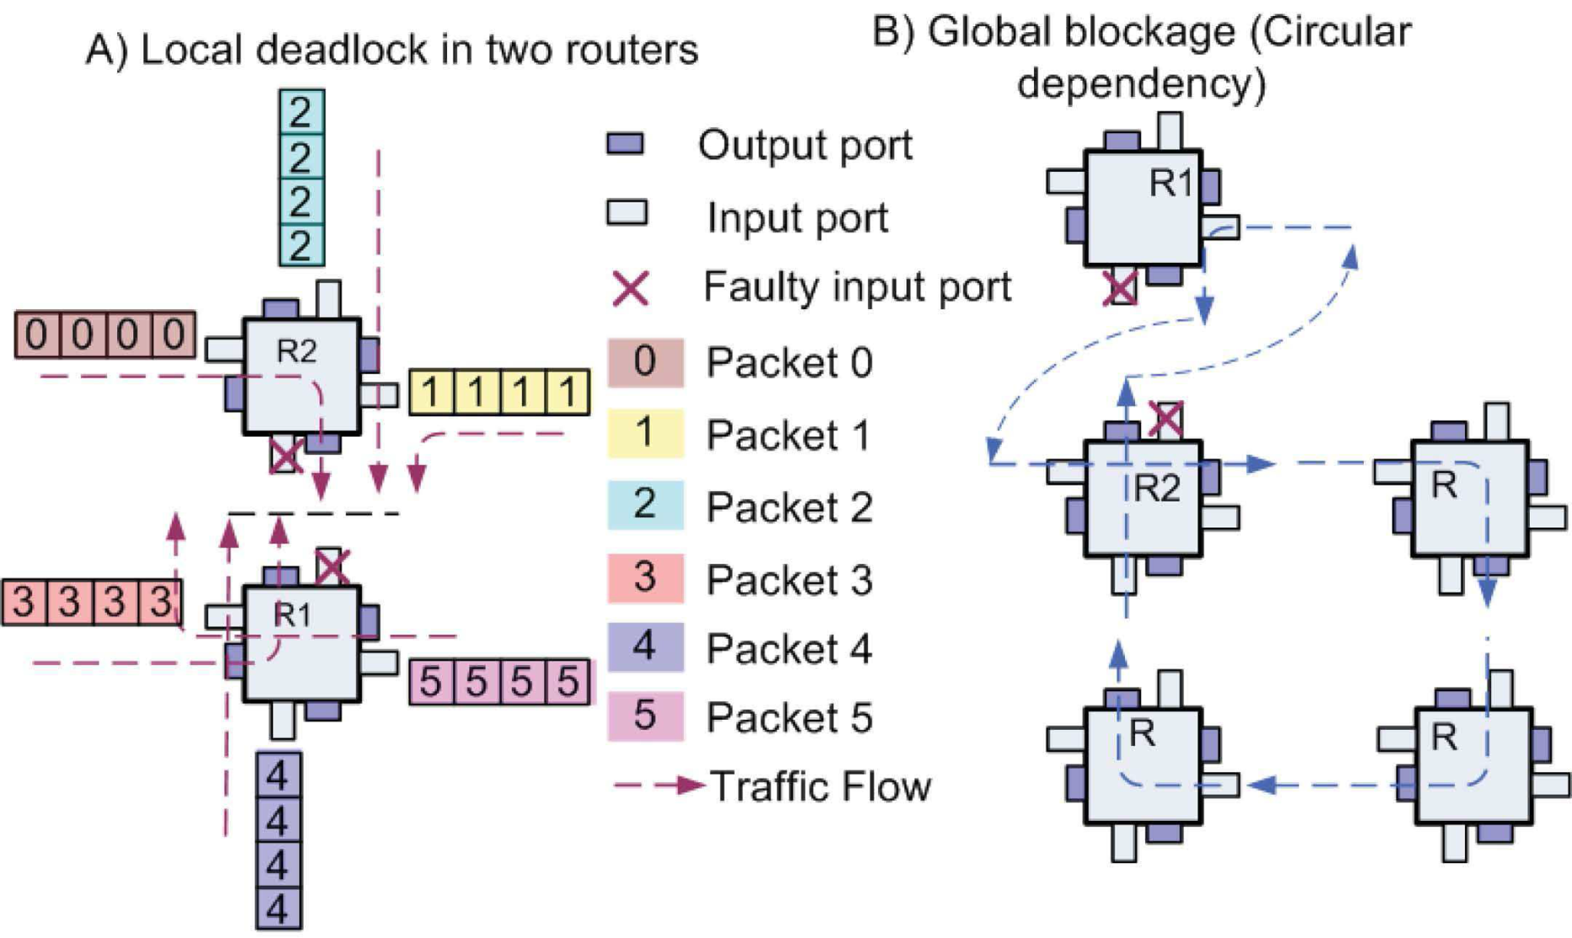
Deadlock Recovery
Local deadlock:
Occurs between the two nodes R1 andR2
The south port of R2 and north port of R1 are faulty
If all the packets in other ports choose these two ports as output R1 (R2) will be stuck at state S1 waiting for the original packets in the substitute port of R2 (R1) being completely transmitted.
Global deadlock:
Assume the south to east turn is forbidden.
Scheduler in R2 arranges its west input buffer to hold packets from north
Scheduler in R1 arranges its east input buffer to substitute the faulty south buffer
a circular dependency on buffer resources can thus be generated

Slide 40
Deadlock Recovery
When the router receives the header flit of a packet, an embedded counter is triggered to count the number of cycles it stays in the buffer.
The counter continues to increment until the tail flit has been successfully transmitted or its value exceeds a predefined threshold Tsh.
In the latter case, the router will enter the deadlock handling mode.
After that the counter would be reset and waits for next packet.

Slide 41
Strategies
The east input buffer of R2 to swap with the north faulty buffer, we can break the original dependency and avoid the blockage.
If all the ports in the router are not available for swapping we will reset the routing computation (RC), switch allocation (SA) information of these packets to request a different output port.
if packet 1 chooses the west instead of south as output direction and leaves R2 successfully, then the deadlock problem can be solved accordingly.

Slide 42
Strategies
Another strategy is to use the leader election algorithm.
Once the nodes in deadlock are detected, the arbiters’ decisions of each node are saved. The node’s output channels are reused for selecting the leader among those nodes.
After the leader node being elected, all nodes reconstruct its previous arbiter decision and wait for the incoming leader packets together with a preemption indicator.
This preemption indicator sent by the elected leader node will make the entire message bypass the deadlocked nodes up to its destination.
When a buffer becomes available after this process, all the other nodes will leave their awaiting state to transmit its deadlocked messages.
This is similar to the prioritization of messages in computer networks.

Slide 43
Strategies
If the re-computation step fails to relieve the blockage, and the local processing element (PE) has available memory spaces in network interface (NI).
Next, we will send these blocked packets to the local PE, and make the PE re-send these packets to the destination.
In order to avoid creating a new circular dependency between the PE and other routers, this operation is carried out only when NI has free memory slots.
If the memory in NI is full, we need to drop the current packet and require a higher level end-to-end re-transmission protocol to re-send the packets

Slide 44
Overview
Network on Chip
Router
Topology & Properties
Faults
  NoC Faults
  Router Faults
Fault Recovery Systems
  Existing System
  Proposed System
Detection of Faults
Dynamic Buffer Swapping
Dynamic Mux Swapping
Deadlock Recovery
Simulation and Results
Summary
Significance

Slide 45
Simulation and Results
The fault rate f and the packet acceptance rate r,

Slide 46
Simulation and Results
An NoC network was constructed using Noxim Simulator and systemC.

Slide 47
Future Work
Simulation for DBS with deadlocks.
Comparison of networks under fault and deadlocks.

Slide 48
Overview
Network on Chip
Router
Topology & Properties
Faults
  NoC Faults
  Router Faults
Fault Recovery Systems
  Existing System
  Proposed System
Detection of Faults
Dynamic Buffer Swapping
Dynamic Mux Swapping
Deadlock Recovery
Simulation and Results
Summary
Significance

Slide 49
Summary
Proposed a fault-tolerant framework for Network on Chips (NoC) to achieve maximum performance under fault.
Distinguish the faulty components and handle them according to their fault classes.
Two new dynamic reconfiguration schemes at the router level, namely Dynamic Buffer Swapping (DBS) and Dynamic MUX Swapping(DMS), are proposed to deal with the buffer and cross-bar faults accordingly, which are the main sources of failure in the router.
Healthy resources in the router are maximally utilized to mitigate the faults
A deadlock recovery scheme is designed to handle the potential deadlock hazard due to the proposed DBS operation

Slide 50
Overview
Network on Chip
Router
Topology & Properties
Faults
  NoC Faults
  Router Faults
Fault Recovery Systems
  Existing System
  Proposed System
Detection of Faults
Dynamic Buffer Swapping
Dynamic Mux Swapping
Deadlock Recovery
Simulation and Results
Summary
Significance

Slide 51
Significance
Aim to propose a fault-tolerant framework for Network-on-Chips (NoC)
To achieve maximum performance under fault.
Can avoid unnecessary partitioning of the network and hence achieve a higher connectivity under high fault rate.
Healthy resources in the router are maximally utilized to mitigate the faults.
Can achieve higher packet acceptance rate and lower latency

Slide 52
References
Zhiliang Qian, Ying-Fei Teh, and Chi-Ying Tsui, “A fault-tolerant network-on-chip design using dynamic reconfiguration of partial-faulty routing resources,” in VLSI and System-on-Chip (VLSI-SoC), 2011 IEEE/IFIP 19th International Conference on, Oct 2011, pp. 192–195.
L. Benini and G. De Micheli, “Networks on chips: a new soc paradigm,” Computer, vol. 35, no. 1, pp. 70 –78, jan 2002.
A. Kohler, G. Schley, and M. Radetzki, “Fault tolerant network on chip switching with graceful performance degradation,” Computer-Aided Design of Integrated Circuits and Systems, IEEE Transactions on, vol. 29, no. 6, pp. 883–896, 2010.
D. Fick, A. DeOrio, Jin Hu, V. Bertacco, D. Blaauw, and D Sylvester, “Vicis: A reliable network for unreliable silicon,” in Design Automation Conference, 2009. DAC ’09. 46th ACM/IEEE, 2009
Shu-Yen Lin, Wen-Chung Shen, Chan-Cheng Hsu, Chih-Hao Chao, and An-Yeu Wu, “Fault-tolerant router with built-in self-test/self-diagnosis and fault-isolation circuits for 2d-mesh based chip multiprocessor systems,” in VLSI Design, Automation and Test, 2009. VLSI-DAT ’09.

Slide 53
References
S. Borkar, “Designing reliable systems from unreliable components: The challenges of transistor variability and degradation,” IEEE Micro, vol. 25, no. 6, pp. 10–16, Nov. 2005.
A. Kohler and M. Radetzki, “Fault-tolerant architecture and deflection routing for degradable NoC switches,” in Proc. Symp. Netw. Chip (NOCS), 2009, pp. 22–31.
J. Wu and D. Wang, “Fault-tolerant and deadlock-free routing in 2-D meshes using rectilinear-monotone polygonal fault blocks,” in Proc. Int. Conf. Parallel Process., 2002, p. 247.
Z. Zhang, A. Greiner, and S. Taktak, “A reconfigurable routing algorithm for a fault-tolerant 2-D-mesh network-on-chip,” in Proc. Design Autom. Conf. (DAC), 2008, pp. 441–446.
Anuradha K.shrimawale and Mahendra A Gaikwad. Article: Review of Odd Even Routing Algorithm for 2D Mesh Topology of Network-on-Chip Architecture for Bursty Traffic. IJCA Special Issue on Recent Trends in Engineering Technology RETRET:9-12, March 2013
Verbeek, F. and Schmaltz, J., “A Decision Procedure for Deadlock-Free Routing in Wormhole Networks”, Parallel and Distributed Systems, IEEE Transactions on, Volume:25 Issue:8, pp.1935 – 1944, 2014

Slide 54

THANK YOU

