Slide 1
Dark Silicon Overview, Analysis and Future Work
Jordan Radice
jordanra@buffalo.edu
Advanced VLSI
Spring 2015
Dr. Ram Sridhar

Slide 2
Background
Moore’s Law (As we all know): Doubling of transistors every 1.5 ~ 2.0 years.
Dennard scaling works in conjunction with Moore’s law in that we maintain the overall power density of the chip area despite the exponential increase in transistors.
Achieved through constant field scaling
Worked for most of the transistors’ history up until about 2005
P = P_{dynamic} = (1-a)×N×C_{ox}×f×V_{dd}²

Slide 3
Constant Field Scaling
Constant Field Scaling Rules (Pre-Dennardian Scaling Breakdown)
Scaling Assumptions | MOSFET Device and Circuit Parameters | Multiplicative Factor (ϰ > 1)
 | Device dimensions (t_{ox}, L, W, x_{j}) | 1/ϰ
 | Doping Concentration (N_{a}, N_{d}) | ϰ
 | Voltage (V_{dd}, V_{t}) | 1/ϰ
Derived scaling behavior of device parameters | Electric Field E | 1
 | Carrier velocity v | 1
 | Depletion-layer width (W_{d}) | 1/ϰ
 | Capacitance (C = ɛ×L×W/t_{ox}) | 1/ϰ
 | Inversion-layer charge density (Q_{i}) | 1
 | Current, Drift (I) | 1/ϰ
 | Channel resistance (R_{ch}) | 1
Derived scaling behavior of circuit parameters | Circuit delay time (τ ~ CV/I) | 1/ϰ
 | Power dissipation per circuit (P ~ VI) | 1/ϰ²
 | Power-delay product per circuit (P τ) | 1/ϰ³
 | Circuit density (∝ 1/A) | ϰ²
 | Power Density (P/A) | 1
(Taur and Ning 2009)

Slide 4
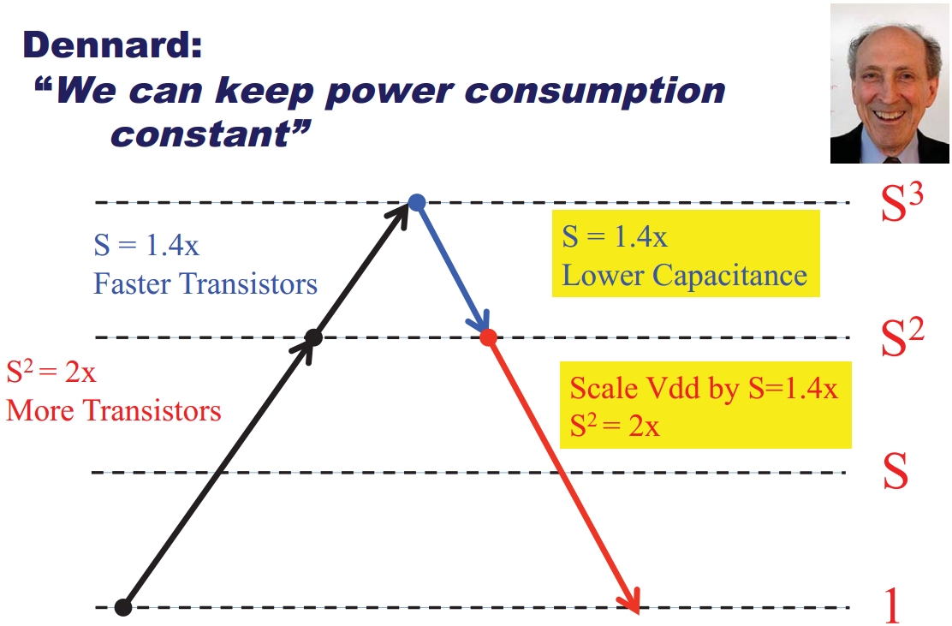
Constant Field Scaling

Slide 5
Intel’s Pentium 4
In 2004 Intel released their 90 nm single core Pentium 4 Prescott processor which had 125 million transistors in an area of 112 mm² with a TDP of 115 W, clocked at a steady 3.8 GHz
In 2013 Intel released their 22 nm hexacore Core i7-4960X Ivy Bridge processor which had 1.8 billion transistors in an area of 257 mm² with a TDP of 130 W, clocked at 3.6 GHz with Turbo Boost to 4.0 GHz
Theoretical transistor scale: ϰ² = (90 nm / 22 nm)² = 16
Theoretical frequency scale: ϰ = (90 nm / 22 nm) = 4
Total theoretical performance scale: ϰ³ = 64
Actual overall theoretical performance improvement is estimated to be only 5.7x (Without other considerations)

Slide 6
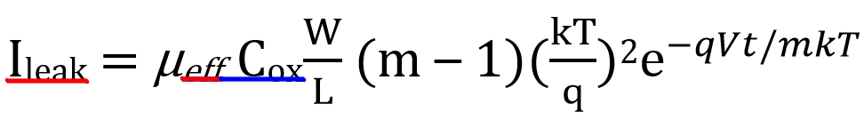
Breakdown
Leakage current (Off-current) of a MOSFET (V_{ds} = V_{dd} >> kT/q)
Post-Dennardian era Power dissipation in a CMOS circuit
(Taur and Ning 2009), (Hardavellas 2012)

Slide 7
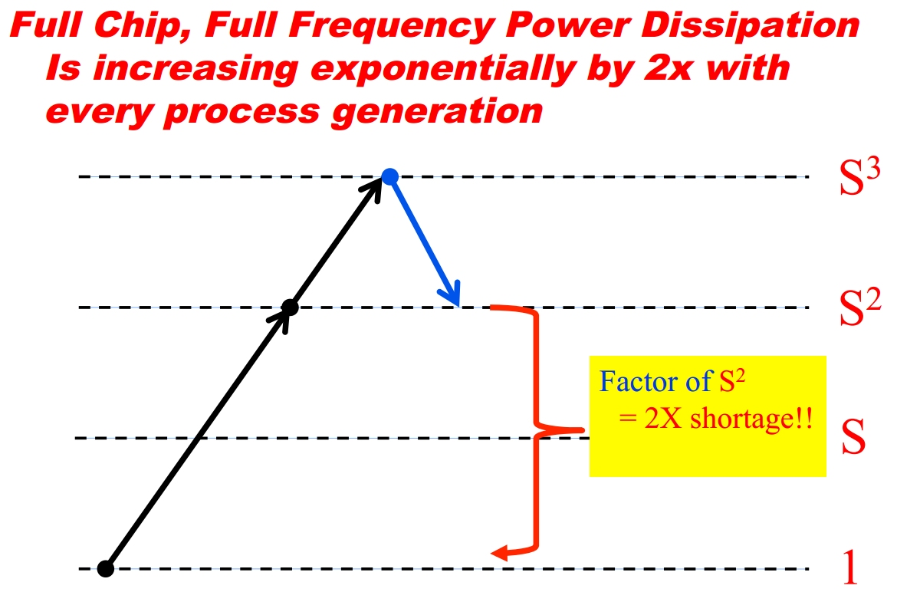
Breakdown
(Venkatesh, 2010)

Slide 8
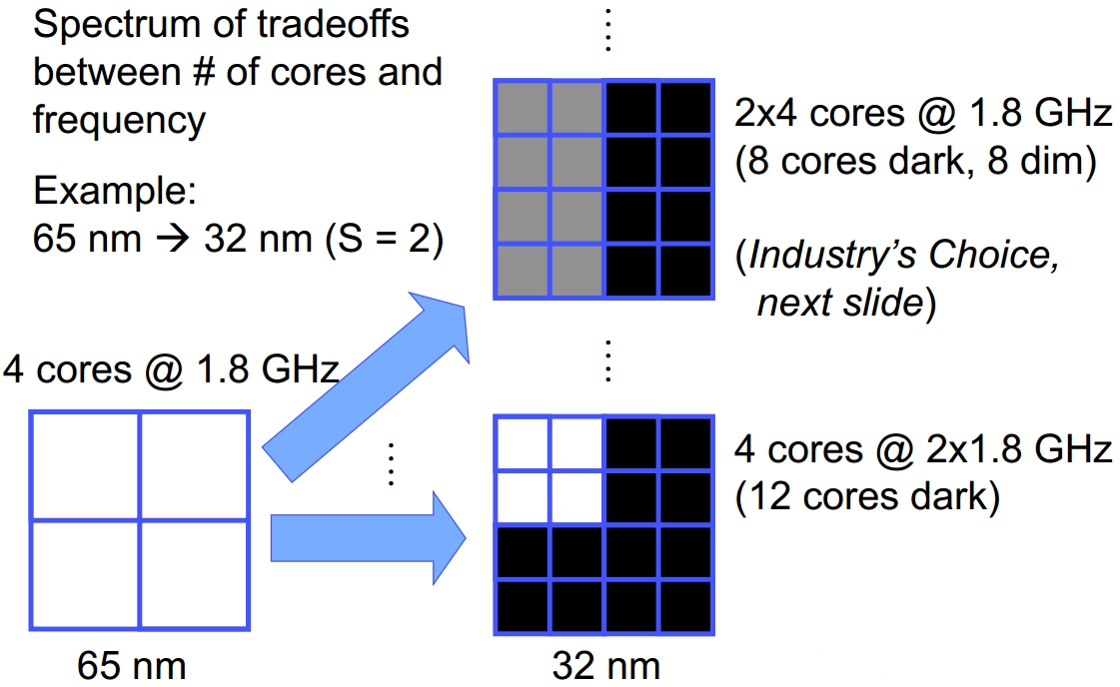
Breakdown
Every generation will exponentially increase dark silicon in a chip
(Taylor, Hotchips, 2010), (Esmaeilzadeh, ISCA 2011)

Slide 9
The Shrinking Die
PROs:
Reduces overall power consumption
Costs goes down
Maintains frequency boosts
Less area
CONs:
Power density goes up exponentially (Temperature as well)
Profit margins goes down
Overall functionality remains the same
Less area to be utilized

Slide 10
Apple’s A8 vs. A7 processor
Apple’s latest two processors for their iPhone 6 and iPhone 5S demonstrate shrinking the die areas.
A7 processor which has over a billion transistors using 28 nm technology, operating at 1.3 GHz, on a 102 mm² die.
A8 processor which has over 2 billion transistors making use of 20 nm technology operating at 1.4 GHz, all while on a die with an area of 89 mm².
Maintaining or improving the phone’s overall battery life.
iPhone 6’s battery is 16% larger than iPhone 5S’s.
iPhone 6’s resolution is 38% larger.
Overall, the iPhone 6 is 50% more efficiency than the iPhone 5S

Slide 11
Dim Silicon
Techniques that put large amounts of otherwise dark silicon area to productive use by heavily underclocking or infrequently using certain areas of the chip to meet the power budget.
Several main techniques:
Bigger Caches
Dynamic Voltage and Frequency Scaling (DVFS)
Parallelism
Near Threshold Voltage Processors (NTV)

Slide 12
Bigger Caches
Area used to be expensive
Fill the dark silicon with more cache (Inherently dim)
Compared to general-purpose logic, a level-1 (L1) cache clocked at its maximum frequency can be about 10x darker per square millimeter, and larger caches can be even darker.
Simultaneously increase performance and lower power density per square millimeter.
However, many applications do not benefit much from additional cache, and upcoming TSV-integrated DRAM will reduce the cache benefit for those applications that do.
(Taylor, A landscape of the new dark silicon design regime, 2013)

Slide 13
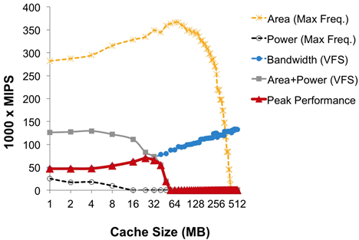
Optimizing Cache Sizes
20 nm high performance double-gate FinFET L2 Cache
Fraction of the die area is dedicated to an L2 cache size
25% of the die area is used for supporting structures
Remaining area populated with cores
(Hardavellas, The Rise and Fall of Dark Silicon, 2012)
Notes:
20 nm high performance double-gate FinFET on a core design (Conventional general-purpose cores modeled after Sun UltraSPARC), with DRAM memory off chip all within a die area of 310 mm2 while using application characteristics with cache misses modeled after TPC-H on DB2 with 99% parallel code [3]. The plot in Figure 1 shows the collective chip performance as a function of L2 cache size on the chip. For each point in the figure, a fraction of the die area is dedicated to an L2 cache size as indicated on the x-axis, 25% of the die area is used for the supporting structures and the remaining area can be populated with cores.

Slide 14
Dynamic Voltage and Frequency Scaling (DVFS)
Done by adjusting the supply voltage V_{dd} and frequency f
P = P_{dynamic} = (1-a)×N×C_{ox}×f×V_{dd}²
Done when computational load is instantly increased
During ramp up, we incur a cubic power increase, but a cubic power decrease is not observed.
During ramp up, we are increasing the temperature rapidly, but during the ramp down, the device isn’t cooled nearly as quickly.
The speed can remain high until either the task is completed or until the thermal limit is reached in which the processor is then throttled back to more temperature appropriate speeds.
Utilized in the mobile industry the most since there is a desire to have thin fanless designs with a long lasting battery.

Slide 15
Apple’s 2015 MacBook
Apple’s new fanless MacBook has a base 1.3 GHz dual-core Intel Core M Processor which utilizes Intel’s Turbo boost to speed it up to 2.9 GHz based on the load.
Thin dimensions of 28.05 cm by 19.65 cm by 0.35 to 1.31 cm (Depending on the side) all while weighing 0.92 kg.
Has a 12” screen with a 2304 x 1440 resolution while using a 39.7-watt-hour battery that provides for 9 hours of wireless web usage.
While there have been a lot of other improvements in processor technology, it is Intel’s Turbo Boost technology must be implemented in order to provide smooth performance under varying loads.

Slide 16
Parallelism
The ability to take a task and allow it to be worked on simultaneously amongst several cores.
Wasn’t popular until after Intel’s Pentium 4 when the performance literally peaked in a single core device.
The successor, the dual-core Pentium D Smithfield was introduced the following year in 2005.
While parallelism has its benefits when utilized properly, the problem is that there aren’t a lot of user applications that benefit from parallelism and the ones that due rarely benefit from more than two cores.
Within multicore systems, there are several architectures one can use.

Slide 17
Symmetric Multicore
It is a symmetric or homogenous multicore topology consisting of multiple copies of the same core operating at the same voltage and frequency.
Resources including the power and area budget are shared equally amongst all cores.
Does not have the ability to throttle back individual cores reduce power consumption, which results in degrading the efficiency of the system.
(Esmaeilzadeh, Power Limitations and Dark Silicon Challenge the Future of Multicore, 2012)

Slide 18
Asymmetric Multicore
In the asymmetric multicore topology, there is one large monolithic core and many identical small cores.
This design utilizes the high performing core for the serial portion of the code and then leverages the smaller cores as well as the large core to compute the parallel portion of the code.
Better suited for programs in which most of the heavy workload can only be utilized by a single core while the parallel workload is light, thus benefiting from the smaller, less powerful cores.
(Esmaeilzadeh, Power Limitations and Dark Silicon Challenge the Future of Multicore, 2012)

Slide 19
Dynamic Multicore
The dynamic multicore topology is a variation of the asymmetric multicore topology in which during the parallel portions of the code, the large core is shut down and during the serial portion, the small cores are turned off and the code only runs on the larger one.
This is likely done since the smaller cores would share the same design, thus making it easier for parallelism to take place.
(Esmaeilzadeh, Power Limitations and Dark Silicon Challenge the Future of Multicore, 2012)

Slide 20
Composed Multicore
The composed multicore topology consists of a collection of the small cores that can logically be combined together to compose a high performance larger core for the execution of the serial portion of the code.
Each of these methods have their tradeoffs, which means that their implementations largely depend on the environment that it would be implemented in.
(Esmaeilzadeh, Power Limitations and Dark Silicon Challenge the Future of Multicore, 2012)

Slide 21
ARM’s big.LITTLE
ARM’s big.LITTLE has three main implementations, depending on the scheduler implemented in the kernel.
There are four powerful cores and 4 low power cores, each for their own tasks.
On a mobile device, the powerful cores are used for intensive tasks, like opening a web browser or an app, whereas lower power tasks (Or idle states) are used power efficiency.
(Jeff, Ten Things to Know About big.LITTLE, 2013), (Grey, big.LITTLE Software Update, 2013)

Slide 22
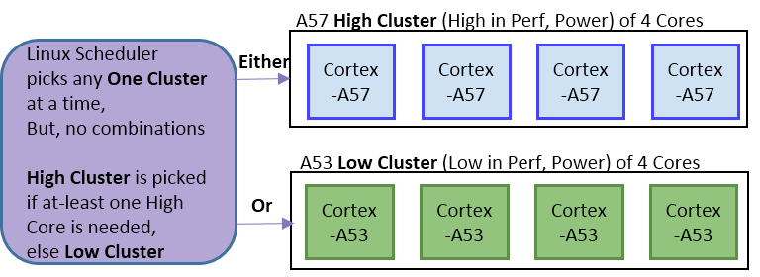
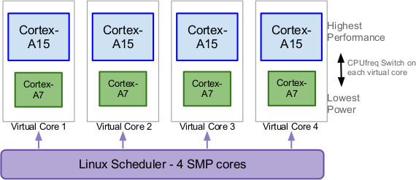
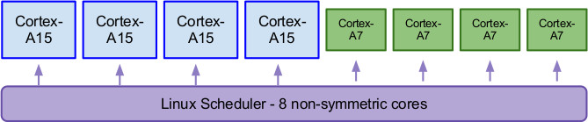
ARM’s big.LITTLE
Clustered Switching
In-Kernal Switcher
Heterogeneous multi-processing
(Jeff, Ten Things to Know About big.LITTLE, 2013), (Grey, big.LITTLE Software Update, 2013)

Slide 23
Near Threshold Voltage Processors (NTV)
Operate the on state of the transistor near the threshold voltage. Have to make use of the previously described parallelism technique.
NTV processors suffer a major performance hit for a significant (but not greater) energy savings.
Per-processor performance of NTV drops faster than the corresponding savings in energy-per-instruction (Say a 5x energy improvement for an 8x performance cost), the performance loss could be offset by using 8x more processors in parallel if the workload and the architecture allow it.
Assuming perfect parallelization, NTV could offer the throughput improvements while absorbing 40x the area – about eleven generations of dark silicon.

Slide 24
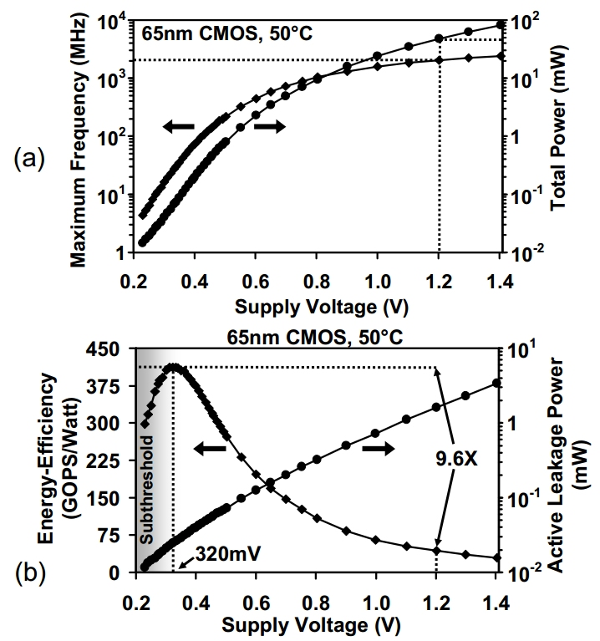
Near Threshold Voltage Processors (NTV)
(a) shows both the frequency and power output vs. the supply voltage as well as the total power vs supply voltage.
(b) clearly indicates that that for 65 nm CMOS technology, the near most optimized point to operate at for NTV is at 0.32 V.
(Kaul, Near-threshold voltage (NTV) design; Opportunities and challenges, 2012)

Slide 25
Hardware Specialization
Special-purpose cores (As opposed to only general-purpose processors)
This can be done since we are at a time where power is now more expensive than area.
These specialized cores can be used to fill in the silicon that previously was unused due to power requirements.
They can be upwards of 10-1000x more energy efficient than a general-purpose processor.
Ultimately leads to an increase in silicon usage as well as a lower overall power budget. These coprocessors are called “Coprocessor Dominated Architectures” or CoDAs.
(Taylor, A landscape of the new dark silicon design regime., 2013)

Slide 26
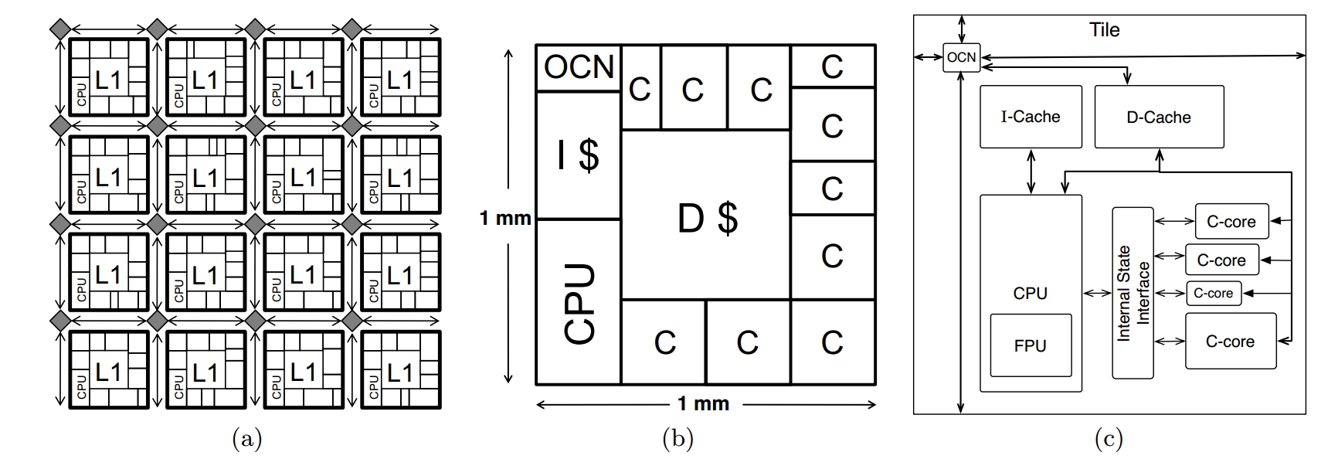
UCSD’s GreenDroid
Mobile application processor that implements Android mobile environment hotspots
Target both irregular and regular code are automatically generated from C or C source code.
They attain an estimated ~8 to 10x energy efficiency improvement
No loss in serial performance, even on nonparallel code
Without end user or programmer intervention
(Taylor, A landscape of the new dark silicon design regime., 2013)

Slide 27
Elastic Fidelity
Not all computations and data in a workload need to maintain 100% accuracy
Perfect computation is not always required to output acceptable results.
Human perception provide a lot of leeway for occasional errors since visual and auditory after-effects compensate for them.
Applications like networking already have built in error correction techniques as they assume unreliable components.
When requirements are less stringent, therein lies the ability to operate components at a significantly lower voltage, quadratically reducing the dynamic energy consumption.
(Hardavellas, The Rise and Fall of Dark Silicon, 2012)

Slide 28
Elastic Fidelity
Portions of the application that are error-sensitive execute at full reliability, while error-tolerant computations run on low-voltage units to produce an acceptable result.
Error-tolerant sections of the data are stored in low-power storage elements (low-voltage cache banks, low-refresh-rate DRAM banks etc..) which allow for occasional errors.
Overall, 13–50% energy savings can be obtained without noticeably degrading the output, while reaching the reliability targets required by each computational segment.
(Hardavellas, The Rise and Fall of Dark Silicon, 2012)

Slide 29
Deus Ex Machina
Unexpected breakthrough comes about when it seemingly feels like there are no other options left
FinFets, Trigate and High-K dielectrics
Still limited to the 60 mV/decade subthreshold slope
The next could be..
Tunnel Field Effect Transistors (TFETs) which have better subthreshold slopes of around 40 mV/decade at lower voltages
NEMS, which have essentially a near-zero subthreshold slope but slow switching times
Isn’t limited to a typical a FET device, but it could be a whole new way of computing, like quantum computing, which would bring unprecedented gains, and nullify any of our current work

Slide 30
Conclusion / Recap
Barring any major advancements, it’ll be up to the computer architecture engineers to find better ways to utilize the chip to its fullest potential.
In the past, we have been very fortunate to simply scale most of the design parameters accordingly without any serious adverse effects.
Because of the mobile space, and the fact that we have a separation from Moore’s Law and Dennard’s law, we can no longer simply scale things down and leave everything running at full speed.
It is through the combination of these different techniques that we will be able to push devices even further, bringing about new capabilities in the mobile field.

Slide 31
Where to go from here?
Due to the exponentially increasing amount of transistors we can use, why not try and make use of unreliable components to try and get a reliable solution?
This could be simply duplicating undervolted hardware (Unreliable) and running it to get say 80% accuracy out of each component and then comparing each output to then take the average solution.
The more duplicates you have, the higher the probability of computing the correct solution.
Spreads out heat dispersion and less of it since the hardware is undervolted.
Slight overhead with comparators (Not overvolted)

Slide 32
Questions?

Slide 33
References
Taur, Y. and T. H. Ning (2009). Fundamentals of Modern VLSI Devices, Cambridge University Press.
Hardavellas, N., The Rise and Fall of Dark Silicon. USENIX 37, 2, 2012.
Taylor, M.B. A landscape of the new dark silicon design regime. in Energy Efficient Electronic Systems (E3S), 2013 Third Berkeley Symposium on. 2013.
Esmaeilzadeh, H., et al., Power Limitations and Dark Silicon Challenge the Future of Multicore. ACM Trans. Comput. Syst., 2012. 30(3): p. 1-27.

Slide 34
References
Jeff, B. Ten Things to Know About big.LITTLE. 2013 2015-04-28]; Available from: http://community.arm.com/groups/processors/blog/2013/06/18/ten-things-to-know-about-biglittle.
Grey, G. big.LITTLE Software Update. 2013; Available from: https://www.linaro.org/blog/hardware-update/big-little-software-update/.
Kaul, H., et al. Near-threshold voltage (NTV) design &#x2014; Opportunities and challenges. in Design Automation Conference (DAC), 2012 49th ACM/EDAC/IEEE. 2012.

