Slide 1
Stability Analysis of CMOS BASED subthreshold sram CIRCUITS
NARAYAN AIYER VENKATESAN
Electrical Engineering

Slide 2
Step 1
Need for STO
Voltage scaling
Problems with ST design
Step 2
PHASE-1
Achieving sub threshold operation (STO)
Step 3
PHASE-2
Designing optimum Memory circuits for STO
Analysis of Results
Step 4

Slide 3
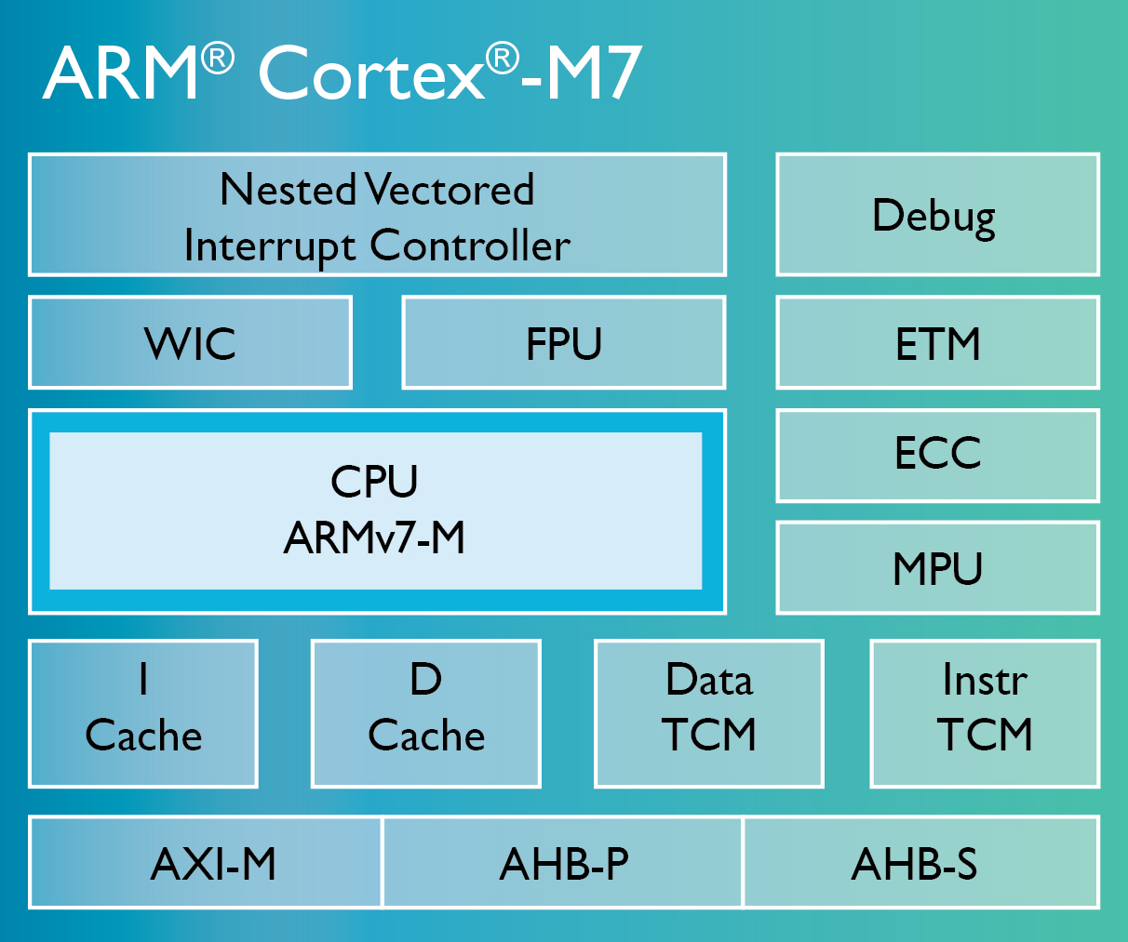
Need for subthreshold range of operation
SRAM- Very Important part of a MCU. Eg:- Some of the advanced Processors such as ARM Cortex M7 constitutes about 20-30% of the total transistor count (on average - depending on the technology used).
Thus contributing significant energy consumption to the overall operation.
Need ways to reduce this consumption as much as possible without compromising the stability of operation
Development in biomedical and Wireless sensor operation surged the need for Ultra low power circuits
ARM-Cortex M7

Slide 4
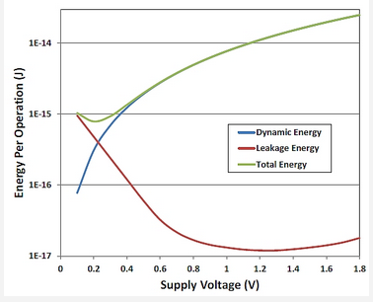
Voltage scaling – subthreshold operation
Voltage Scaling
High Transconductance gain leading to near idea transfer characteristics
Low input capacitance (made of oxide capacitance, depletion capacitance, overlap capacitance and fringing capacitances )
Total power reduces drastically. Mainly due to leakage power. Optimum operating point in ST region.
NEAR THRESHOLD OPERATION : 0.5V → 13x IMPROVEMENT IN DYNAMIC ENERGY
SUB THRESHOLD OPERATION : 0.3V → 36x IMPROVEMENT IN DYNAMIC ENERGY
Variation of Total energy (static and dynamic) with supply voltage scaling

Slide 5
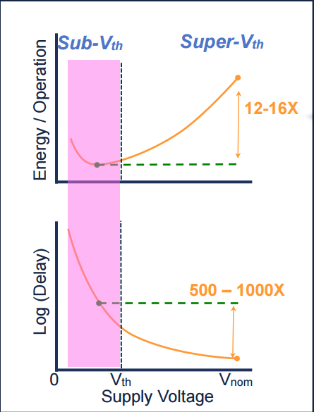
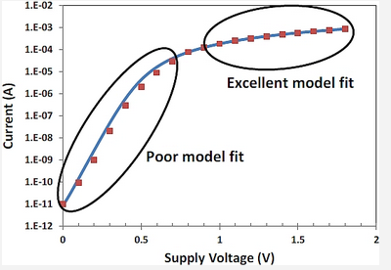
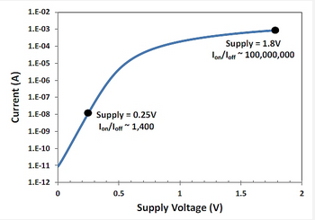
Problems with ST design
Statistical representation of usage of SRAM designs with Supply voltage scaling
Decrease of Ion/Ioff ratio with voltage scaling
Energy and delay as a function of supply voltage scaling
The output in ST circuits are very subtle. More sensitive designs needed. Much of our earlier SRAM models are for super Vth designs.
Ion/Ioff decreases exponentially in sub threshold. High susceptibility to noise. Essentially, both Ion and Ioff are leakage currents. Performance become increasingly untrustworthy.

Slide 6
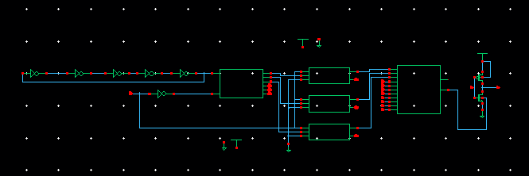
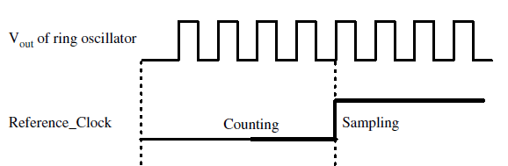
Phase 1 : achieving STO
MAIN COMPONENTS
Ring oscillator
3 bit counter
D flip flops for shifting
8:1 MUX using transmission gates
Varying reference _clock time period decides the sampling.
This decides the value till which the counter can reach
Sampling simultaneously achieves shifting the outputs to MUX

Slide 7
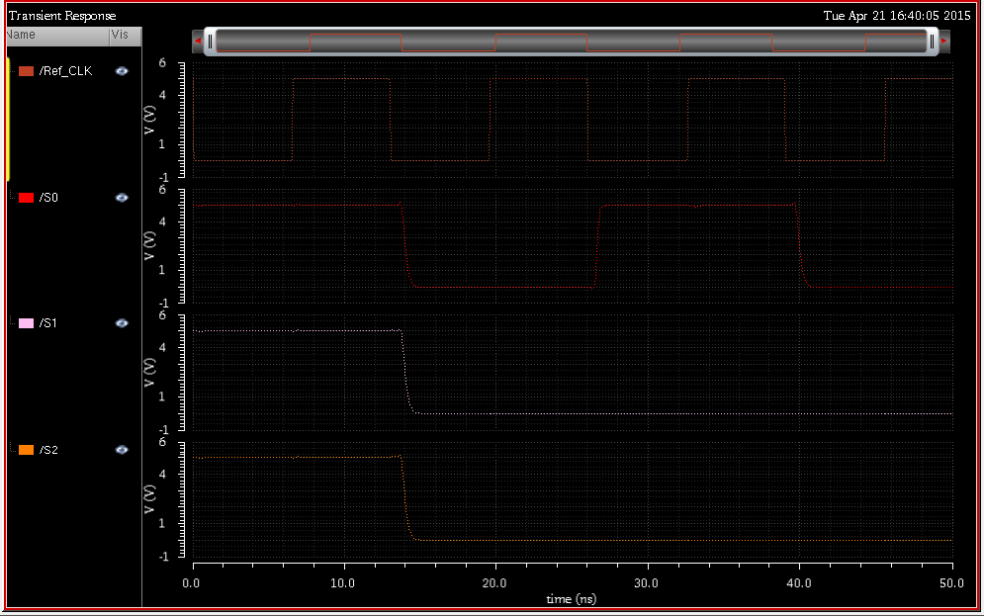
Frequency vs Biasing using above circuit
Incrementing Counter value for 13.5ns
Frequency(MHz) | Time Period (ns) | Vbias (V)
100 | 10 | 0.3
74.07 | 13.5 | 0.2
64.51 | 15.5 | 0.1
50 | 20 | 0

Slide 8
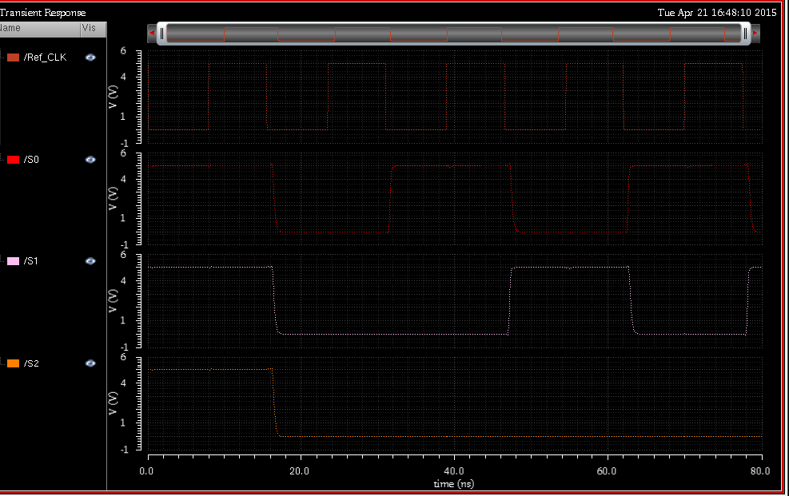
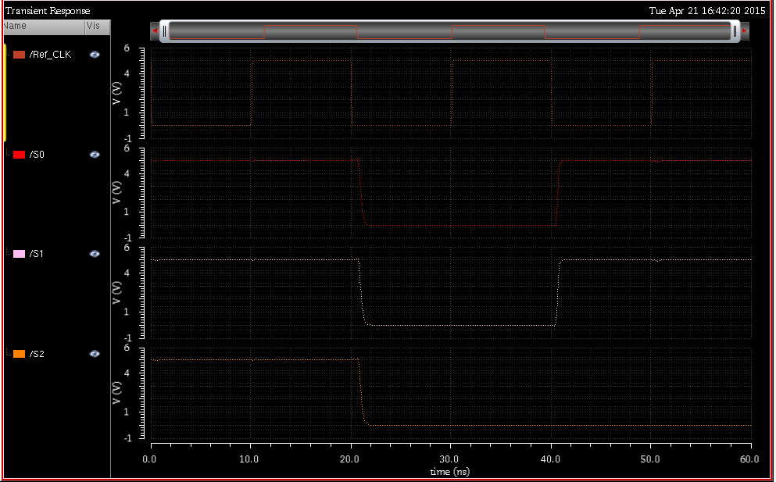
For
15.5ns
For
20ns

Slide 9
Phase 2: Analysis of ST-SRAM circuits
Compare the existing SRAM models with an Virtual Ground based PPN design.
The proposed design overcomes most of the design faults of the previous generation
Analysis is mainly based on N stability curves
Future works based on MonteCarlo Simulations for all the discussed models
Analysis of how Leakage power varies for these models

Slide 10
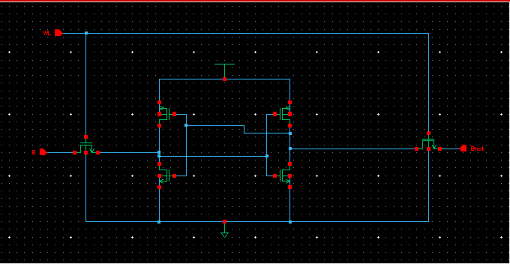
SIMPLE 6T SRAM
Cross coupled inverters- very stable circuit
Explicit sizing not necessary as channel length decreases to few tens of nm.
Write ability is fairly good.
Main problem comes during read operation.
Node that reads 0 may flip the value due to presence of leakage current.
Using same access transistors to read and write can severely damage cell reliability
Unwanted power consumption due to either of the inverters being always ON.

Slide 11
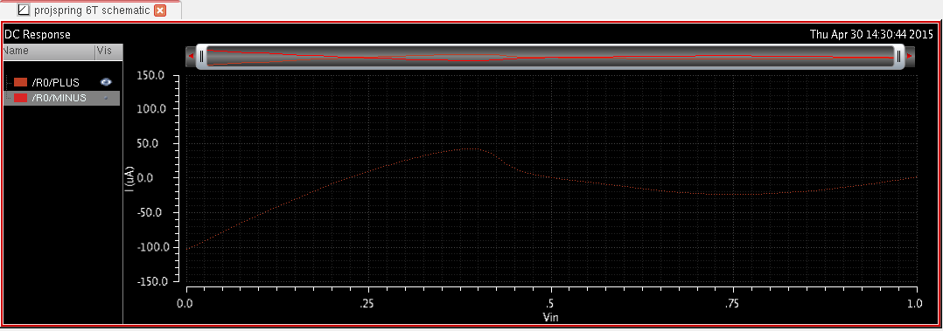
Stability calculations as per supply variation
Vdd (V) | Va (mV) | Vb(mV) | SVNM (mV) | SINM
1 | 223.6294 | 503.8864 | 280.257 | 42.2836u
0.5 | 74.34522 | 252.5551 | 178.2098 | 16.1294u
0.3 | 34.49116 | 154.9077 | 120.41764 | 1.219u
0.2 | 27.65984 | 103.66219 | 76.00235 | 96.00726n
0.1 | 36.66052 | 54.22165 | 17.56113 | 553.1p

Slide 12
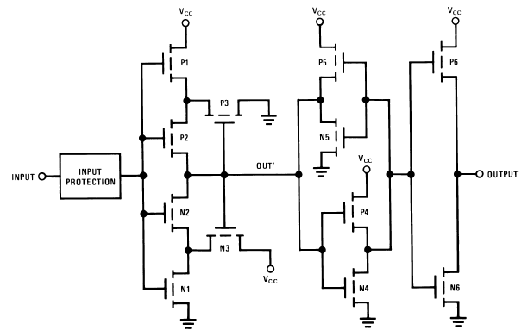
Schmitt trigger based SRAM design
Mainly used to modulate the switching threshold of an inverter depending on the direction of the input Transition.
During 0 to 1 input transition, the feedback transistor tries to preserve the logic 1 at output node by raising the source voltage of pull-down nMOS.
Since a read-failure is initiated by a input transition for the inverter storing logic 1, higher switching threshold with sharp transfer characteristics of the Schmitt trigger gives robust read operation
This is a great improvement in comparison to regular 6T SRAM.
No feedback mechanism present in the SRAM circuits. This results in smooth transfer characteristics that are essential for easy write operation.

Slide 13
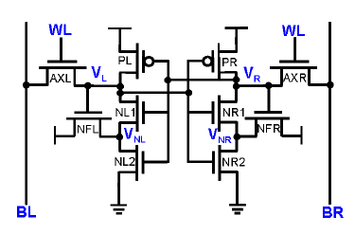
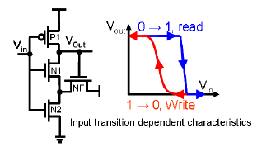
Schmitt trigger based SRAM design
Working essentially same as Schmitt trigger discussed above.
No upper feedback path to have a smooth write operation
During read operation, (if Vl stores 0 and Vr stores 1), if WL becomes 1, the node Vl has to be raised till the switching threshold to cause switching
Meanwhile, Vr is near Vdd because of AXR.This raises the switching needed to flip NR1. Thus a strongly latched Vr does not allow Vl to raise because of this method.

Slide 14
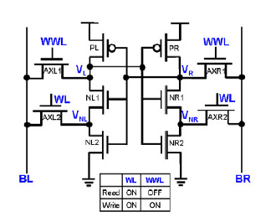
Schmitt trigger based SRAM design
Method of operation very similar to ST-1 circuit.
2 word lines, WL is always on taking care of feedback. WWL is ON during writing.
This circuit provides feedback without any chance of altering the stored data.
Writing happens though WWL and reading through WL
When AXL1 and AXR1 is OFF, the voltage dropped across NL1 and NR1 is taken as the data values.
Provides partition between read and write paths thus avoiding any chance of over writing.

Slide 15
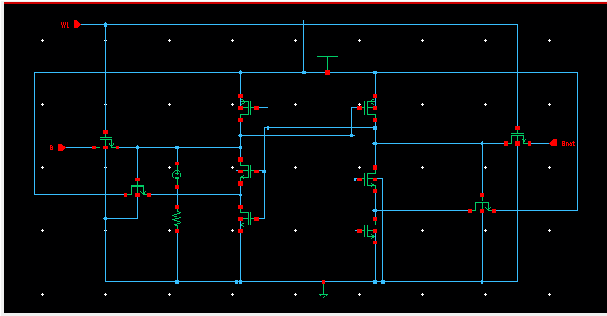
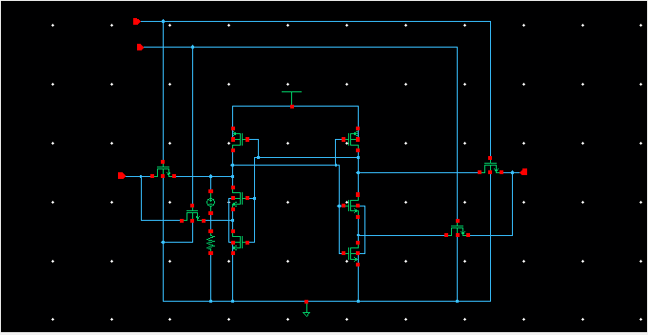
Schmitt trigger based SRAM design

Slide 16
Stability calculations as per supply variation
Vdd (V) | Va (mV) | Vb(mV) | SVNM (mV) | SINM
1 | 316.3518 | 652.0552 | 335.7034 | 50.616u
0.5 | 105.4035 | 326.2587 | 220.8552 | 10.3307u
0.3 | 52.2182 | 205.4168 | 153.1986 | 803.94n
0.2 | 42.3537 | 131.3378 | 88.9841 | 74.8153n
0.1 | 51.0065 | 80.09247 | 29.08597 | 836.6p

Slide 17
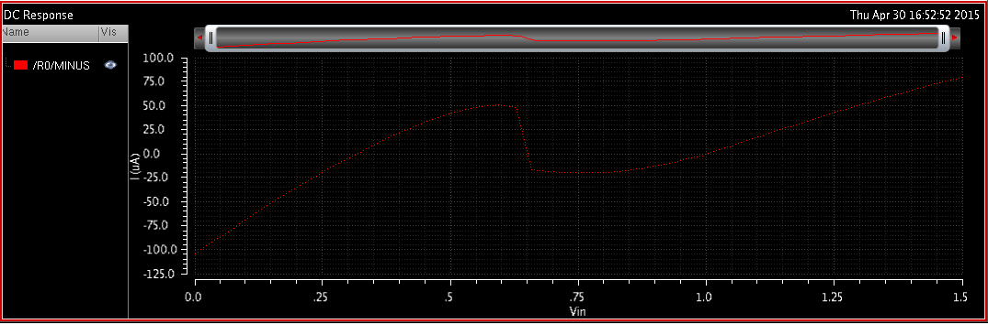
N curve for Schmitt trigger based STSRAM

Slide 18
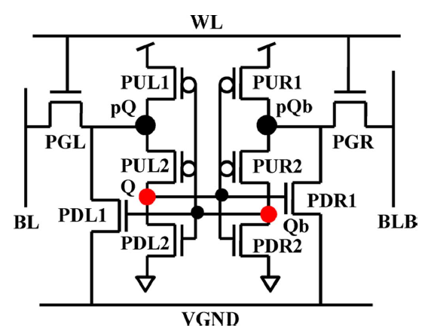
Virtual ground based PPN ST-SRAM Design
Schmitt trigger based designs solve most of the read stability issues encountered in normal 6T SRAM.
One inherent problem with the feedback mechanism is “transient voltage glitch”.
Occasional but costly in terms of stability
That is the node storing 0 when being read can at times flip to 1 if any transistors in the feedback path do not switch ON.
This design handles the above issue.
2 PPN inverters. PQ and PQb are pseudo storage nodes whereas data is actually stored in Q and Qb
Separate discharge path for Pq and PQb with an access transistor and a NMOS.
VGND is connected to GND only during read.
Any transient glitch in the storage node is reflected in the pseudo storage nodes that discharge.
This reflects in the storage nodes as well.

Slide 19
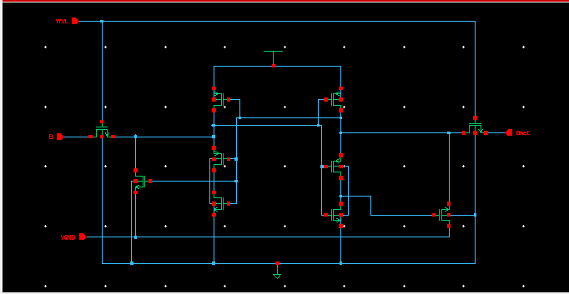
Virtual ground based PPN ST-SRAM design

Slide 20
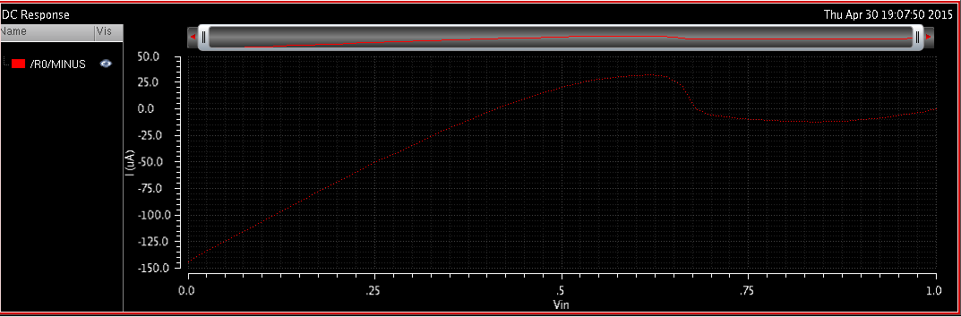
Stability calculations as per supply variation
Vdd (V) | Va (mV) | Vb(mV) | SVNM (mV) | SINM
1 | 223.161 | 677.2279 | 454.0669 | 34.29u
0.5 | 75.4197 | 337.6704 | 262.2507 | 6.2293u
0.3 | 35.5449 | 199.3686 | 163.8237 | 493.94n
0.2 | 27.1857 | 134.3991 | 107.2134 | 51.145n
0.1 | 29.5832 | 69.4812 | 39.898 | 1.33015n

Slide 21
Analysis of results obtained

Slide 22
Future work
Monte Carlo Simulations for all the ST SRAM types to understand how the Ion/Ioff ratio varies in each design
Performing Leakage calculations for all STSRAM designs and finding the optimum design based on leakage power
THANK YOU

Slide 23
references
Benton H.Calhoun, “Low energy Digital circuit Design Using Sub-threshold Operation”, Massachusetts Institute of Technology, 2005
Jabulani Nyathi, Brent Bero and Ryan McKinlay, "A Tunable Body
Biasing Scheme for Ultra-Low Power and High Speed CMOS Designs"
in International Symposium on Low Power Electronics and Design -
2006. October 4-6,2006
Ashok Srivatsava and Chuang Zhang, "An Adaptive Body-Bias Generator for Low Voltage CMOS VLSI Circuits",International Journal of Distributed Sensor Networks, 4: 213–222, 2008
Neeta Pande,Rishi Pandel, Tanvi Mitta, Kirti Gupta, "Rajeshwari Pandey, Ring and Coupled Ring Oscillator in Subthreshold Region",Signal Propagation and Computer Technology (ICSPCT), 2014 International Conference, July 2014
Roy, K.,Kulkarni, J.P., Circuit Res. Lab., Intel Corp., Hillsboro, OR, USA, "Ultralow-Voltage Process-Variation-Tolerant Schmitt-Trigger-Based SRAM Design" Very Large Scale Integration (VLSI) Systems, IEEE Transactions on (Volume:20 , Issue: 2 ), 2012
J. P. Kulkarni, K. Kim and K. Roy, “A 160mV Robust
Schmitt Trigger based Subthreshold SRAM” IEEE Journal
of Solid State Circuits, vol. 42, no. 10, pp. 2303-2313,October 2007
J. P. Kulkarni, K. Kim and K. Roy, “Process Variation Tolerant SRAM Array for Ultra Low Voltage Applications” Design Automation Conference, 2008. DAC 2008. 45th ACM/IEEE, October 2008
Cheng-Hung Lo, Shi-Yu Huang "P-P-N Based 10T SRAM Cell for Low-Leakage and Resilient Subthreshold Operation",IEEE JOURNAL OF SOLID-STATE CIRCUITS, VOL. 46, NO. 3, MARCH 2011
Evelyn Grossar, Michele Stucchi, Karen Maex, Wim Dehaene, "Read Stability and Write-Ability Analysis of SRAM Cells for Nanometer Technologies"IEEE JOURNAL OF SOLID-STATE CIRCUITS, VOL. 41, NO. 11, NOVEMBER 2006

