Slide 1
Exploiting Sequence Number Leakage: TCP Hijacking in NAT-Enabled Wi-Fi Networks - Yuxiang Yang, Xuewei Feng, Qi Li, Kun Sun, Ziqiang Wang, Ke Xu
CSE707 SEM – WiFi Network Security
by Jack Dunfey and Josh Wajnryb

Slide 2
Background
Threat Model
Attack Procedure
Countermeasures
Attack Overview
Why does the attack work?
Step-by-step of attack
Consequences (Paper results)
Countermeasures

Slide 3
SLIDES THAT NEED WORK
9, 10 - NAT
13, 14 – Attack Overview
16, 17, 18 – How it’s possible
19+ – How effective?
21+ - Consequences?

Slide 4
Abstract​
In this paper, we uncover a new side-channel vulnerability in the widely used NAT port preservation strategy and an insufficient reverse path validation strategy of Wi-Fi routers, which allows an off-path attacker to infer if there is one victim client in the same network communicating with another host on the Internet using TCP. After detecting the presence of TCP connections between the victim client and the server, the attacker can evict the original NAT mapping and reconstruct a new mapping at the router by sending fake TCP packets due to the routers' vulnerability of disabling TCP window tracking strategy, which has been faithfully implemented in most of the routers for years. In this way, the attacker can intercept TCP packets from the server and obtain the current sequence and acknowledgment numbers, which in turn allows the attacker to forcibly close the connection, poison the traffic in plain text, or reroute the server's incoming packets to the attacker.

Slide 5
Abstract
A new side-channel vulnerability is uncovered using the NAT port preservation strategy and an insufficient reverse path validation strategy of Wi-Fi routers
This allows an off-path attacker to infer if there is a victim client on the same network communicating with another host (server) on the Internet using TCP (Transmission Control Protocol)
After detecting TCP connections, the attacker can modify existing NAT mapping values and reconstruct a new mapping at the router by sending fake TCP packets due to the routers' vulnearbility of disabled TCP window tracking
The attacker can intercept TCP packets from the server and obtain the current sequence and acknowledgment numbers, which in turn allows the attacker to forcibly close the connection, poison the traffic in plain text, or reroute the server's incoming packets to the attacker.

Slide 6
Steps to Understanding
Review of Background Information and Terminology
Brief Attack Overview
Step-by-Step Attack
Impact of Attack
Consequences
How to protect your network

Slide 7

Background Information and Terminology

Slide 8
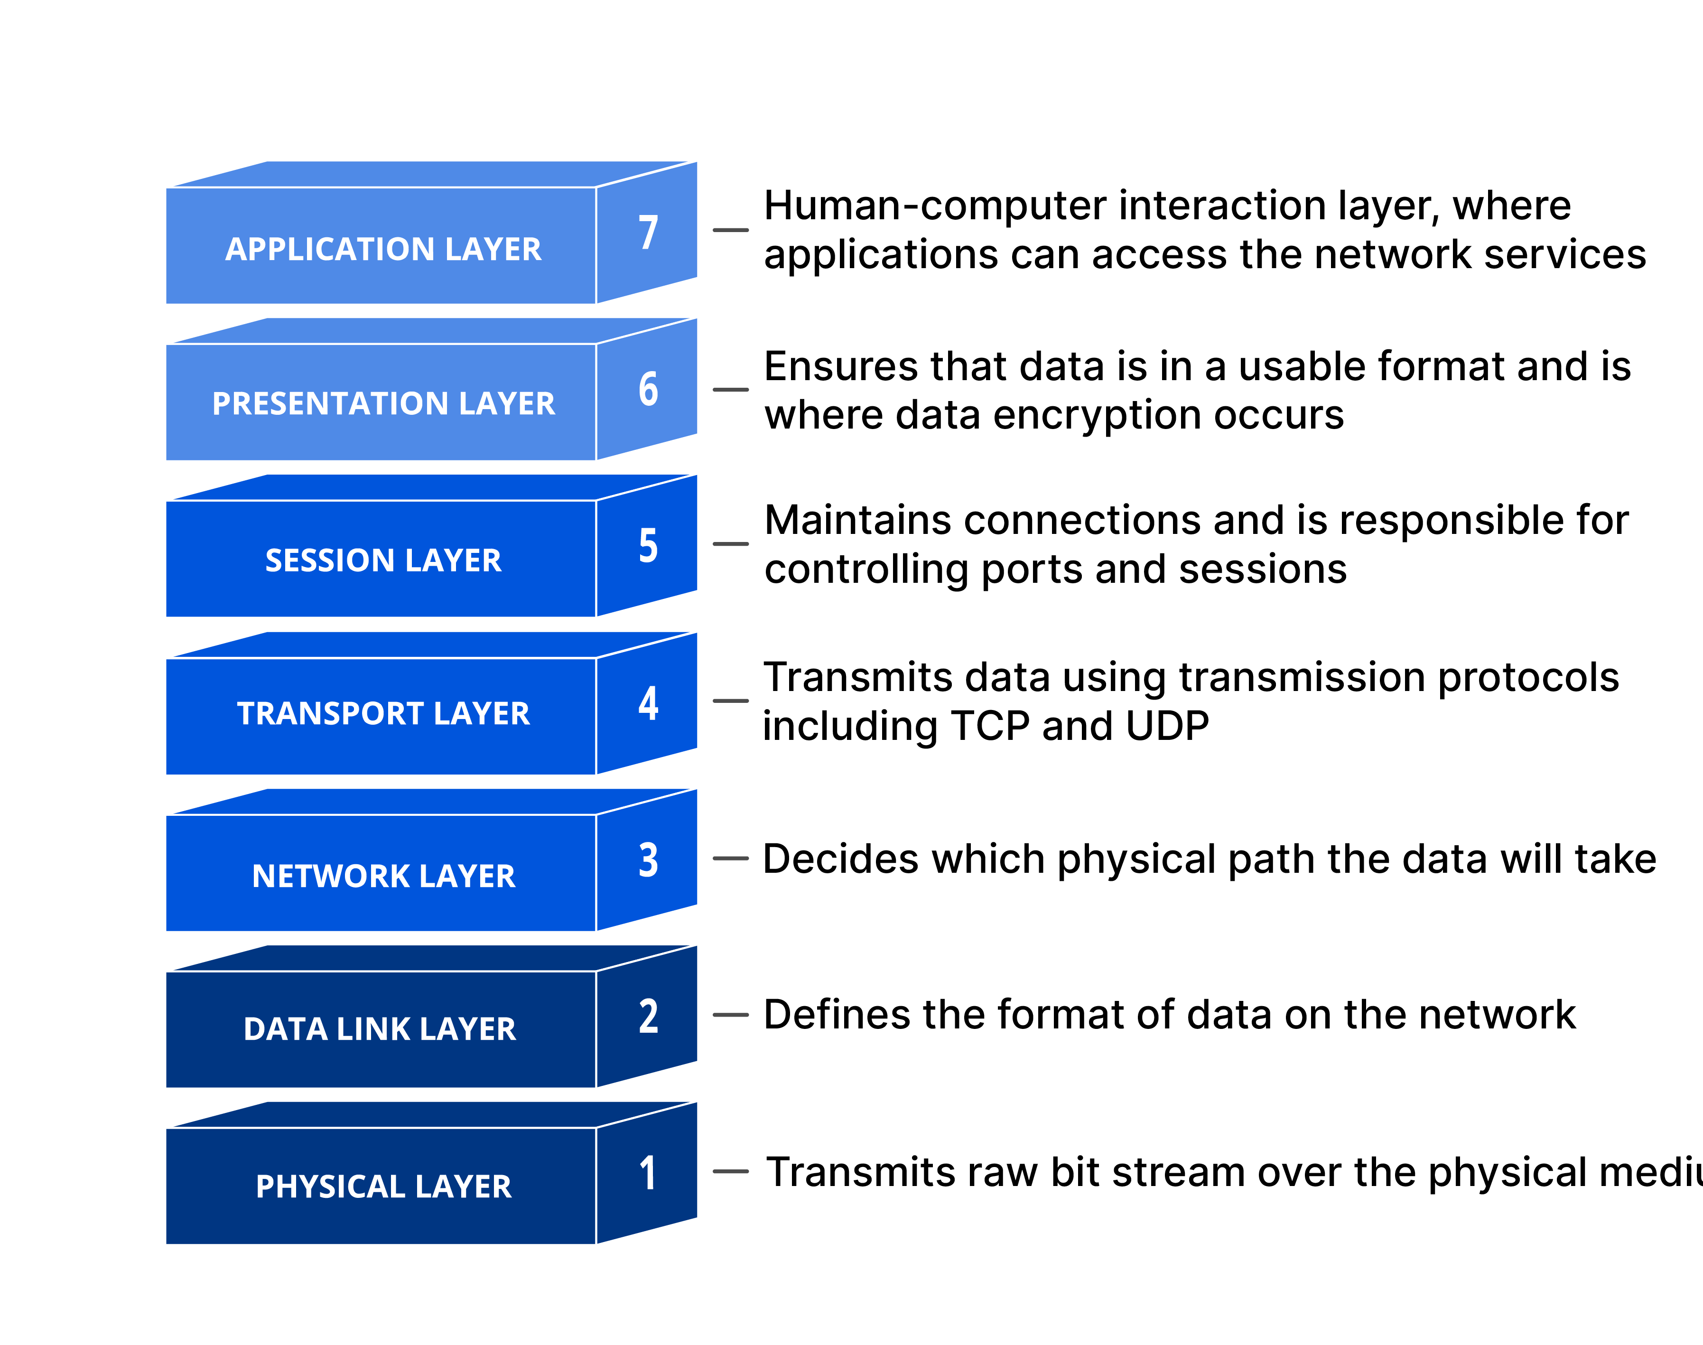
OSI Model
Communication is constructed in a top-down manner
7) A local application wants to access a URL and an HTTP request is generated
6) It is encrypted (to HTTPS) in the presentation layer
5) This layer will be responsible for negotiation the TLS/SSL connection for HTTPS
4) This is where TCP is used to store information about the source port and destination port
Cloudflare. (2024). What is the OSI Model? Retrieved from https://www.cloudflare.com/learning/ddos/glossary/open-systems-interconnection-model-osi/.

Slide 9
OSI Model Cont…
7) HTTP Request
6) HTTP ⇨ HTTPS
5) TLS/SSL negotiation
4) TCP
3) This is where an IP pack is generated which stores the source and destination address, packet length, and some metadata about the packet
2) This is where a frame is generated to send data over ethernet or Wi-Fi
1) This is when the actual bits travel across wires/radio waves
Cloudflare. (2024). What is the OSI Model? Retrieved from https://www.cloudflare.com/learning/ddos/glossary/open-systems-interconnection-model-osi/.

Slide 10
OSI Model Summary
7) HTTP Request
6) HTTP ⇨ HTTPS
5) TLS/SSL negotiation
4) TCP
3) IP
2) Dataframe (ehternet or Wi-Fi)
1) Bit transmission
This attack focuses on layer 4*
Cloudflare. (2024). What is the OSI Model? Retrieved from https://www.cloudflare.com/learning/ddos/glossary/open-systems-interconnection-model-osi/.

Slide 11
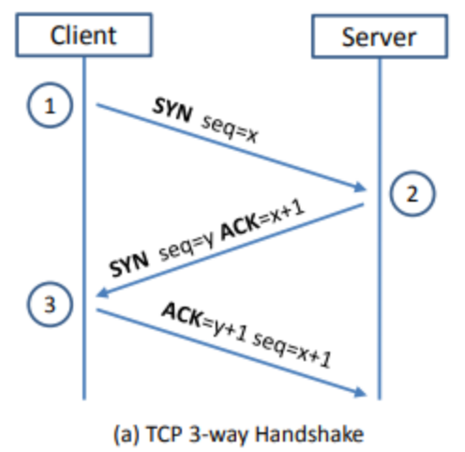
What is TCP?
TCP stands for Transmission Control Protocol outlined in RFC 9293
It’s goal is data reliability. As each packet is sent, the client and server acknowledge receiving the previous packet before continuing transmission, otherwise the data is retransmitted to attempt a resynchronization.

Slide 12
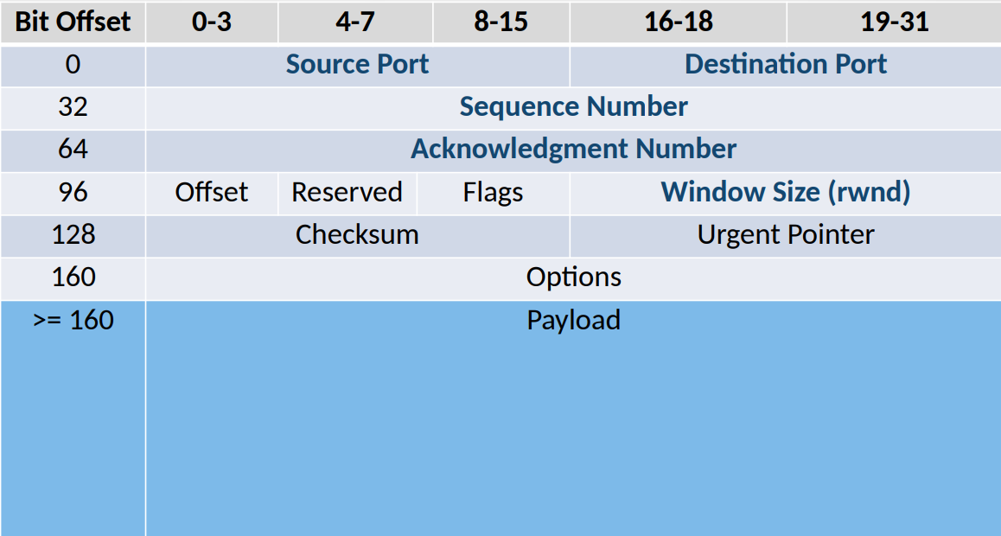
TCP
Packet
Info

Slide 13
What is NAT?
NAT is Network Address Translation
This is what enables one household (or small business) to only own and maintain a single public IP address and still allow many devices to access the internet. This also contributes to reducing address pollution (there is a finite number of IP addresses).
Everyone on the network will have the same public IP address.
It is the job of the router to maintain these mappings.

Slide 14
What is NAT? Cont…
To make this easier, many routers preserve the information for layers 4 (the Transport Layer) and up
This is what leads to many routers using port preservation

Slide 15
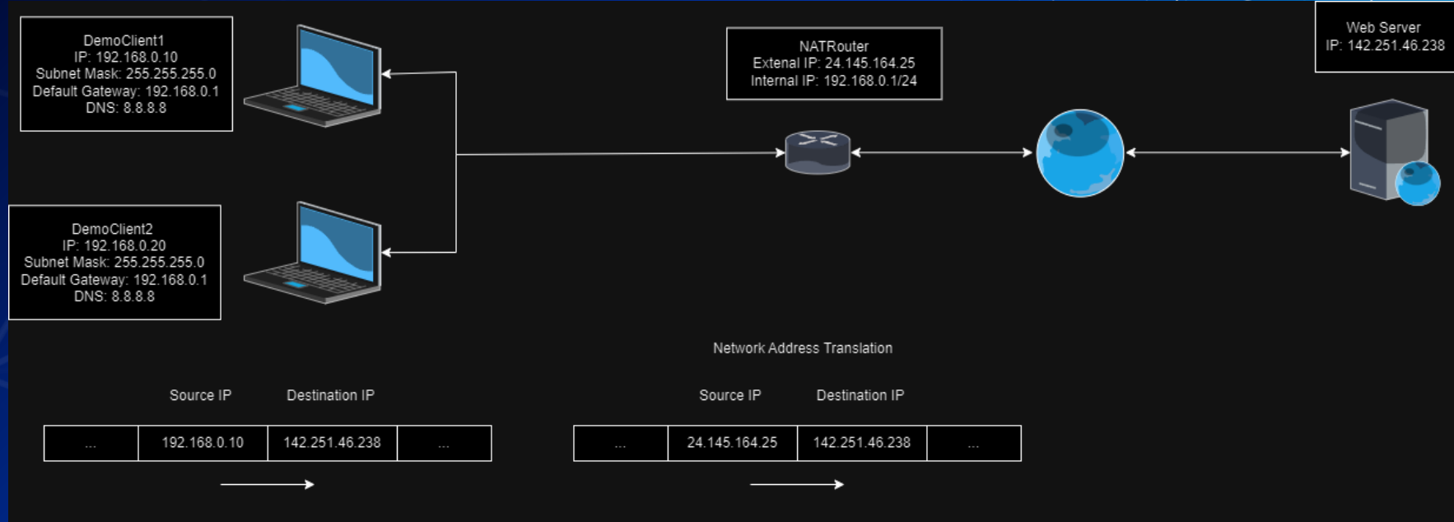
NAT Example Translation
UBNetDef. (2024, February). Networking. https://ubnetdef.org/slides/spring2024/Networking.pdf

Slide 16
On-path vs Off-path attackers
On-path attacks (aka. Man-In-the-Middle attacks)
Rely on the attacker controlling some machine along the communication path between two nodes.
For example, a router between the client and server.
Off-path (no control over the router)
Off-path attackers are those who cannot directly intercept or alter communication between two parties; however, through a variety of means they can still influence or monitor communication indirectly.

Slide 17
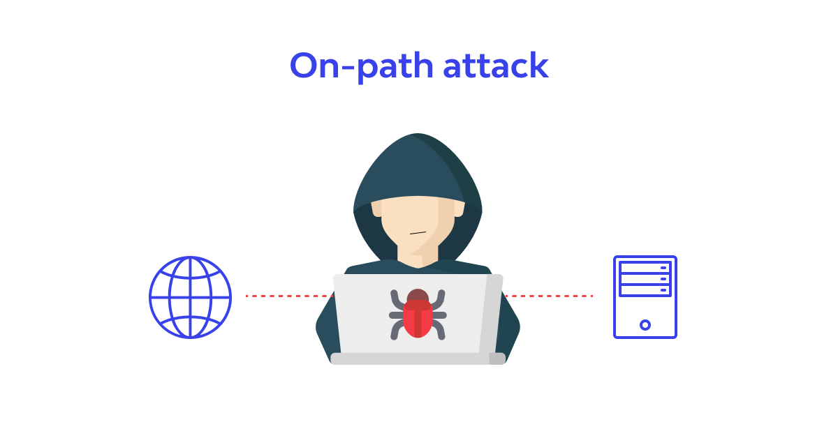
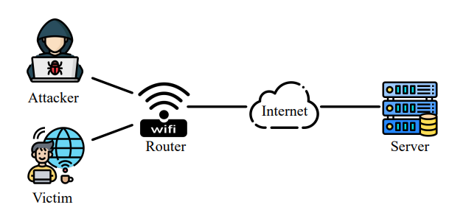
On-path vs Off-path attackers

Slide 18
The Attack

Slide 19
Attack Overview
Probe the router's external IP address and identify whether AP isolation is enabled, thus finding potential victim clients.
Make inferences about whether there is any active connection from the LAN to the server.
Evict and construct NAT mappings at the router and then intercept the sequence and acknowledgement numbers from the replies to unsolicited packets from the server.

Slide 20
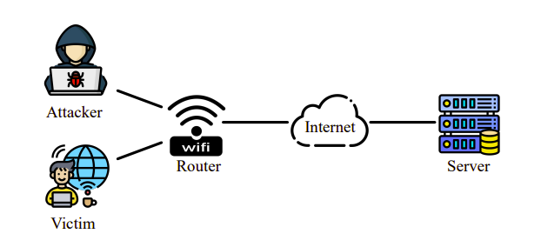
Threat Model of the Off-Path Attacker

Slide 21
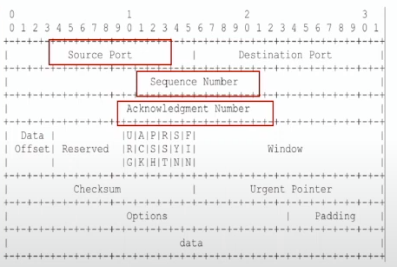
What Does The Attacker Want?
Source Port Number
  Identifies the process that sent the data.
SEQ Number
  Enumerates the packets being sent by a given entity across the network.
ACK Number
  The sequence number of the most recently received packet.

Slide 22
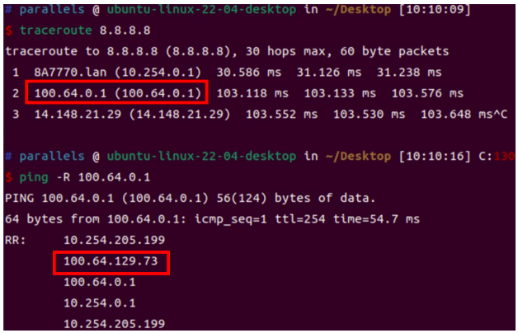
Phase 1: Probing the Network
Identify the status of Access Point (AP) isolation in the network
  Nmap, MacStealer
Probing the external IP address of the router
  TraceRoute and Ping with RECORD_ROUTE (-r) option
  Scan and access IPs via web browsers

Slide 23
Phase 2: Making Inferences about Active Connections
The attacker sends a SYN packet targeting the server with its own IP address and a guessed port number as the source.
If the source port number (e.g., n) specified in the SYN packet does not equal m, the router will create a new NAT mapping with source port n that records this new TCP connection.
The attacker impersonates the server with a forged SYN/ACK packet whose destination port is the guessed source port
Process is repeated until a source port is correctly identified

Slide 24
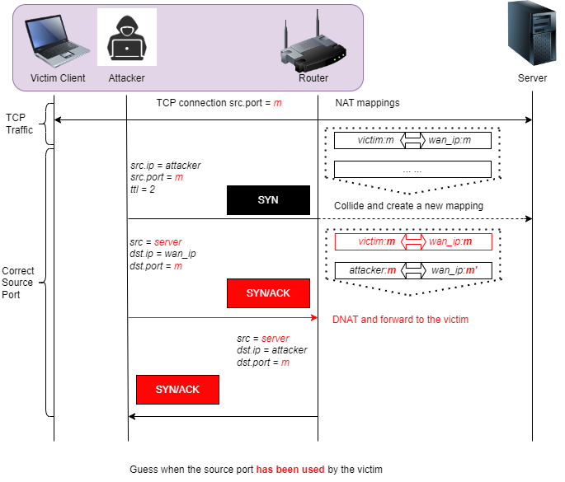

Slide 25
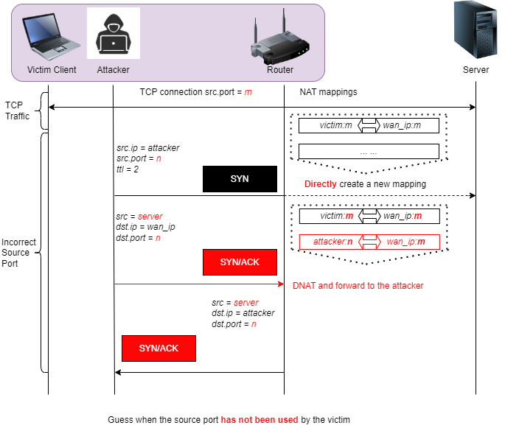

Slide 26
Phase 3: Hijacking Active Connections
Once the attacker has determined an active TCP connection to a given remote server with the source port m, it will attempt to obtain the current sequence number SEQ and the acknowledgment number ACK of the server.
TCP RST – terminates a connection between two devices to stop receiving data
PUSH/ACK - tells the client to push bytes to the application layer

Slide 27
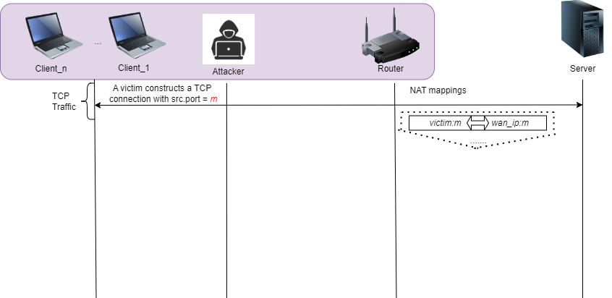

Slide 28
Phase 3.1: What now?
Firstly, the attacker cleans the router’s NAT mapping of the victim connection by sending spoofed TCP RST packets whose source is the server and destination IP is the router’s external IP, and destination port is the previously inferred port m.
As most routers in the experiment disabled TCP window tracking, the SEQ numbers can be specified randomly.

Slide 29
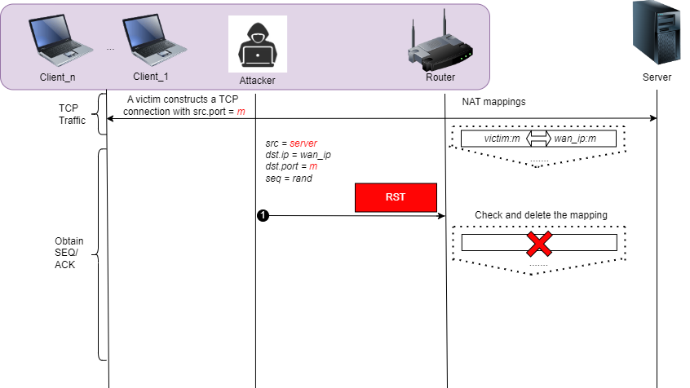

Slide 30
Phase 3.2: Where is the data being sent?
The attacker can now send a data packet with the source IP of itself with an arbitrary SEQ number.
Since there is no mapping anymore, the router will create a new mapping for the attacker
After the translation of the router, the packets sent by the victim and the attacker will look exactly the same!
The attacker has everything to finish the exploit!
  SEQ Numbers
  ACK Numbers

Slide 31
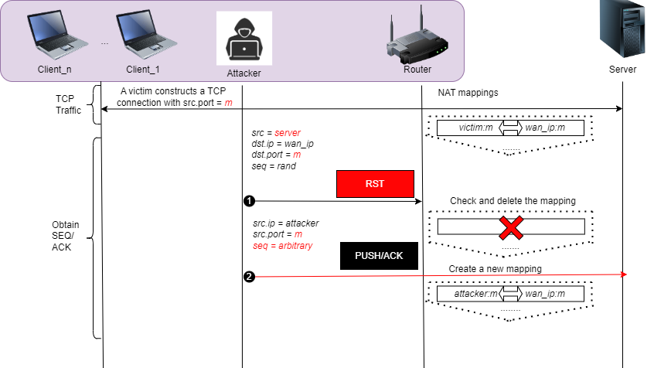

Slide 32


Slide 33
Phase 3.3: Success!
Now, the attacker can send malicious data to the server and terminate connections at will
However, if the attacker wants to inject malicious data to the client, the NAT mapping must be cleared once more and restore the original mapping of the victim client
This can be done by sending more ACK packets to the clients and then drop the connections

Slide 34
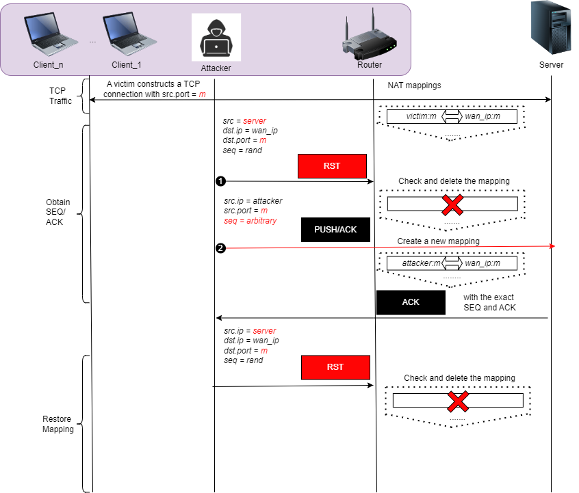

Slide 35
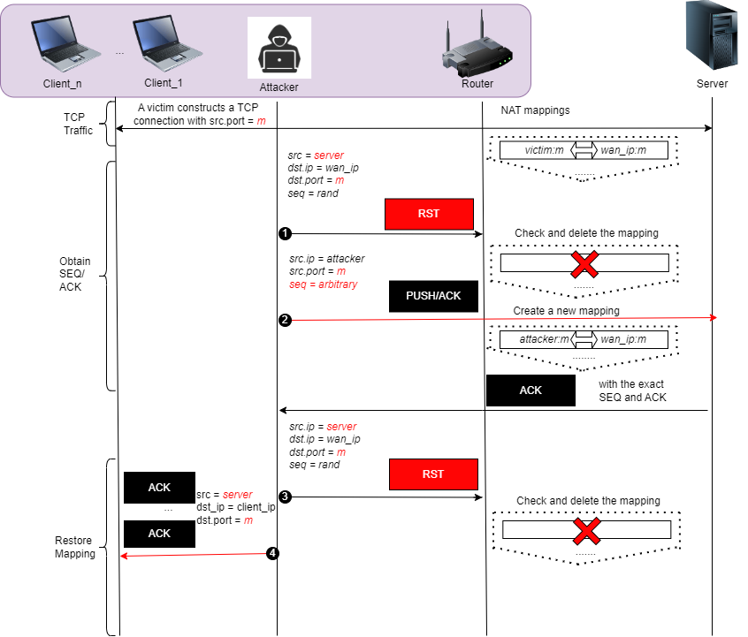

Slide 36
Phase 3.4: Now attack the Client.
The victim client will then respond with an ACK packet to the server and the NAT mapping from the router will be restored.
NOW the attacker can send forced responses to the routers external IP address.
The NAT mapping will make sure the packet will be forwarded to the client.
Attacker can now poison the victim clients.

Slide 37
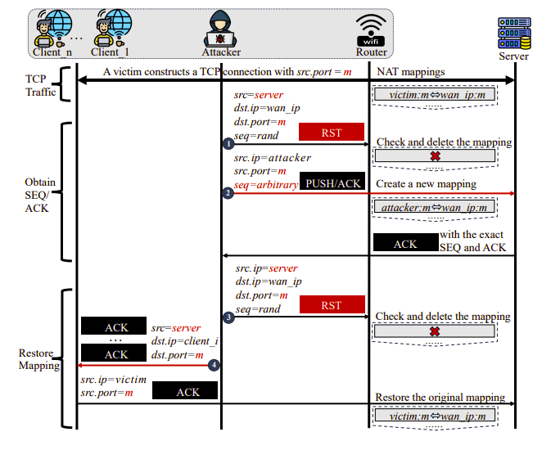

Slide 38
So, What Now?
After the above two steps, the attacker can decide on the follow-up procedures according to the purpose of the attack.
The following attacks come in the form of:
TCP Denial-of-Service (DoS) Attack (SYN Flood)
TCP Hijacking Attack
TCP Injection Attack

Slide 39
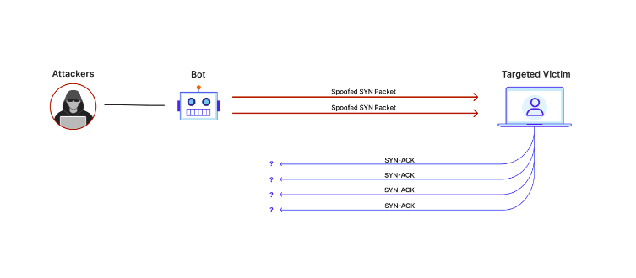
TCP DoS Attack (SYN Flood)
Terminate victim TCP connections directly by sending RST packets.

Slide 40
TCP Hijacking Attack
Take over the NAT mapping and replace the victim by itself since the router will continue to forward packets (intended for the victim client) to the attacker instead.
  Think about Man-In-The-Middle (MITM) attacks
    However, this is off-path
The attacker will pretend to be the server and tell the client to RST the connection, then the attacker will attempt to reestablish the original connection with the server in place of the victim by matching its source port with that of the victim

Slide 41
TCP Injection Attack
Poison the victim TCP traffic by sending crafted data packets after restoring the mapping for the victim client via issuing spoofed TCP RST and ACK packets.
  Can also be referred to a Man-On-The-Side (MOTS) attack
    the attacker only has regular access to the communication channel, which allows him to read the traffic and insert new messages, but not to modify or delete messages sent by other participants [2].

Slide 42
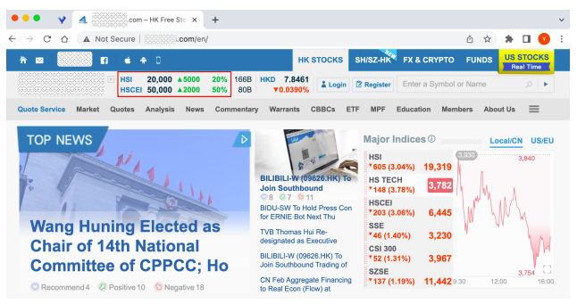
Example of Web Poisoning via TCP Injection Attack

Slide 43
Vulnerabilities Exploited

Slide 44
Why does this work?
Three key security failures, all present in one system, will allow for this exploit:
NAT port preservation
Disabled reverse-path validation
TCP window tracking disabled

Slide 45
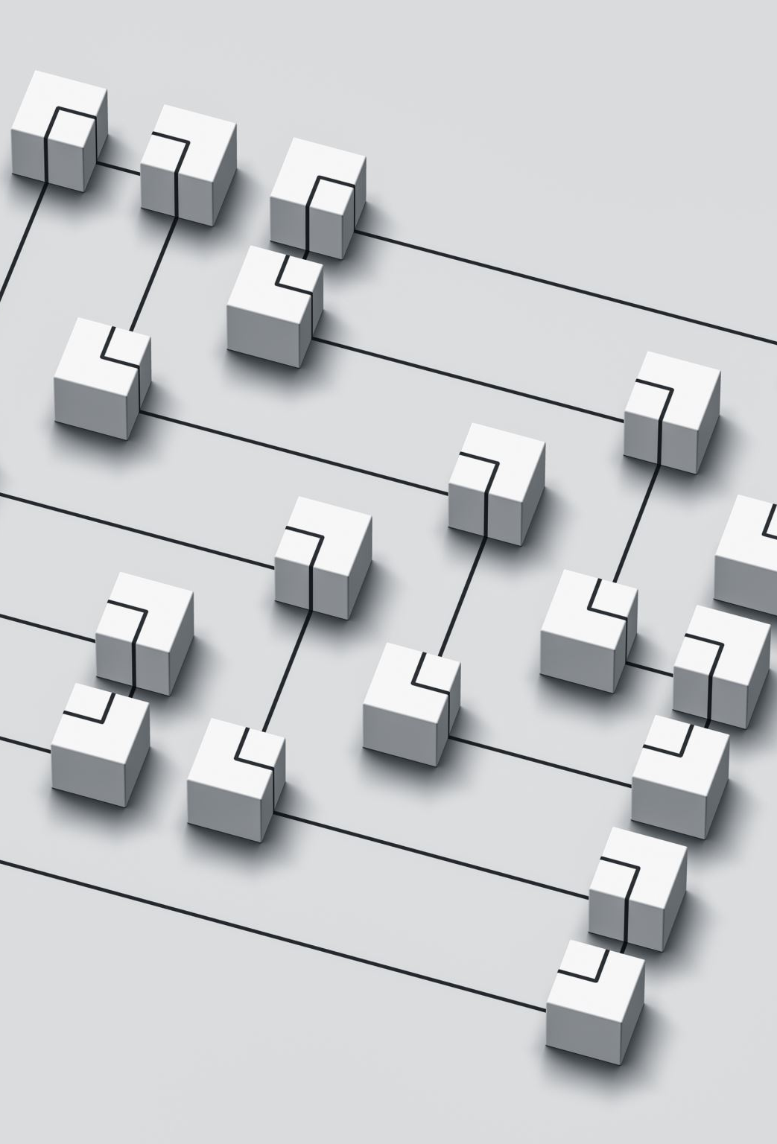
1. NAT Port Preservation
Port preservation describes the practice of many routers to keep the source port of packets rather than switching them
Example:
10.0.2.15:14532 → 128.205.36.18:80 (public IP, direct connection)
10.0.2.15:14532 → (router NAT) 69.12.22.78:14532 → 128.205.36.18:80 [port preserved]
10.0.2.15:14532 → (router NAT) 69.12.22.78:35468 → 128.205.36.18:80 [random port allocation]

Slide 46
2. Disabled reverse-path validation
As of RFC 2827 (May 2000), routers should enable reverse path validation with strict mode
This enables to router to detect IP-spoofing based attacks, in turn detecting the forged SYN/ACK packet and dropping it
Most of the routers tested did not follow this recommendation

Slide 47

What is reverse-path validation
Reverse path validation, also known as reverse path forwarding (RPF), is a security feature that protects networks from IP spoofing and some types of denial-of-service (DoS) and distributed denial-of-service (DDoS) attacks:
RPF verifies that packets are arriving from a legitimate path by comparing the source address of each packet to the forwarding-table entry for its source address.

Slide 48
3. Disabled TCP Window Tracking
In order to improve performance, some sessions don’t SYN/ACK after every packet and instead establish an amount of data that can be transmitted before an ACK is needed.
Therefore, routers will not track the TCP window of the connection and will not check the sequence and acknowledgement numbers of TCP packets strictly.
This is due to the TCP protocol being originally designed for end-to-end communication and does not take the middle devices in consideration.

Slide 49
Time to Attack (for Various Connection Types)
Attack | Time (s) | Success Rate (%)
Terminate SSH Connection | 17.5 | 87.4
Download private FTP files | 19.4 | 82.6
Inject fake HTTP response packets | 54.5 | 76.1

Slide 50
What is reverse-path validation
Reverse path validation, also known as reverse path forwarding (RPF), is a security feature that protects networks from IP spoofing and some types of denial-of-service (DoS) and distributed denial-of-service (DDoS) attacks:
RPF verifies that packets are arriving from a legitimate path by comparing the source address of each packet to the forwarding-table entry for its source address.

Slide 51
Impact and Effectiveness

Slide 52
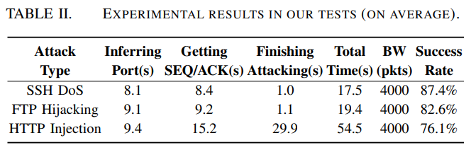
Is the attack effective?
93 networks tested
81% fully vulnerable

Slide 53
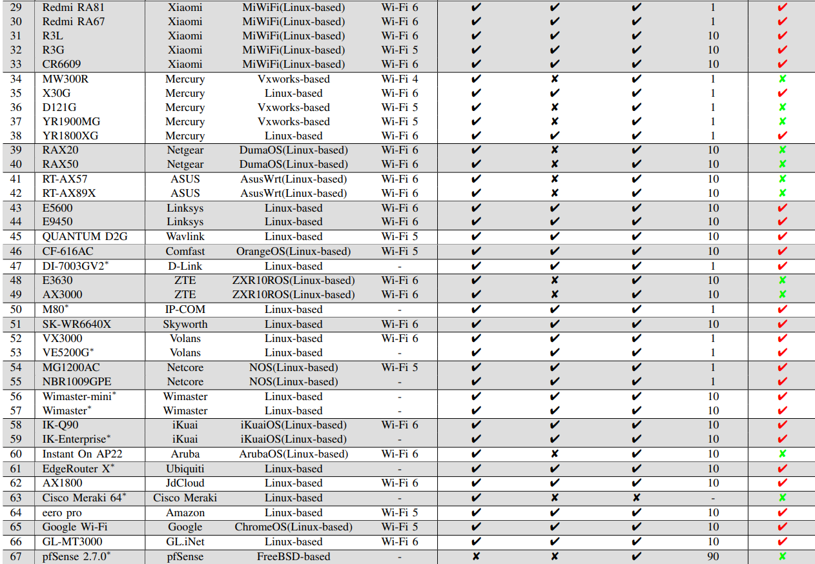
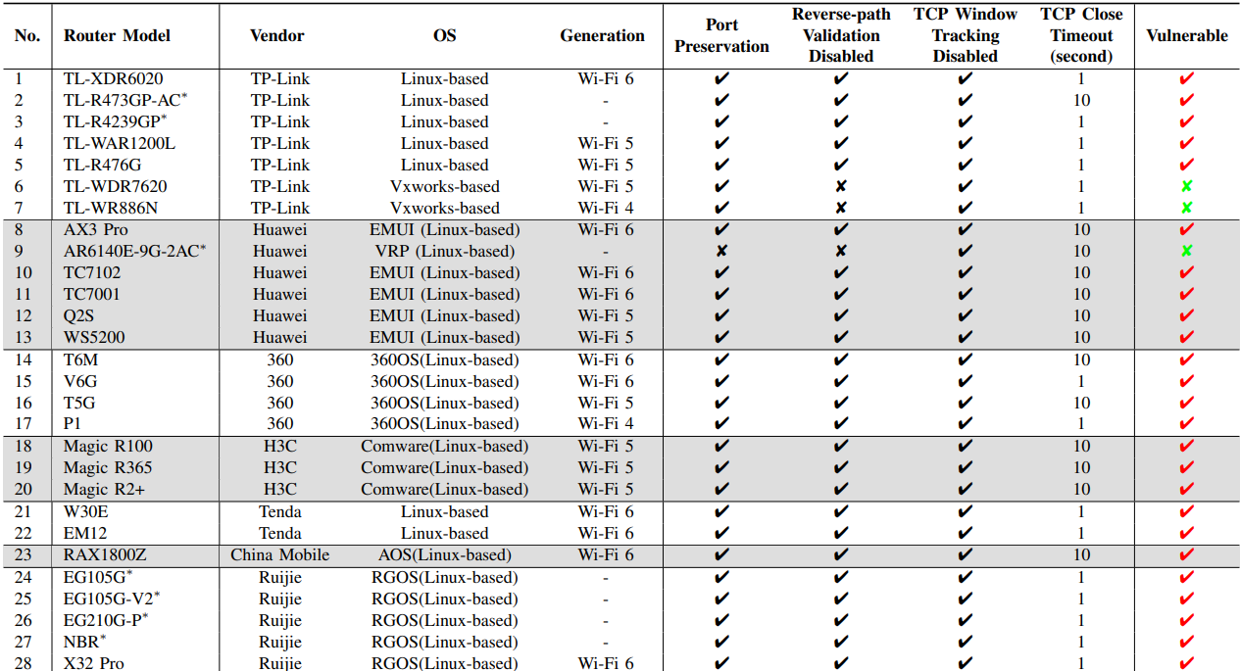
Impacted Routers

Slide 54
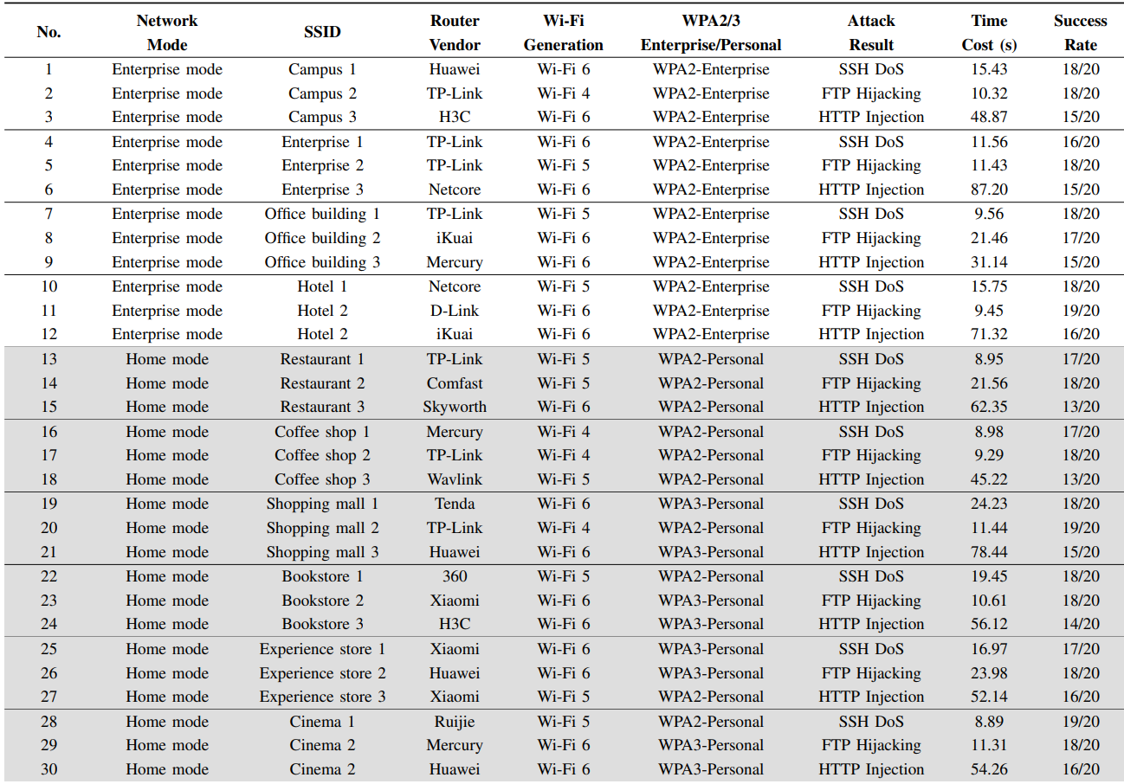
Impacted Networks

Slide 55
Limitations of the Attack
Unable to hijack encrypted connections

Slide 56
Impact
With Wi-Fi being more prevalent than ever, this attack introduces several critical issues:
Compromised Confidentiality
Data Manipulation and Integrity Violations
Potential for Large-Scale Attacks

Slide 57
Countermeasures
Take random port allocation method
Enable reverse path validation
Enable TCP window tracking

Slide 58
Paper Conclusion
In this paper, we uncover a new off-path TCP hijacking attack in the Wi-Fi networks that leverages vulnerable routers. We find that a malicious insider can abuse the NAT port preservation strategy and insufficient reverse path validation strategy of the router to infer the existence of TCP connections from the LAN to a remote server and then obtain the sequence and acknowledgment numbers by manipulating the state of NAT mappings with forged reset packets due to the vulnerable routers disabling TCP window tracking strategy. We confirm the vulnerability in a wide range of routers from different manufacturers and evaluate the new attack in different scenarios, such as SSH DoS, FTP hijacking, and HTTP injection in various Wi-Fi networks. Finally, we suggest countermeasures, report the vulnerabilities to the affected manufacturers, and have received positive acknowledgments.

Slide 59
References
[1] Yuxiang Yang, Xuewei Feng, Qi Li, Kun Sun, Ziqiang Wang, Ke Xu, “Exploiting Sequence Number Leakage: TCP Hijacking in NAT-Enabled Wi-Fi Networks”, Network and Distributed System Security (NDSS) Symposium, 2024.
[2] Wikipedia. “Man-on-the-Side Attack.” Wikipedia, Wikimedia Foundation, 21 Aug. 2024, en.wikipedia.org/wiki/Man-on-the-side_attack.

