Slide 1

CSE 707:
Wireless Networks Security – Principles and Practices
Group 1:
Aayush Pandey
Kevin Prabhu

Slide 2
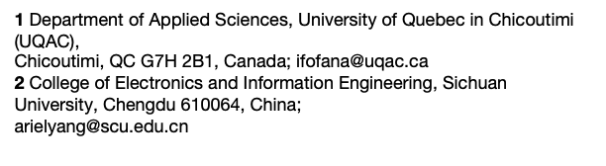
Paper Details
Title: “Security Risk Modeling in Smart Grid Critical Infrastructures in the Era of Big Data and Artificial Intelligence”
Authors: Abdellah Chehri¹, Issouf Fofana¹, Xiaomin Yang²

Slide 3
Paper Discussion Agendas
1. Smart Grids: The Backbone of Modern Infrastructure
2. Why Cybersecurity is Critical for Smart Grids
3. Overview of Big Data in Smart Grids
4. Artificial Intelligence in Smart Grids
5. Research Goal and Objectives
6. Literature Review: Trends in Smart Grid Cybersecurity
7. Smart Grid Architecture & Data Flows
8. Cybersecurity in Smart Grids: The CIA Triad
9. Common Cybersecurity Threats in Smart Grids
10. Risk Modeling: The CORAS Method
11. Artificial Intelligence and Risk Mitigation
12. Deep Learning for Threat Detection
13. Predictive Analytics in Grid Security
14. Survey of Cybersecurity Techniques
15. Visualizing Smart Grid Cybersecurity Risks
17. Case Study: Application of AI in Smart Grid Security
18. How Big Data Enhances Grid Cybersecurity
19. Optimization Algorithms for Security
20. Challenges of Implementing AI in Smart Grids
21. Technical Limitations of Current Security Models
22. Proposed Future Research Directions
23. Practical Impact on the Energy Sector
24. Policy and Regulatory Considerations
25. AI's Trustworthiness in Cybersecurity
26. Recent Advances in AI for Smart Grid Security
27. Trustworthy AI Frameworks
28. Recent Cybersecurity Threats and AI’s Role
29. Conclusion: The Future of AI in Smart Grids
16. Mitigating the risk of Cyberattack
Introduction to Smart Grid Cybersecurity (Slides 1-7)
Smart Grid Architecture & Risk Overview (Slides 8-15)
AI and Big Data in Action (Slides 16-22)
Policy, Trust & Future of AI in Smart Grids (Slides 23-29)

Slide 4
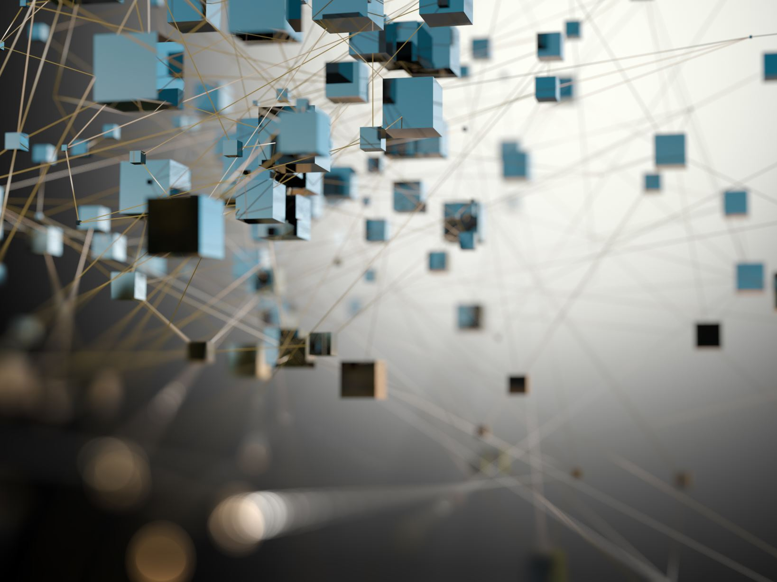
Introduction to Smart Grid Cybersecurity

Slide 5

1. Smart Grids: The Backbone of Modern Infrastructure
Smart grids represent the next evolution in power distribution allowing for real time monitoring and control. They integrate renewable energy sources and data driven automation which increases efficiency and sustainability in energy distribution.
Why Smart Grids are Essential ?
Sustainability: Smart grids help reduce emissions by optimizing energy usage, integrating renewable energy sources, and minimizing wastage.
Efficiency: They enable better energy distribution through automated systems, responding to changes in demand and supply in real-time.
Smart Grid is presented as an Intelligent Power Grid to optimize production , distribution and consumption of electricity. It helps to balance its delivery and demand through the introduction of the ICT (Information and Communication Technology) on the electric grid. So, it combines between the classical electrical distribution networks and the ICT.

Slide 6
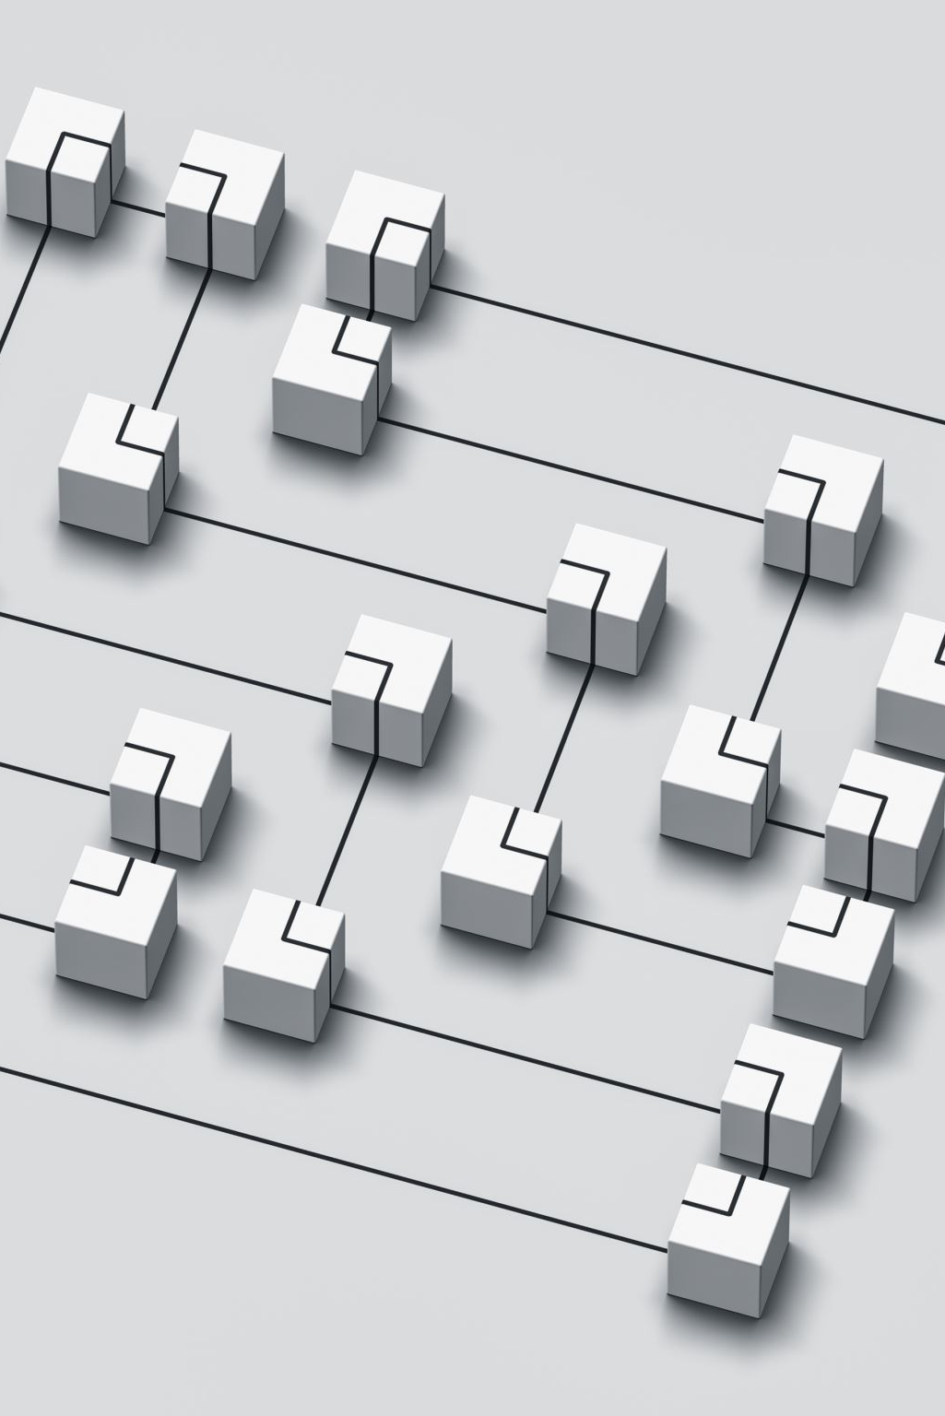
2. Why Cybersecurity is Critical for Smart Grids
With the integration of the internet and IoT devices, smart grids have opened themselves to cyberattacks. Further, dependence on digital communications opens up possibilities of attacks on power infrastructures.
Examples of possible threats:
• DoS Attacks - The grid may not function effectively due to such attacks.
• Data tampering - unauthorized changes to control data can lead to significant outages.
• Malware - Viruses could hack smart-grid control systems and potentially destroy both software and physical infrastructures.

Slide 7
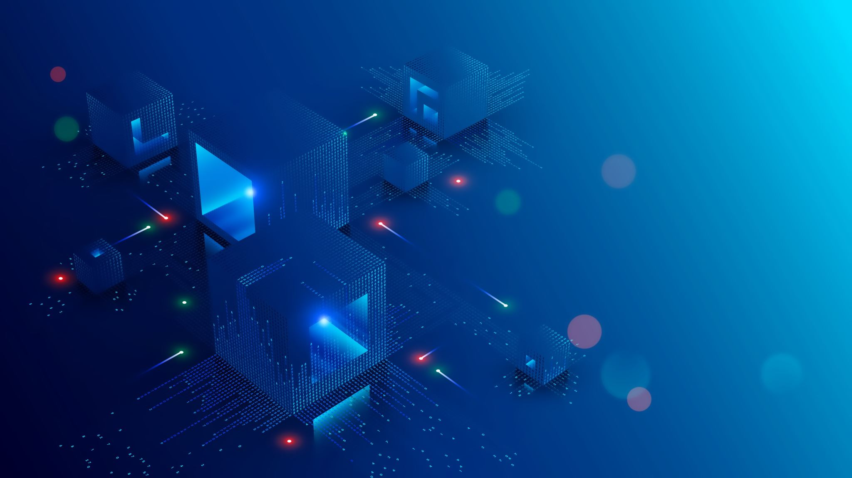
3. Overview of Big Data in Smart Grids
Big Data plays a crucial role in managing and optimizing the smart grids. It allows utility companies to process vast amounts of real time data from energy consumption to grid performance.
Role of Big Data in Smart Grids
Predict Power Demand
Support Predictive Maintenance
Optimize Energy Distribution
Detect Anomalies
Improve Customer Engagement
Enhance Renewable Energy Integration
Real-Time Grid Monitoring

Slide 8
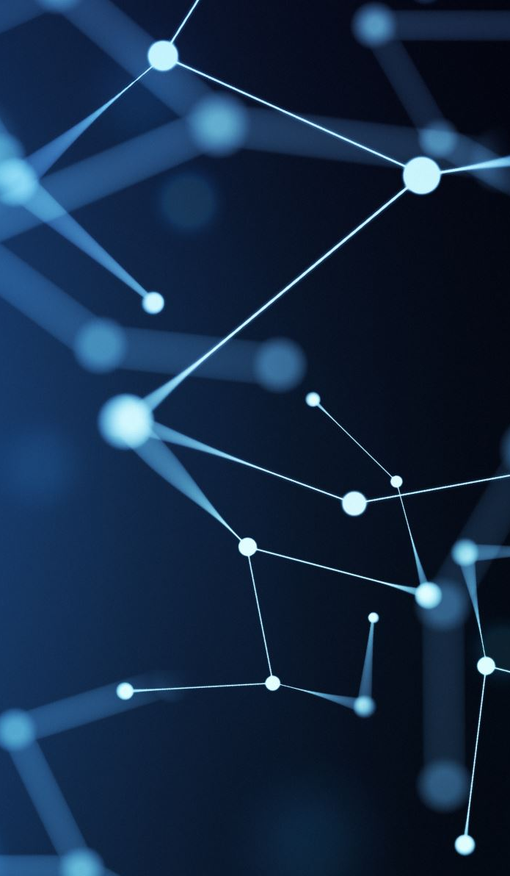
4. Artificial Intelligence in Smart Grids
.
Artificial Intelligence plays an important role in enhancing smart grid operations with real-time optimization and threat detection.
Key Benefits of AI in Smart Grids:
• Forecasting Grid Load: AI models predict demand for stable inferences of energy supply.
• Anomaly detection: AI detects failures or anomalies within systems faster than traditional approaches.
• Cybersecurity: AI identifies and mitigates cybersecurity threats in real time.

Slide 9
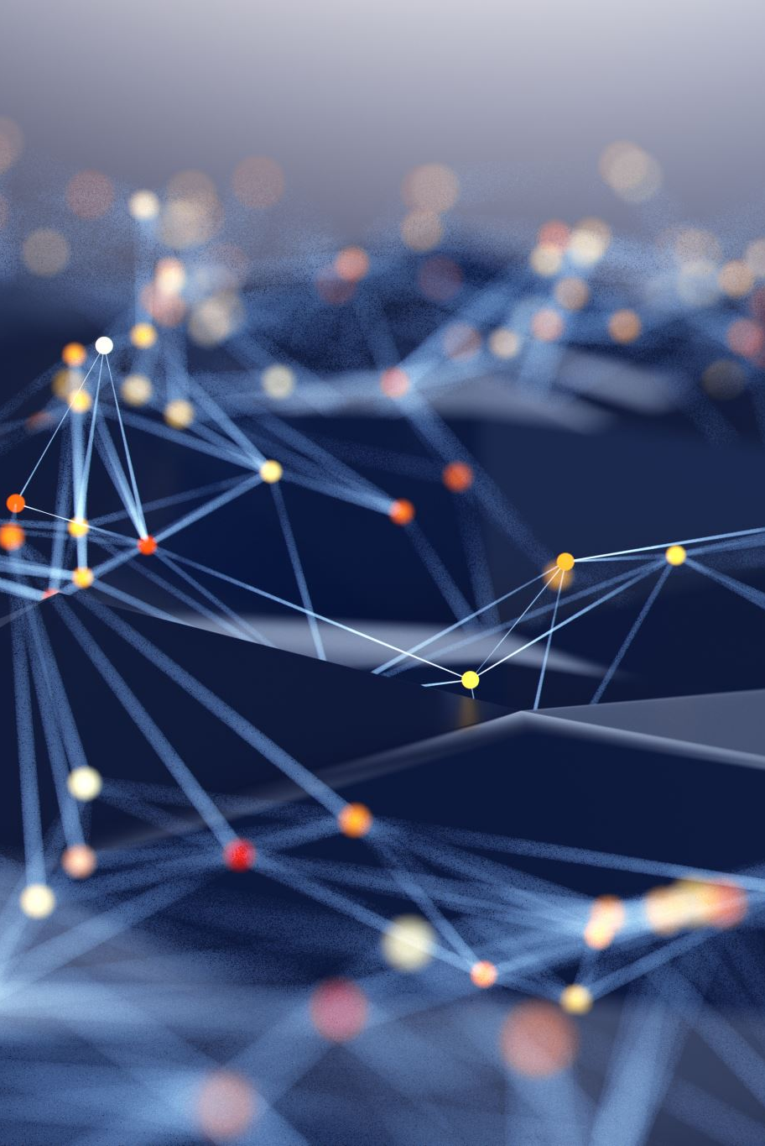
5. Research Goal and Objectives
This research will discuss the roles of Big Data and AI in improving cybersecurity in smart grid infrastructures.
Research questions:
How does AI predict and mitigate the cyber threats in real time?
What are the most suitable risk modelling techniques in Smart Grids?
Can AI actually be used to protect smart grids against constantly shifting threats?

Slide 10

6. Literature Review: Trends in Smart Grid Cybersecurity
In recent times, cybersecurity in smart grids has witnessed an ecosystem of significant change, especially with the adoption of AI and Big Data.
Key Trends:
Previous studies focused on traditional tools in cybersecurity, which had poor performance concerning new kinds of threats.
2017 marked the year when the introduction of AI became the turning point for threat detection and mitigation.
Analytics of Big Data in recent years have been important for detecting vulnerabilities in real-time.

Slide 11

Smart Grid Architecture & Risk Overview

Slide 12

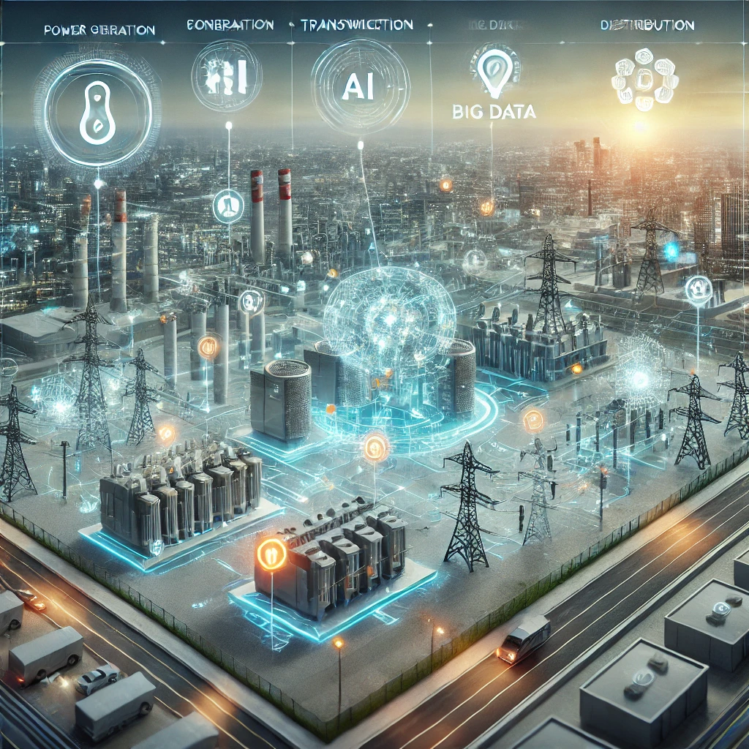
7. Smart Grid Architecture & Data Flows
Smart grid architectures consist of three main layers:
Data Layer: It contains a vast amount of grid points and every grid point provides “smart” energy impacts as well as environmental impacts sensed hours energy consumption and grid performance is examined in real time. Related technologies include Internet-based technologies, wireless sensing networks and data transmission protocols that are all geared towards effective data transmission.
Control Layer: Control layer helps to process and analyze the real time data collected from the data layer. Al works effectively in the area of predictive analytics that provides demand prediction forecasting, system failure detection, and risk management strategies.
Physical Layer: This is the base of the system which includes devices for power production, power storage provision and power distribution. The physical construct of Smart grid system consists of generation units, distribution stations, electric transmission system, electric distribution systems, etc.

Slide 13

8. Cybersecurity in Smart Grids: The CIA Triad
The CIA Triad represents the three fundamental principles of cybersecurity:
  Confidentiality: It ensures that sensitive data, such as consumer energy usage patterns, grid control signals, and communications between components of the smart grid, are available only to authorized entities. ^{[1]}
  Integrity: Grid systems heavily depend on real-time, data-intensive decision-making, such as load balancing and resource allocation. Any unauthorized modification to any one of these three-grey areas-grid control commands, sensor readings, or system configuration may result in incorrect power delivery or even a complete shutdown of the system. Mitigation : Robust authentication, digital signatures, and hashing techniques that ensure the accuracy, authenticity, and freedom from unauthorized changes for data in transit. ^{[1]}
  Availability: It ensures that the smart grid infrastructure is available and usable for authorized users such as grid operators and energy providers at any given instance of time. Smart grid components, such as the control systems, sensors, and communication networks, should work continuously to ensure the reliable and uninterrupted supply of electricity. Measures : redundancy, failover systems, and mechanisms for load distribution. ^{[1]}

Slide 14
How AI Can Help in Cybersecurity References
Automated Detection
Quick Identification Errors
Secure Authentication
Faster Response Times
Cybersecurity without Errors

Slide 15
Classification based on security requirements.
^{[1-3]}
9. Common Cybersecurity Threats in Smart Grids
Attacks
Switching Attacks
DoS (Denial of Service)
Fraud Detection
Cyber Threat Detection
Data Integrity
Replay
Packet Dropping
Dynamic Load Altering Attack
Data Injection Attacks
Malicious Software (Malware)
Vulnerability Analysis
Anomaly Detection

Slide 16
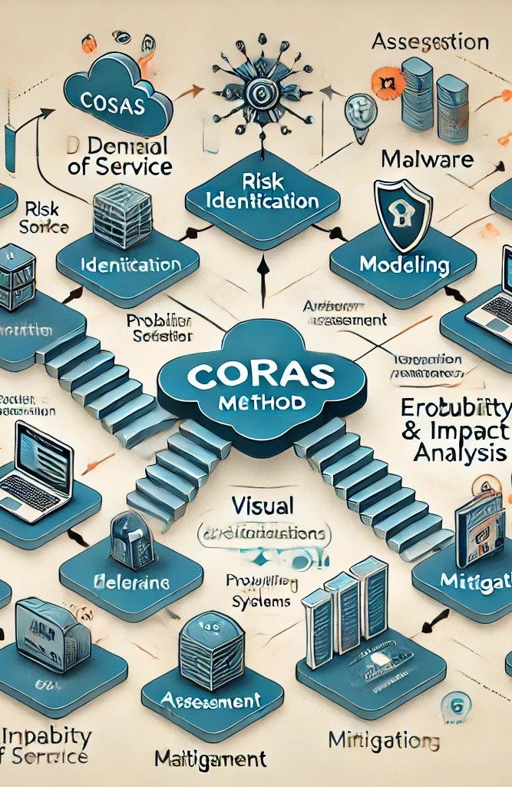
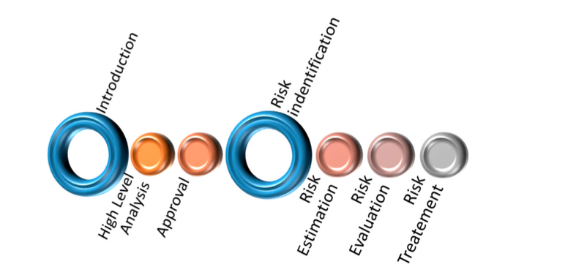
10. Risk modeling: The CORAS method ^{[3-5]}
The CORAS method is a structured approach to identifying and modeling cybersecurity threats in smart grids ³⁻⁵:
Risk Identification: Identifying potential threats to grid security.
Modeling: Creating visual models to assess the impact and likelihood of threats.
Assessment: Evaluating the risk levels and prioritizing mitigation strategies.
CORAS method for security risk analysis ^{[1]}.

Slide 17
Cyber security risk assessment methods for supervisory control and data acquisition (SCADA) (supervisory control and data acquisition) systems - Methods
Analysis, classification, and detection methods of attacks through wireless sensor networks
Detection of cyberattacks using temporal pattern recognition techniques
CPI-enabled firewall model for SCADA security in smart grid networks
Combining ensemble methods and social media metrics to improve the accuracy of OCSVM in intrusion detection in SCADA systems
Vulnerability Analysis
Data Integrity for cloud-based private SCADA architecture
Simulation and Malicious Software (Malware)
Replay and pre-distribution key scheme
Packet Dropping and attack-resistant SCADA system
Dynamic Load Altering Attack
Data Injection Attacks using using deep belief
Anomaly Detection and optimization for intrusion detection

Slide 18

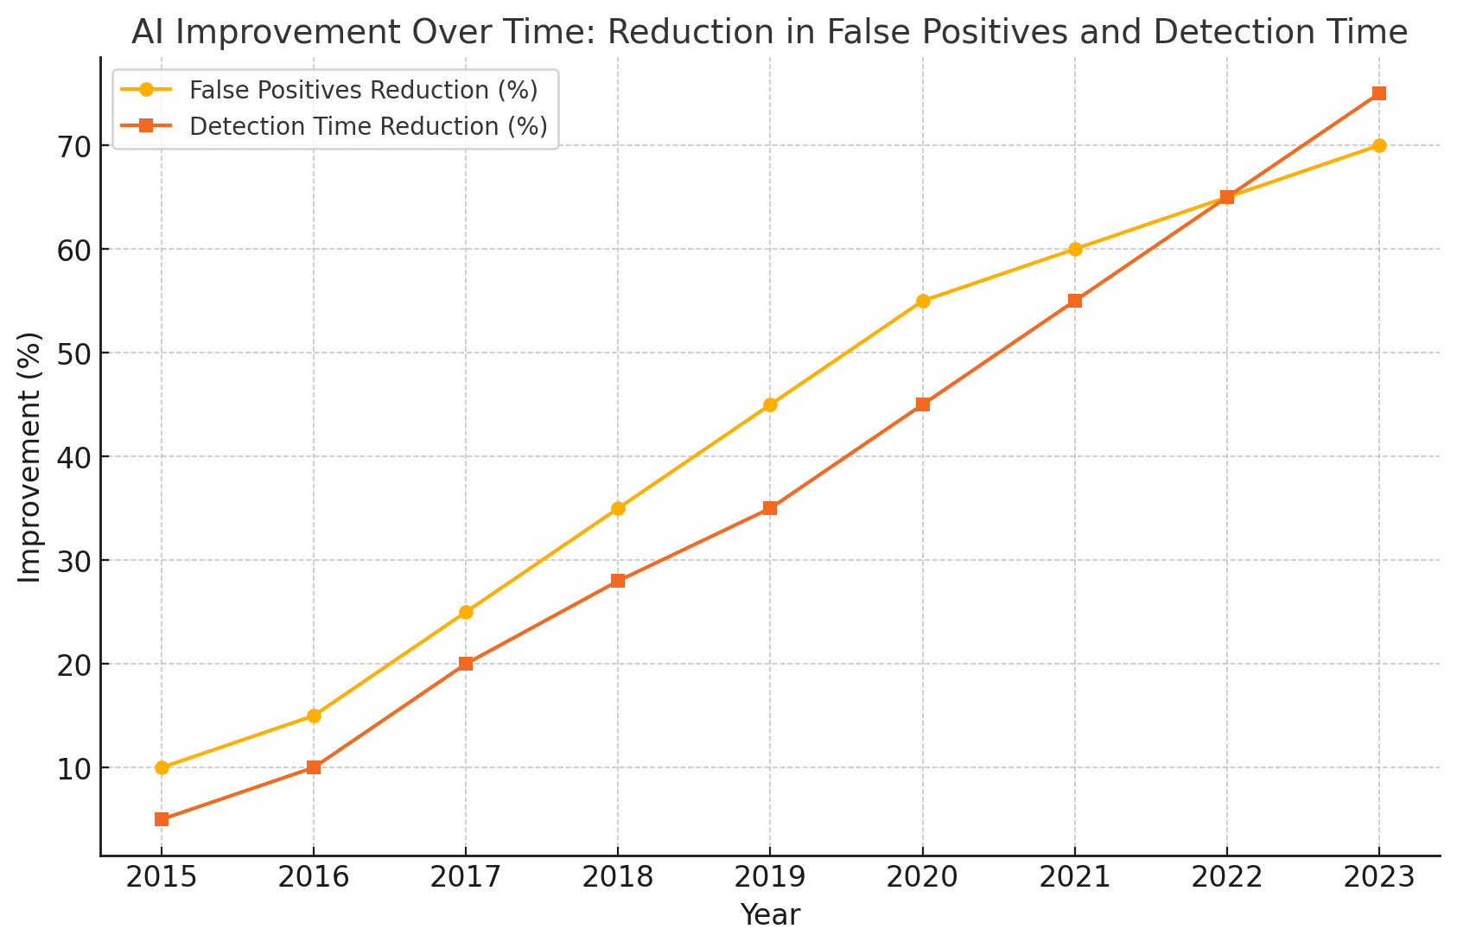
11. Artificial Intelligence and Risk Mitigation
Based on Data from ^{[16-17]}
AI systems automate the response for speedier response times with minimized human error in critical situations. Artificial Intelligence (AI) plays a crucial role in mitigating risks in smart grids:
  Threat Identification: AI's ability to analyze large data sets in real-time helps identify emerging and unknown threats. AI models continuously monitor grid behavior, analyzing data patterns from various grid components, such as smart meters, sensors, and energy distribution points.
  Anomaly Detection: AI and machine learning models excel at recognizing normal grid behavior; thus, anomaly detection of potential threats is a strong suit. These models learn to recognize unusual patterns - for instance, unexpected spikes in energy usage or irregular grid communication signals-that may hint at malfunctioning equipment, cyber-attacks, or unauthorized access through training on historical data. After the flagging of such anomalies, alerts can be generated for further investigation before affecting performance on the grid.
  Mitigation: Once an anomaly or threat is detected, AI systems can trigger mitigation measures automatically to limit the impact. This may include managing power distribution by shifting power around, cutting off portions of the grid in case of an attack, or deploying cybersecurity measures to shut down malicious access points.

Slide 19

12. Deep Learning for Threat Detection
Deep learning models are particularly effective for identifying sophisticated threats in smart grids:
Complex Pattern Recognition: Only deep learning models, particularly CNNs (Convolutional Neural Networks ), are able to process and analyze the complex patterns in the timeseries data generated by such smart grid systems. Advanced techniques through GAF (Gramian Angular Field) transformation can convert time-series data into images and visualize in a structure that the deep learning algorithm may be able to realize in normal and attack data. ^{[8][9]}
Zero-Day Attack Detection: Deep learning models, especially autoencoders and RNNs, play a significant role in zero-day attack detection. Because deep learning models do not depend on predefined attack signatures, they can identify unseen attack behaviors effectively. For example, autoencoders learn the typical data distribution of smart grids and detect anomalies that deviate from the learned data distribution. They are hence very effective for zero-day detection scenarios, enabling up to 89-99% detection rates for unseen attacks. This capability is further enhanced by the use of Long Short-Term Memory (LSTM) networks, a variant of RNNs, in modeling temporal dependencies within the data, helping in prediction and identification of patterns that emerge over time. ^{[9][10]}

Slide 20
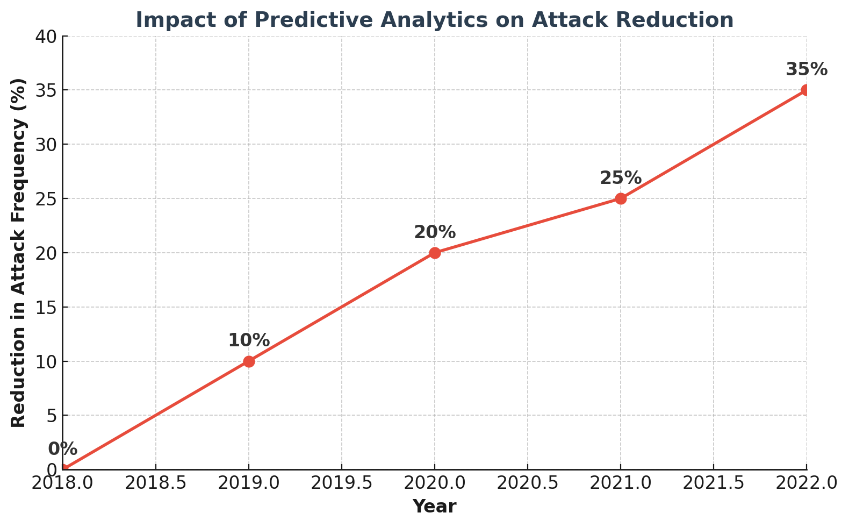
13. Predictive Analytics in Grid Security
Predictive analytics uses both historical data and real-time information to help in the anticipation of grid failures and cyberattacks. It has played an important role in keeping all systems of smart grids resilient against evolving threats.
1. Forecasting Threats: Once forecasted, predictive analytics can allow grid operators to take proactive defense measures against any threats. For instance, if a model predicts a potential overload, it gives grid operators the time to adjust the load distribution and prevent blackouts. In cybersecurity ; For instance, by analyzing historical data on ransomware behavior (e.g., file renaming patterns or increased disk I/O activity), AI-powered models can predict a potential ransomware event. This allows security teams to proactively quarantine systems showing these early signs and block outbound connections before the ransomware fully executes, preventing further spread across the network.
2. Proactive Measures: Once threats are forecasted, predictive analytics enables grid operators to implement proactive defensive measures. For example, if a model predicts a potential overload, grid operators can adjust the load distribution to prevent blackouts. In cybersecurity ; e.g. - Predicting insider threats. Predictive analytics tools that analyze employee behavior patterns, such as accessing confidential data outside working hours or using unauthorized USB devices, can flag suspicious activity. Once a potential insider threat is detected, these systems can automatically trigger security policies like revoking user privileges, restricting access to sensitive files, or flagging the user’s behavior for further investigation by the security team.
Benefits:
• Early Detection: Predictive analytics provides early alerts, allowing operators to mitigate threats before they cause significant harm .
• Resource Optimization: Resources can effectively be allotted to high-risk areas to enhance grid security
• Improved Response Time: Predictive models, by simulating potential attack scenarios, help organizations reduce the time taken to respond to any incident. This will definitely ensure quick action if real threats arise.

Slide 21
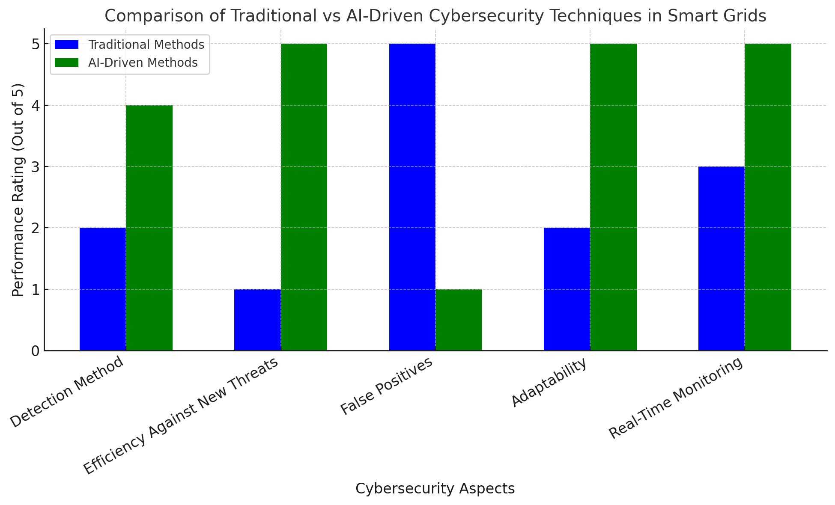
14. Survey of Cybersecurity Techniques
Comparing traditional and AI-based cybersecurity techniques in smart grids:
Traditional Security Solutions: Firewalls, signature-based IDS, and antivirus all represent other classic security solutions traditionally considered for smart grid protection, along with other critical infrastructures. Most of the techniques are reactive in nature, where threat detection is done by using some predefined set of rules and known attack signatures. ^{[11-14]}
Challenges
High False Positives: Conventional methods normally result in a high number of false positives-from benign actions being flagged up incorrectly as threats-which overwhelm the operators of the system.
Limited Adaptability: These methods are static, with very little dynamism in adjusting to new forms of cyberattacks, hence carrying out poorly in modern smart grid environments that are rapidly changing.
AI-driven Cybersecurity techniques: AI and ML signify an active form of cybersecurity. Given the massive amount of data generated by smart grids, continuous learning can be granted to these systems to identify both known and unknown threats in real time. ^{[11-14]}
Advantages
Reduced False Positives: AI models constantly enhance their detection mechanisms, bringing down the percentage of false positives considerably compared to traditional methods.
Real-Time Monitoring : AI-driven systems have real-time threat detection and response, hence enabling more speed and comprehensiveness in the protection of smart grid infrastructures.
Adaptability: AI-based systems learn and improve on their own, adapting to new types of threats without dependence on predefined signatures.

Slide 22
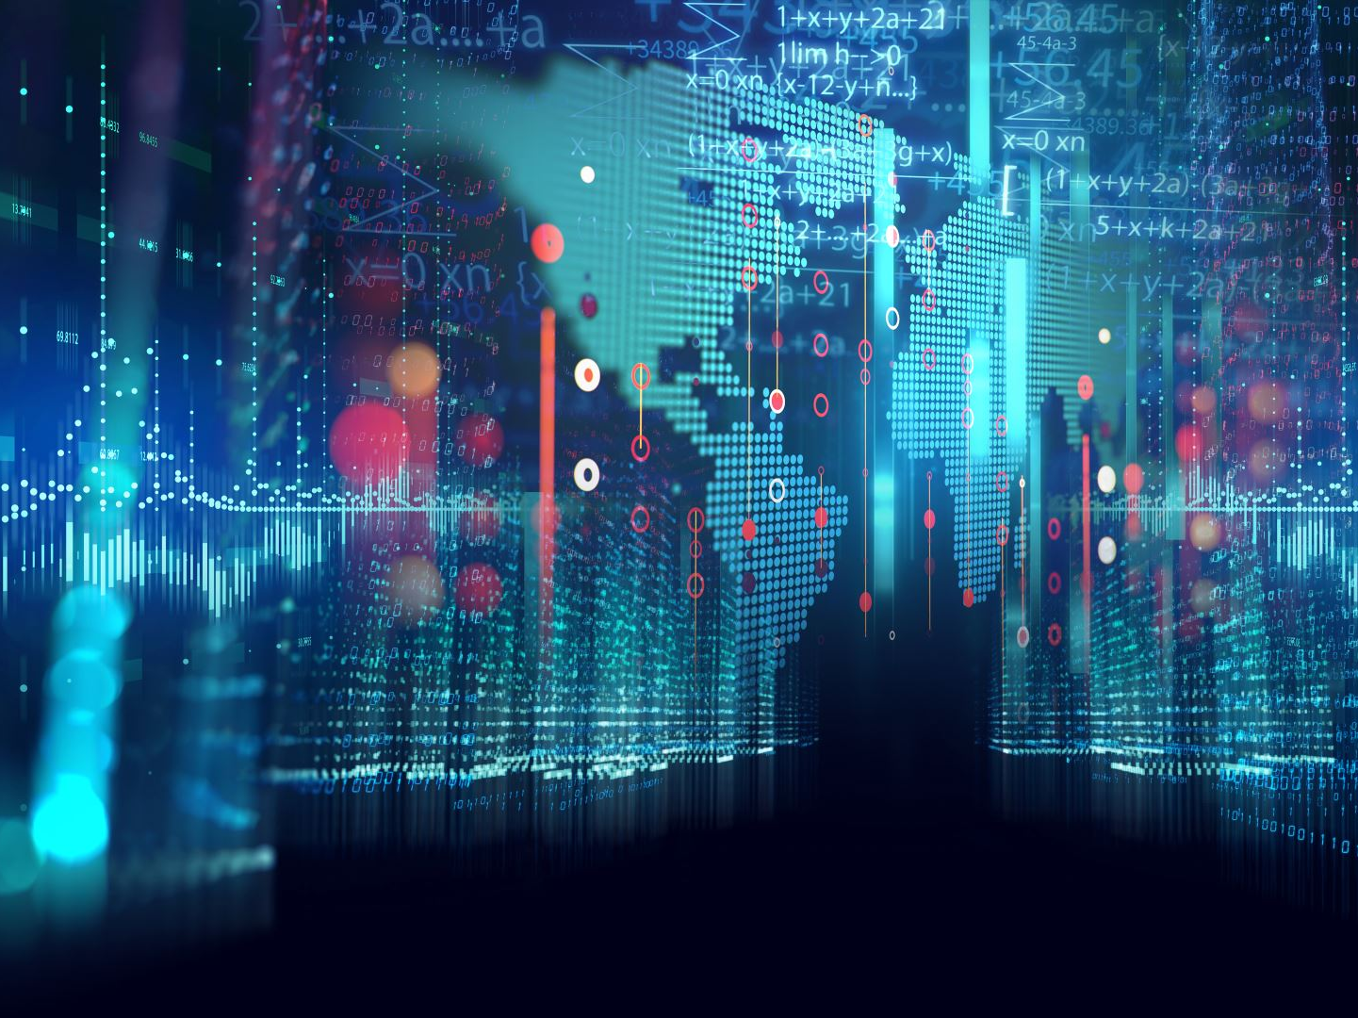
AI and Big Data in Action

Slide 23

15. Visualizing Smart Grid Cybersecurity Risks
Cybersecurity risks in smart grids span multiple layers:
Physical Layer: Physical attacks against the infrastructures, tampering of devices, and power cuts.
Data Layer: This is attributed to all forms of unauthorized data access, data tampering, and data breaches.
Control Layer: There is a critical threat from malware, denial-of-service-type attacks, and unauthorized control of the grid operations.

Slide 24
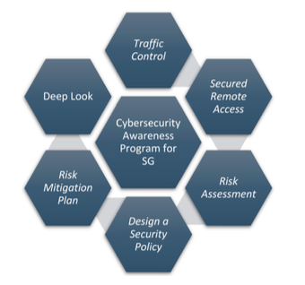
16. Mitigating the risk of cyberattack
Establishing and maintaining a robust and adequately implemented cybersecurity awareness program for SG several approaches must be followed[10]:
1. Secured Remote Access - Make use of encrypted links like VPNs, and not just use passwords.
2. Traffic Control - Make use of firewalls for controlling communications between IT and OT systems.
3. Risk Assessments - Internal and external threat analyses should be done in great detail.
4. Security Policies and Processes - Elaborate the policy and define various roles of accountability by employees, suppliers, and users.
5. Execute Risk Mitigation Projects - Actually implement cybersecurity technologies against internationally accepted standards.
6. Anomaly Detection Implementation - Use deep packet inspection for threat detection in real time.

Slide 25

17. Case Study: Application of AI in Smart Grid Security
In a very practical application, AI has been implemented with great success to improve the security of smart grids.
Then came the use of artificial intelligence when the city of Shanghai worked on the implementation of the technology which would help them in real-time anomaly detection.
With AI, the frequency of cyberattacks went down, and thus responses could be quicker, yielding increased stability and security of the grid.

Slide 26
18. How Big Data Enhances SG Cybersecurity
Big Data raises the grid's cybersecurity by allowing real-time analytics, thus detection of anomalies:
- Real-time Monitoring: Big Data allows for continuous monitoring of grid operations, identifying any deviations from normal behavior.
- Threat Detection: Utilities can detect the emergent threats much quicker by analyzing large volumes of data, enabling the prevention of potential attacks.
- Predictive Analytics: Big Data analytics helps anticipate the likelihood of vulnerabilities and identifies where, in general, a cyberattack might occur.

Slide 27
19. Optimization Algorithms for Security
Optimization algorithms are widely applied in the optimization of smart grid security strategies.
Genetic Algorithms: These algorithms help in optimizing resource allocation and cybersecurity defenses for an improved efficiency of grid security.
Neural Networks: AI-driven neural networks continuously learn from and adapt to evolving threats

Slide 28
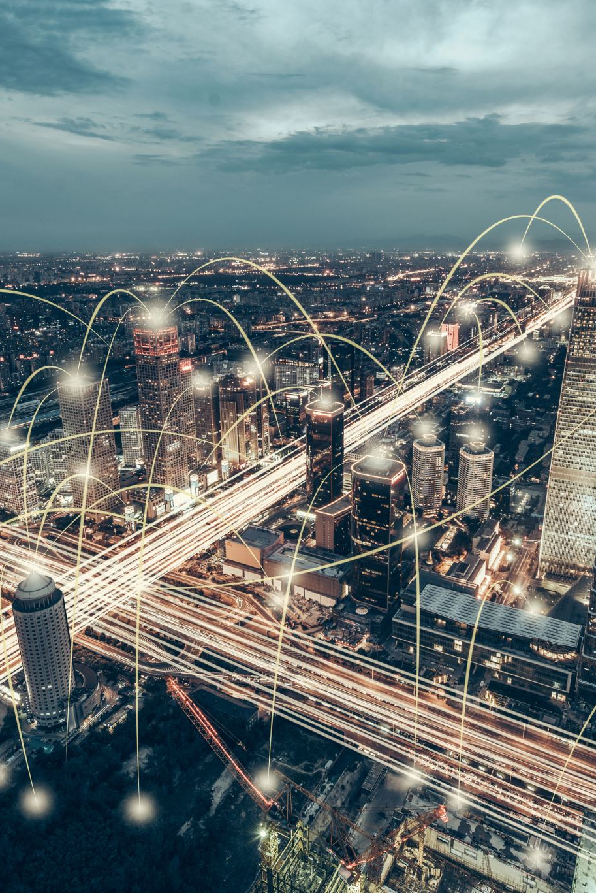
20. Challenges of Implementing AI in Smart Grids
In reality, there are many challenges to AI implementations in smart grid cybersecurity:
Legacy Systems: Most grid infrastructures are very outdated and do not have the requisite infrastructure to support AI-based systems.
Scalability: Currently, most AI systems can't yet be scaled in congruence with the inherent complexity and pervasiveness of today's power grids.
Cost and Resources: Most utility companies cannot invest in the implementation and maintenance of such security systems employing AI because of their high costs.

Slide 29
21. Technical Limitations of Current Security Models
Existing security models for smart grids face several technical limitations:
Lack of Real-World Testing: Many AI-based models are only tested in controlled environments and may not perform well under real-world conditions.
Computational Costs: AI models require significant computational resources, making them expensive to deploy at a large scale.
Adaptability: Traditional models are slow to adapt to new and evolving cyber threats, leaving grids vulnerable to sophisticated attacks.

Slide 30
22. Proposed Future Research Directions
Other areas of future research in smart grid cybersecurity are:
Real-World Testing of AI Models: Testing AI security models in real world environments will always be necessary for assessing their effectiveness.
Scalable AI: Development of AI models that can scale on high performance grid infrastructures without degradation in performance.
Low-Cost Solutions: Investigation should also highlight ways to minimize computational and financial

Slide 31

Policy, Trust & Future of AI in Smart Grids

Slide 32
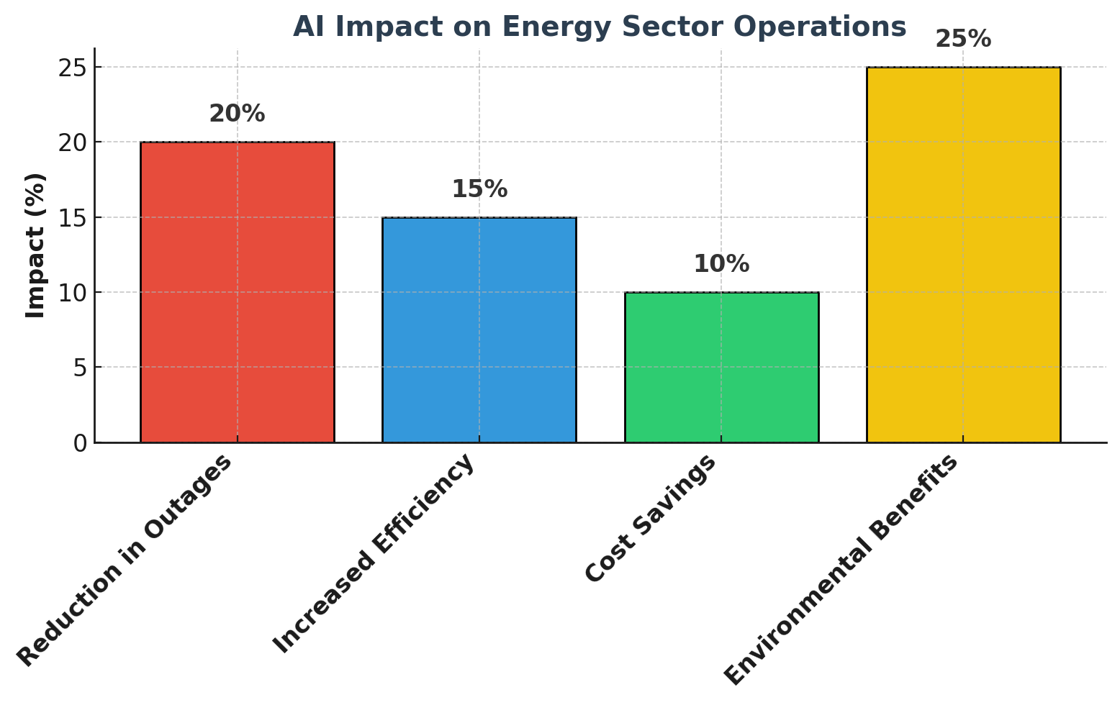
23. Practical Impact on the Energy Sector
AI and Big Data have the potential to significantly impact the energy sector:
Reducing Outages: By predicting potential failures and responding to threats in real-time, AI and Big Data can help reduce the number of outages.
Improving Efficiency: AI-driven automation can optimize energy distribution and usage, leading to greater energy efficiency.
Environmental Benefits: Smarter grids can help reduce greenhouse gas emissions by integrating renewable energy sources and optimizing energy consumption.

Slide 33
25. Policy and Regulatory Considerations
The integration of AI in smart grids is a serious cause for data privacy, standardization, and compliance policy and regulatory issues.
Data Privacy: Smart grids deal with intelligent systems that process large volumes of consumer data; hence, data privacy is a major concern. Compliance with such regulations in AI-driven smart grids requires mechanisms of robust privacy preservation, including encryption techniques and anonymization methods. These techniques shield consumer data while the AI systems analyze the patterns in your data for efficient forecasting of energy demands. Examples include federated learning: a technique where analysis is done in a manner that there is no leakage of individual data points. ^{[15]}
Compliance: AI-based systems bigly need to comply with all existing regulations in both the cybersecurity and energy sectors. This shall include the alignment of AI technologies to existing frameworks like the NIST Cybersecurity Framework that provide guidelines on how to manage cybersecurity risks within critical infrastructures that also include smart grids.
Standardization: This would lead to an emerging need for standardized protocols that not only guarantee cybersecurity but also ensure efficient integration of AI into diverse grid systems. Most of the current applications of AI in smart grids are oriented toward standardization; thus, they many times pose interoperability issues across diverse systems. ISO- and IEC-like international standards will play a great role in framing standard guidelines to deploy AI uniformly, taking proper care of cybersecurity risks and allowing seamless data exchanges between grid operators and AI solutions. ^{[5]}
Interoperability : Ensuring that different parts of the grid (e.g., legacy systems and new AI-driven systems) work seamlessly together.

Slide 34
26. AI's Trustworthiness in Cybersecurity
Probably, the most important ingredient for AI systems to be used in the cybersecurity of smart grids is trustworthiness. The key factors for building trust include the following:
1. Transparency: First and foremost, if users are to start building confidence in them, AI systems must be transparent. Transparency includes explanations of how the AI algorithms work, how they come up with decisions, and why a particular outcome is derived. This involves providing lucid, comprehensible explanations for the AI's conclusions, let alone in scenarios where AI affects critical decisions, such as smart grid cyber threat detection. (Source: IBM on Trustworthy AI. )
2. Accountability: Accountability is very cardinal in ensuring that auditing, monitoring, and evaluation of AI systems on compliance and performance are allowed. In AI-driven cybersecurity, accountability mechanisms should ensure traceability of decisions made by AI into traceable data inputs and algorithms. According to the NIST AI framework, accountability mechanisms enable AI systems to be compliant with applicable laws and regulations to engender public trust. That will be quite accountable, with regular audits and oversight by independent bodies.
3. Ethical Concerns: Since there may be biases the AI systems have unconsciously within their algorithms, one has to ensure that all trust is not damaged. Such biases in AI systems for decision-making might lead to unfair outcomes, like hurting particular people disproportionately by cybersecurity measures. The design and monitoring of AI systems must ensure fairness and prohibition of discrimination. It means various sets of data used in training AI models and constant checking to see that no new biases are formed. Ethical consideration also means that AI must be projected and operate within a right and acceptable legal and social framework with regard to privacy, equity, and inclusion.
These three cornerstones - transparency, accountability, and ethics - form the bedrock for developing AI systems that are not only reliable but trusted for critical applications in smart grids cybersecurity.

Slide 35
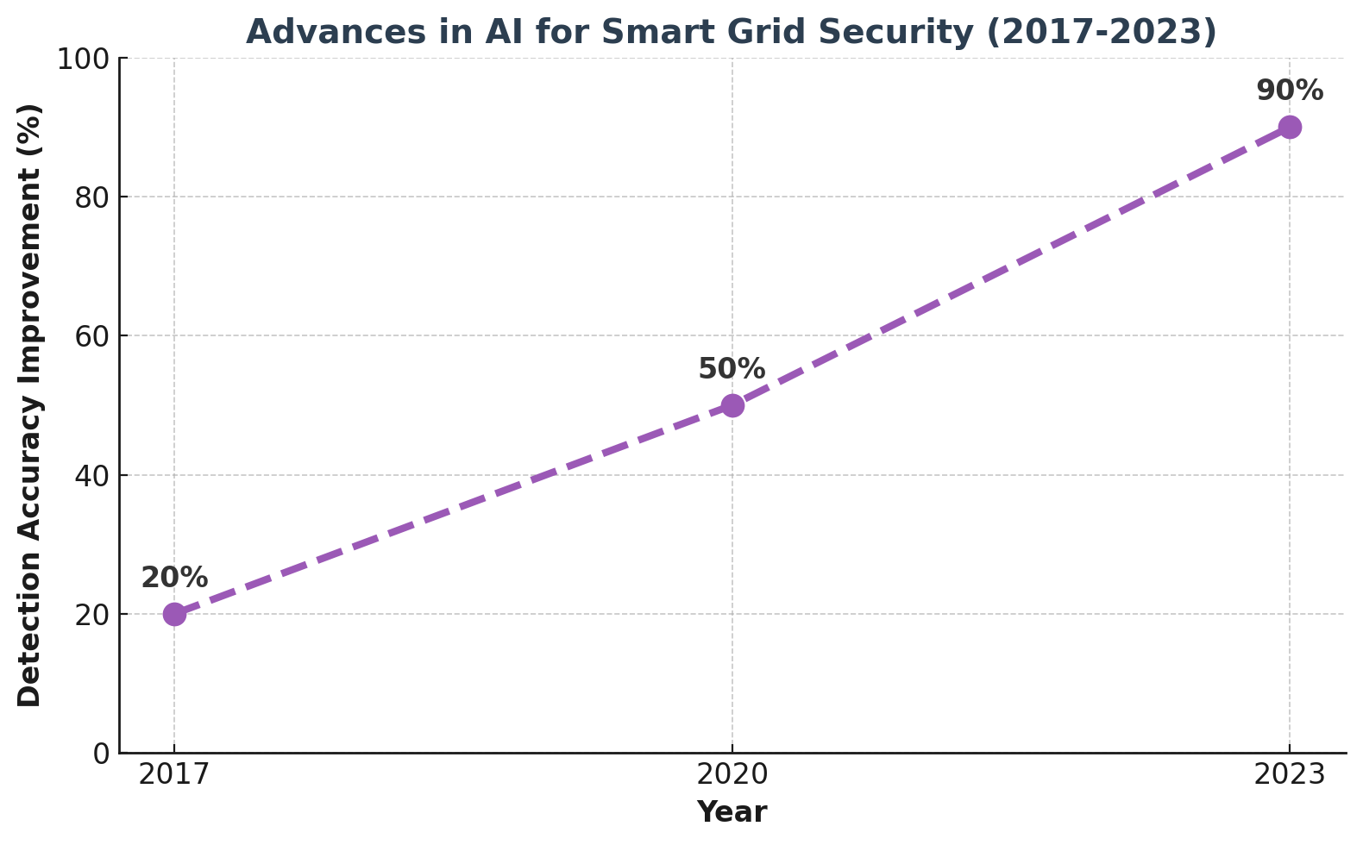
27. Recent Advances in AI for Smart Grid Security
There have been several recent advancements in using AI for smart grid security:
Reinforcement Learning: AI models that use reinforcement learning have shown promise in improving grid security by learning optimal responses to potential threats.
Adversarial Defense Mechanisms: New techniques have been developed to defend against adversarial AI attacks that attempt to exploit vulnerabilities in the grid’s AI systems.

Slide 36
28. Trustworthy AI Framework
Concretely, to make the AI systems trustworthy, specific frameworks are currently under development:
Explainable AI: XAI techniques present AI decision-making processes in a more transparent manner and, therefore, much easier to understand, thus helping build trust in the system. By bringing more transparency to the system, XAI fosters trust into AI systems, since users and regulators can understand how and for what reason decisions are made. The system is accountable to that extent, reducing risks of hidden biases in the decision-making process.
Ethical AI Frameworks: These frameworks ensure a set of ethics in which the AI systems operate, minimizing biases and ensuring fairness in decisions. Fairness and bias mitigation across the AI lifecycle are approached in various global initiatives, including the World Economic Forum and European Union's "NoBIAS" project. Such frameworks make sure that a model is trained and deployed in a manner consistent with societal values and legal standards.

Slide 37
29. Recent Cybersecurity Threats and AI’s Role
Recent cybersecurity threats targeting smart grids have evolved, and AI has taken on a critical role in combating these threats:
Adversarial AI Attacks: These are attacks on the AI systems used in the protection of smart grids, targeting manipulations within AI models. These could imply that attackers will no longer have the capability to disrupt grid operations through the manipulation of AI algorithms' vulnerabilities, tamper with energy pricing systems, or even trigger citywide outages. These forms of adversarial attacks constitute one of the fastest growth areas of concerns, as AI becomes increasingly embedded into smart grid operations.
Zero-Day Exploits: AI helps identify zero-day attacks, or unknown vulnerabilities, before the adversary could use them. Advanced machine learning and deep learning algorithms analyze streams of data in real time coming from smart grid networks. It would be possible for the system to trace slight variations in the operational pattern, an abnormality signaling a possible upcoming zero-day exploit. ^{[2][3]}

Slide 38
Recent Attack
A recent cyberattack on smart grid infrastructure occurred in early 2023. Utilities in the U.S. reported over 60 incidents in the first quarter alone, including two cyberattacks. One attack on Hydro-Quebec’s systems caused disruptions to their app and website, which are used for verifying outages. Another incident in Clark County, Nevada, left over 11,000 customers without power.
These attacks highlight the increasing vulnerability of smart grids to both physical and cyber threats, with adversaries targeting critical infrastructure more frequently than before

Slide 39
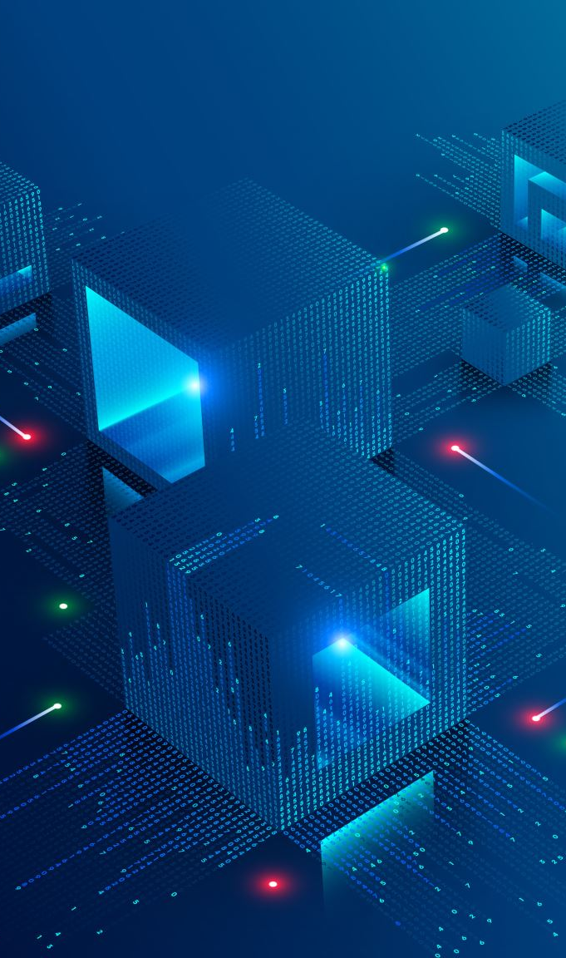
30. Conclusion: The Future of AI in Smart Grids
In this regard, AI and Big Data will assume even more important roles as smart grids evolve: securing and optimizing these critical infrastructures.
Improved Security: AI will continue to improve to locate and block new forms of threats in real-time.
Smart Grid Optimization: Big Data and AI will further enhance the efficiency and sustainability of smart grids with better energy distribution and reduction in losses.
Future Research: Future research will be continuously welcome in coming up with scalable, reliable, and inexpensive AI solutions to help satisfy emerging smart grid security demands.

Slide 40
References
Chehri, A.; Fofana, I.; Yang, X. Security Risk Modeling in Smart Grid Critical Infrastructures in the Era of Big Data and Artificial Intelligence. Sustainability 2021, 13, 3196. https://doi.org/10.3390/su13063196 (Presentation Paper)
Velusamy, D. An effective trust based defense mechanism to thwart malicious attack in smart grid communication network. In proceedings of the 2017 IEEE international conference on intelligent techniques in control, optimization and signal processing (INCOS), srivilliputtur, india, 23–25 march 2017.
Jiang, j.; Qian, Y. Defense mechanisms against data injection attacks in smart grid networks. IEEE commun. Mag. 2017, 55, 76–82. [Crossref]
Xu, R.; Wang, R.; Guan, Z.; Wu, L.; Wu, J.; Du, X. Achieving efficient detection against false data injection attacks in smart grid. IEEE access 2017, 5, 13787–13798. [Crossref]
Oozeer, M.I.; Haykin, S. Cognitive risk control for mitigating cyber-attack in smart grid. IEEE access 2019, 7, 125806–125826. [Crossref]
Yeboah-ofori, A.; Islam, S.; Brimicombe, A. Detecting cyber supply chain attacks on cyber physical systems using bayesian belief network. In proceedings of the 2019 international conference on cyber security and internet of things (icsiot), accra, ghana, 29–31 may 2019; pp. 37–42.
How ai can reduce false positives for fraud - loraine lawson – bank automation news ;
Ai made to reduce false positives - part 2: vendor spectrum ; celent ; mcgowan, joan 03 july 2018 ; [ref]
Utilising Deep Learning Techniques for Effective Zero-Day Attack Detection , Hanan Hindy, Robert Atkinson, Christos Tachtatzis, Jean-Noël Colin, Ethan Bayne, Xavier Bellekens [Ref]
Attack Detection and Localization in Smart Grid with Image-based Deep Learning - Mostafa Mohammadpourfard1, Istemihan Genc, Subhash Lakshminarayana, Charalambos Konstantinou [Ref]
Detection of cyber-attacks on smart grids using improved VGG19 deep neural network architecture and Aquila optimizer algorithm - Volume 18, pages 1477–1491, (2024) ; Ahmed Abdulmunem Mhmood, Özgür Ergül & Javad Rahebi [Ref]
Artificial Intelligence Techniques in Smart Grid: A Survey - MDPI (2023) [Ref] .
Enhancing Smart Grid Security with AI-Driven Cyber Resilience - Frontiers Research (2023) [Ref ].
Advancing Cybersecurity: A Comprehensive Review of AI-Driven Detection Techniques - Journal of Big Data (2023) [Ref].
Cybersecurity in Smart Grids: Challenges and Solutions - AIMS Press (2023) [Ref] .
Trustworthy AI: From Principles to Practices ; [Ref]

