Slide 1
A Data Exfiltration and
Remote Exploitation Attack on Consumer 3D Printers
Quang Do, Ben Martini,
Kim-Kwang Raymond Choo
CSE 707 SEM
BY ANDREW BALOTIN AND RAGHAVI

Slide 2
3D PRINTING AND ITS ADVANTAGES
3D Printing:
3D printing, also known as additive manufacturing, is a process that builds three-dimensional objects by layering materials according to a digital model. It is a revolutionary technology that enables the precise creation of complex shapes and objects.
The 3D printing process begins with a digital 3D model, typically created using CAD (Computer-Aided Design) software. This model is then converted into a format, such as STL or G-code, which the printer software reads to guide the printing process.
Most consumer 3D printers use the extrusion process, in which materials like plastic are melted and deposited in layers to form the designed object.
Advantages of 3D Printing:
Rapid Prototyping: Allows companies to quickly design, test, and modify prototypes. This rapid iteration shortens development cycles and accelerates time to market.
Customization: 3D printing supports the creation of highly customized items, tailored to individual needs. This is particularly valuable in fields like medicine, where custom prosthetics or implants are often required.
Cost Efficiency: For small production runs or prototypes, 3D printing is often more affordable than traditional manufacturing due to the elimination of molds and setup costs.

Slide 3

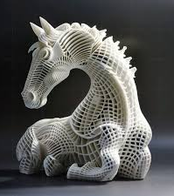
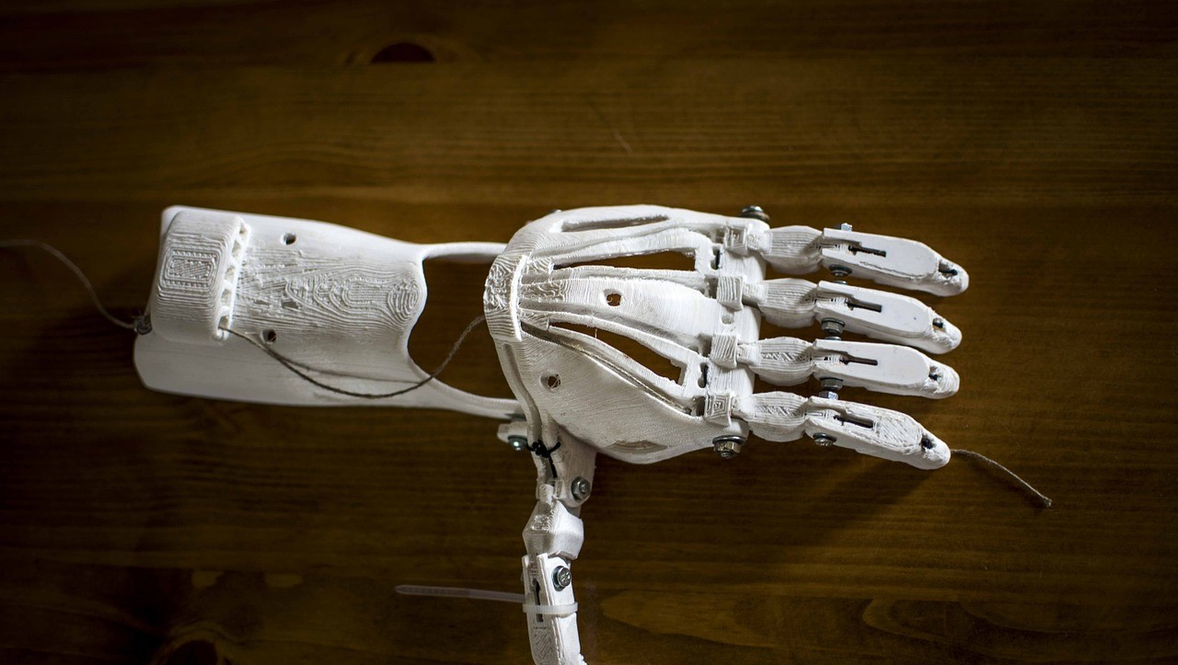
APPLICATIONS OF 3D PRINTING
Healthcare:
3D printing enables the creation of customized prosthetics, dental implants, and even hearing aids, tailored precisely to individual patients for comfort and fit.
Aerospace and Automotive:
Engineers use 3D printing to develop and test prototypes of parts, reducing the time and cost associated with traditional manufacturing methods.
3D printing allows for the creation of complex, lightweight structures, which is essential for fuel efficiency in aircraft and vehicles.
Consumer Products and Art:
3D printing allows individuals to create custom items. Artists and designers use 3D printing to produce intricate and innovative sculptures, jewelry, and installations that would be challenging to create with traditional methods.

Slide 4
SECURITY CONCERNS IN 3D PRINTERS
Consumer-grade 3D printers often prioritize cost-effectiveness and ease of use over robust security features. This trade-off results in devices with minimal security, increasing vulnerability to unauthorized access.
3D printers are frequently connected to the internet or local networks for remote access and monitoring. However, without adequate security protocols, they can be easily discovered and accessed by attackers, posing risks to both home and business networks.
Many 3D printers store valuable design files, including proprietary prototypes and unique designs. If these files are accessed by unauthorized users, it could lead to intellectual property theft, resulting in financial loss and competitive disadvantages for businesses relying on sensitive designs.

Slide 5
OBJECTIVES OF THE STUDY
Despite the rapid adoption of 3D printing technology, there has been little research on the security vulnerabilities of consumer-grade devices, particularly in widely-used models like those from MakerBot.
Previous literature and industry guidelines, have not adequately addressed the security risks associated with 3D printers. This lack of comprehensive security research leaves users vulnerable.
This study specifically aims to identify and analyze vulnerabilities in two popular consumer models of MakerBot 3D printers. By focusing on these commonly used devices, the researchers hope to uncover security flaws that could lead to data exfiltration and remote exploitation.
Based on the identified vulnerabilities, the study intends to offer practical recommendations for both manufacturers and users. These recommendations aim to address the highlighted risks and improve the overall security of consumer 3D printers, ensuring that users can benefit from the technology without compromising data security.

Slide 6
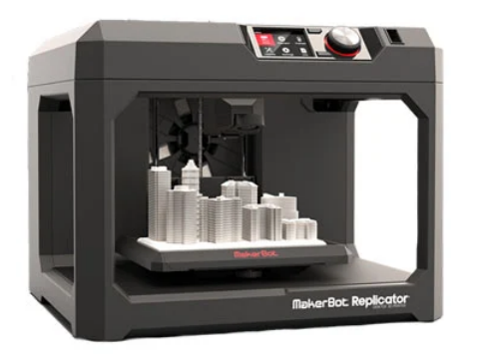
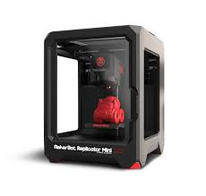
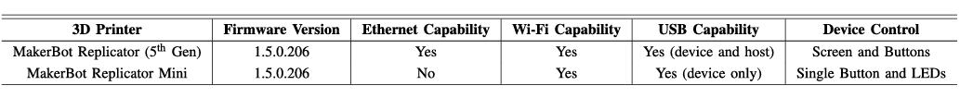
MAKERBOT REPLICATOR AND REPLICATOR MINI
The MakerBot Replicator and Replicator Mini are popular consumer and small business 3D printers, chosen for their accessibility and ease of use. Both printers use the MakerBot Desktop software, compatible with standard 3D file formats like STL.
Uses extrusion-based printing, where material is heated in the extruder and deposited layer-by-layer to build 3D objects. This approach is both simple and cost-effective, ideal for consumer-grade applications.
Operate HTTP (Port 80) and HTTPS (Port 443) web servers for network-based file access, while Port 9999 allows JSON-RPC command communication between the printer and client.
For device discovery, the printers respond to broadcast packets with details like model information, IP address, and firmware version, enabling easy network recognition and access.

Slide 7
MAKERBOT 3D PRINTER COMMUNICATION PROTOCOL

Slide 8
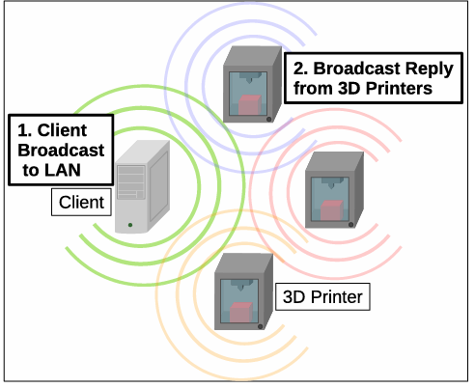
DEVICE DISCOVERY
To connect with a MakerBot 3D printer, a client device first sends a broadcast packet on the local network.
Devices with only TCP ports 80, 443, and 9999 open are likely to be MakerBot printers. The broadcast packet prompts all MakerBot printers on the network to respond.
When a MakerBot printer receives the broadcast packet, it sends a reply broadcast packet containing important device information, such as the printer’s model, IP address, and firmware version. This reply allows the client to detect and list all available MakerBot printers on the network for easy selection.
After discovering printers, the MakerBot Desktop software presents the user with a list of available printers. If only one printer is found, it is selected automatically.

Slide 9
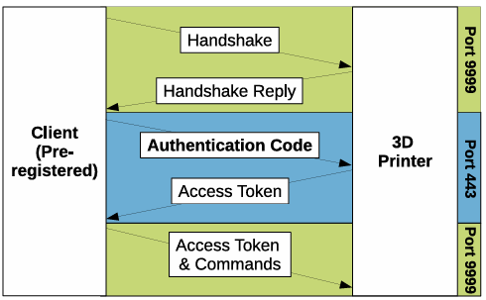
INITIAL CONNECTION AND AUTHENTICATION PROCESS
Once the client device selects a MakerBot printer, it initiates the connection by sending a handshake packet.
The printer replies to the handshake packet, confirming the initial connection between the client and printer.
If the client has previously connected to this printer, it likely has an Authentication Code saved from the earlier session.
Using this code, the client can directly request a new access token for the current session, simplifying reconnection.
To generate a new access token, the client sends both the Authentication Code and a client secret via an encrypted HTTPS request.
The printer responds with an access token, enabling secure, authenticated communication between the client and printer for the duration of the session.

Slide 10
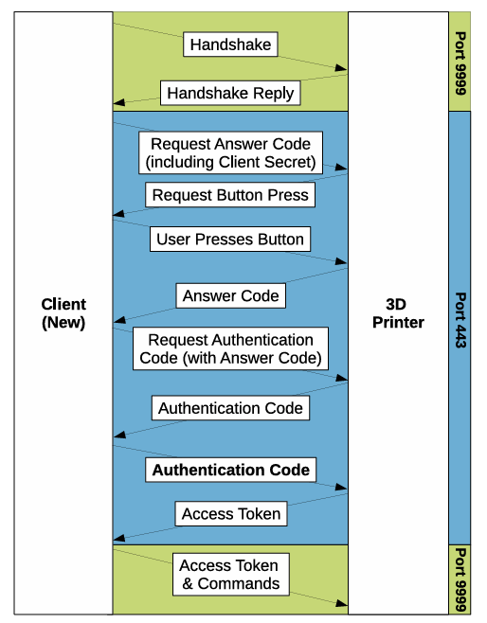
AUTHENTICATION PROCESS FOR
NEW CLIENTS

Slide 11
When a client tries to connect to a MakerBot 3D printer for the first time, the device requires an authentication code to establish a secure connection.
Since the client has no prior history with the printer, it needs to undergo an authentication process to obtain this code. This helps ensure that only authorized clients can control or interact with the printer.
The authentication begins with the client sending a request to the printer for an answer code. This answer code is a temporary code that initiates the process of establishing trust between the client and printer.
To proceed, the printer requires physical confirmation from the user. The printer will wait until the user physically presses its answer button to confirm that a legitimate user is present and authorizes the connection.
Once the answer button is pressed, the printer generates and sends the answer code back to the client. This step ensures that only someone with physical access to the printer can authorize a new client, enhancing security.
The client uses the answer code it received to request an authentication code from the printer.
Upon receiving this request, the printer generates the authentication code, which the client can store for future use. This code acts as a long-term credential, allowing the client to reconnect with the printer in future sessions without repeating the physical authentication steps.

Slide 12
Threat Model

Slide 13

Threat Model
Adversary assumed to have access to the network
No elevated privileges or access to any printer on the network
Goal is to obtain a legitimate authentication code which allows for access code generation
Two ways to complete this:
  Adversary must communicate directly with printer
  Steal an authentication code from a client which has already authenticated with the printer
Notes:
Assumed to have access to the network
Does not have elevated privileges and does ot have access to any of the printers or client devices on the network
Comparable to a client device
The goal is to obtain a legitimate authentication code to allow for the adversary to generate multiple access tokens for a single printer
Two ways to get an authentication code
Adversary must communicate directly with the printer
Steal an authentication code from a client who has already authenticated with the printer

Slide 14
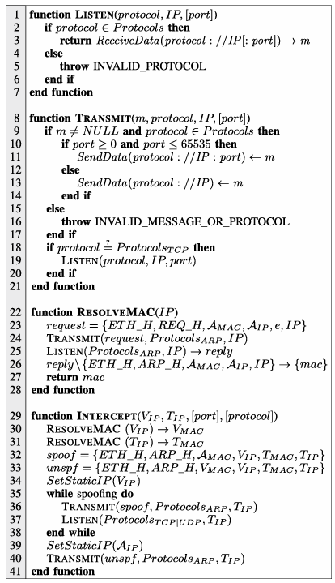
Adversary Capabilities
Four different capabilities:
  Listen
  Transmit
  ResolveMac
  Intercept

Slide 15
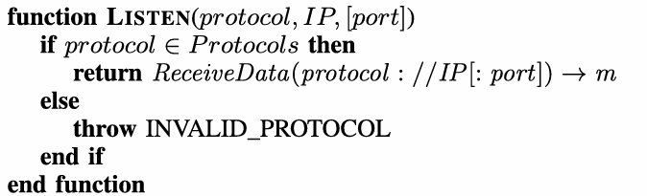
Adversary Capability: Listen
Allows the adversary to listen to unencrypted traffic on the network
If no port is provided then this will return all traffic with the target IP address
An empty set will be returned if no data is received
Notes:
This capabilities allows the adversary to listen to unencrypted traffic on the network from a target device with its protocol, IP address, and the optional port number
If no port is provided, then this will return all traffic involving the target IP address
This does not allow the adversary to prevent traffic from reaching a device on the network
An empty set will be returned if no data is received from the device

Slide 16
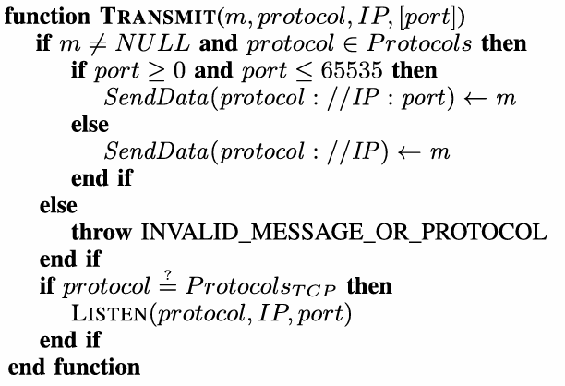
Adversary Capability: Transmit
Allows the adversary to send a message to an individual device or all devices on the network using specified protocol
An IP address and a port number can be provided
If TCP protocol is used to transmit then a response is expected from the device or network
If ARP or UDP protocol is used then a response is not expected
Notes:
This allows the adversary to send any message to any individual or all devices on the network using a protocol
Messages may be a set or tuple with results in transmission of the concatenation of the contents of the set or tuple
An ip address and a port number(optional) can be provided
This allows adversary to send a message to the whole network
TCP is stateful and the use of this is a response from the device or network
ARP and UDP is stateless so the message is transmitted and a response is not expected

Slide 17
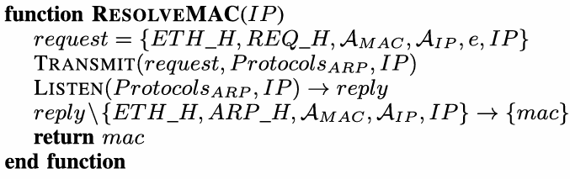
Adversary Capability: ResolveMAC
Adversary returns the MAC address associated with the specified IP address on the network

Slide 18
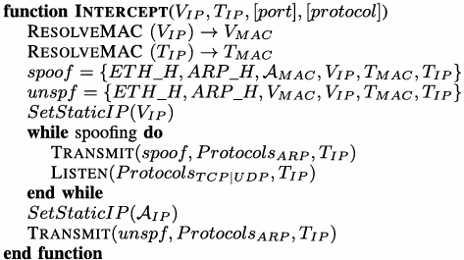
Adversary Capability: Intercept
Allows adversary to redirect traffic directed to a victim host on the network to a specified target host
This is achieved using ARP spoofing
Technique to direct traffic from a victim's IP to the adversary's physical MAC address
Notes:
Allows the adversary to redirect traffic to a victim host on the network to a target host
Achieved using ARP spoofing
Directs traffic meant for the victims IP to the adversary’s physical MAC address
Assumed that the adversary has a statically set IP Address

Slide 19
Insecurity
A system is considered insecure if it violates the following:
  Confidentiality: A system used to protect data or information such that only authorized parties have access to it
  Data Integrity: No Modification of data or information by unauthorized parties
  Entity Authentication: Ability to ensure that two devices can mutually identify themselves
Notes:
A system is considered insecure if it violates confidentiality, integrity and/or entity authentication
Confidentiality is defined as a system that is used to protect data or information such that only authorized parties have access to it
Violation occurs when the adversary obtains any sensitive data from the client or device
Data integrity deals with the modification of data or information by unauthorized parties
Violation occurs when the adversary's data is present in the printer or client
Entity authentication ensures that two devices are able to mutually identify themselves
Violation occurs adversary has the ability to impersonate another entity on the network

Slide 20
Attack Technique
The attack technique consists of a 16-step process
Steps 1-7 are the information gathering stage
Step 8 determines the adversary's targets
Steps 9-10 are the ARP spoofing attacks
Steps 11-12 are where the adversary obtains the victims authentication code
Step 13 is where the client is unspoofed
Steps 14-15 generate and authenticate a new access token from the stolen code
Step 16 grants privilege to the printer
Attack is performed using a Raspberry Pi 2 running the Raspbian OS
Adversary is only assumed to have their IP and MAC address

Slide 21

Step 1
Derive the broadcast address for the subnet
Used to distribute packets to devices on the network

Slide 22
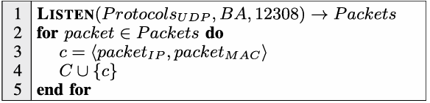
Step 2
Obtain the set of all client devices C on the network
Listening on this port will return a set of broadcast packets directed at MakerBot printing services
Each packet in this set that contains the message "{command: broadcast}" includes the clients IP and MAC address
Notes:
Listening on this port will return a set of broadcast packets directed at makerbot printing services
Each packet in this set that contains the message”{command: broadcast}” identifies a client and includes the clients IP address and MAC address
Iterates through every packet extracting each client’s IP and MAC address
Adversary now has knowledge of the IP and MAC address of every client

Slide 23

Step 3
Broadcast packet to the network to obtain the set of all printer replies
BA denotes the broadcast address which was found in step 1
b is the broadcast message
Transmitted on UDP port 12308 and broadcast reply is received on UDP port 12307

Slide 24
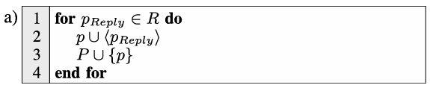

Step 4
Obtain a set of printers from the broadcast replies in step 2
Each broadcast reply contains the printer's configuration information
The adversary gets a reply from each printer on the network and the set of all printers is populated
The adversary then gets the corresponding IP from each printer

Slide 25
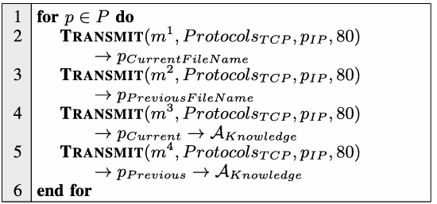
Step 5
Retrieve the current and previously printed 3D models from each printer
m1 and m2 are HTTP GET commands for the current and last print file path
m3 and m4 are HTTP GET commands are strings requesting the current and previous print files
This action does not require any authentication and only requires the adversary has knowledge of the printers IP

Slide 26
Insecurity
A system is considered insecure if it violates the following:
  Confidentiality: A system used to protect data or information such that only authorized parties have access to it
  Data Integrity: No Modification of data or information by unauthorized parties
  Entity Authentication: Ability to ensure that two devices can mutually identify themselves
Notes:
confidentiality is now breached since the adversary now has sensitive data that was stored on the 3d printer

Slide 27
Insecurity
A system is considered insecure if it violates the following:
  Confidentiality: A system used to protect data or information such that only authorized parties have access to it
  Data Integrity: No Modification of data or information by unauthorized parties
  Entity Authentication: Ability to ensure that two devices can mutually identify themselves
Notes:
confidentiality is now breached since the adversary now has sensitive data that was stored on the 3d printer

Slide 28
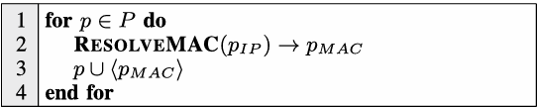
Step 6
Obtain the MAC address for each printer
Use ResolveMAC to obtain the MAC address

Slide 29
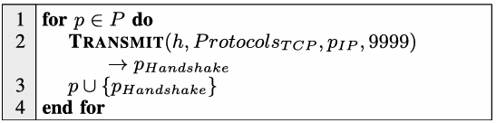
Step 7
Commence a "handshake" with each printer and obtain the responses
h is the client's handshake commencement JSON-RPC string consisting of a null username, host_version, and method handshake
This request can be hardcoded or the adversary can listen to the network for handshake instances on port 9999
  Communication on this port is unencrypted
Notes:
Where h is the client’s handshake commencement JSON-RPC string consisting of a null “username” and “host_version” and method “handshake”
The adversary can either hard code this request or listen to the network for instances of this handshake on port 9999
All communication on this port is unencrypted
All clients and printers must perform a handshake prior to any other operation so this would not be a difficult task
Handshake reply string is unique to each 3D printer

Slide 30

Step 8
Determine the attack targets
At this point the adversary has each printer's IP, MAC address, broadcast reply, and handshake reply
Also has the client's IP and MAC address
This is everything needed for the spoofing attack

Slide 31
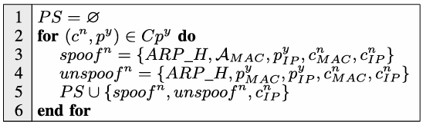
Step 9
Craft the ARP spoofing and unspoofing packets
ARP packets are crafted to directly target client devices to allow for easy reversal of the attack
Allows the network to be reverted back to its prior state
Notes:
Craft the ARP packet to perform the spoofing attack and the unspoof packet needed to restore the target’s ARP tables after an attack. Packets should be constructed using the details of the targeted client and printer pair
Target's MAC address is switched with the Adversary's MAC address

Slide 32
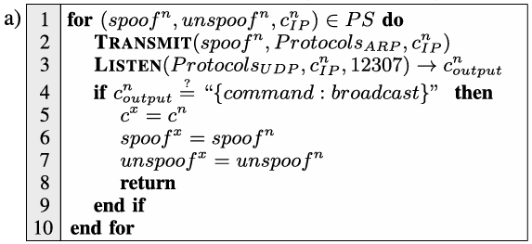

Step 10
Transmit each spoof and unspoof packet to each Client/Printer pair
If the reply from the client on port 12307 is the same as a MakerBot command broadcast message ("{command:broadcast}") then the attacker has correctly targeted a client who was connected to the chosen printer
Once a client has been identified the spoofed ARP packet should be sent continuously during the attack

Slide 33

Step 11
Open a connection with the client device
Transmit: Sends a broadcast reply containing the printer's configuration information to the client's IP address. The configuration information was found in step 4
Listen: Handshake command indicating to the printer that the client device has chosen to open a connection. The printer must then reply with a handshake acknowledgement
Transmit: Used to send the printer's handshake to the client which was found in step 7

Slide 34
Insecurity
A system is considered insecure if it violates the following:
  Confidentiality: A system used to protect data or information such that only authorized parties have access to it
  Data Integrity: No Modification of data or information by unauthorized parties
  Entity Authentication: Ability to ensure that two devices can mutually identify themselves
Notes:
The adversary has knowledge of the IP address, the MAC address, the broadcast reply, and the handshake reply that uniquely identifies the printer
It has convinced the client that they are the legitimate printer
This means that the principle of entitiy authentication has now been violated

Slide 35
Insecurity
A system is considered insecure if it violates the following:
  Confidentiality: A system used to protect data or information such that only authorized parties have access to it
  Data Integrity: No Modification of data or information by unauthorized parties
  Entity Authentication: Ability to ensure that two devices can mutually identify themselves
Notes:
The adversary has knowledge of the IP address, the MAC address, the broadcast reply, and the handshake reply that uniquely identifies the printer
It has convinced the client that they are the legitimate printer
This means that the principle of entity authentication has now been violated

Slide 36
Step 12
Open the client's authentication code and client secret
As a result of the handshake in step 11, the client will attempt to communicate with the adversary on port 443 (HTTPS)
A number of parameters are sent including the authentication code and the client secret

Slide 37

Step 13
Unspoof the client
At this point the adversary has everything to manipulate the targeted 3D printer
Adversary needs to restore the network to its former state
Done by sending the unspoofed packet directly to the client

Slide 38
Step 14
Generate a new access token
The adversary must use the stolen long term authentication code and client secret to generate a new short term access token
Transmits an HTTP request to MakerBots web server at "/auth" with these credentials
Receives a response as a JSON string with the new access token
Adversary can now impersonate the client

Slide 39

Step 15
Authenticate to the 3D printer with the access token
Adversary can now generate access tokens whenever they require privilege
The first transmit is the same client handshake used in step 7
  The output is the printer's handshake but the adversary no longer requires this information
The second transmit is the authentication JSON with the generated access token
  The printer will return a null JSON string informing the adversary that they are now authenticated

Slide 40
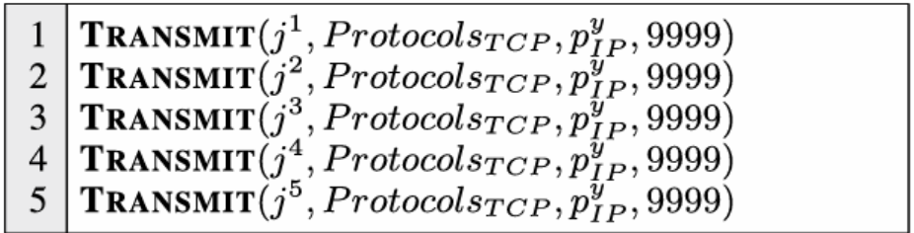
Step 16
Perform a privileged task after authentication
Printing:
  Can send/store files on the printer
  Can delete files on the printer
  Can send start commands to the printer with the assumption the build plate is cleared
  Can cancel a current print

Slide 41
Insecurity
A system is considered insecure if it violates the following:
  Confidentiality: A system used to protect data or information such that only authorized parties have access to it
  Data Integrity: No Modification of data or information by unauthorized parties
  Entity Authentication: Ability to ensure that two devices can mutually identify themselves
Notes:
Since the adversary can send and delete files on the printer
This violates the integrity of the printer

Slide 42
Insecurity
A system is considered insecure if it violates the following:
  Confidentiality: A system used to protect data or information such that only authorized parties have access to it
  Data Integrity: No Modification of data or information by unauthorized parties
  Entity Authentication: Ability to ensure that two devices can mutually identify themselves
Notes:
Since the adversary can send and delete files on the printer
This violates the integrity of the printer

Slide 43
IMPLICATIONS OF SECURITY FLAWS IN MAKERBOT 3D PRINTERS
While MakerBot 5th generation printers use HTTPS for client authentication, they lack proper certificate validation. This lack of validation allows attackers to bypass secure communication, making it easier for them to intercept data exchanged between the client and printer, ultimately compromising the security of the entire system.
Attackers need only basic equipment, such as a Raspberry Pi 2 and a Wi-Fi dongle, to exploit these vulnerabilities. They simply need access to the same network as the printer and client devices, which can be achieved wirelessly without physical presence.
Attackers connecting to the network can exploit the MakerBot protocol to access and control printers without even knowing the entire network layout.
Malware on any device within the network could also compromise the 3D printers, leading to unauthorized access or data theft.
Organizations that rely on multiple consumer 3D printers instead of a single industrial printer are particularly at risk, as the vulnerabilities affect each device on the network.

Slide 44
RECOMMENDATIONS TO MITIGATE SECURITY RISKS
MakerBot should store a trusted SSL certificate on each printer and update client software to verify this certificate. This would prevent impersonation and enhance secure communication.
Limit access to current and past print jobs by securing the network and implementing authentication protocols to prevent unauthorized devices from retrieving files.
Secure the network with measures to prevent ARP spoofing attacks. However, without addressing the unsecured web server, this alone won’t prevent data access.
Disconnect Wi-Fi and Ethernet, using only USB to connect the 3D printer to a dedicated computer. This would block network-based attacks.

Slide 45
CONCLUSION
The study demonstrated a data exfiltration and remote exploitation attack on MakerBot 5th generation 3D printers using a Raspberry Pi 2.
The attack allowed remote control of the printer, including sending new print jobs, canceling current jobs, and retrieving files without authentication.
These vulnerabilities could lead to intellectual property theft and financial losses, especially in organizations using 3D printers for prototype production.
The core components of the attack (e.g., ARP interception, packet modification) could apply to other 3D printer brands, though specific customization is required.
Future work: Future work includes exploring the feasibility of injecting data into object packets being transmitted to the printer. Success of this attack may vary based on network type (Ethernet or Wi-Fi) and the printer’s error-checking mechanisms. Other IoT devices (e.g., home automation systems, GPS receivers) could be examined for similar vulnerabilities.

Slide 46
References
Quang Do, B. Martini, and K.-K. R. Choo, "A Data Exfiltration and Remote Exploitation Attack on Consumer 3D Printers," IEEE Transactions on Information Forensics and Security, vol. 11, no. 10, pp. 2174-2186, Oct. 2016.

