Slide 1
PRIVACYSCOUT:
ASSESSING VULNERABILITY TO SHOULDER SURFING ON MOBILE DEVICES
CSE 707 - Wireless Networks Security, Principles and Practices
Presented by Group - 3,
Dharshini Adimoolam
Suraj Jaganathan

Slide 2
Paper Title:
Privacyscout: Assessing vulnerability to shoulder surfing on mobile devices
Published Date – 16th March 2022.
Authors - Mihai Bâce∗, Alia Saad∗, Mohamed Khamis, Stefan Schneegass, and Andreas Bulling.
Mihai Bâce∗: University of Stuttgart, Germany, E-mail: mihai.bace@vis.uni-stuttgart.de
Alia Saad∗: University of Duisburg-Essen, Germany, E-mail: alia.saad@uni-due.de
Mohamed Khamis: University of Glasgow, United Kingdom, E-mail: mohamed.khamis@glasgow.ac.uk
Stefan Schneegass: University of Duisburg-Essen, Germany, E-mail: stefan.schneegass@uni-due.de
Andreas Bulling: University of Stuttgart, Germany, E-mail: andreas.bulling@vis.uni-stuttgart.de

Slide 3
AGENDA

Slide 4
OVERVIEW & BACKGROUND
What is Shoulder Surfing on mobile devices?
Unauthorized observation of sensitive information on someone’s screen without their consent.
Nowadays, this has shown a serious impact on user’s privacy, security and safety.
Several existing methods such as image-based methods, gaze-based authentications or augmenting a screen protector can reduce the risk of a loss of sensitive information.
However, research indicates that these methods fails to warn the users when a shoulder surfing attack is happening at a particular moment of time.
Later, an effective approach found to detect shoulder surfing is to detect the presence of bystander using the front-facing camera. This also comes with a problem such as by warning the users every time a face is detected without assessing the real shoulder surfing risks.
This significantly minimizes the system’s effectiveness.

Slide 5
KEY CHARACTERISTICS OF SHOULDER SURFING
Vulnerability factors includes viewing distance, observation angle and the type of on-screen content.
Previous works by an author named Adam focuses on assessing the risk of content observation from different angles by focusing only on authentication and very limited viewing points.
While another author named Ali used a paper-based visual acuity test to measure text readability based on distance.
This study is the first to examine shoulder surfing vulnerabilities for text, photos and PINs.
A broader range of distances (50cm, 100cm, 150cm, 200cm) and angles (0°, 30°, 60°) were analyzed to allow for realistic simulation. The study results showed that attackers can easily observe whether a photo was taken indoor or outdoors or can count how many people are present in the photo. However, they are unlikely to observe finer details such as facial expressions.
PINs are highly vulnerable regardless of distance or angle.

Slide 6
PRIVACYSCOUT
A computational model that can predict the vulnerability of a shoulder surfing attack.
It extracts visual features from the attacker’s face, as captured by a wide range front facing camera of a mobile device and regresses a shoulder surfing risk score.
The risk assessment score was based on the results of the analysis and is a value between 0 to 3 for the text condition and 0 to 4 for the photo condition– where a higher value means a higher shoulder surfing risk for the mobile device user.
The first analysis focuses on the success of shoulder surfing beyond user authentication against commonly attacked content types. It is based on (4 distances * 3 observation angles) and on 16 participants in a lab.
Results on regressing the shoulder surfing risk score for text and photos shows that this method is the best performing in terms of the MAE and can more accurately assess the risk of a shoulder surfing attack.

Slide 7
EXPLORING THE CONCEPT OF SHOULDER SURFING
Most work on understanding shoulder surfing focused on observing knowledge-based authentication methods, about unauthorized access threats through inter views and online surveys.
Study 1:
Previous studies based on both the observer’s and user’s perspectives indicate that users reported negative feelings such as anger, embarrassment, and pressure.
Content that was surfed were text, pictures, games and authentication credentials are the most shoulder surfed content types.
Study 2:
authors used controlled video recordings of different authentication patterns and PIN
featured combinations of different display sizes, phone grips
Study showed that PINs are less vulnerable to attacks, when compared to unlock patterns.
Study 3:
same team extended their work by comparing the shoulder surfing videos with actual live simulations
participants, representing the attackers, stood behind a sitting user
suc cess of the observation attacks in replayed videos is not consistent
Study 4:
A recent study by Saad et al. [38] recorded 360-degree staged videos of shoulder surfing scenarios in public transportation, and displayed them to participants in a VR headset.
concluded that short glances allow observers to disclose the con tent and impose privacy threats.
Other studies focused on understanding the attacks’ susceptibility, due to sev eral reasons such as keyboard layout [41], or graphical passwords

Slide 8
APPROACHES TO PREVENT SHOULDER SURFING
Solutions Based on Authentication:
Privacy Filters
Gaze-Based Entry
Multimodal Authentication
Pattern Doodling
Image-Based Schemes
Beyond Authentication:
Detecting Faces
Screen Adjustments
iAlert App
Special Content Types:
Sensitive Pictures Distortion
Unreadable Fonts
EyeSpot and PrivateReader
HideScreen
PrivacyScout:
Vulnerability Estimation
Generic Use
Extended Concept
Accurate Detection
Research Contribution

Slide 9
FRAMEWORK FOR EVALUATING SHOULDER SURFING RISKS

Slide 10
CRUCIAL FACTORS AFFECTING SHOULDER SURFING EFFECTIVENESS

Slide 11
RESEARCH METHODOLOGY

Slide 12
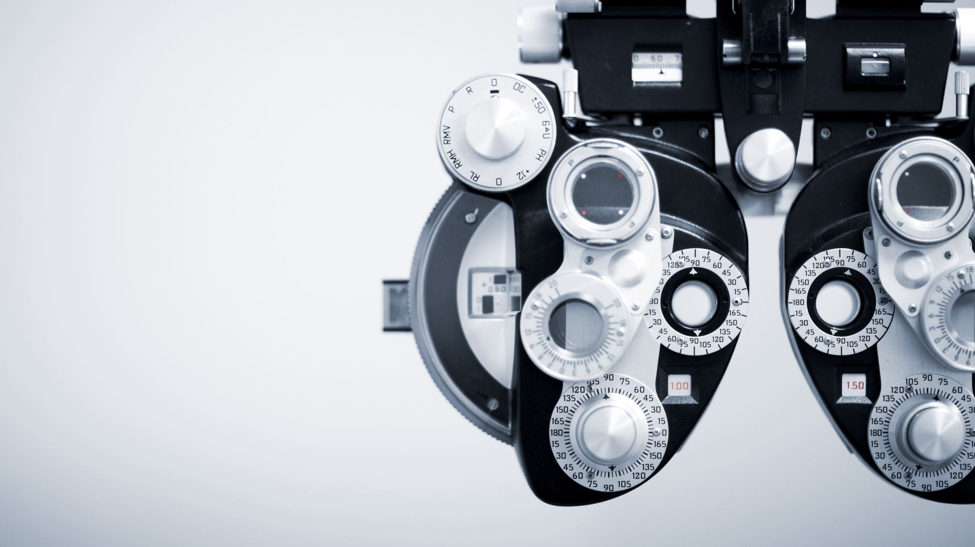
APPARATUS

Slide 13
PARTICIPANTS

Slide 14
STEPS AND PROTOCOLS

Slide 15
ANALYSING RESPONSES TO OPEN-ENDED QUESTIONS

Slide 16
ASSESSING VULNERABILITY TO SHOULDER SURFING ON MOBILE DEVICES

Slide 17
PINs, PHOTOS & TEXT

Slide 18
PRIVACYSCOUT: A METHOD TO ASSESS VULNERABILITY TO SHOULDER SURFING

Slide 19
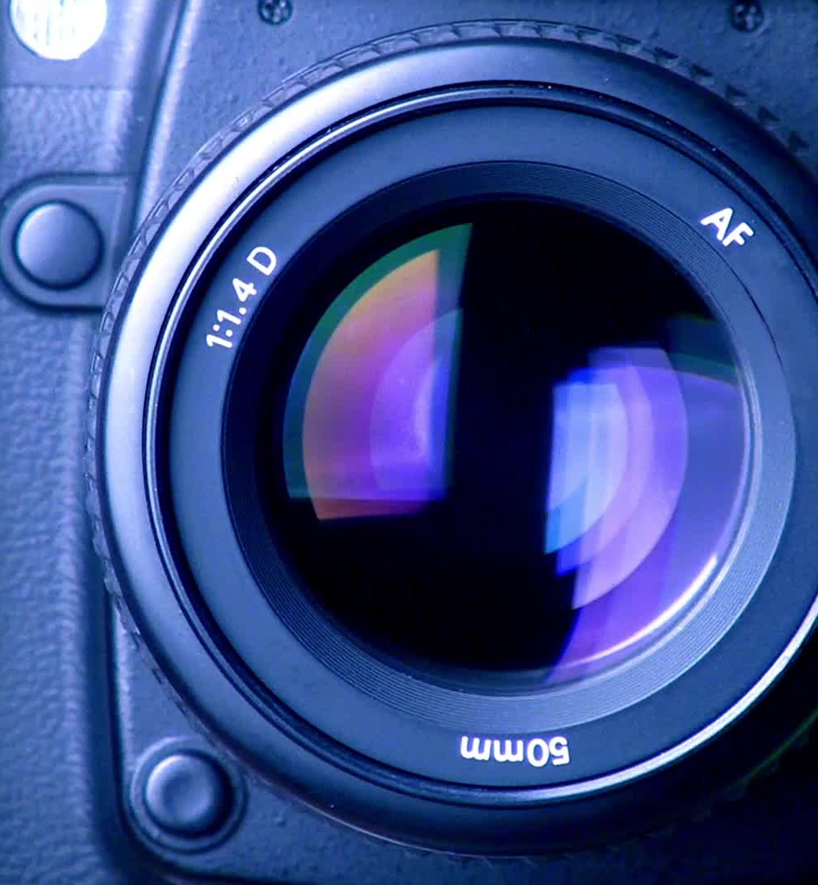
FACE DETECTION USING FRONT CAMERAS ON MOBILE

Slide 20
FINDINGS AND OUTCOMES

Slide 21
IN-DEPTH ANALYSIS

Slide 22
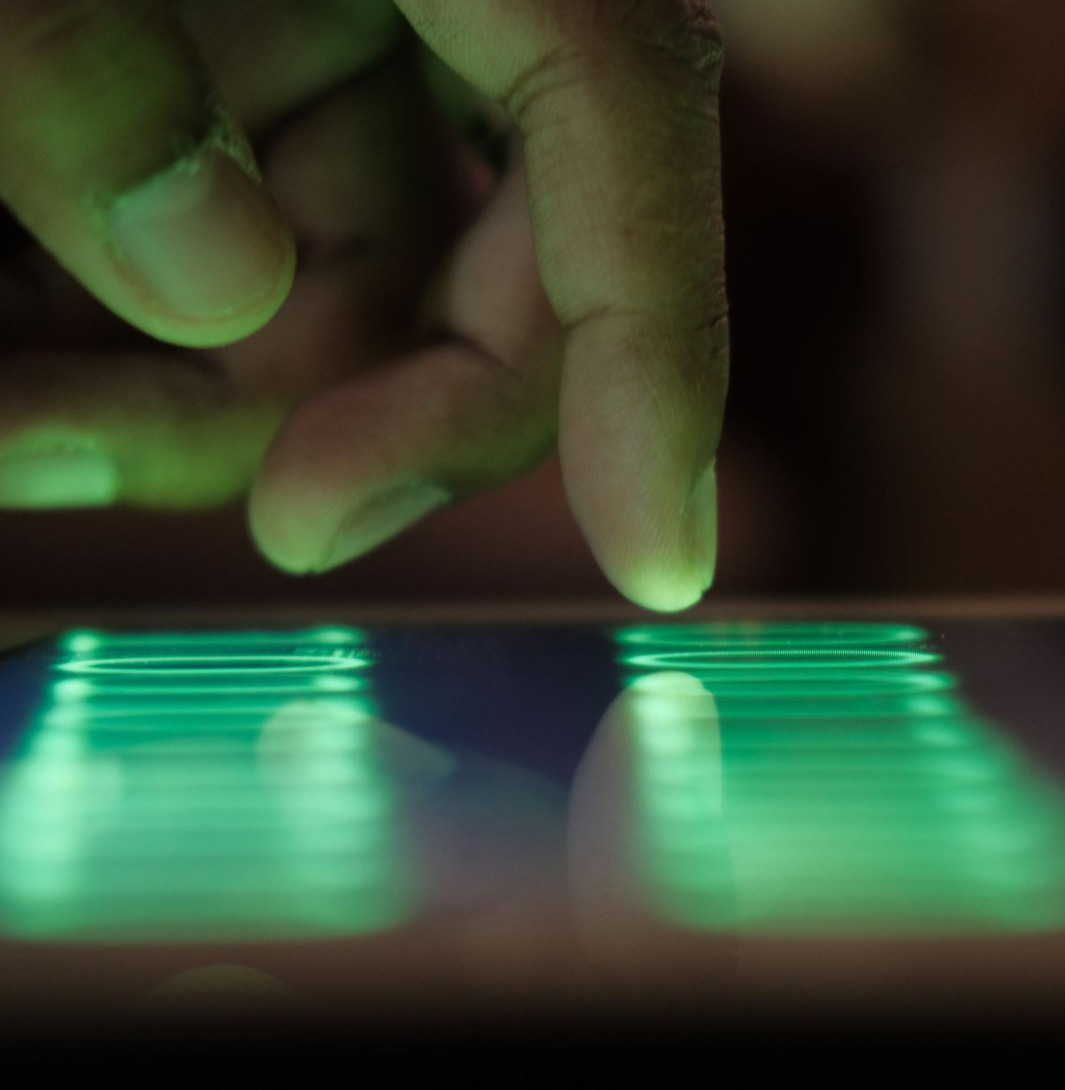
KEY INFLUENCES OF MOBILE DEVICE SHOULDER SURFING

Slide 23
REAL-TIME MONITORING OF SHOULDER SURFING RISKS

Slide 24
PRACTICAL USES OF PRIVACYSCOUT

Slide 25
USER EXPERIENCE AND SOCIAL IMPACT OF SHOULDER SURFING PREVENTION

Slide 26
CHALLENGES AND FUTURE WORK

Slide 27
CONCLUSION

