Slide 1
CSE 486/586 Distributed Systems
Domain Name System
Steve Ko
Computer Sciences and Engineering
University at Buffalo

Slide 2
Last Time
Two multicast algorithms for total ordering
  Sequencer
  ISIS
Multicast for causal ordering
  Uses vector timestamps

Slide 3
Review: Causally Ordered Multicast
Each process keeps a vector clock.
  Each counter represents the number of messages received from each of the other processes.
When multicasting a message, the sender process increments its own counter and attaches its vector clock.
Upon receiving a multicast message, the receiver process waits until it can preserve causal ordering:
  It has delivered all the messages from the sender.
  It has delivered all the messages that the sender had delivered before the multicast message.

Slide 4
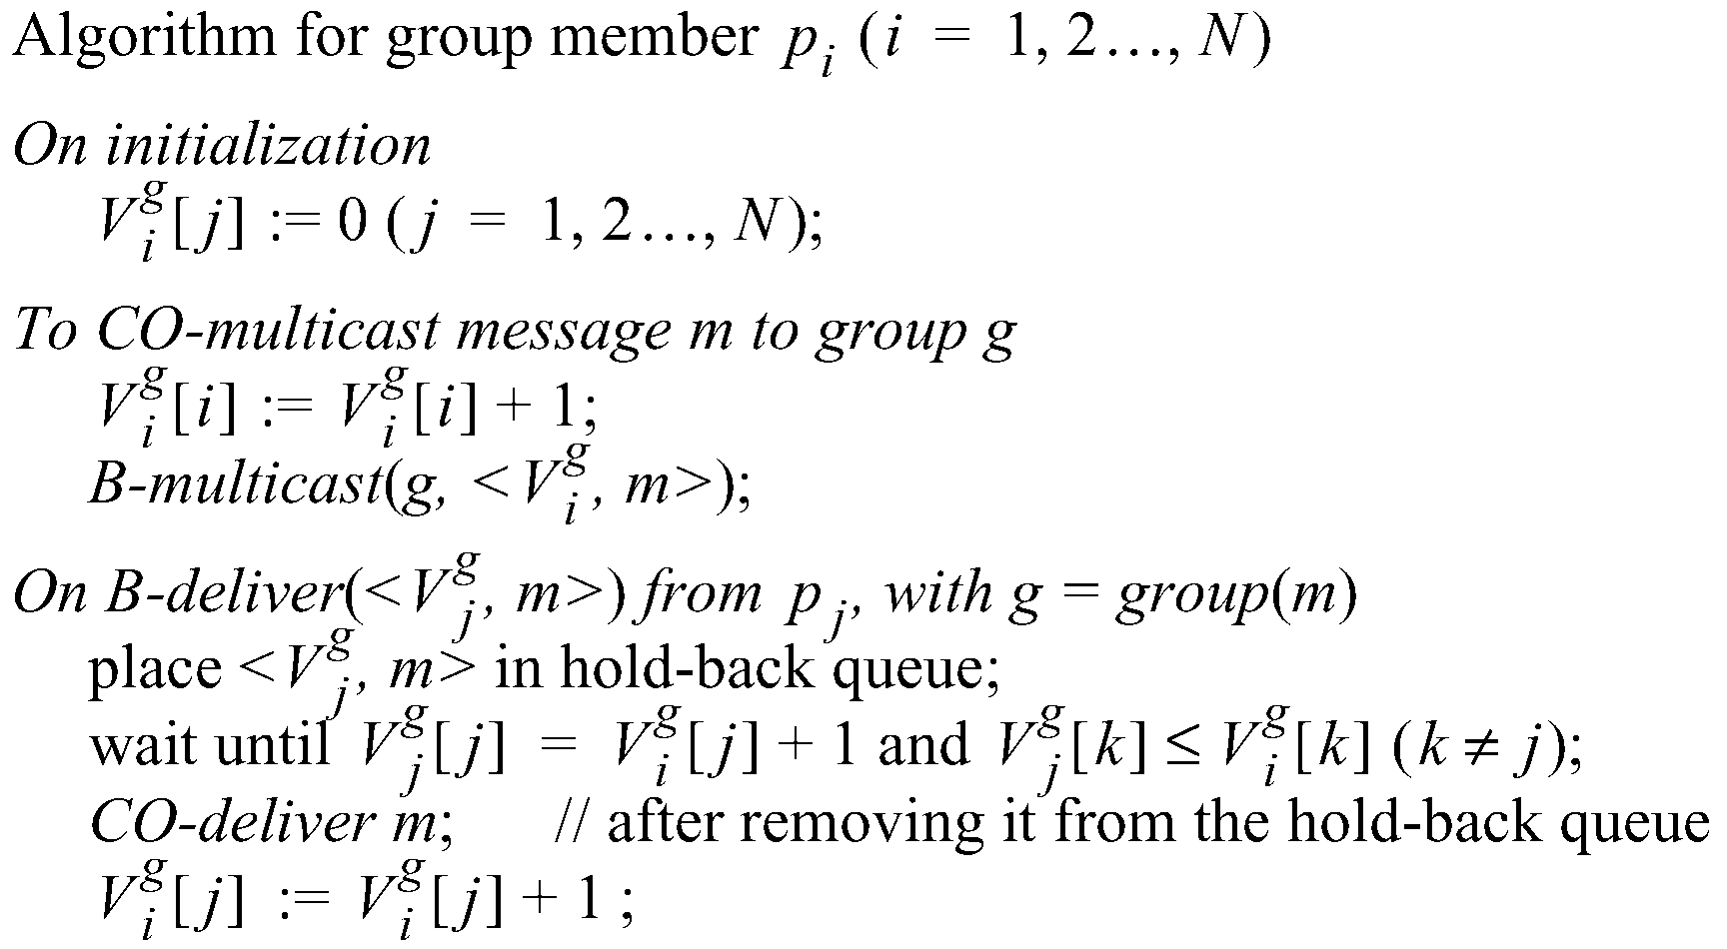
Review: Causal Ordering
The number of group-g messages
from process j that have been seen at
process i so far

Slide 5
Example: Causal Ordering Multicast
Reject:
Accept
P1
1,0,0
1,1,0
1,1,0
0,0,0
(1,0,0)
(1,1,0)
(1,1,0)
P2
0,0,0
1,0,0
1,1,0
(1,1,0)
(1,0,0)
P3
0,0,0
1,0,0
1,1,0
1,1,0
Accept
Accept:
Accept Buffered message
Buffer, missing P1(1)
Physical Time

Slide 6
Today’s Question
How do we organize the nodes in a distributed system?
Up to the 90’s
  Prevalent architecture: client-server (or master-slave)
  Unequal responsibilities
Now
  Emerged architecture: peer-to-peer
  Equal responsibilities
Studying an example client-server: DNS (today)
Studying peer-to-peer as a paradigm (not just as a file-sharing application)
  Learn the techniques and principles

Slide 7

Separating Names and IP Addresses
Names are easier (for us!) to remember
  www.cnn.com vs. 64.236.16.20
IP addresses can change underneath
  Move www.cnn.com to 173.15.201.39
  E.g., renumbering when changing providers
Name could map to multiple IP addresses
  www.cnn.com to multiple replicas of the Web site
Map to different addresses in different places
  Address of a nearby copy of the Web site
  E.g., to reduce latency, or return different content
Multiple names for the same address
  E.g., aliases like ee.mit.edu and cs.mit.edu

Slide 8
Two Kinds of Identifiers
Host name (e.g., www.cnn.com)
  Mnemonic name appreciated by humans
  Provides little (if any) information about location
  Hierarchical, variable # of alpha-numeric characters
IP address (e.g., 64.236.16.20)
  Numerical address appreciated by routers
  Related to host’s current location in the topology
  Hierarchical name space of 32 bits

Slide 9
Hierarchical Assignment Processes
Host name: www.cse.buffalo.edu
  Domain: registrar for each top-level domain (e.g., .edu)
  Host name: local administrator assigns to each host
IP addresses: 128.205.32.58
  Prefixes: ICANN, regional Internet registries, and ISPs
  Hosts: static configuration, or dynamic using DHCP

Slide 10
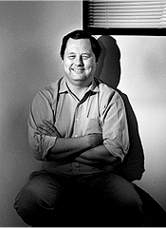
Domain Name System (DNS)
Proposed in 1983 by Paul Mockapetris

Slide 11
Overview: Domain Name System
A client-server architecture
  The server-side is still distributed for scalability.
  But the servers are still a hierarchy of clients and servers
Computer science concepts underlying DNS
  Indirection: names in place of addresses
  Hierarchy: in names, addresses, and servers
  Caching: of mappings from names to/from addresses
DNS software components
  DNS resolvers
  DNS servers
DNS queries
  Iterative queries
  Recursive queries
DNS caching based on time-to-live (TTL)

Slide 12
Strawman Solution #1: Local File
Original name to address mapping
  Flat namespace
  /etc/hosts
  SRI kept main copy
  Downloaded regularly
Count of hosts was increasing: moving from a machine per domain to machine per user
  Many more downloads
  Many more updates

Slide 13
Strawman Solution #2: Central Server
Central server
  One place where all mappings are stored
  All queries go to the central server
Many practical problems
  Single point of failure
  High traffic volume
  Distant centralized database
  Single point of update
  Does not scale
Need a distributed, hierarchical collection of servers

Slide 14
Domain Name System (DNS)
Properties of DNS
  Hierarchical name space divided into zones
  Distributed over a collection of DNS servers
Hierarchy of DNS servers
  Root servers
  Top-level domain (TLD) servers
  Authoritative DNS servers
Performing the translations
  Local DNS servers
  Resolver software

Slide 15
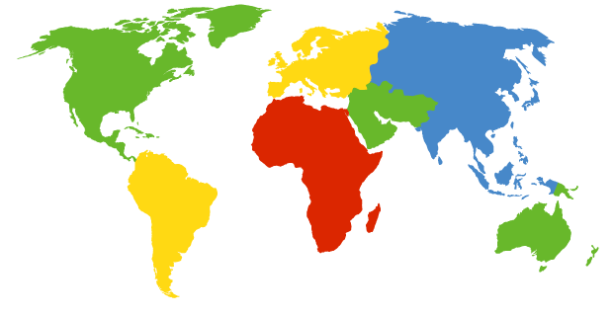
DNS Root Servers
13 root servers (see http://www.root-servers.org/)
Labeled A through M
A Verisign, Dulles, VA
C Cogent, Herndon, VA (also Los Angeles)
D U Maryland College Park, MD
G US DoD Vienna, VA
H ARL Aberdeen, MD
J Verisign, ( 11 locations)
K RIPE London (+ Amsterdam, Frankfurt)
I Autonomica, Stockholm (plus 3 other locations)
E NASA Mt View, CA
F Internet Software C. Palo Alto, CA (and 17 other locations)
m WIDE Tokyo
B USC-ISI Marina del Rey, CA
L ICANN Los Angeles, CA

Slide 16
TLD and Authoritative DNS Servers
Top-level domain (TLD) servers
  Generic domains (e.g., com, org, edu)
  Country domains (e.g., uk, fr, ca, jp)
  Typically managed professionally
    Network Solutions maintains servers for “com”
    Educause maintains servers for “edu”
Authoritative DNS servers
  Provide public records for hosts at an organization
  For the organization’s servers (e.g., Web and mail)
  Can be maintained locally or by a service provider

Slide 17
Distributed Hierarchical Database
unnamed root
com
edu
org
ac
uk
zw
arpa
generic domains
country domains
bar
ac
in-
addr
west
east
cam
12
foo
my
usr
34
my.east.bar.edu
usr.cam.ac.uk
56
12.34.56.0/24

Slide 18
Using DNS
Local DNS server (“default name server”)
  Usually near the end hosts who use it
  Local hosts configured with local server (e.g., /etc/resolv.conf) or learn the server via DHCP
Client application
  Extract server name (e.g., from the URL)
  Do gethostbyname() to trigger resolver code
Server application
  Extract client IP address from socket
  Optional gethostbyaddr() to translate into name

Slide 19
CSE 486/586 Administrivia
Please start PA2 if you haven’t.
PA1 grades will be out over the coming weekend.
AWS codes are distributed on UBLearns.
  Will post setup instructions.
Practice problem set 1 & midterm example posted on the course website.
Moving the midterm from Friday (3/8) to Wednesday (3/6)?
Come talk to me!

Slide 20
Example
root DNS server
Host at cis.poly.edu wants IP address for gaia.cs.umass.edu
2
3
TLD DNS server
4
local DNS server
dns.poly.edu
5
7
6
1
8
authoritative DNS server
dns.cs.umass.edu
requesting host
cis.poly.edu
gaia.cs.umass.edu

Slide 21
Recursive vs. Iterative Queries
Recursive query
  Ask server to get answer for you
  E.g., request 1 and response 8
Iterative query
  Ask server who
  to ask next
  E.g., all other request-response pairs
root DNS server
2
3
TLD DNS server
4
local DNS server
dns.poly.edu
5
7
6
1
8
authoritative DNS server
dns.cs.umass.edu
requesting host
cis.poly.edu

Slide 22
DNS Caching
Performing all these queries take time
  And all this before the actual communication takes place
  E.g., 1-second latency before starting Web download
Caching can substantially reduce overhead
  The top-level servers very rarely change
  Popular sites (e.g., www.cnn.com) visited often
  Local DNS server often has the information cached
How DNS caching works
  DNS servers cache responses to queries
  Responses include a “time to live” (TTL) field
  Server deletes the cached entry after TTL expires

Slide 23
Negative Caching
Remember things that don’t work
  Misspellings like www.cnn.comm and www.cnnn.com
  These can take a long time to fail the first time
  Good to remember that they don’t work
  … so the failure takes less time the next time around

Slide 24
DNS Resource Records
DNS: distributed db storing resource records (RR)
RR format: (name, value, type, ttl)
Type=A
  name is hostname
  value is IP address
Type=CNAME
  name is alias for some “canonical” (the real) name:
  www.ibm.com is really
  srveast.backup2.ibm.com
  value is canonical name
Type=NS
  name is domain
  (e.g. foo.com)
  value is hostname of authoritative name server for this domain
Type=MX
  value is name of mailserver associated with name

Slide 25
Reliability
DNS servers are replicated
  Name service available if at least one replica is up
  Queries can be load balanced between replicas
UDP used for queries
  Need reliability: must implement this on top of UDP
Try alternate servers on timeout
  Exponential backoff when retrying same server
Same identifier for all queries
  Don’t care which server responds

Slide 26

Inserting Resource Records into DNS
Example: just created startup “FooBar”
Register foobar.com at Network Solutions
  Provide registrar with names and IP addresses of your authoritative name server (primary and secondary)
  Registrar inserts two RRs into the com TLD server:
    (foobar.com, dns1.foobar.com, NS)
    (dns1.foobar.com, 212.212.212.1, A)
Put in authoritative server dns1.foobar.com
  Type A record for www.foobar.com
  Type MX record for foobar.com
Play with “dig” on UNIX

Slide 27
$ dig nytimes.com ANY
; QUESTION SECTION:
;nytimes.com. IN ANY
;; ANSWER SECTION:
nytimes.com. 267 IN MX 100 NYTIMES.COM.S7A1.PSMTP.com.
nytimes.com. 267 IN MX 200 NYTIMES.COM.S7A2.PSMTP.com.
nytimes.com. 267 IN A 199.239.137.200
nytimes.com. 267 IN A 199.239.136.200
nytimes.com. 267 IN TXT "v=spf1 mx ptr ip4:199.239.138.0/24 include:alerts.wallst.com include:authsmtp.com ~all"
nytimes.com. 267 IN SOA ns1t.nytimes.com. root.ns1t.nytimes.com. 2009070102 1800 3600 604800 3600
nytimes.com. 267 IN NS nydns2.about.com.
nytimes.com. 267 IN NS ns1t.nytimes.com.
nytimes.com. 267 IN NS nydns1.about.com.
;; AUTHORITY SECTION:
nytimes.com. 267 IN NS nydns1.about.com.
nytimes.com. 267 IN NS ns1t.nytimes.com.
nytimes.com. 267 IN NS nydns2.about.com.
;; ADDITIONAL SECTION:
nydns1.about.com. 86207 IN A 207.241.145.24
nydns2.about.com. 86207 IN A 207.241.145.25

Slide 28
$ dig nytimes.com +norec @a.root-servers.net
;; ->>HEADER<<- opcode: QUERY, status: NOERROR, id: 53675
;; flags: qr; QUERY: 1, ANSWER: 0, AUTHORITY: 13, ADDITIONAL: 14
;; QUESTION SECTION:
;nytimes.com. IN A
;; AUTHORITY SECTION:
com. 172800 IN NS K.GTLD-SERVERS.NET.
com. 172800 IN NS E.GTLD-SERVERS.NET.
com. 172800 IN NS D.GTLD-SERVERS.NET.
com. 172800 IN NS I.GTLD-SERVERS.NET.
com. 172800 IN NS C.GTLD-SERVERS.NET.
;; ADDITIONAL SECTION:
A.GTLD-SERVERS.NET. 172800 IN A 192.5.6.30
A.GTLD-SERVERS.NET. 172800 IN AAAA 2001:503:a83e::2:30
B.GTLD-SERVERS.NET. 172800 IN A 192.33.14.30
B.GTLD-SERVERS.NET. 172800 IN AAAA 2001:503:231d::2:30
C.GTLD-SERVERS.NET. 172800 IN A 192.26.92.30
D.GTLD-SERVERS.NET. 172800 IN A 192.31.80.30
E.GTLD-SERVERS.NET. 172800 IN A 192.12.94.30
;; Query time: 76 msec
;; SERVER: 198.41.0.4#53(198.41.0.4)
;; WHEN: Mon Feb 23 11:24:06 2009
;; MSG SIZE rcvd: 501

Slide 29
$ dig nytimes.com +norec @k.gtld-servers.net
;; ->>HEADER<<- opcode: QUERY, status: NOERROR, id: 38385
;; flags: qr; QUERY: 1, ANSWER: 0, AUTHORITY: 3, ADDITIONAL: 3
;; QUESTION SECTION:
;nytimes.com. IN A
;; AUTHORITY SECTION:
nytimes.com. 172800 IN NS ns1t.nytimes.com.
nytimes.com. 172800 IN NS nydns1.about.com.
nytimes.com. 172800 IN NS nydns2.about.com.
;; ADDITIONAL SECTION:
ns1t.nytimes.com. 172800 IN A 199.239.137.15
nydns1.about.com. 172800 IN A 207.241.145.24
nydns2.about.com. 172800 IN A 207.241.145.25
;; Query time: 103 msec
;; SERVER: 192.52.178.30#53(192.52.178.30)
;; WHEN: Mon Feb 23 11:24:59 2009
;; MSG SIZE rcvd: 144

Slide 30
$ dig nytimes.com ANY +norec @ns1t.nytimes.com
;; ->>HEADER<<- opcode: QUERY, status: NOERROR, id: 39107
;; flags: qr aa; QUERY: 1, ANSWER: 13, AUTHORITY: 0, ADDITIONAL: 1
;; QUESTION SECTION:
;nytimes.com. IN ANY
;; ANSWER SECTION:
nytimes.com. 300 IN SOA ns1t.nytimes.com.
root.ns1t.nytimes.com. 2009070102 1800 3600 604800 3600
nytimes.com. 300 IN MX 200 NYTIMES.COM.S7A2.PSMTP.com.
nytimes.com. 300 IN MX 100 NYTIMES.COM.S7A1.PSMTP.com.
nytimes.com. 300 IN NS ns1t.nytimes.com.
nytimes.com. 300 IN NS nydns1.about.com.
nytimes.com. 300 IN NS nydns2.about.com.
nytimes.com. 300 IN A 199.239.137.245
nytimes.com. 300 IN A 199.239.136.200
nytimes.com. 300 IN A 199.239.136.245
nytimes.com. 300 IN TXT "v=spf1 mx ptr ip4:199.239.138.0/24
include:alerts.wallst.com include:authsmtp.com ~all"
;; ADDITIONAL SECTION:
ns1t.nytimes.com. 300 IN A 199.239.137.15
;; Query time: 10 msec
;; SERVER: 199.239.137.15#53(199.239.137.15)
;; WHEN: Mon Feb 23 11:25:20 2009
;; MSG SIZE rcvd: 454

Slide 31
Content Distribution Networks (CDNs)
31
Content providers are CDN customers
Content replication
CDN company installs thousands of servers throughout Internet
  In large datacenters
  Or, close to users
CDN replicates customers’ content
When provider updates content, CDN updates servers
origin server
in North America
CDN distribution node
CDN server
in S. America
CDN server
in Asia
CDN server
in Europe

Slide 32
Content Distribution Networks
Replicate content on many servers
Challenges
  How to replicate content
  Where to replicate content
  How to find replicated content
  How to choose among replicas
  How to direct clients towards a replica

Slide 33
Server Selection
Which server?
  Lowest load: to balance load on servers
  Best performance: to improve client performance
    Based on what? Location? RTT? Throughput? Load?
  Any alive node: to provide fault tolerance
How to direct clients to a particular server?
  As part of routing: anycast, cluster load balancer
  As part of application: HTTP redirect
  As part of naming: DNS

Slide 34
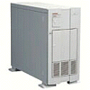

How Akamai Works
34
cnn.com (content provider)
HTTP
DNS root server
GET index.html
Akamai
cluster
http://cache.cnn.com/cnn.com/foo.jpg
Akamai global
DNS server
1
2
HTTP
Akamai regional
DNS server
Nearby
Akamai
cluster
End-user

Slide 35
How Akamai Works
35
cnn.com (content provider)
HTTP
DNS root server
DNS lookup
cache.cnn.com
Akamai
cluster
Akamai global
DNS server
1
2
3
ALIAS:
g.akamai.net
4
Akamai regional
DNS server
Nearby
Akamai
cluster
End-user

Slide 36
How Akamai Works
36
cnn.com (content provider)
HTTP
DNS root server
DNS lookup
g.akamai.net
Akamai
cluster
Akamai global
DNS server
5
1
2
3
4
6
Akamai regional
DNS server
ALIAS
a73.g.akamai.net
Nearby
Akamai
cluster
End-user

Slide 37
How Akamai Works
37
cnn.com (content provider)
HTTP
DNS root server
Akamai
cluster
Akamai global
DNS server
5
1
2
3
4
6
Akamai regional
DNS server
7
DNS a73.g.akamai.net
8
Address
1.2.3.4
Nearby
Akamai
cluster
End-user

Slide 38
How Akamai Works
38
cnn.com (content provider)
HTTP
DNS root server
Akamai
cluster
Akamai global
DNS server
5
1
2
3
4
6
Akamai regional
DNS server
7
8
9
Nearby
Akamai
cluster
End-user
GET /foo.jpg
Host: cache.cnn.com

Slide 39

How Akamai Works
39
cnn.com (content provider)
HTTP
DNS root server
GET foo.jpg
11
12
Akamai
cluster
Akamai global
DNS server
5
1
2
3
4
6
Akamai regional
DNS server
7
8
9
Nearby
Akamai
cluster
End-user
GET /foo.jpg
Host: cache.cnn.com

Slide 40
How Akamai Works
40
cnn.com (content provider)
HTTP
DNS root server
11
12
Akamai
cluster
Akamai global
DNS server
5
1
2
3
4
6
Akamai regional
DNS server
7
8
9
Nearby
Akamai
cluster
End-user
10

Slide 41
Summary
DNS as an example client-server architecture
Why?
  Names are easier (for us!) to remember
  IP addresses can change underneath
  Name could map to multiple IP addresses
  Map to different addresses in different places
  Multiple names for the same address
Properties of DNS
  Distributed over a collection of DNS servers
Hierarchy of DNS servers
  Root servers, top-level domain (TLD) servers, authoritative DNS servers

Slide 42
Acknowledgements
These slides contain material developed and copyrighted by Indranil Gupta (UIUC), Michael Freedman (Princeton), and Jennifer Rexford (Princeton).

