Slide 1
CSE 486/586 Distributed Systems
Security --- 1
Steve Ko
Computer Sciences and Engineering
University at Buffalo

Slide 2
Security Threats
Leakage: An unauthorized party gains access to a service or data.
  Attacker obtains knowledge of a withdrawal or account balance
Tampering: Unauthorized change of data, tampering with a service
  Attacker changes the variable holding your personal checking $$ total
Vandalism: Interference with proper operation, without gain to the attacker
  Attacker does not allow any transactions to your account

Slide 3

Security Properties
Confidentiality: Concealment of information or resources
Authenticity: Identification and assurance of origin of info
Integrity: Trustworthiness of data or resources in terms of preventing improper and unauthorized changes
Availability: Ability to use desired info or resource
Non-repudiation: Offer of evidence that a party indeed is sender or a receiver of certain information
Access control: Facilities to determine and enforce who is allowed access to what resources (host, software, network, …)

Slide 4
Attack on Confidentiality
Eavesdropping
  Unauthorized access to information
  Packet sniffers and wiretappers (e.g. tcpdump)
  Illicit copying of files and programs
A
B
Eavesdropper

Slide 5
Attack on Integrity
Tampering
  Stop the flow of the message
  Delay and optionally modify the message
  Release the message again
A
B
Perpetrator

Slide 6
Attack on Authenticity
Fabrication
  Unauthorized assumption of other’s identity
  Generate and distribute objects under identity
A
B
Masquerader: from A

Slide 7
Attack on Availability
Destroy hardware (cutting fiber) or software
Modify software in a subtle way
Corrupt packets in transit
Blatant denial of service (DoS):
  Crashing the server
  Overwhelm the server (use up its resource)
A
B

Slide 8
Designing Secure Systems
Your system is only as secure as your weakest component!
Need to make worst-case assumptions about attackers:
  exposed interfaces, insecure networks, algorithms and program code available to attackers, attackers may be computationally very powerful
  Tradeoff between security and performance impact/difficulty
  Typically design system to withstand a known set of attacks (Attack Model or Attacker Model)
It is not easy to design a secure system.
And it’s an arms race!

Slide 9
CSE 486/586 Administrivia
PA4 is due Friday next week.

Slide 10
Cryptography
Comes from Greek word meaning “secret”
  Primitives also can provide integrity, authentication
Cryptographers invent secret codes to attempt to hide messages from unauthorized observers
Modern encryption:
  Algorithm public, key secret and provides security
  May be symmetric (secret) or asymmetric (public)
Cryptographic algorithms goal
  Given key, relatively easy to compute
  Without key, hard to compute (invert)
  “Level” of security often based on “length” of key
encryption
decryption
plaintext
ciphertext
plaintext

Slide 11
Three Types of Functions
Cryptographic hash Functions
  Zero keys
Secret-key functions
  One key
Public-key functions
  Two keys

Slide 12
Cryptographic Hash Functions
Take message, m, of arbitrary length and produces a smaller (short) number, h(m)
Properties
  Easy to compute h(m)
  Pre-image resistance (strong collision): Hard to find an m, given h(m)
    “One-way function”
  Second pre-image resistance (weak collision): Hard to find two values that hash to the same h(m)
    E.g. discover collision: h(m) == h(m’) for m != m’
  Often assumed: output of hash fn’s “looks” random
What’s wrong with collisions?
  E.g., message authentication (MAC) (will discuss later).

Slide 13
How Hard to Find Collisions?
Think like an attacker. What would be the simplest strategy to try?
  Brute-force trials.
  Then the question is how many trials do we need?
  The “strength” of your crypto hash depends on how hard it is to find out collisions.
Birthday paradox
  In a set of n random people, what’s the probability of two people having the same birthday?
What’s the similarity between this and the crypto hash collision?
Calculation
  Compute probability of different birthdays
  Random sample of n people taken from k=365 days
Notes:
Choose one date and assign it to one person. Remove that from the choice. Choose another date and assign it to a second person. Remove that from the choice.
Repeat the above n times, and get all possible choices for everybody having a different birthday.

Slide 14
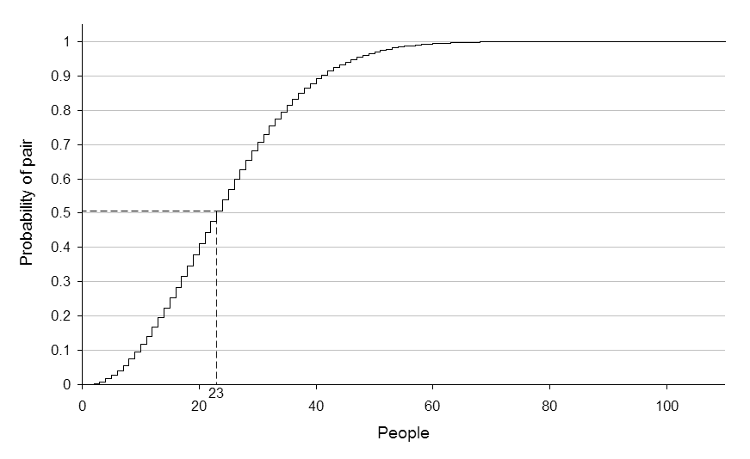
Birthday Paradox
Probability of no repetition:
  P = 1 – (1) (1 - 1/365) (1 – 2/365) (1 – 3/365) … (1 – (n-1)/365)
  (k = # of slots, e.g., 365) P ≈ 1 – e^{-(n(n-1)/2k}
  For p, it takes roughly sqrt(2k * ln(1/(1-p))) people to find two people with the same birthday.
With p = 50%,
Notes:
With 60~80 people, the probability is very close to 1. You do not need 366 people to find a collision.

Slide 15
How Many Bits for Hash?
If m bits, how many numbers do we need to find (weak) collision?
  It’s not 2^{m} + 1!
  It takes 2^{m/2} to find weak collision (with high probability)
  Still takes 2^{m} to find strong (pre-image) collision
64 bits, takes 2³² messages to search
MD5 (128 bits) considered too little
SHA-1 (160 bits) getting old
Notes:
Apply the same analysis, and you find two values that hash to the same value.

Slide 16
Example: Password
Password hashing
  Can’t store passwords in a file that could be read
  Concerned with insider attacks!
Must compare typed passwords to stored passwords
  Does hash (typed) === hash (password)?
Actually, a salt is often used: hash (input || salt)
  Avoids precomputation of all possible hashes in “rainbow tables” (available for download from file-sharing systems)

Slide 17
Symmetric (Secret) Key Crypto
Also: “conventional / private-key / single-key”
  Sender and recipient share a common key
  All classical encryption algorithms are private-key
  Dual use: confidentiality (encryption) or authentication/integrity (message authentication code)
Was only type of encryption prior to invention of public-key in 1970’s
  Most widely used
  More computationally efficient than “public key”

Slide 18
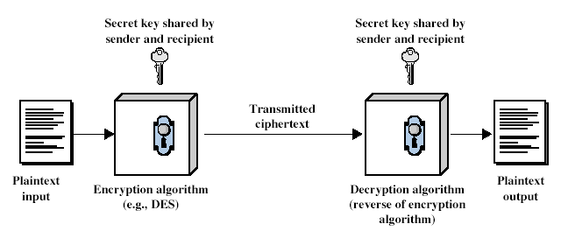
Symmetric Cipher Model

Slide 19
Requirements
Two requirements
  Strong encryption algorithm
  Secret key known only to sender/receiver
Goal: Given key, generate 1-to-1 mapping to ciphertext that looks random if key unknown
  Assume algorithm is known (no security by obscurity)
  Implies secure channel to distribute key

Slide 20
Uses
Encryption
  For confidentiality
  Sender: Compute C = AES_{K}(M) & Send C
  Receiver: Recover M = AES’_{K}(C)
Message Authentication Code (MAC)
  For integrity and authenticity
  Sender: Compute H = AES_{K}(SHA1 (M)) & Send <M, H>
  Receiver: Computer H’ = AES_{K}(SHA1 (M)) & Check H’ == H
Notes:
SHA1 gives a “summary” of M. AES gives a proof.

Slide 21
Public (Asymmetric) Key Crypto
Developed to address two key issues
  Key distribution: secure communication without having to trust a key distribution center with your key
  Digital signature: verifying that a message comes from the claimed sender without prior establishment
Public invention Diffie & Hellman in 1976
  Known earlier to classified community

Slide 22
Public (Asymmetric) Key Crypto
Involves two keys
  Public key: can be known to anybody, used to encrypt and verify signatures
  Private key: should be known only to the recipient, used to decrypt and sign signatures
Asymmetric
  Can encrypt messages or verify signatures w/o ability to decrypt msgs or create signatures
  If “one-way function” goes c ← F(m), then public-key encryption is a “trap-door” function:
    Easy to compute c ← F(m)
    Hard to compute m ← F⁻¹(c) without knowing k
    Easy to compute m ← F⁻¹(c,k) by knowing k

Slide 23
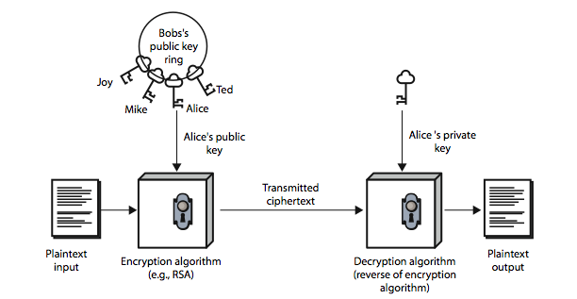
Public (Asymmetric) Key Crypto

Slide 24
Security of Public Key Schemes
Like private key schemes, brute force search possible
  But keys used are too large (e.g., >= 1024 bits)
Security relies on a difference in computational difficulty b/w easy and hard problems
  RSA: exponentiation in composite group vs. factoring
  ElGamal/DH: exponentiation vs. discrete logarithm in prime group
  Hard problems are known, but computationally expensive
Requires use of very large numbers
  Hence is slow compared to private key schemes
  RSA-1024: 80 us / encryption; 1460 us / decryption [cryptopp.com]
  AES-128: 109 MB / sec = 1.2us / 1024 bits

Slide 25
(Simple) RSA Algorithm
Security due to cost of factoring large numbers
  Factorization takes O(e ^{log n log log n}) operations (hard)
  Exponentiation takes O((log n)³) operations (easy)
To encrypt a message M the sender:
  Obtain public key {e,n}; compute C = Me mod n
To decrypt the ciphertext C the owner:
  Use private key {d,n}; computes M = C^{d} mod n
Note that msg M must be smaller than the modulus n
Otherwise, hybrid encryption:
  Generate random symmetric key r
  Use public key encryption to encrypt r
  Use symmetric key encryption under r to encrypt M

Slide 26
Typical Applications
Secure digest (with cryptographic hash functions)
  A fixed-length that characterizes an arbitrary-length message
  Typically produced by cryptographic hash functions, e.g., SHA-1 or MD5.
Digital signature with asymmetric crypto
  Verifies a message or a document is an unaltered copy of one produced by the signer
  Signer: compute H = RSA_{K}(SHA1(M)) & send <M, H>
  Verifier: compute H’ = SHA1(M) & verify RSA_{K’}(H) == H’

Slide 27
Summary
Security properties
  Confidentiality, authenticity, integrity, availability, non-repudiation, access control
Three types of functions
  Cryptographic hash, symmetric key crypto, asymmetric key crypto
Applications
  Secure digest, digital signature, MAC, digital certificate

Slide 28
Acknowledgements
These slides contain material developed and copyrighted by Indranil Gupta (UIUC), Jennifer Rexford (Princeton) and Michael Freedman (Princeton).

