Slide 1
CSE 490/590 Computer Architecture
Cache III
Steve Ko
Computer Sciences and Engineering
University at Buffalo

Slide 2
Last time…
Basic cache architecture
  Placement policy
  Replacement policy
Average memory access time =
hit time + miss rate * miss penalty
To improve performance, reduce:
  hit time
  miss rate
  and/or miss penalty
Primary cache parameters:
  Total cache capacity
  Cache line size
  Associativity

Slide 3
Causes for Cache Misses
Compulsory: first-reference to a block a.k.a. cold
start misses
- misses that would occur even with infinite cache
Capacity: cache is too small to hold all data needed by the program
- misses that would occur even under perfect
replacement policy & full associativity
Conflict: misses that occur because of collisions
due to block-placement strategy
    - misses that would not occur with full associativity

Slide 4
Effect of Cache Parameters on Performance
Larger cache size
  reduces capacity and conflict misses
  hit time will increase
Higher associativity
  reduces conflict misses
  may increase hit time
Larger block size
  reduces compulsory and capacity (reload) misses
  increases conflict misses and miss penalty
Notes:
Requested block first….
The following could be in the slide…
spatial locality reduces compulsory misses and capacity reload misses
fewer blocks may increase conflict miss rate
larger blocks may increase miss penalty

Slide 5
Write Policy Choices
Cache hit:
  write through: write both cache & memory
    Generally higher traffic but simpler pipeline & cache design
  write back: write cache only, memory is written only when the entry is evicted
    A dirty bit per block further reduces write-back traffic
    Must handle 0, 1, or 2 accesses to memory for each load/store
Cache miss:
  no write allocate: only write to main memory
  write allocate (aka fetch on write): fetch into cache
Common combinations:
  write through and no write allocate
  write back with write allocate

Slide 6
Write Performance
Tag
Index
Block
Offset
b
t
k
V
Tag
Data
2^{k}
lines
t
=
WE
HIT
Data Word or Byte
Notes:
Completely serial (jse)

Slide 7
Reducing Write Hit Time
Problem: Writes take two cycles in memory stage, one cycle for tag check plus one cycle for data write if hit
Solutions:
Design data RAM that can perform read and write in one cycle, restore old value after tag miss
Write buffer: Hold write data for store in single buffer ahead of cache, and write returns immediately
Notes:
Need to bypass from write buffer if read address matches write buffer tag!

Slide 8
Write Buffer to Reduce Read Miss Penalty
Data Cache
CPU
RF
Write
buffer
Processor is not stalled on writes, and read misses can go ahead of write to main memory
Problem: Write buffer may hold updated value of location needed by a read miss
Simple scheme: on a read miss, wait for the write buffer to go empty
Faster scheme: Check write buffer addresses against read miss addresses, if no match, allow read miss to go ahead of writes, else, return value in write buffer
Notes:
Deisgners of the MIPS M/1000 estimated that waiting for a four-word buffer to empty
increased the read miss penalty by a factor of 1.5.

Slide 9
Multilevel Caches
Problem: A memory cannot be large and fast
Solution: Increasing sizes of cache at each level
DRAM
CPU
L2$
L1$
Local miss rate = misses in cache / accesses to cache
Global miss rate = misses in cache / CPU memory accesses
Misses per instruction = misses in cache / number of instructions
Notes:
MPI makes it easier to compute overall performance (jse)

Slide 10
Presence of L2 influences L1 design
Use smaller L1 if there is also L2
  Trade increased L1 miss rate for reduced L1 hit time and reduced L1 miss penalty
Use simpler write-through L1 with on-chip L2
  Write-back L2 cache absorbs write traffic, doesn’t go off-chip
  At most one L1 miss request per L1 access (no dirty victim write back) simplifies pipeline control
  Simplifies error recovery in L1 (can use just parity bits in L1 and reload from L2 when parity error detected on L1 read)

Slide 11
Inclusion Policy
Inclusive multilevel cache:
  Inner cache holds copies of data in outer cache
  External coherence snoop access need only check outer cache
Exclusive multilevel caches:
  Inner cache may hold data not in outer cache
  Swap lines between inner/outer caches on miss
  Used in AMD Athlon with 64KB primary and 256KB secondary cache
Why choose one type or the other?
Notes:
New slide (jse)

Slide 12
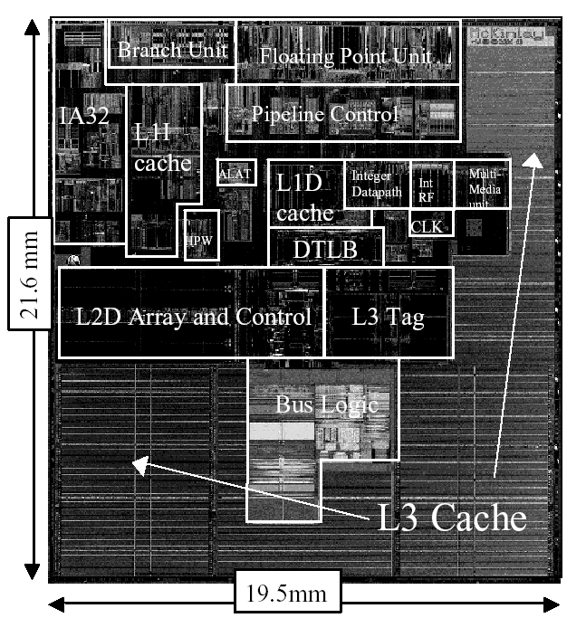
Itanium-2 On-Chip Caches
(Intel/HP, 2002)
Level 1: 16KB, 4-way s.a., 64B line, quad-port (2 load+2 store), single cycle latency
Level 2: 256KB, 4-way s.a, 128B line, quad-port (4 load or 4 store), five cycle latency
Level 3: 3MB, 12-way s.a., 128B line, single 32B port, twelve cycle latency
Notes:
If two is good, then three must be better (jse)

Slide 13
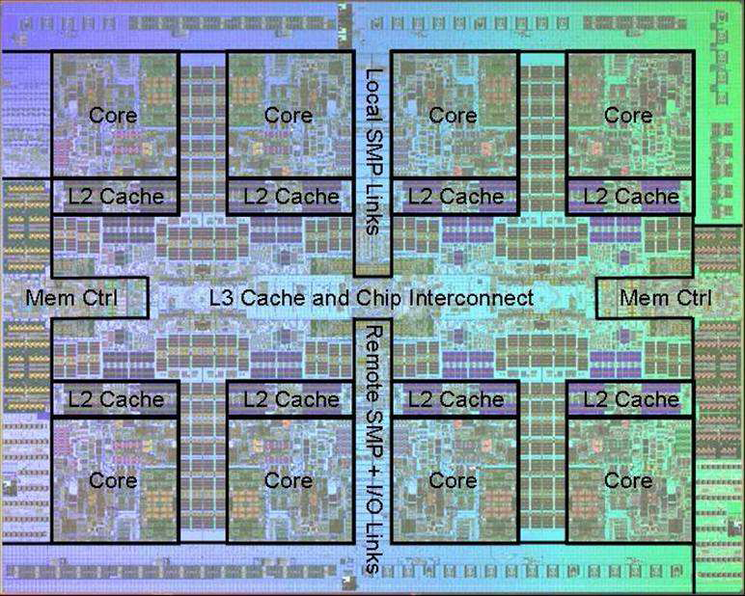
Power 7 On-Chip Caches [IBM 2009]
32KB L1 I$/core
32KB L1 D$/core
3-cycle latency
256KB Unified L2$/core
8-cycle latency
32MB Unified Shared L3$
Embedded DRAM
25-cycle latency to local slice

Slide 14
CSE 490/590 Administrivia
Very important to attend
  Recitations this week
Quiz 1
  Grading will be done by next Monday.
Office hours changed
  Tuesdays 3pm-6pm

Slide 15
Prefetching
Speculate on future instruction and data accesses and fetch them into cache(s)
  Instruction accesses easier to predict than data accesses
Varieties of prefetching
  Hardware prefetching
  Software prefetching
  Mixed schemes
What types of misses does prefetching affect?
Notes:
Reduces compulsory misses, can increase conflict and
capacity misses.

Slide 16
Issues in Prefetching
Usefulness – should produce hits
Timeliness – not late and not too early
Cache and bandwidth pollution
L1 Instruction
Unified L2 Cache
CPU
L1 Data
RF
Prefetched data

Slide 17
Acknowledgements
These slides heavily contain material developed and copyright by
  Krste Asanovic (MIT/UCB)
  David Patterson (UCB)
And also by:
  Arvind (MIT)
  Joel Emer (Intel/MIT)
  James Hoe (CMU)
  John Kubiatowicz (UCB)
MIT material derived from course 6.823
UCB material derived from course CS252

