Slide 1
CSE 490/590 Computer Architecture Directory-Based Caches II
Steve Ko
Computer Sciences and Engineering
University at Buffalo

Slide 2
Last time…
True sharing vs. false sharing
Miss vs. hit in multiprocessors

Slide 3
A Cache Coherent System Must:
Provide set of states, state transition diagram, and actions
Manage coherence protocol
(0) Determine when to invoke coherence protocol
(a) Find info about state of address in other caches to determine action
whether need to communicate with other cached copies
(b) Locate the other copies
(c) Communicate with those copies (invalidate/update)
(0) is done the same way on all systems
state of the line is maintained in the cache
protocol is invoked if an “access fault” occurs on the line
Different approaches distinguished by (a) to (c)

Slide 4
Bus-based Coherence
All of (a), (b), (c) done through broadcast on bus
faulting processor sends out a “search”
others respond to the search probe and take necessary action
Could do it in scalable network too
broadcast to all processors, and let them respond
Conceptually simple, but broadcast doesn’t scale with number of processors, P
on bus, bus bandwidth doesn’t scale
on scalable network, every fault leads to at least P network transactions
Scalable coherence:
can have same cache states and state transition diagram
different mechanisms to manage protocol

Slide 5
Scalable Approach: Directories
Every memory block has associated directory information
keeps track of copies of cached blocks and their states
on a miss, find directory entry, look it up, and communicate only with the nodes that have copies if necessary
in scalable networks, communication with directory and copies is through network transactions
Many alternatives for organizing directory information

Slide 6
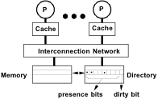
Basic Operation of Directory
• k processors.
• With each cache-block in memory: k presence-bits, 1 dirty-bit
• With each cache-block in cache: 1 valid bit, and 1 dirty (owner) bit
• Read from main memory by processor i:
• If dirty-bit OFF then { read from main memory; turn p[i] ON; }
• if dirty-bit ON then { recall line from dirty proc (downgrade cache state to shared); update memory; turn dirty-bit OFF; turn p[i] ON; supply recalled data to i;}
• Write to main memory by processor i:
• If dirty-bit OFF then {send invalidations to all caches that have the block; turn dirty-bit ON; supply data to i; turn p[i] ON; ... }

Slide 7
Directory Cache Protocol
CPU
CPU
CPU
CPU
CPU
CPU
Cache
Cache
Cache
Cache
Cache
Cache
Interconnection Network
Directory Controller
Directory Controller
Directory Controller
Directory Controller
DRAM Bank
DRAM Bank
DRAM Bank
DRAM Bank
Assumptions: Reliable network, FIFO message delivery between any given source-destination pair
Notes:
Delay is a fact of life
Serialization by directory, no longer the bus
SC not guarantied

Slide 8
Cache States
For each cache line, there are 4 possible states:
C-invalid (= Nothing): The accessed data is not resident in the cache.
C-shared (= Sh): The accessed data is resident in the cache, and possibly also cached at other sites. The data in memory is valid.
C-modified (= Ex): The accessed data is exclusively resident in this cache, and has been modified. Memory does not have the most up-to-date data.
C-transient (= Pending): The accessed data is in a transient state (for example, the site has just issued a protocol request, but has not received the corresponding protocol reply).
Notes:
- common cases
- read miss to private (victim clean or dirty)
- write miss to private
- read miss to shared
- write miss to shared

Slide 9
Home directory states
For each memory block, there are 4 possible states:
R(dir): The memory block is shared by the sites specified in dir (dir is a set of sites). The data in memory is valid in this state. If dir is empty (i.e., dir = ε), the memory block is not cached by any site.
W(id): The memory block is exclusively cached at site id, and has been modified at that site. Memory does not have the most up-to-date data.
TR(dir): The memory block is in a transient state waiting for the acknowledgements to the invalidation requests that the home site has issued.
TW(id): The memory block is in a transient state waiting for a block exclusively cached at site id (i.e., in C-modified state) to make the memory block at the home site up-to-date.

Slide 10
CSE 490/590 Administrivia
Keyboards available for pickup at my office
Project 2: less than 2 weeks left (Deadline 5/2)
Will have demo sessions
No class on 5/2 (finish the project!)
Final exam: Thursday 5/5, 11:45pm – 2:45pm
Project 2 + Final = 55%

Slide 11
Protocol Messages
There are 10 different protocol messages:
Category | Messages
Cache to Memory Requests | ShReq, ExReq
Memory to Cache Requests | WbReq, InvReq, FlushReq
Cache to Memory Responses | WbRep(v), InvRep, FlushRep(v)
Memory to Cache Responses | ShRep(v), ExRep(v)
Notes:
LL-SC

Slide 12
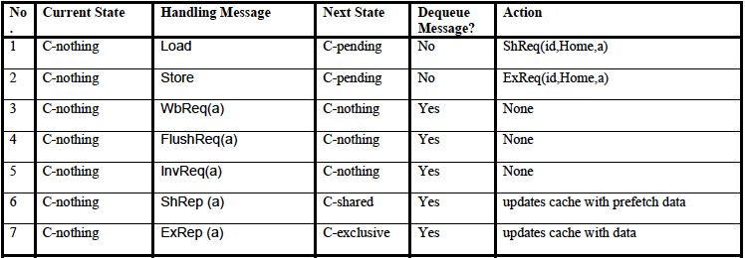
Cache State Transitions (from invalid state)

Slide 13
Cache State Transitions (from shared state)

Slide 14
Cache State Transitions (from exclusive state)

Slide 15
Cache Transitions (from pending)

Slide 16
Home Directory State Transitions
Messages sent from site id

Slide 17
Home Directory State Transitions
Messages sent from site id

Slide 18
Home Directory State Transitions
Messages sent from site id

Slide 19
Home Directory State Transitions
Messages sent from site id

Slide 20
Acknowledgements
These slides heavily contain material developed and copyright by
Krste Asanovic (MIT/UCB)
David Patterson (UCB)
And also by:
Arvind (MIT)
Joel Emer (Intel/MIT)
James Hoe (CMU)
John Kubiatowicz (UCB)
MIT material derived from course 6.823
UCB material derived from course CS252

