Slide 1






Lecture 2: IoT Concept and Project Overview
Wenyao Xu | Associate Professor | Computer Science and Engineering

Slide 2
Course Info
Website: https://cse.buffalo.edu/~wenyaoxu/courses/spring2019/cse610c.htm

Slide 3
Project 1: Total Motion Spoofing
Background: many applications on smartphone deploy motion data, e.g., health & well-being, user authentication, etc.
Hypothesis: is it possible to design a specific motion platform which can generate arbitrary sensor data as needed?
Reference: http://www.unfitbits.com/

Slide 4


Project 2: Wireless PC Sensing
Motivation:; PC Management is critical;
Challenge: How to conveniently determine the state of PC

Slide 5
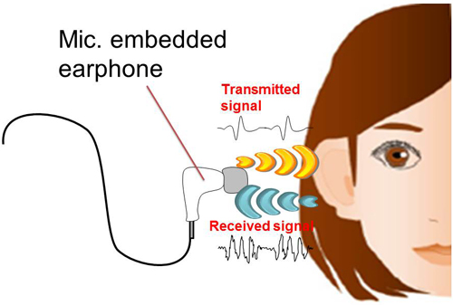
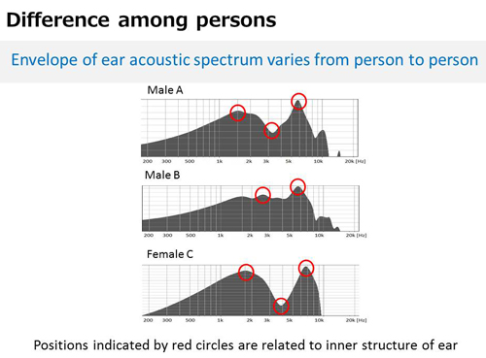
Project 3: Continuous Ear Biometrics
Motivation: Continuous wearable user authentication;
Challenge: A New Ear Biometrics

Slide 6
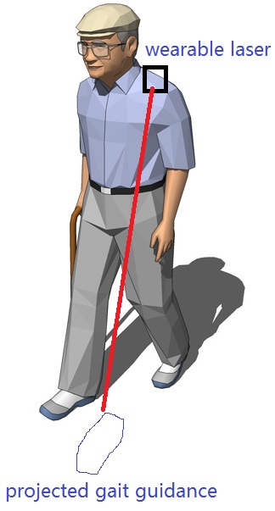
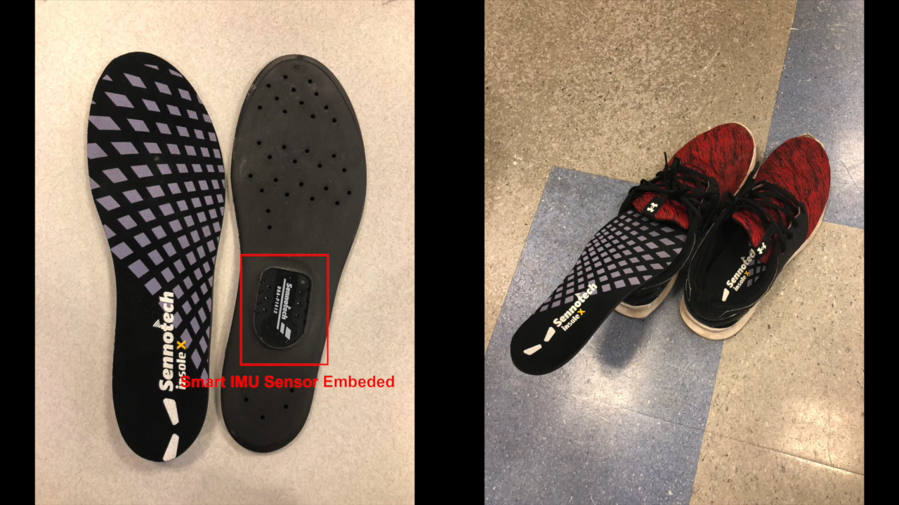
Project 4: Wearable Laser
Motivation: Gait Adaptability Training in Daily Life;
Challenge: How to provide a visual cue besides auditory cues.

