Slide 1
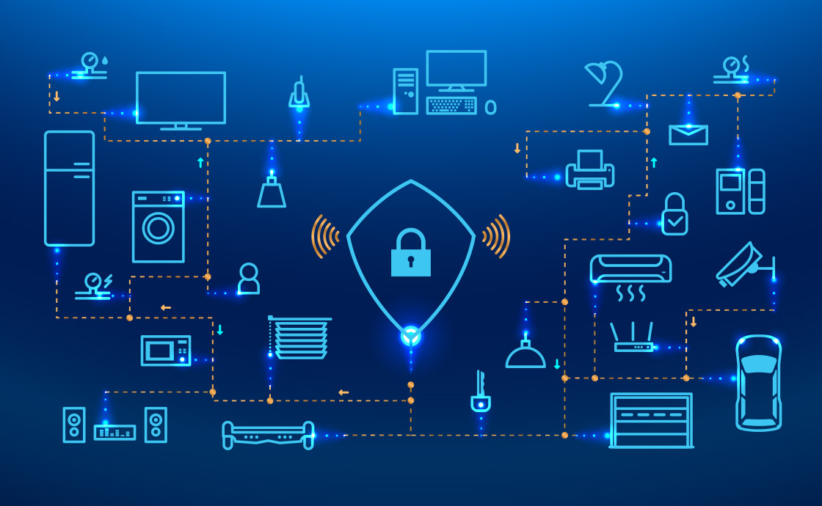
Internet of Things Security: An Overview
Wenyao Xu | Associate Professor | Computer Science and Engineering
Notes:
Thanks for that introduction.
The goal of this talk is to provide you an overview of some of my research at the University at Buffalo.
Let me start with a bit of background about me and my group.

Slide 2



Agenda Today
Course Logistics & Administration
IoT Security Overview
IoT Security Practice Examples

Slide 3
Course Information
Class time: 10 – 11:30am Friday
Location: Baldy 200G
Office hour: 10-12 Wednesday (Davis 330)
Email: wenyaoxu@buffalo.edu
Course Website: https://cse.buffalo.edu/~wenyaoxu/courses/spring2020/CSE741/cse741_spring2020.htm

Slide 4
About Course Organization
This seminar course will discuss emerging biometrics and IOT security.
Each student will present 2 research papers selected from top CS conferences.
HW: each student need to send me 3 paper candidates you wish to present by *TODAY*.
Each presentation will be about 25 minutes.
Share the slides with me before Wednesday.

Slide 5
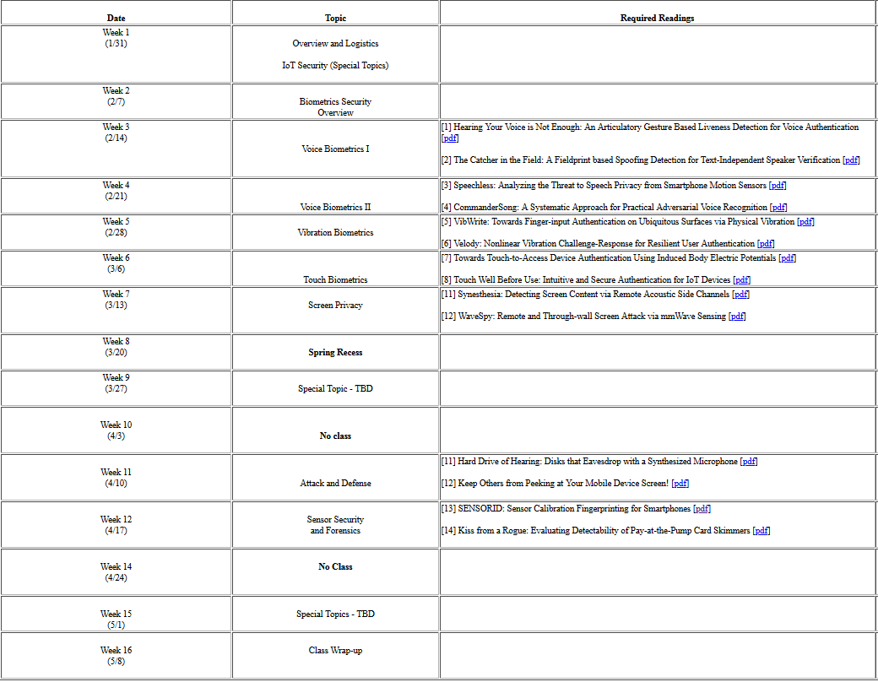

Slide 6
Paper Presentation
Each research paper presents a research
direction.
Don’t just present the paper content. Do expand your thought on this topic.
For example, in face recognition, can we
Distinguish twins?
Can we recognize lineage relation?
Can we recognize incomplete face image?
Can we match with aging effect or plastic surgery?
Spoofing and Anti-spoofing

Slide 7
Paper Reading: Q7
Q1: Contributions (novelty, creativity, and technical depth of the paper.)
Q2: Briefly summarize the main ideas/the approach to the solution.
Q3: What are the paper's strengths? Be brief.
Q4: What are the paper's weaknesses? Be brief.
Q5: Comment on the paper's evaluation methodology.
Q6: Are there any issues/directions this work left open? List a few possible extensions of this work.
Q7: Any other comments/questions.

Slide 8

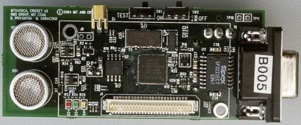

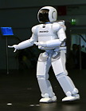
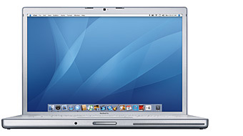

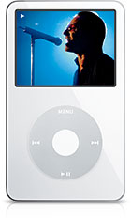



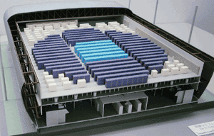
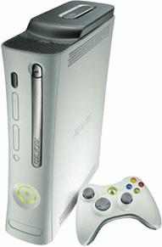
Topics Overview
Set-top boxes
Media Players
Sensor Nets
Cameras
Laptops
Servers
Robots
Routers
Smart phones
Games
Automobiles
8
Supercomputers
8

Slide 9
Topics Overview
Student Presentation
Special Topic Presentation
Emerging Biometrics Security
Voice Biometrics
Touch Biometrics
Vibration Biometrics
Screen Privacy
Attack & Defense in Physical Systems
Sensory Security & Forensics
Wireless Security
Manufacturing Security
Biometrics Security
Hardware Security

Slide 10
IoT Security

Slide 11
What is Security?
“The quality or state of being secure—to be free from danger”
A successful organization should have multiple layers of security in place:
Physical security
Personal security
Operations security
Communications security
Network security
Information security

Slide 12
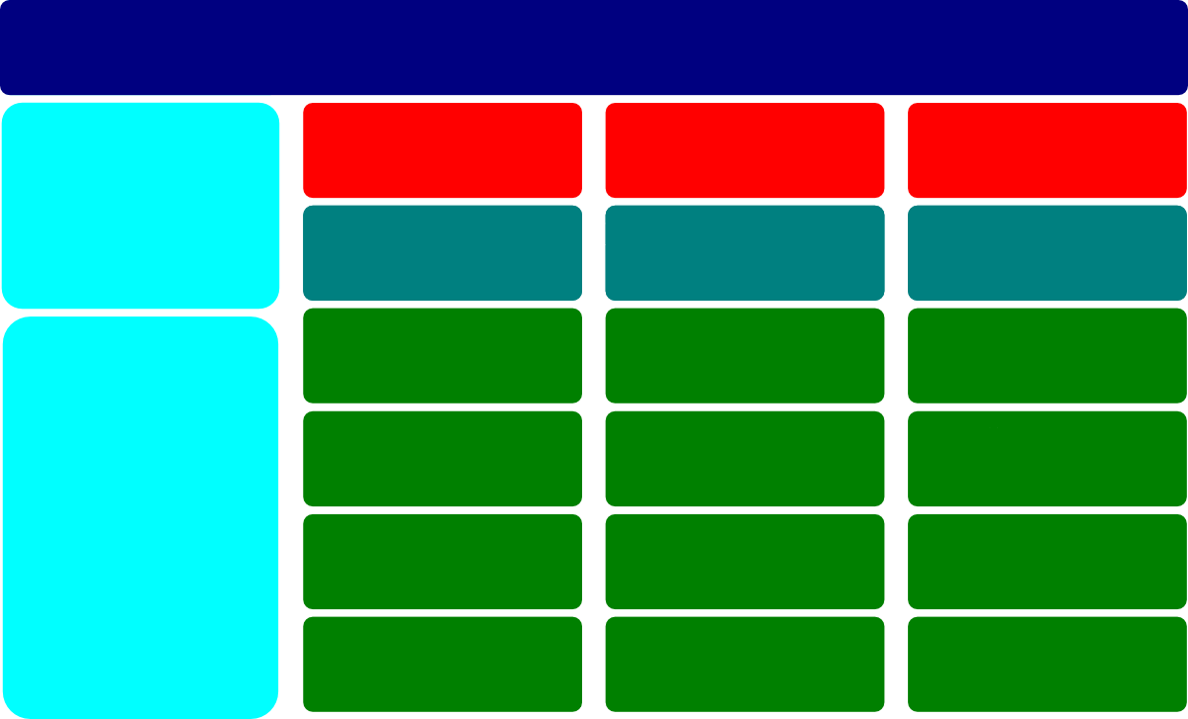
Security Concept
Security Concepts
Confidentiality
Integrity
Availibility
Core
Authentication
Authorization
Accountability
Need to Know
Least Privilege
Separation of Duties
Economy of Mechanisms
Least Common Mechanisms
Leveraging Existing Components
Fail Safe / Fail Secure
Defense in Depth
Design
Complete Mediation
Psychological Acceptability
Open Design
Weakest Link

Slide 13

Confidentiality-Integrity-Availability (CIA)
To ensure protection against unauthorized access to or use of confidential information
To ensure that information and vital services are accessible for use when required
To ensure the accuracy and completeness of information to protect business processes

Slide 14

Security v.s. Usability
Security
Usability

Slide 15
Security v.s. Safety
Security is concerned with malicious humans that actively search for and exploit weaknesses in a system.
Safety is protection against mishaps that are unintended (such as accidents)

Slide 16
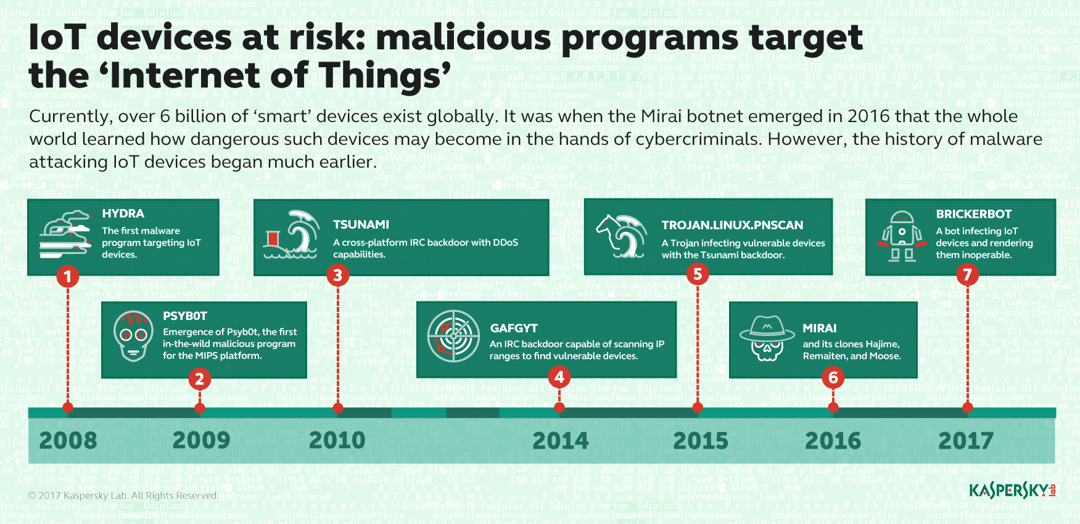
Rises of Threats Target IoT Devices

Slide 17



Three Areas
Wireless Sensing
Biometric System
Smart Manufacturing

Slide 18
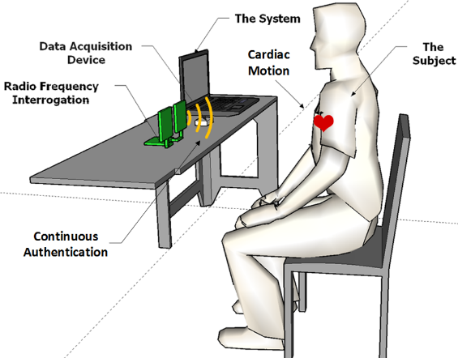
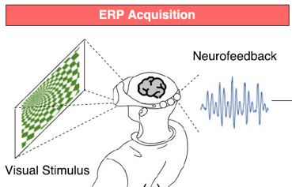
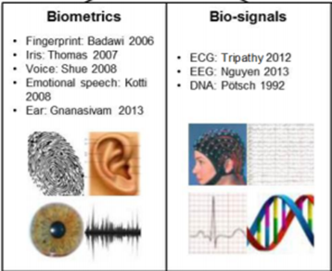
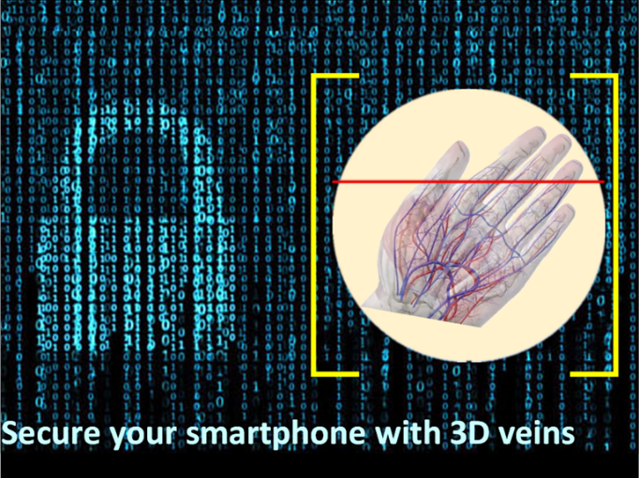
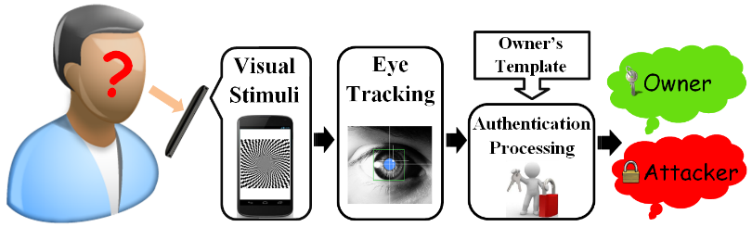
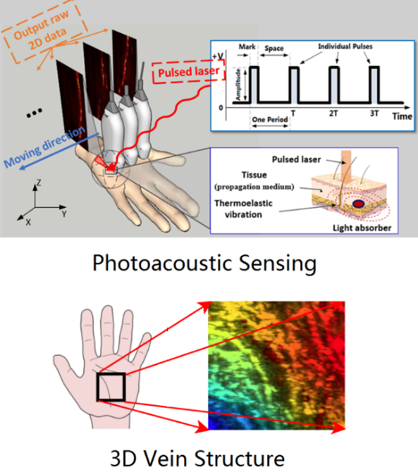
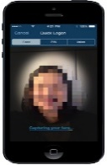

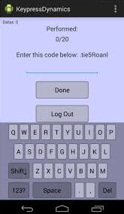
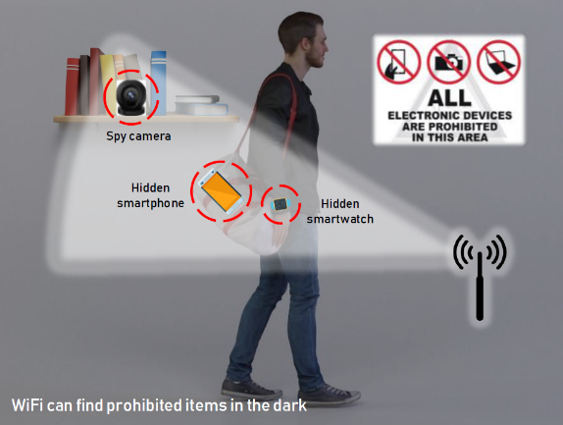
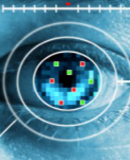

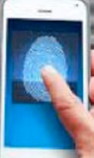
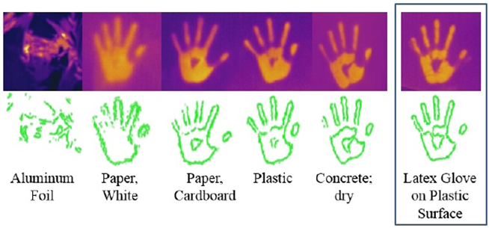
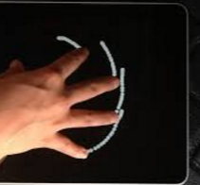
Innovation in IoT Security
at a glance
Cardiac Authentication
Brainwave Authentication
Gender Recognition
Finger/Palm Vein Two-Factor Authentication
Gaze Authentication on Mobiles
Mobile Biometrics for e-Commerce
Hidden Electronics Identification
Thermal Handprint
3D Palm Vein Biometrics

Slide 19






Innovation in IoT Security
Wenyao Xu | Associate Professor | Computer Science and Engineering
Notes:
Thanks for that introduction.
The goal of this talk is to provide you an overview of some of my research at the University at Buffalo.
Let me start with a bit of background about me and my group.

