Slide 1
On Design & scalability of distributed shared-data databases
Authors: Simon Loesing, Markus Pilman, Thomas Etter & Donald Kossmann
Presented by : Amneet Kaur
Date: 11/10/2021

Slide 2
Introduction
Modern large scale web applications
Problem : Traditional RDBMS cannot scale up
Limitations:
- Inflexible with evolving data
- Too rigid for dynamic cloud environment
Solution: NoSQL Storage systems?
Why? Scalability, Availability & Operational Flexibility

Slide 3
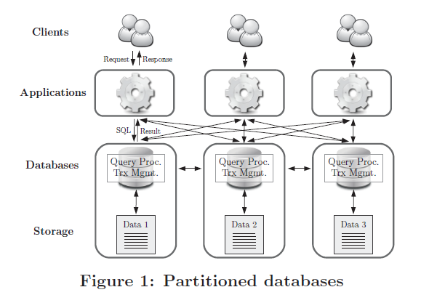
Goal
Operational Flexibility: Elasticity, ease-of-use & deployment flexibility
Goal → To propose an architecture for distributed transaction processing (scalable & flexible system)
Add on with Operational flexibility
Preserves SQL and ACID properties of RDBMS
Option: Data scale out through Partition based database system
Limitations: Inflexible in large scale environments and assumes data workload is partition friendly

Slide 4
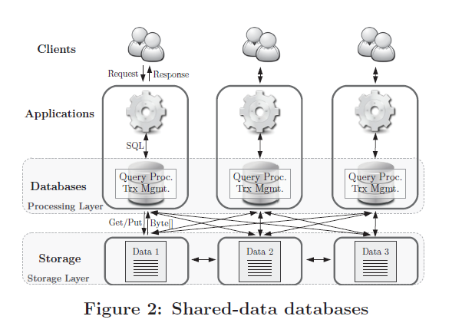
Shared-data Architecture
For:
Distributed Relational Databases
Principles:
Data is shared across all database instances (can execute whole query) → scalability
Decoupling query processing and transaction management from data storage → Elasticity & deployment Flexibility
This logical separation gives two-tiered architecture → ‘Shared-data Architecture’

Slide 5
Flow of the content in Paper
First, architecture design for distributed relational database
Second, Combination of concepts and hardware trends (references of Tell database system)
Effectiveness and evaluation of design against VoltDB, MySQL cluster and FoundationDB

Slide 6
Design Principles : Shared-data Architecture
Shared Data : No exclusive data ownership; Transaction executed & committed by single instance of DB
Decoupling of Query Processing and Storage: Transaction query processing (PNs), data storage (SNs)
In-Memory Storage: In memory data storage; Low access latencies, No complex buffering mechanisms
ACID Transactions: Part of processing layer
Complex Queries: Aggregate, order or filter by predicates scalable way

Slide 7
Technical Challenges:
Data Access :
  remote location; access over network
  Restricted buffering possibilities
  Distributed indexes (B+ Tree Index)
Concurrency Control
  Distributed MVCC protocol
  Conflict detection using lightweight LL/SC primitive → atomic RMW (read-modify-write) operation
  Non blocking synchronization

Slide 8
Limitations
Best performance with LAN (local area network); WAN not suited
  Low latency communication
  Critical performance factors
  shared data with limited buffering ; heavy data access over network
  Synchronous in-memory data replication
Network Bandwidth
  Data exchange between PNs and SNs
  Heavy loads can cause bottlenecks; network saturation

Slide 9
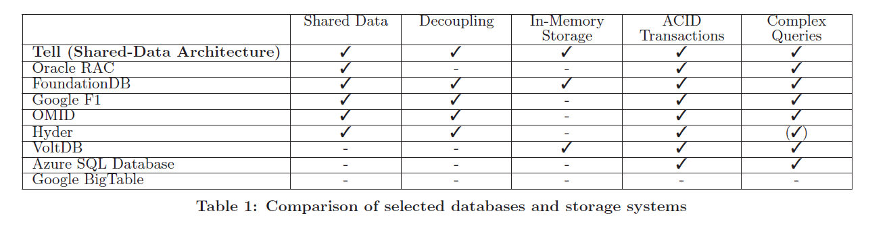
Previous Related work in this area:

Slide 10
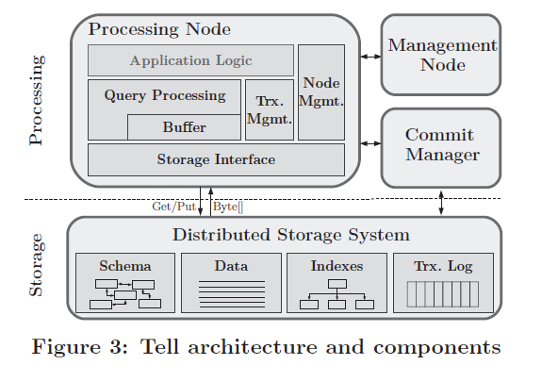
Tell Database System – Components & Architecture
Processing Node (PN):
  Central component
  Query processing & Transaction execution
Commit Manager:
  Lightweight; Manages global transaction state
Management Node:
  System monitoring and recovery from failure
Storage Nodes (PN):
  Distributed storage system
  Manges data records, indexes and logs

Slide 11
Concurrency Control – Distributed Snapshot Isolation
Optimistic protocol
MVCC protocol → Stores multiple versions of every data item
Part of transaction management on each PN
Transaction retrieves all the valid versions of data item (consistent snapshot)
Conflict check at commit time
Buffering of updates; applied to shared store at commit
LL/SC for conflict detection in the storage layer
SI semantic across all PNs through Commit Manager

Slide 12
Commit Manager
Global snapshot information
New transactions → transaction id (tid), snapshot descriptor and lowest active version number (lav)
Transaction id(tid) : Unique identifier, incremented monotonically
  Defines version no for updated items
Snapshot descriptor : data structure computed for each transaction
  Specifies which versions can be accessed
  2 elements→ base version ‘b’ (integer) and a set of newly committed transactions ‘N’ (bitset)
  Low computation cost of implementation
  Valid version number set transaction can access V’ :
V’ := { x | x ≤ b ∨ x ∈ N } V: version no set of data item
v := max( V ∩ V) v: version accessed

Slide 13
Commit Manager (contd.)
Lowest active version number (lav):
  Lowest base version among all active transactions
  Highest version number globally visible to all transactions
  Versions smaller than v → garbage collection
Functions supported:
  start() → (tid, snapshot descriptor, lav)
  setCommitted(tid) → void
  setAborted(tid) → void

Slide 14
Lifecycle of a transaction
Begin → Retrieves snapshot from commit manager
Running → can read or write items
Try-commit → log entry to transaction log with ids of updated items
  Apply updates to store using LL/SC operations
  Success means commit else abort transaction
Commit → updates applied, Index altered and commit flag set in transaction log
Abort → Conflict arises then rollback
  Notify commit manager

Slide 15
Recovery & Fail-over
Failure of processing node : Crash-stop model
  Abort all active transactions on failed node
  Rollback active transactions on PN
  Refer transaction logs → ordered map with tid, PN id, timestamp, write set and flag
Failure of storage node : Fail-over
  Replica of SN is kept in volatile memory before acknowledging the req
  In case of failure, storage system fails-over to the replicas
  Management node → detects failures, manages partitioning, restores replication factor, enables PN to lookup for replicas location

Slide 16
Recovery & Fail-over (contd.)
Failure of commit manager: single commit manager→ system-wide impact
  PNs cannot start new transactions
  Active transactions can commit even in face of failure
  New commit manger can be started
  Restores state from last used tid and most recently committed transaction from log
  Multiple commit managers in a cluster
  Syncronization of state between multiple managers
  One unavailable, PNs can access others
  State info accessible independently of availability of commit manager

Slide 17
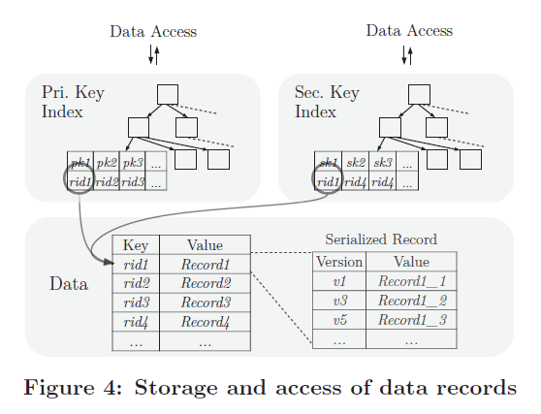
Data Access & Storage
Tell : SQL Interface & complex queries
Iterator model to access records
Records → Read and write data operations
    → Stored in key-value format
Data Mapping:
  Each record → one key value pair
  Key : rid (unique record identifier)
  Value: serialized set of all versions of the record
  Reduce storage access → single read gets all versions; choose valid ones from snapshot
  Update op → add new version to the set; writes back during commit (single atomic write req)

Slide 18
Data Access & Storage
Data Mapping:
  Read a record: Index structures on rid
  Update record: Read→ Add new version to set of versions → keep in transaction buffer → further updates to same version → Apply record at commit
  Batch operations: Access multiple records in single req; Diff transaction read operations on same PN
Mixed Workloads:
  Push-down selection relation to Storage layer
  Reduces result set size → Low data over network

Slide 19
Latch-free Index Structures
Concurrency control & data integrity for latches
Latch free algo for index integrity → reduces network traffic to acquire latch
B+ Tree Index:
  Stored & maintained in storage layer; each node key: value pair
  Can be accessed by all PNs
  Index update sync : LL/SC ops to automatically modify all nodes in storage system
  Lookup: Transaction accesses root node; traverses' tree until leaf level is reached
  B+ tree nodes cached in PN except leaf nodes; Leaf nodes retrieved from storage
  Range of leaf nodes doesn’t match data in parent; updated data is fetched from SN
  Caching independent of Index synchronization
  Single index entry per record; for all versions (limitations)

Slide 20
Garbage Collection
Delete versions and entries that aren’t going to be used
2 strategies: Eager (update and read ops) and Lazy (background at regular intervals)
Record GC : Before applying record
  A record with version set V and lav of a given transaction used to get evictable versions of record:
        C := { x | x ∈ V ∧ x ≤ lav } C: version set of record visible to all transactions
        G := { x | x ∈ C ∧ x = max(C) } G: Garbage collectable version set
  Max(C) isn’t collected → guarantee that one version of item always remains
Index GC : During read operation
  Given an index entry k with key a, Va : set of all versions having a with Va ⊆ V.
        Va\G = ∅ → K can be removed from the index

Slide 21
Buffering Strategies
Transaction Buffer: Records are cached in private buffer; reused in scope of transaction
  No shared buffer between transactions
Shared record buffer: shared by all parallel running transactions on a PN
  Version number sets used to decide if record in buffer can be used or not
  Vtx : version no set of tx ; B : version no set of record in Buffer →
    Vtx ⊆ B → Buffer is recent; can be used
    Vtx ⊆ B → Cache is outdated; Get Vmax : Version no set of most recently started tx; replace buffer entry from SN; Update B to Vmax
Shared buffer with version set sync: Record grouping
  Multiple records grouped in cache unit; share a common version number set
  Version set update → Entire buffer is invalidated

Slide 22
Experimental Evaluation
Environment
Methodology
TPC-C benchmark
PNs interact with RamCloud Storage system
Atomic get/put ops (LL/SC)
RF – no of data copies
Infra – 12 servers,
  2 quad core Intel Xeon E5—2609 2.4 GHz processors
  128 GB DDR3-RAM
  256 GB Samsung 840 Pro SSD
  2 processes per server (2 NUMA units)
Terminal clients send request to PNs
Standard TPC-C transaction mix – write intensive write ratio 35.84% (TpmC)
TPC-C mix – read ratio 95.11% (Tps)

Slide 23
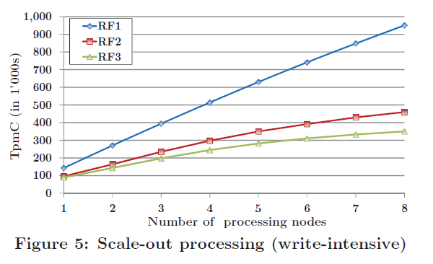
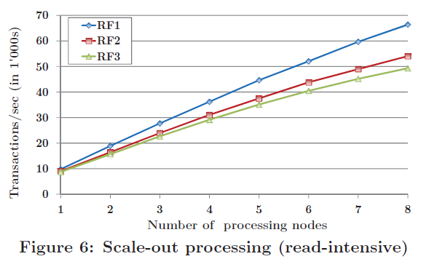
Scale out – Processing
Processing – Write intensive
Processing – Read intensive
RF3: Peak throughput 63.2% less than RF1 (overhead of replicas)
Higher read-write ratio → low impact of RF

Slide 24
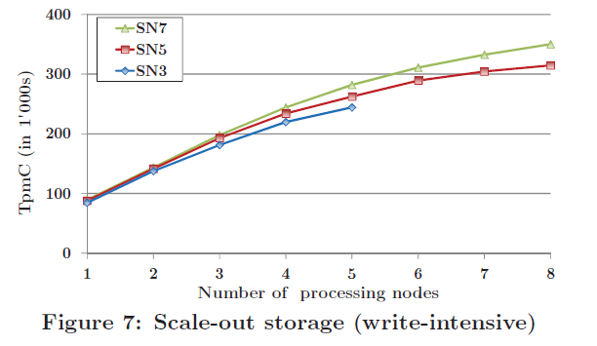
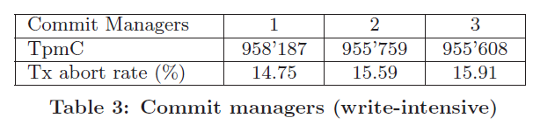
Scale out – Storage & commit manager
Storage – Write intensive
Commit Manager
Storage layer isn’t a bottleneck
Does simple tasks, So not a bottleneck

Slide 25
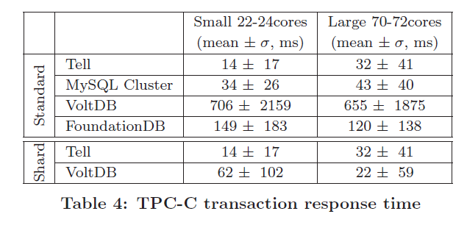
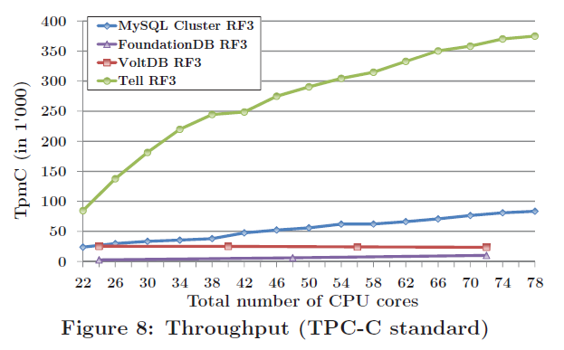
Partitioned & Shared-data DB
VoltDB, MySQL Cluster & Foundatiodb
Partitioned DB- distributed Txs require node’s sync
Shared-data perform better than partitioned (OLTP)
Foundation DB – lower throughput than Tell

Slide 26
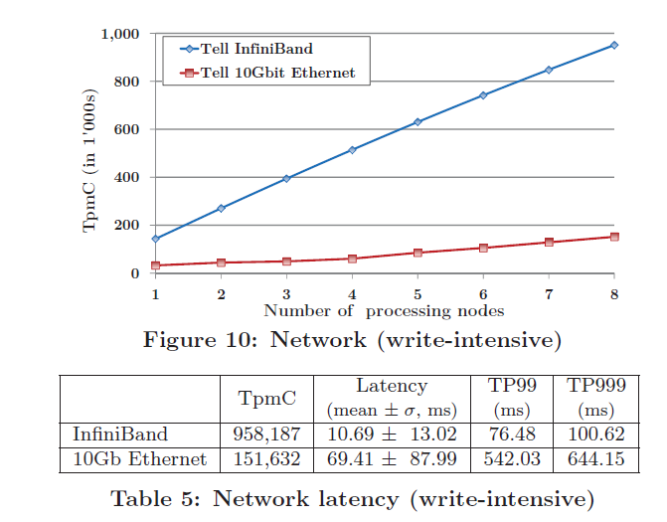
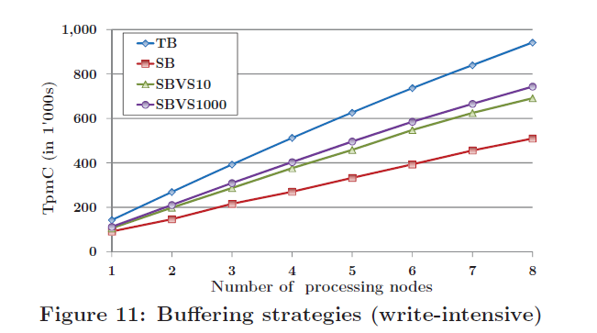
Network & Buffering Strategies
Network
Buffering Strategies – TB, SB, SBVS
TpmC 6 times higher with Infiniband
SBVS – cache unit set of size 10 or 1000(higher cache hit ratio 37.37%)
TB better over others

Slide 27
Conclusions
Tell- Shared-data based architecture
Decouples Txn and query processing from storage system
Data shared among all database instances
Performance boost using right techniques combined with modern hardware
Alternative distributed database system with high throughput than partitioned as well as other shared-data DBs
Elastic
Independent of any workload assumptions

